Slide 1
Multipitch Tracking for Noisy Speech
DeLiang Wang
The Ohio State University, U.S.A.
Joint work with
Mingyang Wu (The Ohio State University)
and
Guy Brown (University of Sheffield, U.K.)

Slide 2
What is Pitch?
“The attribute of auditory sensation in terms of which sounds may be ordered on a musical scale.” (American Standards Association)
Periodic sound: musical tone, vowel, voiced speech.
Aperiodic sound with pitch sensation: e.g. comb-filtered noise

Slide 3
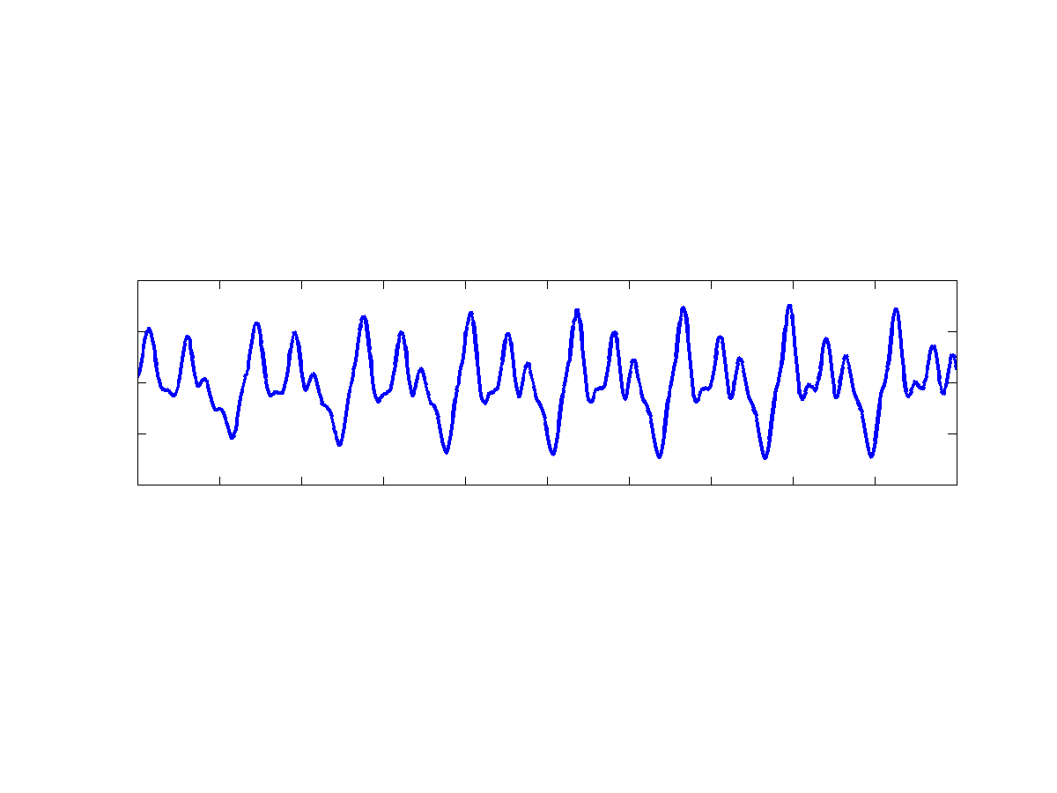
Pitch of a Periodic Sound
Fundamental Frequency
(period)
Pitch Frequency
(period)
d

Slide 4
Applications of Pitch Tracking
Computational Auditory Scene Analysis (CASA)
Automatic music transcription
Speech coding, analysis, speaker verification and language identification.

Slide 5
Categories of Pitch Determination Algorithms (PDAs)
Time-domain algorithms
Frequency-domain algorithms
Time-frequency domain algorithms

Slide 6
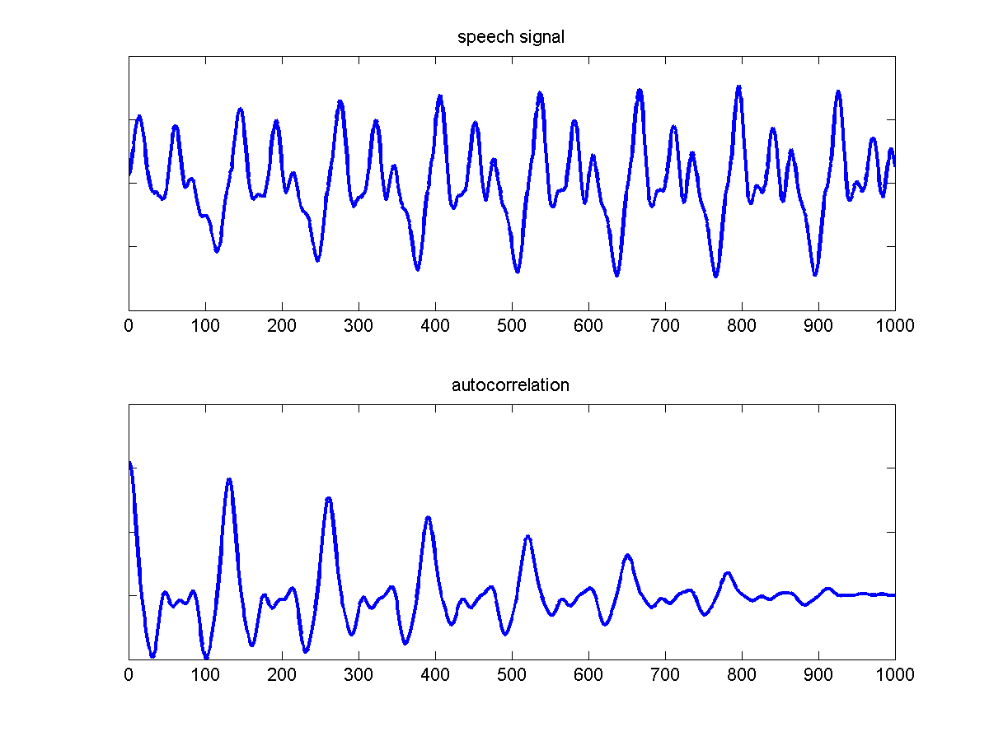
Time-domain PDAs

Slide 7
Frequency-domain PDAs
f₀
2f₀
4f₀
Frequency

Slide 8
Time-frequency Domain PDAs
Periodicity analysis
Acoustic
input
Periodicity analysis
…
Filterbank
Periodicity analysis
Pitch estimates
Integration across channels

Slide 9
Pitch Determination Algorithms
Numerous PDAs have been proposed. For example, see Hess (1983), Hermes (1992), and de Cheveigne & Kawahara (2002).
Many PDAs are designed to detect single pitch in noisy speech.
Some PDAs are able to track more than one pitch contour. However, their performance is limited on tracking speech mixed with broadband interference.

Slide 10
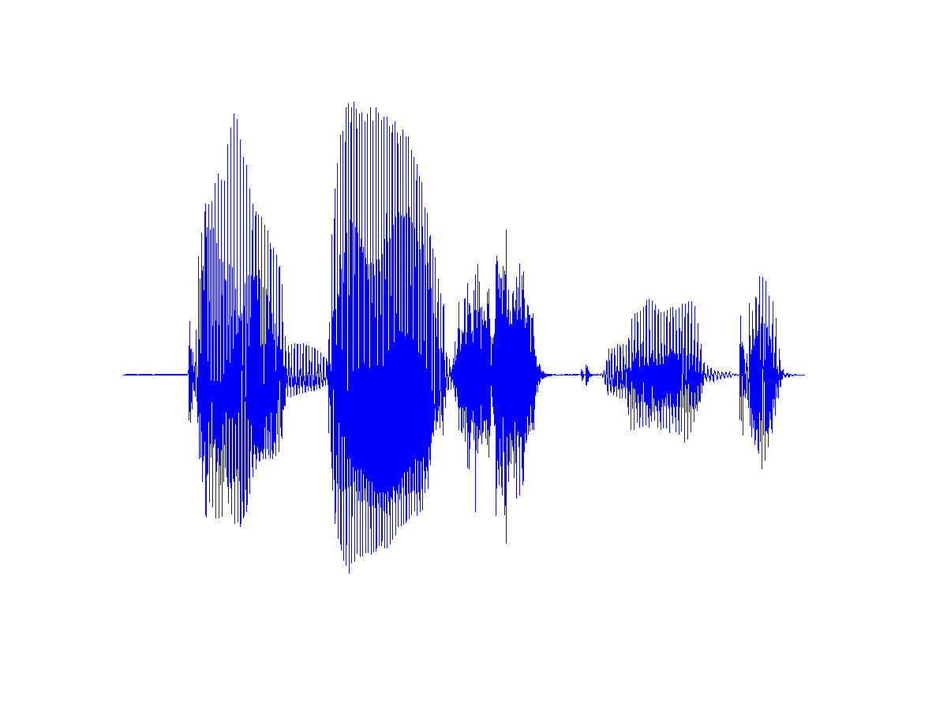
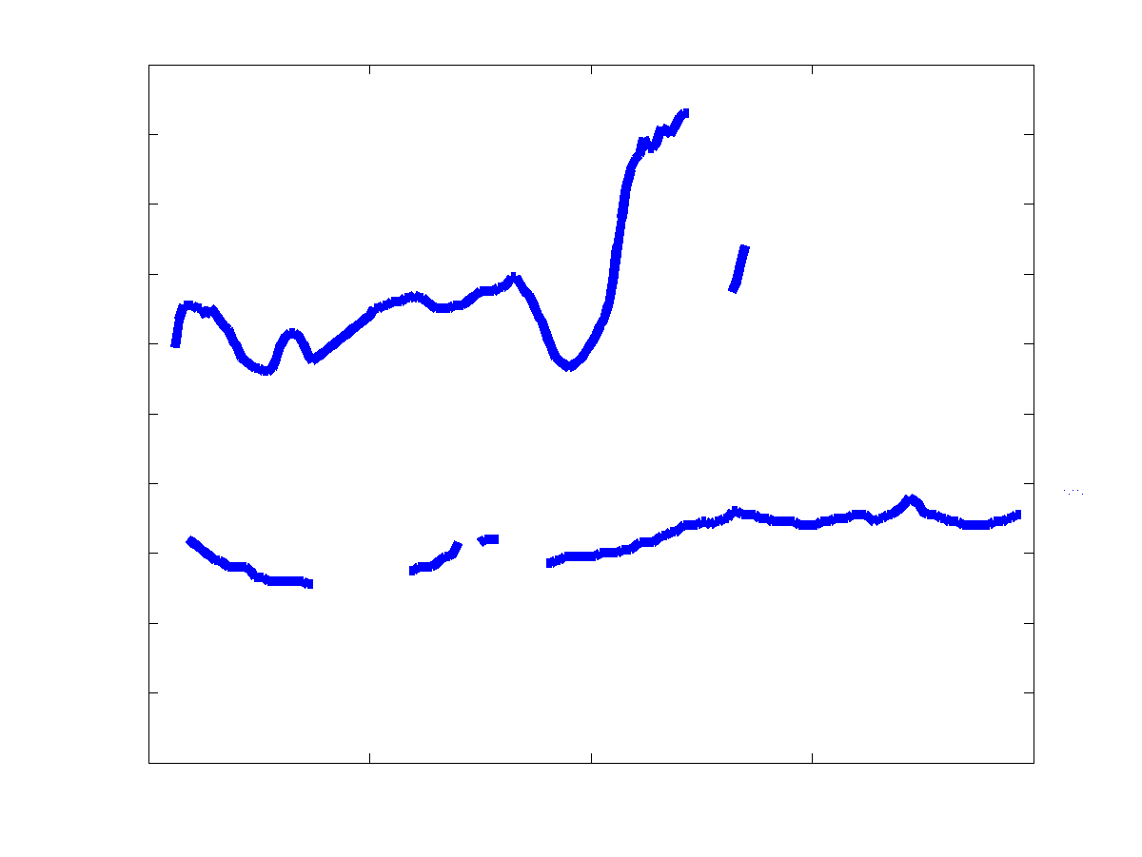
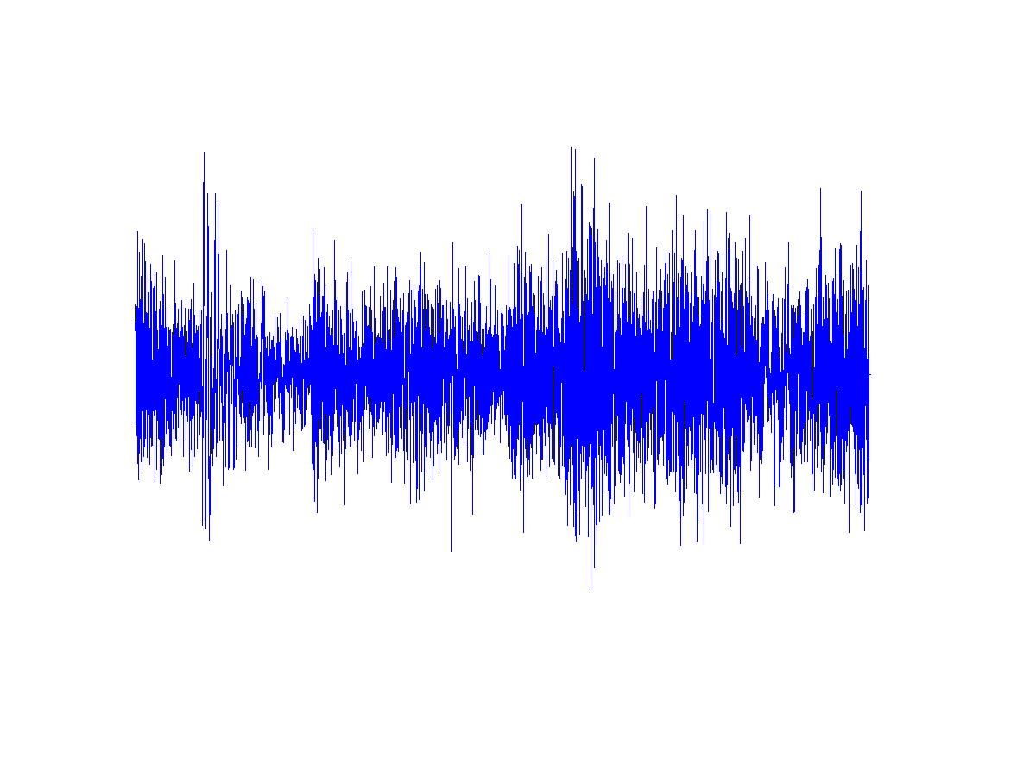
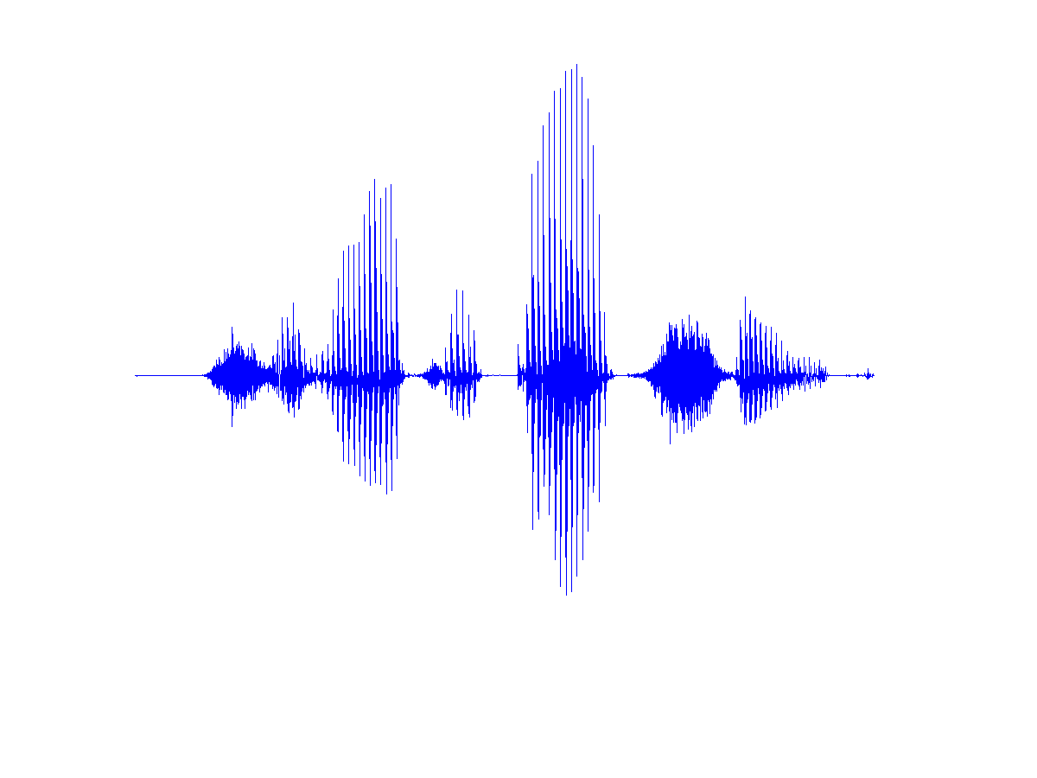
PDAs for Multipitch in Noisy Environments
speech
Output Pitch Tracks
noise
PDA
speech

Slide 11

Diagram of the Proposed Model
Normalized Correlogram
Channel/Peak Selection
Speech/
Interference
Cochlear
Filtering
Pitch Tracking Using HMM
Channel
Integration
Continuous
Pitch Tracks

Slide 12
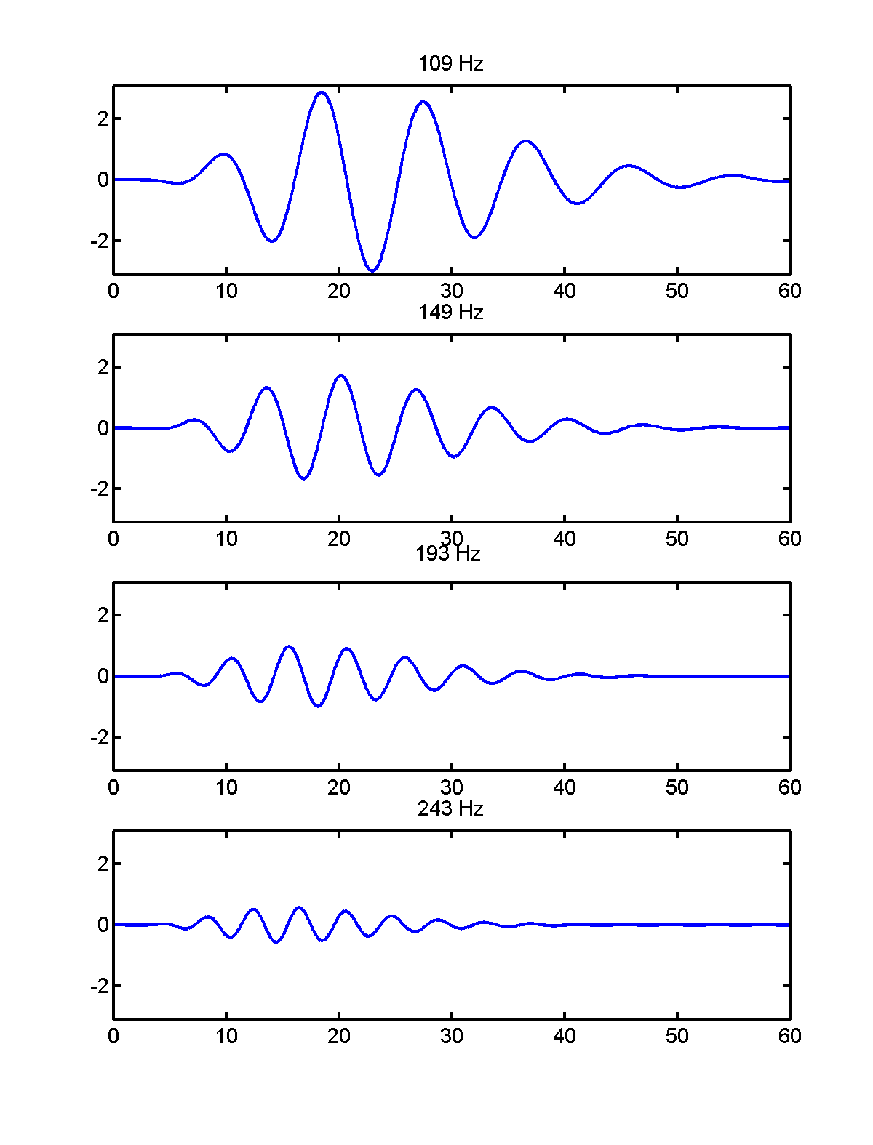
Gammatone Filterbank to Model Cochlea Filtering

Slide 13
Multi-channel Front-end
Envelope
Extraction
High Frequency
Channels
Speech/
Interference
Low Frequency
Channels
Gammatone filterbank
Notes:
Separation at 800 Hz

Slide 14
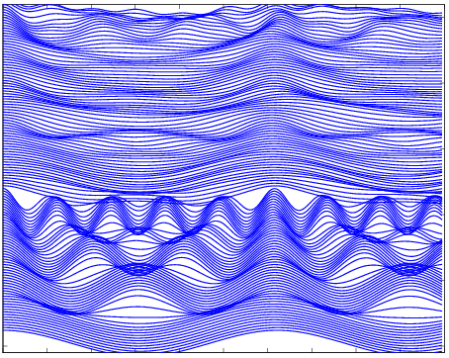
Periodicity Extraction
Normalized Correlogram
Frequency channels
Delay
Response to clean speech

Slide 15
Second Stage of the Model
Normalized Correlogram
Channel/Peak Selection
Speech/
Interference
Cochlear
Filtering
Pitch Tracking Using HMM
Channel
Integration
Continuous
Pitch Tracks

Slide 16
Channel and Peak Selection for Reducing Noise Interference
Some channels are masked by interference and provide corrupting information on periodicity. These corrupted channels are excluded from pitch determination.
Different strategies are used for selecting valid channels in low- and high-frequency ranges.

Slide 17
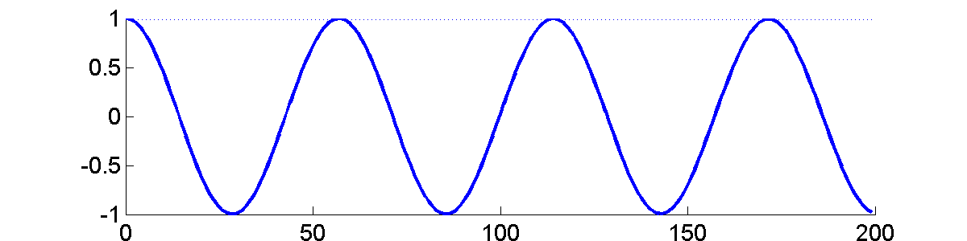
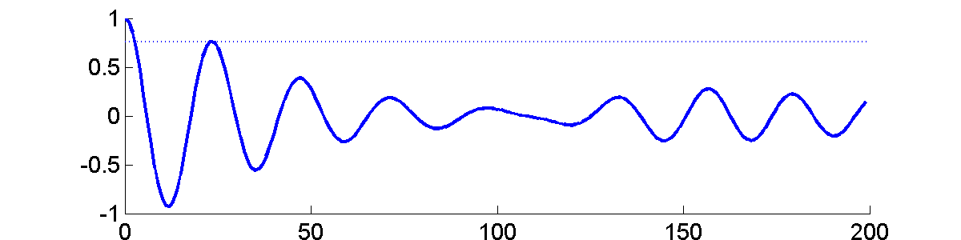
In a clean channel, peaks at non-zero delays are close to one. But these peaks are relatively low in a corrupted channel.
Selection of a Low-frequency Channel
Clean Channel
Corrupted Channel
Lag (delay steps)

Slide 18
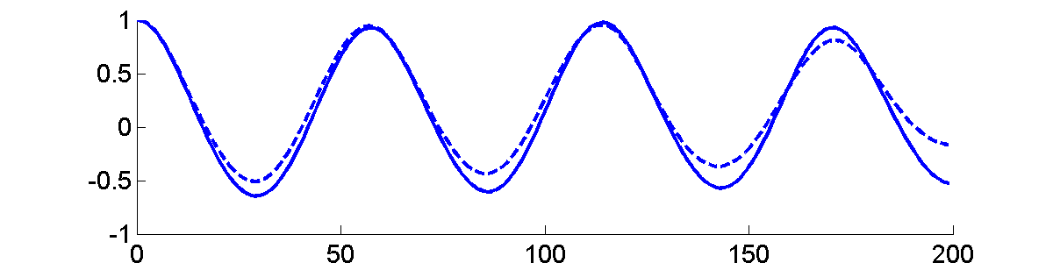
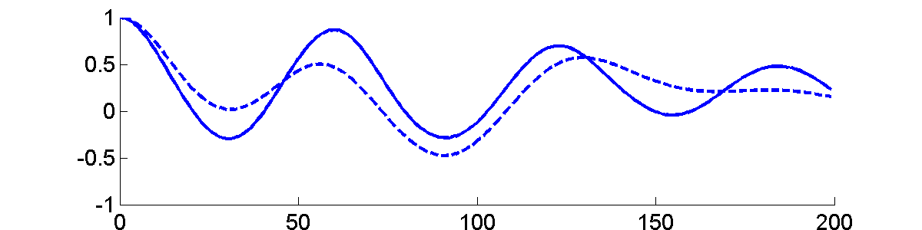
Selection of a High-frequency Channel
Clean Channel
Corrupted Channel
Lag (delay steps)
- In a clean channel, normalized correlogram within the original time window and that within a longer time window have similar patterns, but in a corrupted channel they have dissimilar patterns.
- Further peak selection is performed in a high-frequency channel.

Slide 19
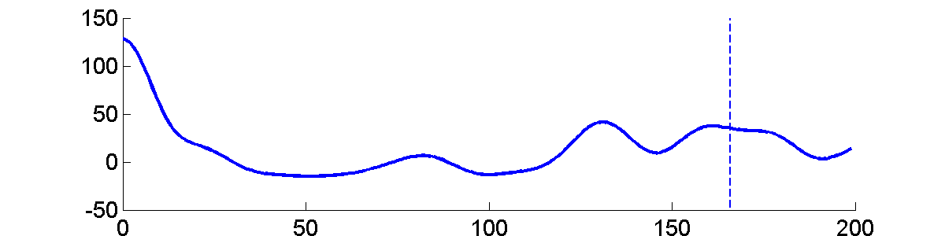
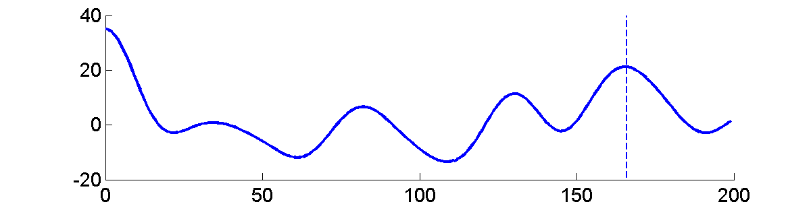
Summary Correlogram of Selected Channels
All channels
Only selected channels
Lag (delay steps)

Slide 20
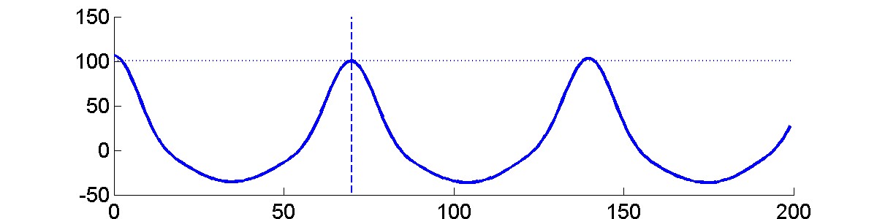
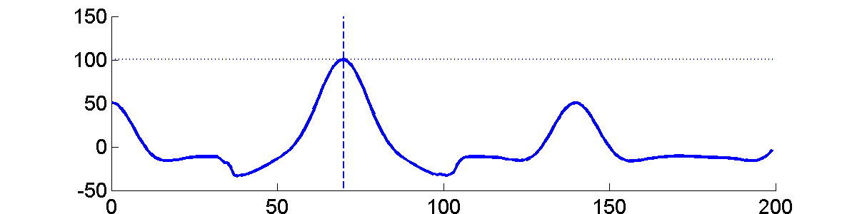
Summary Correlogram of Selected Channels with Selected Peaks
Without Peak Selection
With Peak Selection
Lag (delay steps)

Slide 21
Third Stage of the Model
Normalized Correlogram
Channel/Peak Selection
Speech/
Interference
Cochlear
Filtering
Pitch Tracking Using HMM
Channel
Integration
Continuous
Pitch Tracks

Slide 22
Integration of Periodicity Information Across Channels
How does a frequency channel contribute to a pitch-period hypothesis?
How to integrate the contributions from different channels?

Slide 23
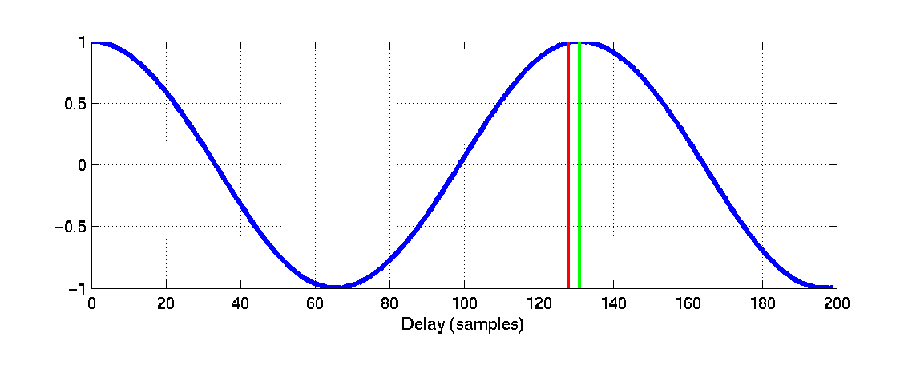
Peaks and Pitch Delay
Ideal Pitch Delay
Peak Delay
Relative Time Lag

Slide 24
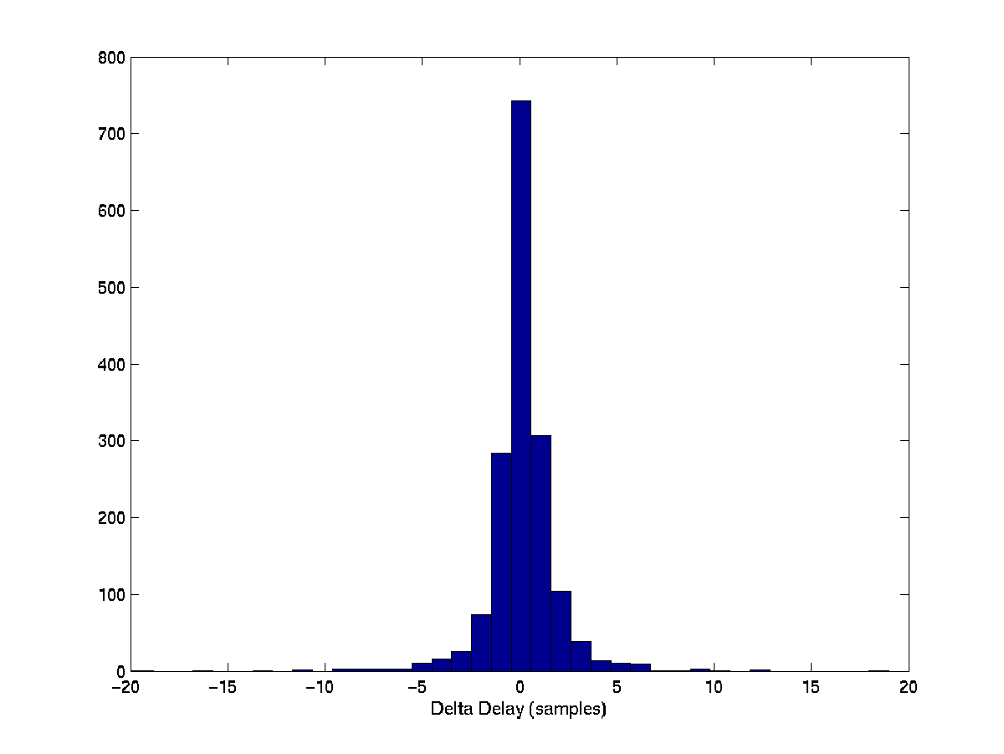
Relative Time Lag Statistics
Histogram of relative time lags from natural speech

Slide 25
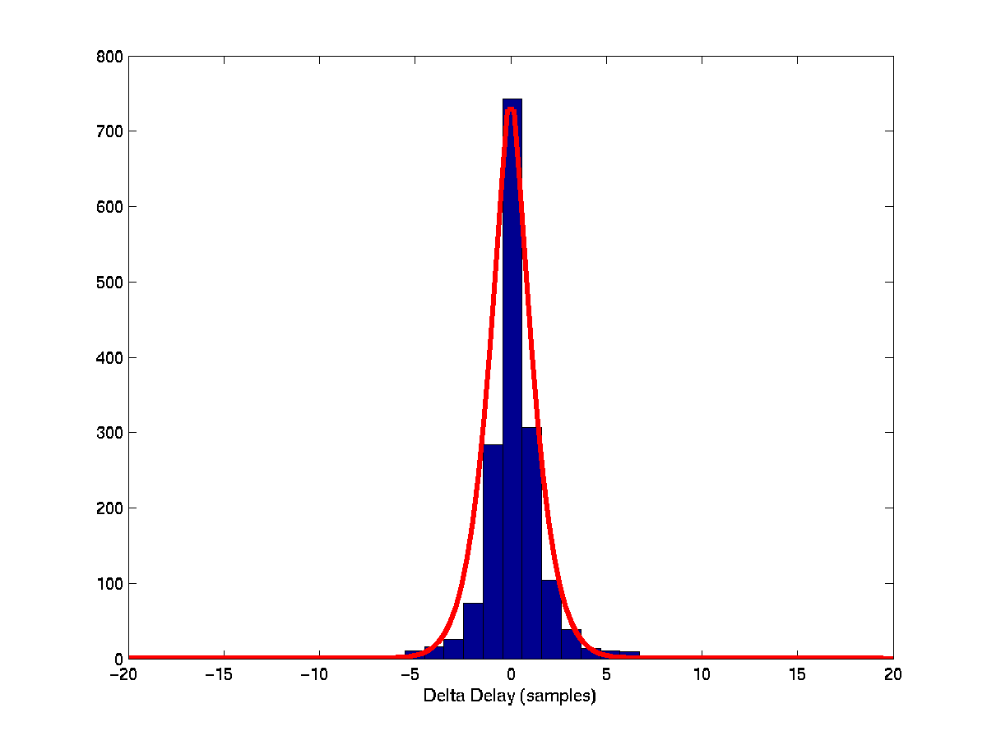
Relative Time Lag Statistics
Estimated probability distribution of relative time lags
(sum of Laplacian and uniform distributions)

Slide 26
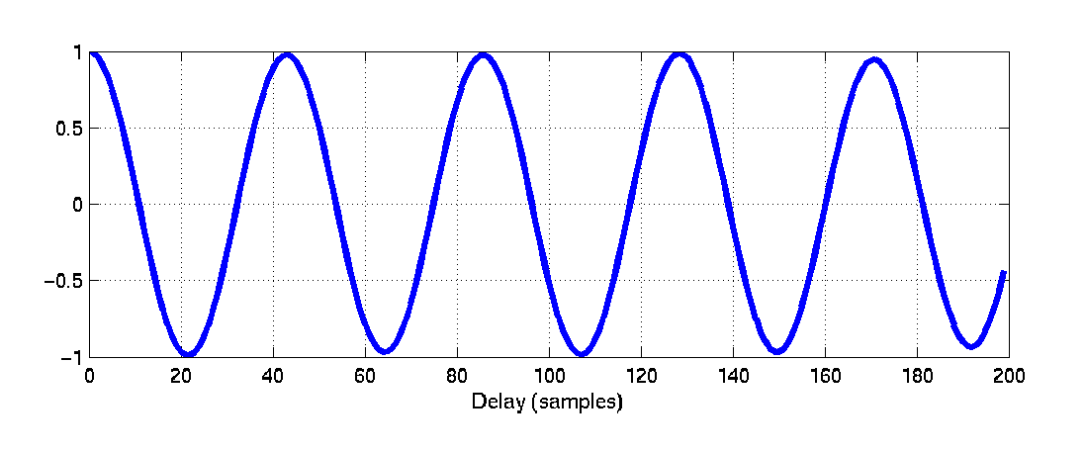
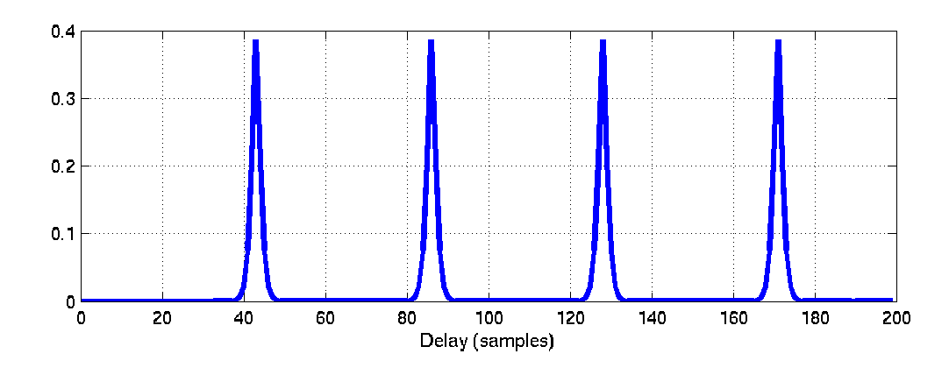
Observation Probability in One Channel
Normalized Correlogram
p(channel|pitch delay)
Notes:
Channel 29.

Slide 27
Channel Combination
Step 1: taking the product of observation probabilities of all channels in a time frame.
Step 2: flattening the product probability. The responses of different channels are usually correlated and this step is used to correct the probability overshoot phenomenon.

Slide 28
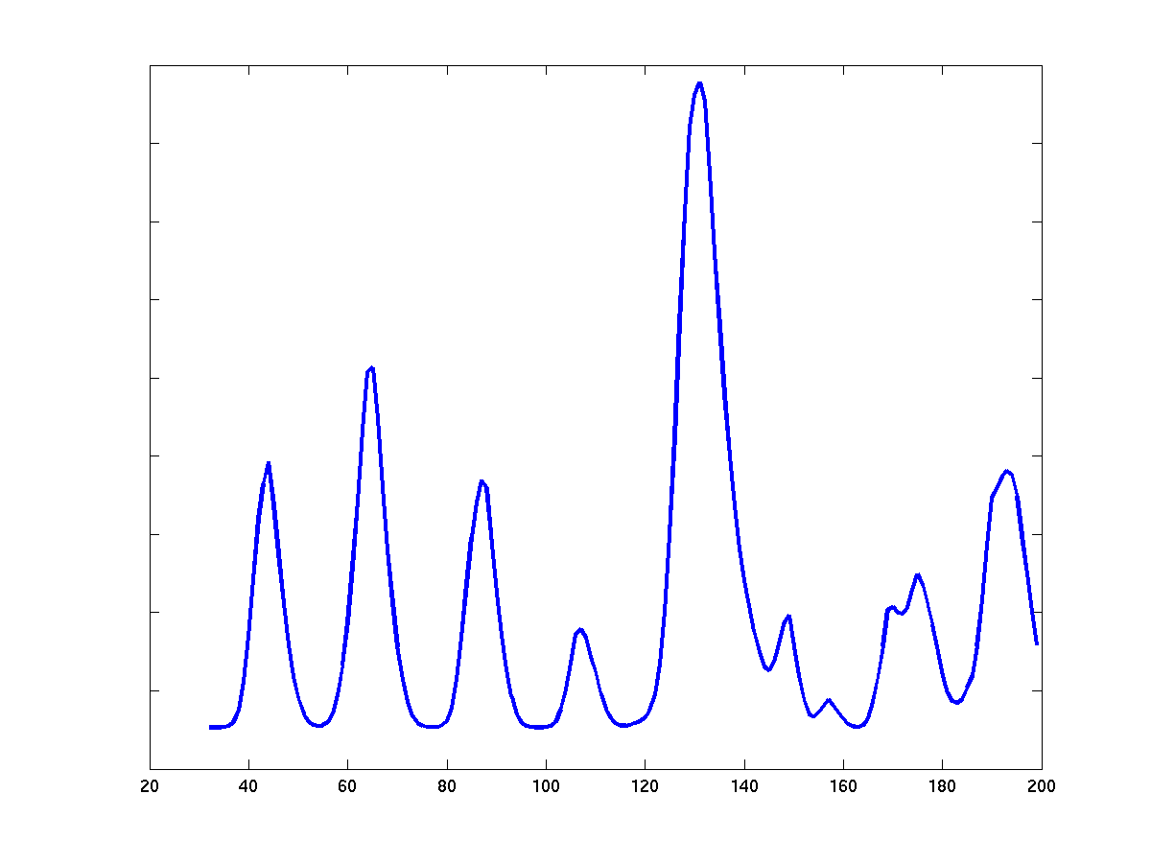
Integrated Observation Probability Distribution (1 Pitch)
Log(Probability)
Pitch delay

Slide 29
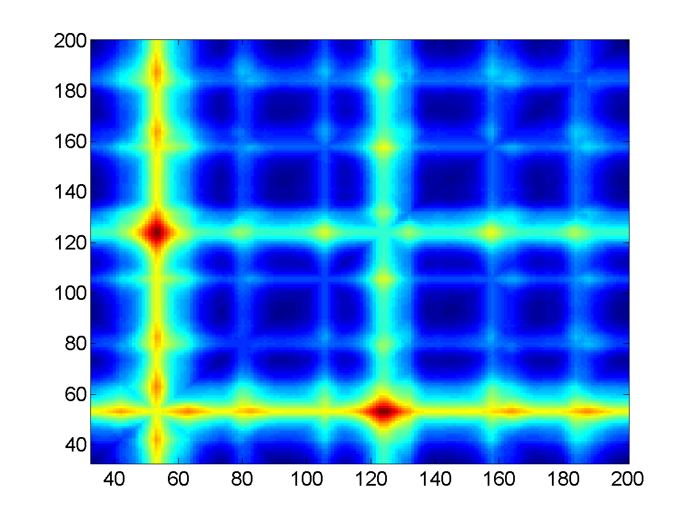
Integrated Observation Probability Distribution (2 Pitches)
Log(Probability)
Pitch Delay 2
Pitch Delay 1
Notes:
The colors indicate the likelihood (log(Probability)) of pitch hypotheses. Big red spots represent the most likely pitch hypotheses. The identified pitch periods for this time frame are 52 and 123.

Slide 30
Fourth Stage of the Model
Normalized Correlogram
Channel/Peak Selection
Speech/
Interference
Cochlear
Filtering
Pitch Tracking Using HMM
Channel
Integration
Continuous
Pitch Tracks

Slide 31
Prediction and Posterior Probabilities
Prior probabilities
for time frame t
Assuming pitch
period d for
time frame t-1
d
Observation probabilities
for time frame t
Posterior probabilities
for time frame t
d
d

Slide 32
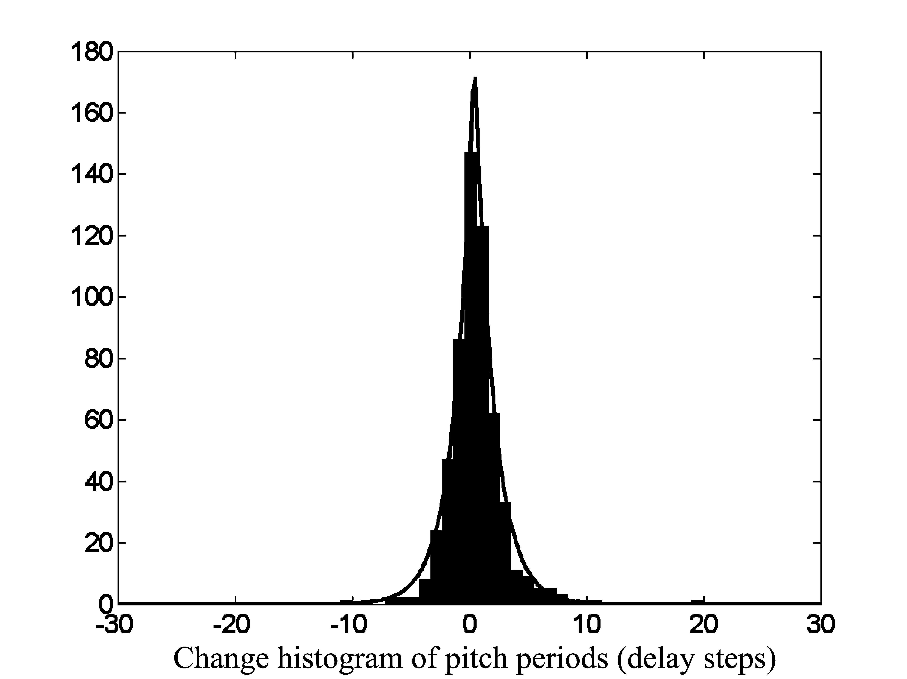
Pitch Change Statistics in Consecutive Time Frames
Consistent with the pitch declination phenomenon in natural speech.

Slide 33
Hidden Markov Model as Tracking Mechanism
Observed
Signal
Observation Probability
Pitch State
Space
Pitch Dynamics
One Time Frame
Viterbi algorithm is used to find the optimal sequence of pitch states.

Slide 34
Results
Test the system on the mixtures of 10 speech utterances and 10 interferences (Cooke, 1993).
The interferences are 1 kHz tone, white noise, noise bursts, “cocktail party” noise, rock music, siren, trill telephone, two female and one male utterances of speech.

Slide 35
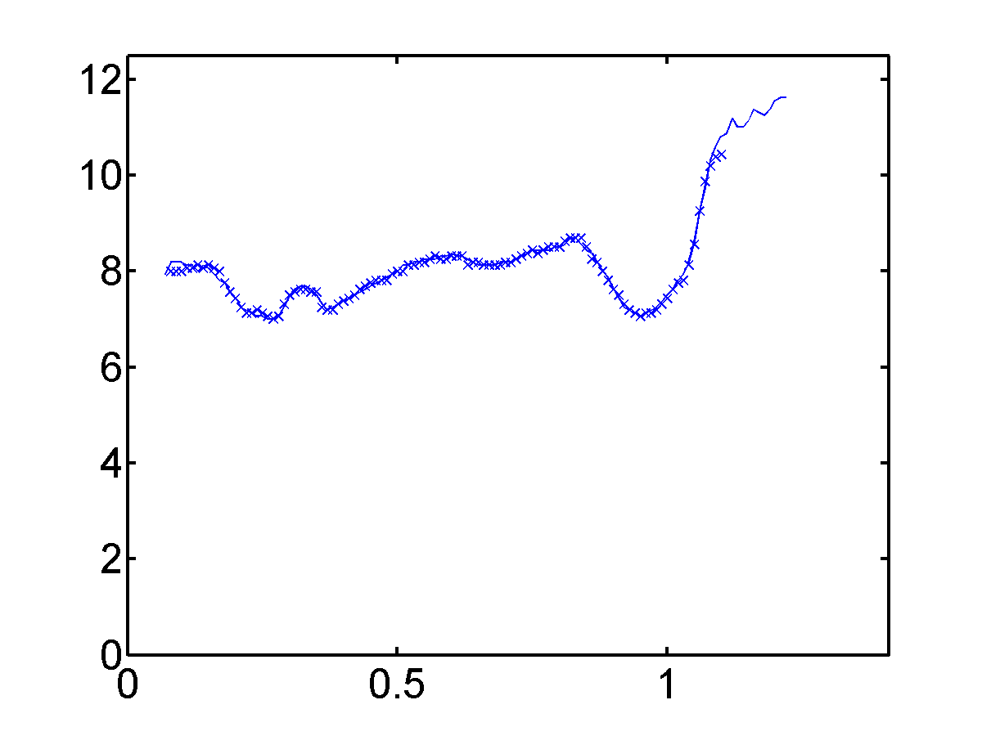
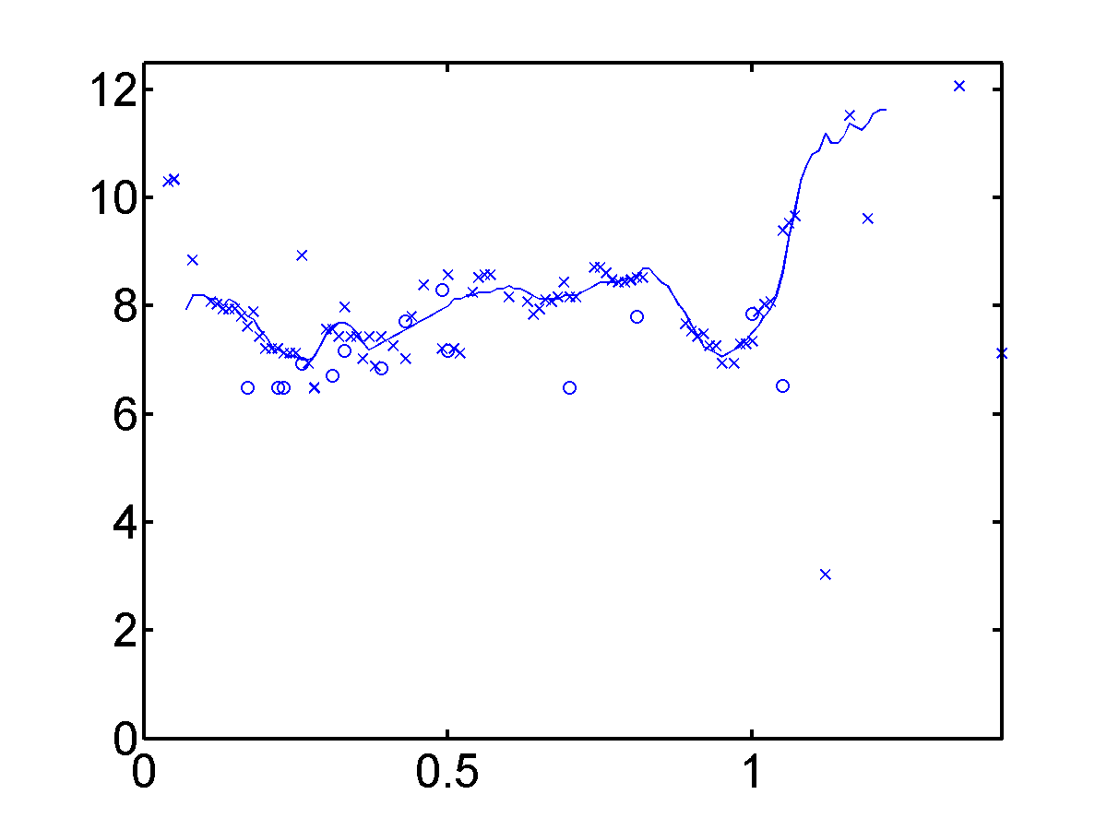

A Male Utterance and White Noise (SNR = –2 dB)
Our algorithm
Tolonen & Karjalainen (2000)
Pitch Period (ms)
Time (s)
Time (s)

Slide 36
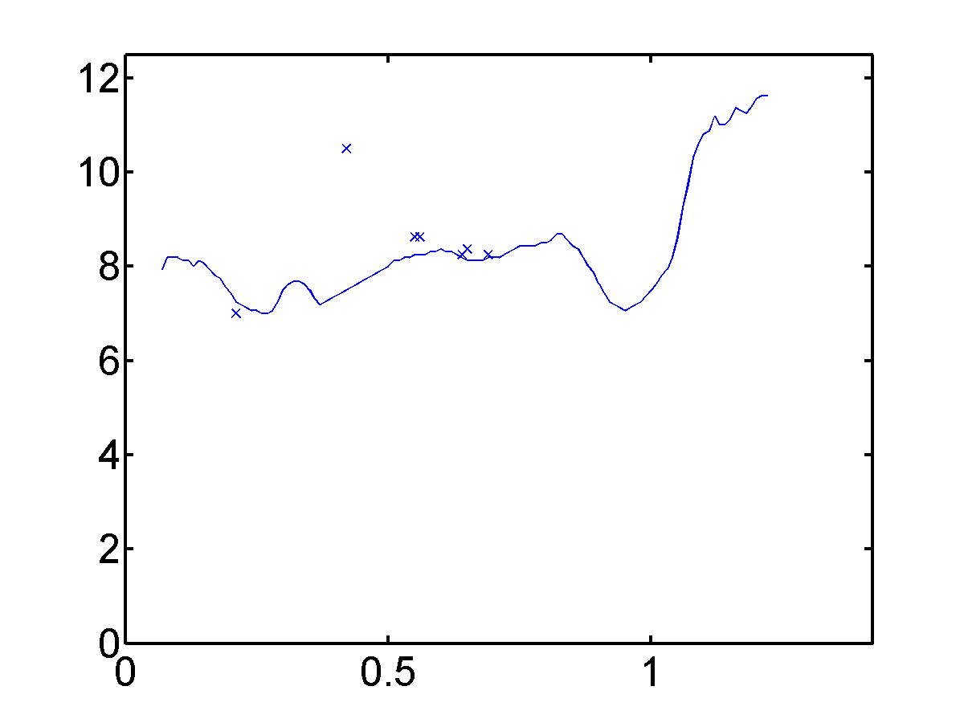

A Male Utterance and White Noise (cont.)
Gu & Bokhoven (1991)
Revised Gu & Bokhoven (1991)
Pitch Period (ms)
Time (s)
Time (s)

Slide 37
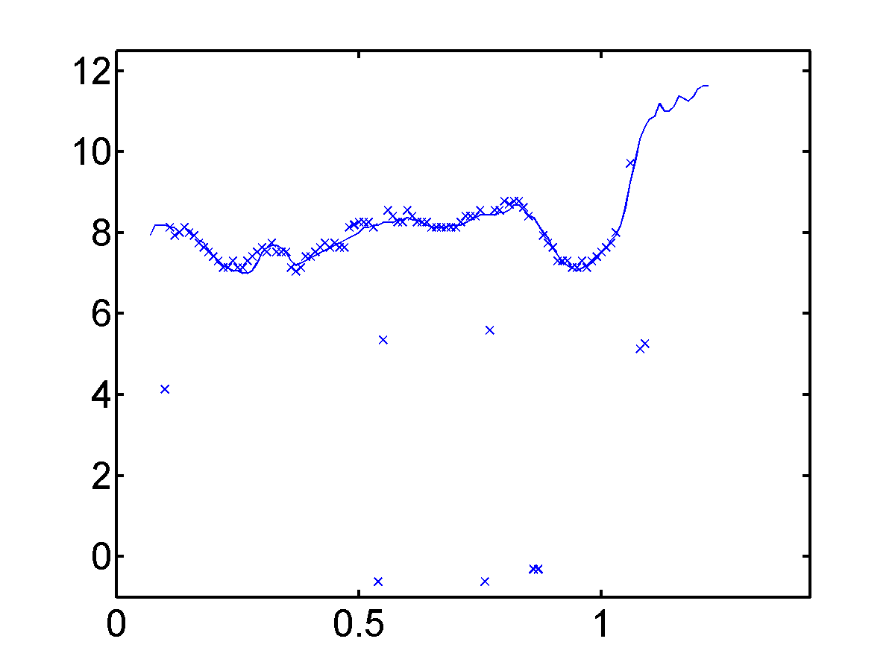
A Male Utterance and White Noise (cont.)
A single pitch tracker by Rouat, Liu & Morissette (1997)
Pitch Period (ms)
Time (s)

Slide 38
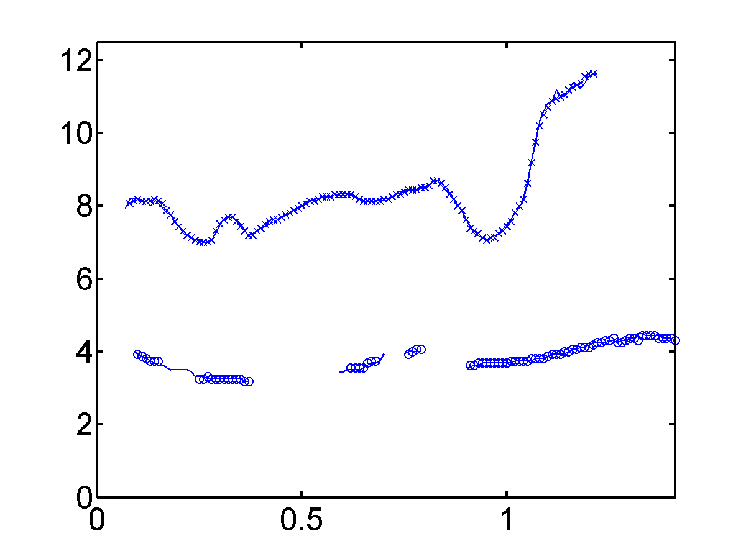
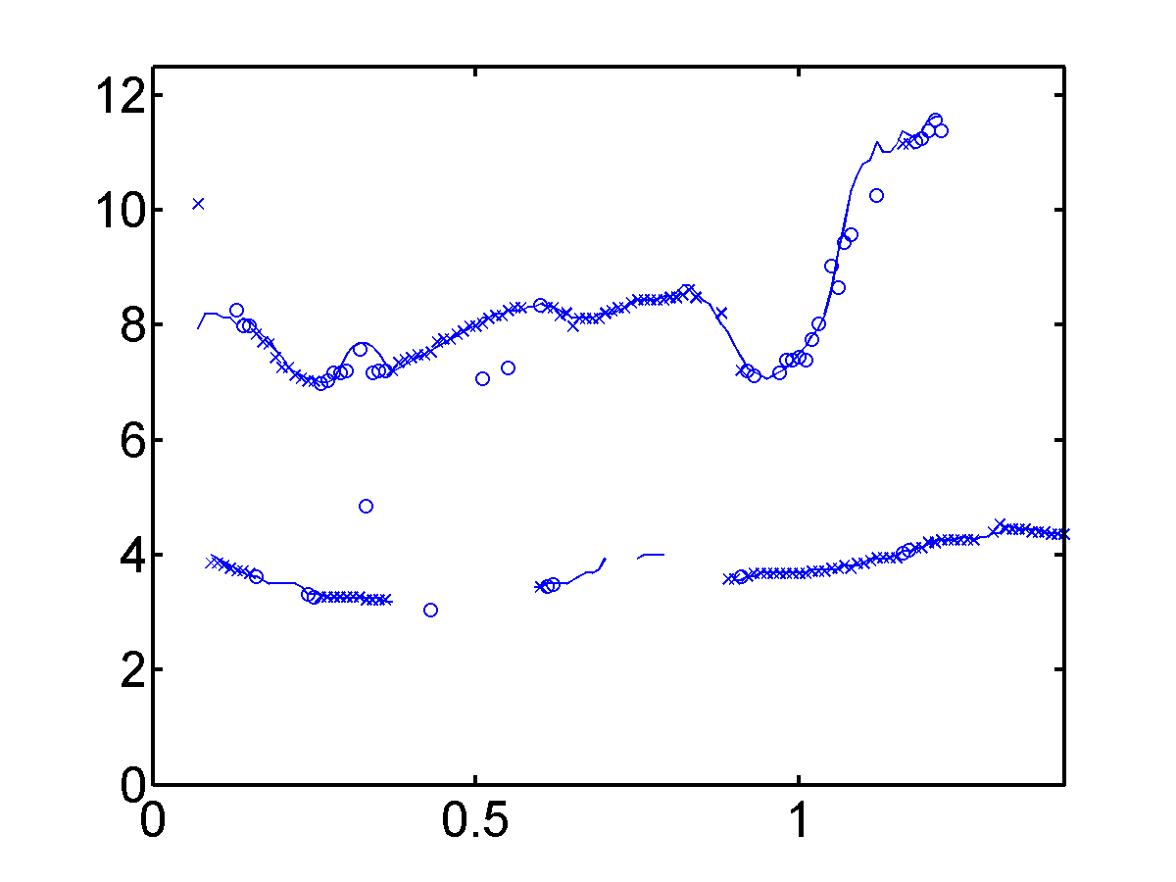
Simultaneous Utterances of a Male and a Female Speaker
Our algorithm
Tolonen & Karjalainen (2000)
Pitch Period (ms)
Time (s)
Time (s)

Slide 39
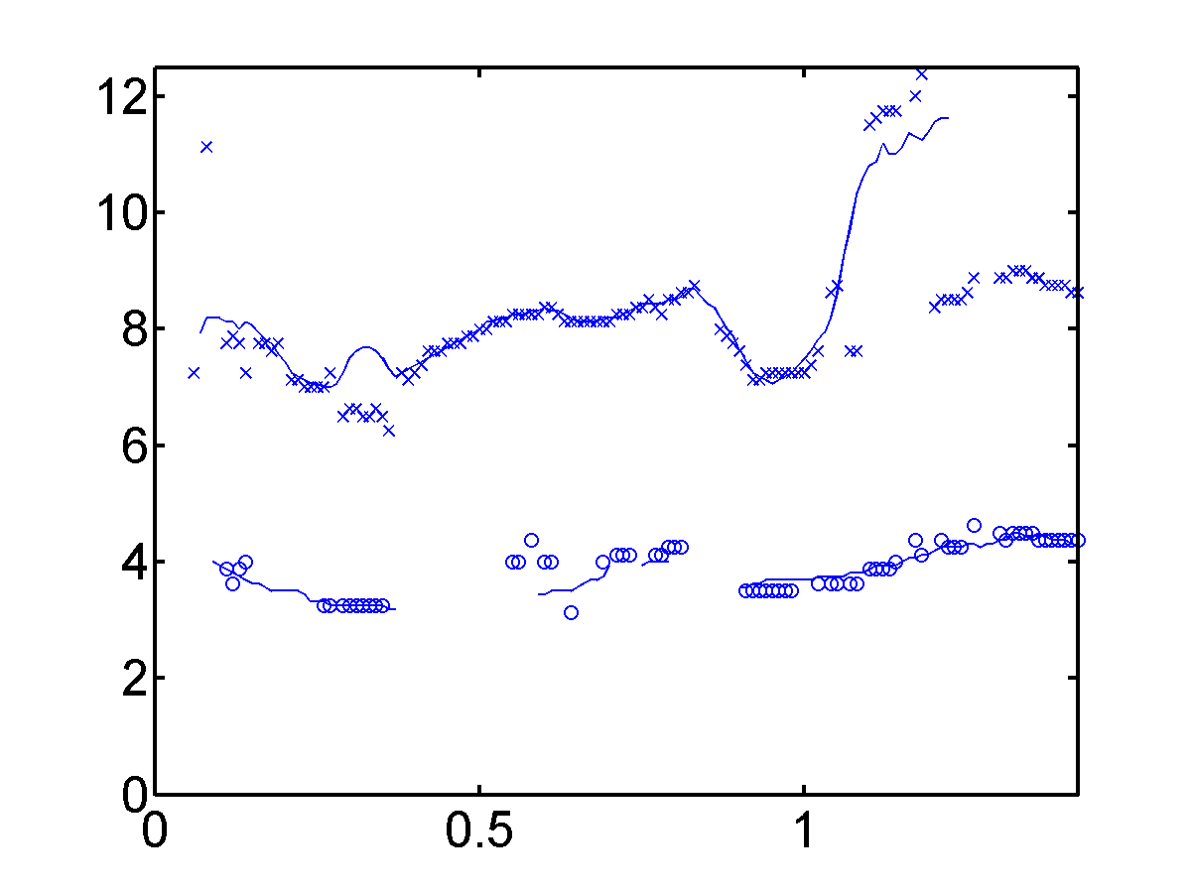
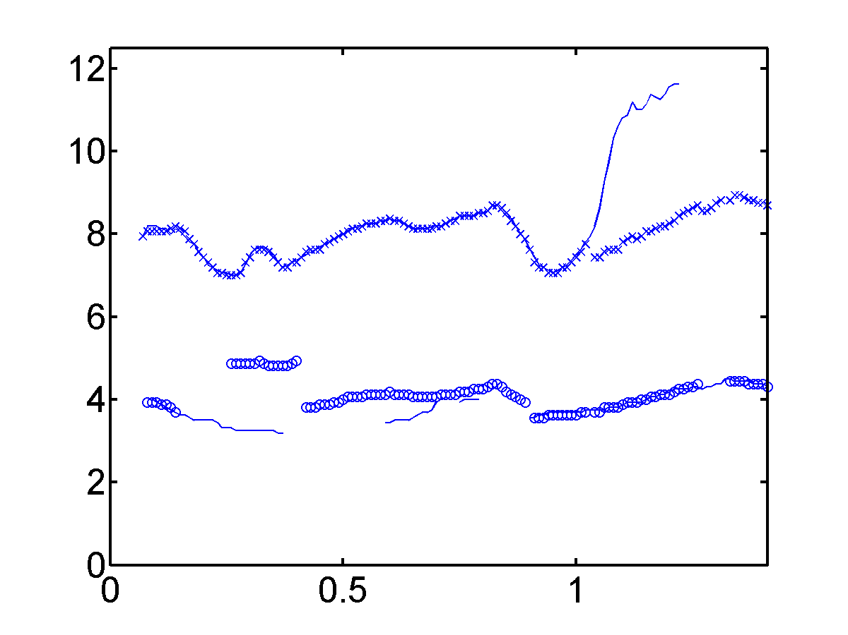
Simultaneous Utterances of a Male and a Female Speaker (cont.)
Gu & Bokhoven (1991)
Revised Gu & Bokhoven (1991)
Pitch Period (ms)
Time (s)
Time (s)

Slide 40
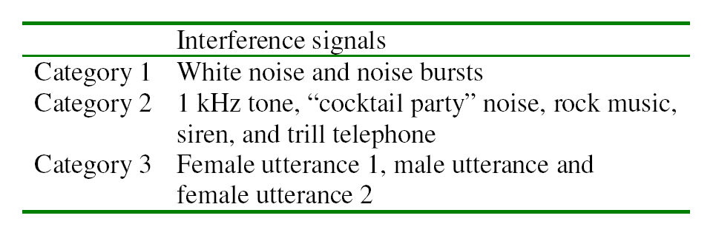
Categorization of Interference Signals

Slide 41
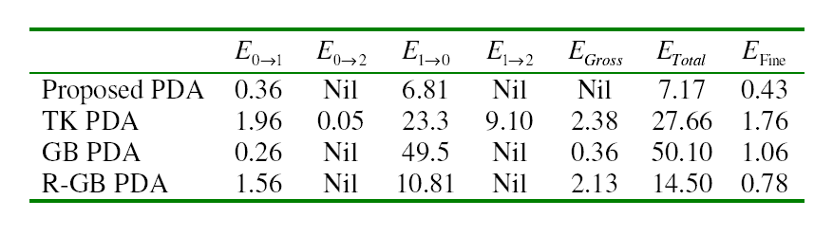
Error Rates (in Percentage) for Category 1 Interference

Slide 42
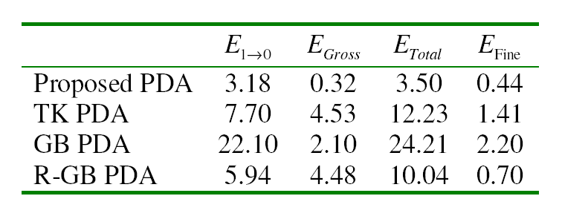
Error Rates (in Percentage) for Category 2 Interference

Slide 43
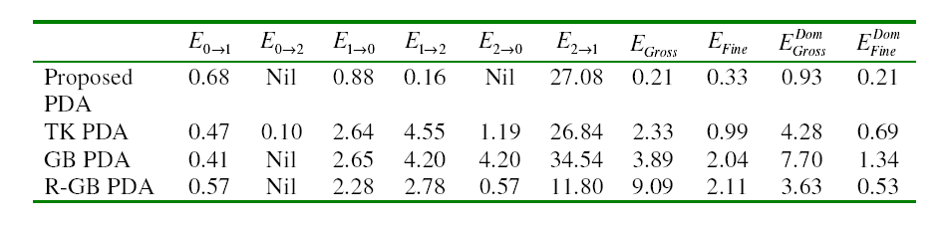
Error Rates (in Percentage) for Category 3 Interference

Slide 44

A CASA Application Demo
Original mixture
Segregated male utterance using a correlogram-based pitch tracker (Wang & Brown’99)
Segregated utterance using our algorithm

Slide 45
Conclusion
Improved channel/peak selection method for reducing noise interference.
Statistical integration method effectively utilizing the periodicity information across all channels.
HMM for modeling continuous pitch tracks.
Our algorithm performs reliably for tracking single and double pitch tracks in noisy acoustic environments.
The algorithm outperforms others by a substantial margin.

