Slide 1
SORTING ALGORITHMS
CS163 – SEMINAR – GROUP 5

Slide 2
Table of Contents
01
02
03
Heapsort
Counting Sort
Pigeonhole Sort

Slide 3
01
Heapsort
Comparison-based, in-place algorithm
that uses a heap

Slide 4

OVERVIEW
Heap Sort is a comparison-based, in-place sorting algorithm that leverages the properties of a heap data structure - specifically a max heap, when sorting in ascending order.
J. W. J. Williams,
inventor of Heap Sort

Slide 5
OVERVIEW
1. Type:
Comparison-based, in-place algorithm that sorts by using a max heap.
2. Workings:
Using max heap property, sort by continuously popping the largest element from the heap and place it at the end of the output array.
3. Time complexity:
Consistently runs at O(n log(n)), even in the worst case.

Slide 6
Visualization
33
22
11
55
66
44
77
33
22
11
55
66
44
77
Step 1: Build a Max Heap

Slide 7
Visualization
33
22
11
55
66
44
77
33
22
11
(Last non-leaf node)
55
66
44
77
Step 1: Build a Max Heap

Slide 8
Visualization
33
22
77
55
66
44
11
33
22
77
(Heapify)
55
66
44
11
Step 1: Build a Max Heap

Slide 9
Visualization
33
22
77
55
66
44
11
33
22
77
(Heapify)
55
66
44
11
Step 1: Build a Max Heap

Slide 10
Visualization
33
22
77
55
66
44
11
33
(Move to next non-leaf node)
22
77
55
66
44
11
Step 1: Build a Max Heap

Slide 11
Visualization
33
66
77
55
22
44
11
33
(Heapify)
66
77
55
22
44
11
Step 1: Build a Max Heap

Slide 12
Visualization
33
66
77
55
22
44
11
33
(Heapify)
66
77
55
22
44
11
Step 1: Build a Max Heap

Slide 13
Visualization
33
66
77
55
22
44
11
(Move to next non-leaf node)
33
66
77
55
22
44
11
Step 1: Build a Max Heap

Slide 14
Visualization
77
66
33
55
22
44
11
(Heapify)
77
66
33
55
22
44
11
Step 1: Build a Max Heap

Slide 15
Visualization
77
66
44
55
22
33
11
(Heapify)
77
66
44
55
22
33
11
Step 1: Build a Max Heap

Slide 16
Visualization
77
66
44
55
22
33
11
77
66
44
55
22
33
11
Step 2: Sort the array

Slide 17
Visualization
11
66
44
55
22
33
77
11
66
44
(Swap largest element
with last element)
55
22
33
77
Step 2: Sort the array

Slide 18
Visualization
11
66
44
55
22
33
77
11
66
44
(Last element is now sorted)
55
22
33
77
Step 2: Sort the array

Slide 19
Visualization
11
66
44
55
22
33
77
11
66
44
(Call heapify again)
55
22
33
77
Step 2: Sort the array

Slide 20
Visualization
66
55
44
11
22
33
77
66
55
44
(Call heapify again)
11
22
33
77
Step 2: Sort the array

Slide 21
Visualization
33
55
44
11
22
66
77
33
55
44
(Continue Sorting)
11
22
66
77
Step 2: Sort the array

Slide 22
Visualization
55
33
44
11
22
66
77
55
33
44
(Heapify)
11
22
66
77
Step 2: Sort the array

Slide 23
Visualization
22
33
44
11
55
66
77
22
33
44
(Continue sorting)
11
55
66
77
Step 2: Sort the array

Slide 24
Visualization
44
33
22
11
55
66
77
44
33
22
(Heapify)
11
55
66
77
Step 2: Sort the array

Slide 25
Visualization
11
33
22
44
55
66
77
11
33
22
(Continue sorting)
44
55
66
77
Step 2: Sort the array

Slide 26
Visualization
33
11
22
44
55
66
77
33
11
22
(Heapify)
44
55
66
77
Step 2: Sort the array

Slide 27
Visualization
22
11
33
44
55
66
77
22
11
33
(Continue Sorting)
44
55
66
77
Step 2: Sort the array

Slide 28
Visualization
22
11
33
44
55
66
77
22
11
33
(Heapify)
44
55
66
77
Step 2: Sort the array

Slide 29
Visualization
11
22
33
44
55
66
77
11
22
33
(Continue sorting)
44
55
66
77
Step 2: Sort the array

Slide 30
Visualization
11
22
33
44
55
66
77
11
22
33
(Last element)
=> Array is sorted.
44
55
66
77
Step 2: Sort the array

Slide 31
Visualization
11
22
33
44
55
66
77
11
22
33
(Last element)
=> Array is sorted.
44
55
66
77
Step 2: Sort the array

Slide 32
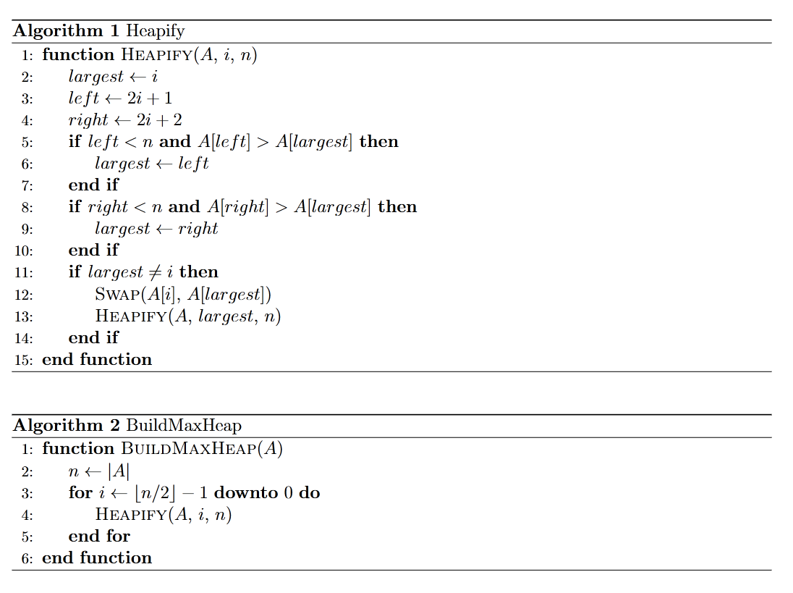
Pseudocode

Slide 33
Pseudocode

Slide 34
Pseudocode

Slide 35
Pseudocode

Slide 36
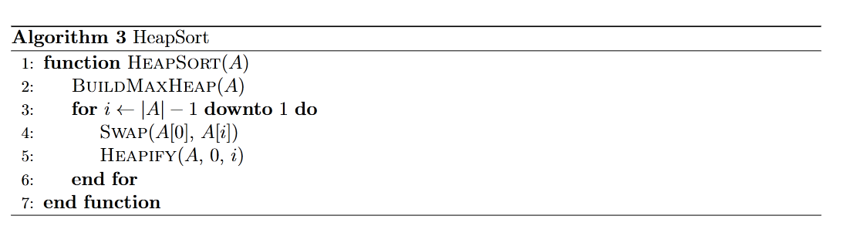
Pseudocode

Slide 37
Complexity Analysis
TIME COMPLEXITY:
Function | Complexity | Analysis
Building the Heap | O(n) | Optimization when handling lower-level elements.
Extracting element from Heap | O(n log(n)) | For each heapify call, n extractions follow.
In-place sorting | O(n log(n)) | Heapify is called once for each swap.
SPACE COMPLEXITY: O(1) since Heap Sort is done in-place.

Slide 38
Applications
1. Priority queue
2. Real-time systems
3. Game development
Scheduling algorithms in OSs or task management systems.
Sorting sensor data in autonomous vehicles.
Managing objects based on their distance and position.

Slide 39
02
Counting Sort
Non-comparison-based algorithm
that uses number of occurrences

Slide 40
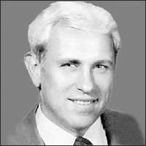
OVERVIEW
Counting Sort is a non-comparison-based sorting algorithm that sorts elements by counting the number of occurrences of each unique value in the input array.
Harold H. Seward,
inventor of Counting Sort

Slide 41
OVERVIEW
1. Type:
Non-comparison-based, stable sorting algorithm that sorts based on frequency of occurrences.
2. Workings:
Count frequency of occurrences of elements then place them according to their count.
3. Time complexity:
O(n + k), where n is the number of elements and k is the range of the input values.

Slide 42
VISUALIZATION
3
2
1
0
3
2
2
Max: 3
Min: 0
Range: (3 – 0) + 1 = 4

Slide 43
VISUALIZATION
3
2
1
0
3
2
2
Step 1: Initialize Count array

Slide 44
VISUALIZATION
3
2
1
0
3
2
2
0
1
2
3
0
0
0
0
COUNT
Step 1: Initialize Count array

Slide 45
VISUALIZATION
3
2
1
0
3
2
2
0
1
2
3
0
0
0
0
COUNT
Step 1.5: Fill Count array

Slide 46
VISUALIZATION
3
2
1
0
3
2
2
0
1
2
3
0
0
0
1
COUNT
Step 1.5: Fill Count array

Slide 47
VISUALIZATION
3
2
1
0
3
2
2
0
1
2
3
0
0
1
1
COUNT
Step 1.5: Fill Count array

Slide 48
VISUALIZATION
3
2
1
0
3
2
2
0
1
2
3
0
1
1
1
COUNT
Step 1.5: Fill Count array

Slide 49
VISUALIZATION
3
2
1
0
3
2
2
0
1
2
3
1
1
1
1
COUNT
Step 1.5: Fill Count array

Slide 50
VISUALIZATION
3
2
1
0
3
2
2
0
1
2
3
1
1
1
2
COUNT
Step 1.5: Fill Count array

Slide 51
VISUALIZATION
3
2
1
0
3
2
2
0
1
2
3
1
1
2
2
COUNT
Step 1.5: Fill Count array

Slide 52
VISUALIZATION
3
2
1
0
3
2
2
0
1
2
3
1
1
3
2
COUNT
Step 1.5: Fill Count array

Slide 53
VISUALIZATION
3
2
1
0
3
2
2
0
1
2
3
1
1
3
2
COUNT
Step 3: Cumulatively summing occurrences

Slide 54
VISUALIZATION
3
2
1
0
3
2
2
0
1
2
3
1
1
3
2
COUNT
[0 + 1]
Step 3: Cumulatively summing occurrences

Slide 55
VISUALIZATION
3
2
1
0
3
2
2
0
1
2
3
1
2
3
2
COUNT
[1 + 1]
Step 3: Cumulatively summing occurrences

Slide 56
VISUALIZATION
3
2
1
0
3
2
2
0
1
2
3
1
2
5
2
COUNT
[2 + 3]
Step 3: Cumulatively summing occurrences

Slide 57
VISUALIZATION
3
2
1
0
3
2
2
0
1
2
3
1
2
5
7
COUNT
[5 + 2]
Step 3: Cumulatively summing occurrences

Slide 58
VISUALIZATION
3
2
1
0
3
2
2
0
0
0
0
0
0
0
OUTPUT
0
1
2
3
1
2
5
7
COUNT
Step 4: Create Output array

Slide 59
VISUALIZATION
3
2
1
0
3
2
2
0
0
0
0
2
0
0
OUTPUT
0
1
2
3
1
2
4
7
COUNT
Step 4: Create Output array

Slide 60
VISUALIZATION
3
2
1
0
3
2
2
0
0
0
2
2
0
0
OUTPUT
0
1
2
3
1
2
3
7
COUNT
Step 4: Create Output array

Slide 61
VISUALIZATION
3
2
1
0
3
2
2
0
0
0
2
2
0
3
OUTPUT
0
1
2
3
1
2
3
6
COUNT
Step 4: Create Output array

Slide 62
VISUALIZATION
3
2
1
0
3
2
2
0
0
0
2
2
0
3
OUTPUT
0
1
2
3
0
2
3
6
COUNT
Step 4: Create Output array

Slide 63
VISUALIZATION
3
2
1
0
3
2
2
0
1
0
2
2
0
3
OUTPUT
0
1
2
3
0
1
3
6
COUNT
Step 4: Create Output array

Slide 64
VISUALIZATION
3
2
1
0
3
2
2
0
1
2
2
2
0
3
OUTPUT
0
1
2
3
0
1
2
6
COUNT
Step 4: Create Output array

Slide 65
VISUALIZATION
3
2
1
0
3
2
2
0
1
2
2
2
3
3
OUTPUT
0
1
2
3
0
1
2
5
COUNT
Step 4: Create Output array

Slide 66
VISUALIZATION
3
2
1
0
3
2
2
0
1
2
2
2
3
3
OUTPUT (SORTED)
0
1
2
3
0
1
2
5
COUNT
Step 5: Return Output array

Slide 67
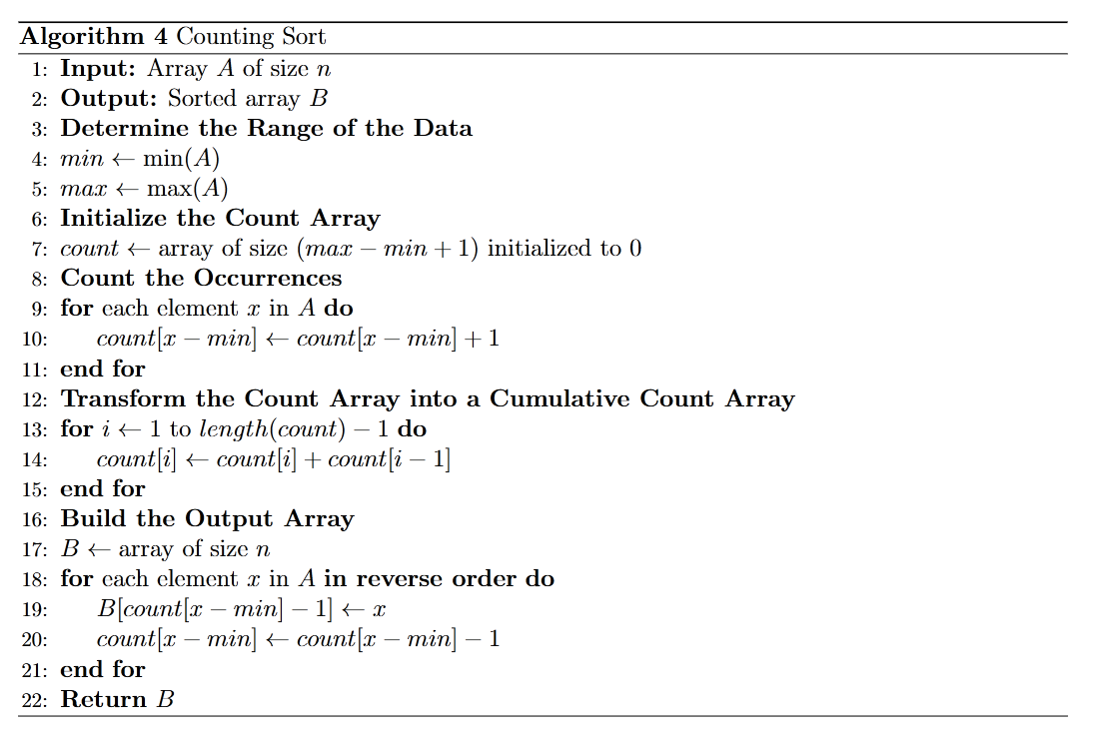
PSEUDOCODE

Slide 68
PSEUDOCODE

Slide 69
PSEUDOCODE

Slide 70
PSEUDOCODE

Slide 71
PSEUDOCODE

Slide 72
Complexity Analysis
TIME COMPLEXITY:
Function | Complexity | Analysis
Building the Count array | O(n) | Each element is processed once to track its frequency.
Modifying the Count frequency | O(max – min + 1) | Cumulative summing over the range of values.
Reconstructing the sorted array | O(n) | Each element in the input array is processed once to be put in the right place.
SPACE COMPLEXITY: O(max – min + 1) since Counting Sort creates a Count array with size (max – min + 1) to store the frequency counts.

Slide 73
Applications
1. Data compression
2. Sort small datasets
3. Counting occurrences
Building frequency tables for other algorithms like Huffman encoding.
Sorting small sets of integers and characters, or database records with small key ranges.
Count number of occurrence of elements in a dataset.

Slide 74
03
Pigeonhole Sort
Classic non-comparison-based algorithm

Slide 75
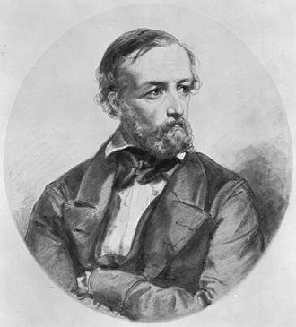
OVERVIEW
Pigeonhole sorting is a non-comparison-based algorithm suitable for sorting lists of elements where the number of elements and the number of possible key values are approximately the same.
Peter Gustav Lejeune Dirichlet,
inventor of Pigeonhole Sort

Slide 76
OVERVIEW
1. Type:
Non-comparison-based, (potentially) stable sorting algorithm that sorts based on frequency of occurrences.
2. Working:
Similar to Counting Sort, but move items twice: once to the bucket array and once to the destination array.
3. Time complexity:
O(n + Range), where n is the number of elements in the input array and ‘Range’ is the number of possible values in the array.

Slide 77
VISUALIZATION
4
2
1
1
3
1
2

Slide 78
VISUALIZATION
4
2
1
1
3
1
2
Max: 4
Min: 1
Range: (4 - 1) + 1 = 4

Slide 79
VISUALIZATION
4
2
1
1
3
1
2
1
2
3
4
PIGEONHOLE
Step 1: Initialize Pigeonhole array

Slide 80
VISUALIZATION
4
2
1
1
3
1
2
1
2
3
4
PIGEONHOLE
Step 2: Calculate distribution

Slide 81
VISUALIZATION
4
2
1
1
3
1
2
1
2
3
4
PIGEONHOLE
Step 2: Calculate distribution

Slide 82
VISUALIZATION
4
2
1
1
3
1
2
1
2
3
4
PIGEONHOLE
Step 2: Calculate distribution

Slide 83
VISUALIZATION
4
2
1
1
3
1
2
1
2
3
4
PIGEONHOLE
Step 2: Calculate distribution

Slide 84
VISUALIZATION
4
2
1
1
3
1
2
1
2
3
4
PIGEONHOLE
Step 2: Calculate distribution

Slide 85
VISUALIZATION
4
2
1
1
3
1
2
1
2
3
4
PIGEONHOLE
Step 2: Calculate distribution

Slide 86
VISUALIZATION
4
2
1
1
3
1
2
1
2
3
4
PIGEONHOLE
Step 2: Calculate distribution

Slide 87
VISUALIZATION
1
2
1
1
3
1
2
1
2
3
4
PIGEONHOLE
Step 3: Copy elements back to original array

Slide 88
VISUALIZATION
1
1
1
1
3
1
2
1
2
3
4
PIGEONHOLE
Step 3: Copy elements back to original array

Slide 89
VISUALIZATION
1
1
1
1
3
1
2
1
2
3
4
PIGEONHOLE
Step 3: Copy elements back to original array

Slide 90
VISUALIZATION
1
1
1
2
3
1
2
1
2
3
4
PIGEONHOLE
Step 3: Copy elements back to original array

Slide 91
VISUALIZATION
1
1
1
2
2
1
2
1
2
3
4
PIGEONHOLE
Step 3: Copy elements back to original array

Slide 92
VISUALIZATION
1
1
1
2
2
3
2
1
2
3
4
PIGEONHOLE
Step 3: Copy elements back to original array

Slide 93
VISUALIZATION
1
1
1
2
2
3
4
1
2
3
4
PIGEONHOLE
Step 3: Copy elements back to original array

Slide 94
VISUALIZATION
1
1
1
2
2
3
2
SORTED ARRAY
1
2
3
4
PIGEONHOLE
Step 3: Copy elements back to original array

Slide 95
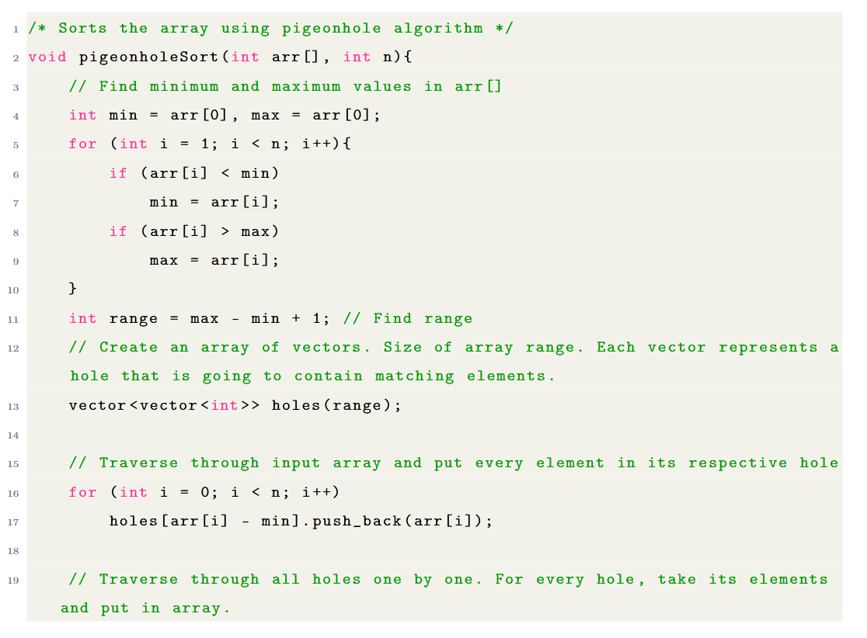
PSEUDOCODE

Slide 96
PSEUDOCODE

Slide 97
PSEUDOCODE

Slide 98
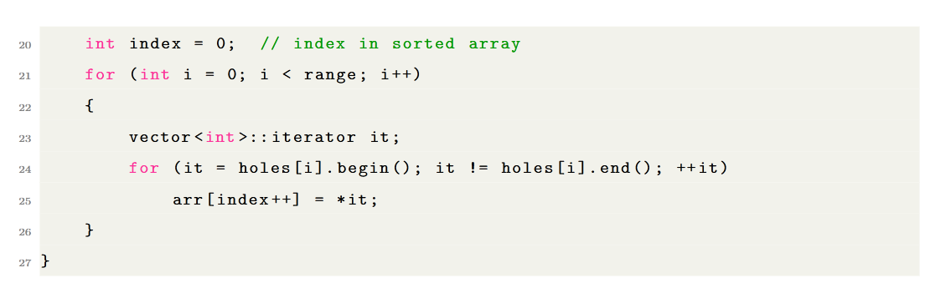
PSEUDOCODE

Slide 99
Complexity Analysis
TIME COMPLEXITY:
Function | Complexity | Analysis
Building the Pigeonhole array | O(n + range) | Each unique element is placed into its respective pigeonhole.
Filling the Pigeonhole array | O(n) | Fill each bucket of pigeonhole with elements.
Reconstructing the sorted array | O(n + range) | Transfer element from buckets back to the original array.
SPACE COMPLEXITY: O(range) since Pigeonhole Sort creates a Pigeonhole array with size (max – min + 1) to store the frequency counts.

Slide 100
Applications
1. Statistical Analysis
2. Sort small datasets
3. Histogram generation
Sort survey responses or experiment data.
Sorting small sets of integers and characters, or database records with small key ranges.
Generate histograms or frequency-based distribution of data.

Slide 101
04
Odd-even Transposition Sort
Simple parallelized
sorting algorithm

Slide 102
OVERVIEW
Odd-Even Transposition Sort (OETS) is a parallel sorting algorithm derived from Bubble Sort, using alternating comparison phases to enable efficient concurrent execution.
Peter Gustav Lejeune Dirichlet,
inventor of Pigeonhole Sort

Slide 103
OVERVIEW
1. Type:
Comparison-based sorting algorithm that can be parallelized on multi-core systems.
2. Working:
Similar to Bubble Sort, comparing and swapping elements on a 1D array.
3. Time complexity:
Operates in O(n^2) time sequentially but achieves O(n) time with n processors in parallel implementation.

Slide 104
VISUALIZATION
4
0
1
5
3
6
2

Slide 105
VISUALIZATION
EVEN PHASE
4
0
1
5
3
6
2
(Each pair of number is using individual threads executing in parallel)

Slide 106
VISUALIZATION
EVEN PHASE
0
4
1
5
3
6
2
(Each pair of number is using individual threads executing in parallel)

Slide 107
VISUALIZATION
ODD PHASE
0
4
1
5
3
6
2
(Each pair of number is using individual threads executing in parallel)

Slide 108
VISUALIZATION
ODD PHASE
0
1
4
3
5
2
6
(Each pair of number is using individual threads executing in parallel)

Slide 109
VISUALIZATION
EVEN PHASE
0
1
4
3
5
2
6
(Each pair of number is using individual threads executing in parallel)

Slide 110
VISUALIZATION
EVEN PHASE
0
1
3
4
2
5
6
(Each pair of number is using individual threads executing in parallel)

Slide 111
VISUALIZATION
ODD PHASE
0
1
3
4
2
5
6
(Each pair of number is using individual threads executing in parallel)

Slide 112
VISUALIZATION
ODD PHASE
0
1
3
2
4
5
6
(Each pair of number is using individual threads executing in parallel)

Slide 113
VISUALIZATION
EVEN PHASE
0
1
3
2
4
5
6
(Each pair of number is using individual threads executing in parallel)

Slide 114
VISUALIZATION
EVEN PHASE
0
1
2
3
4
5
6
(Each pair of number is using individual threads executing in parallel)

Slide 115
VISUALIZATION
ODD PHASE
0
1
2
3
4
5
6
(Each pair of number is using individual threads executing in parallel)

Slide 116
VISUALIZATION
ODD PHASE (NO CHANGE)
0
1
2
3
4
5
6
(Each pair of number is using individual threads executing in parallel)

Slide 117
VISUALIZATION
ARRAY IS SORTED!
0
1
2
3
4
5
6
(Each pair of number is using individual threads executing in parallel)

Slide 118
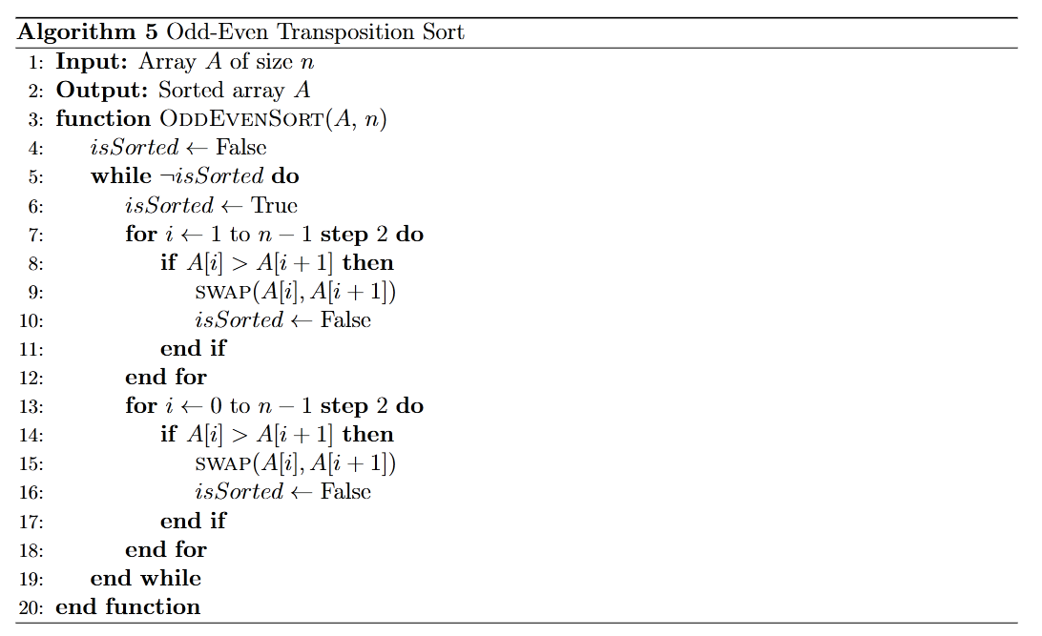
Pseudocode

Slide 119
Pseudocode

Slide 120
Pseudocode

Slide 121
Complexity Analysis
TIME COMPLEXITY:
Function | Complexity | Analysis
Create and set up the array for sorting the input elements | O(n) | Straightforward operation to allocate memory for the array.
Linear traversal of the array | O(n) | Move through the array to perform comparisons and swaps.
Even/Odd phases of sorting | O(n) | Each phase requires comparing and (potentially) swapping elements.
SPACE COMPLEXITY: O(1) since Odd-Even Sort is an in-place sorting algorithm.

Slide 122
Applications
1. Education
2. Parallel computing
3. Sorting networks
Simple example of sorting algorithm and parallel processing.
Efficient sorting in environments with multiple processors.
Used in hardware implementations of sorting algorithms.

Slide 123
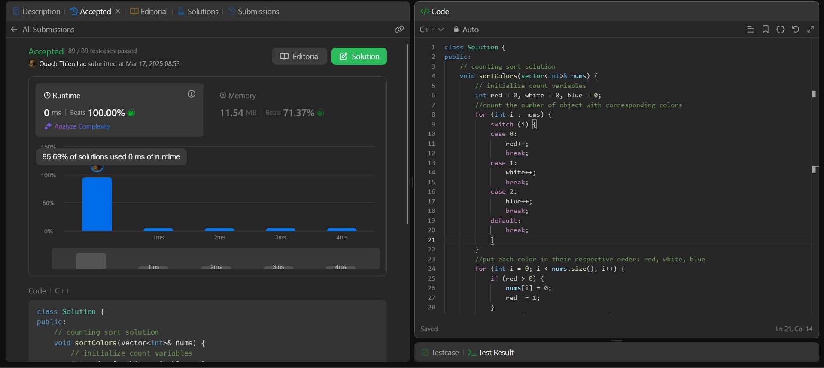
EXAMPLE PROBLEM: LEETCODE NO.75
Counting Sort Approach: O(n) time
Count the frequency of red, white, and blue objects in the array.
Refill the array, first with red objects, then white objects, and blue objects.
► Sorting is done in-place as required, with only 3 integer variables required.

Slide 124
COMPARISON OF SORTING ALGORITHMS
Algorithm | Stability | Time Complexity | Space Complexity | Pros | Cons
Heap Sort | Not stable | O(n log(n)) | O(1) | Stable performance, memory efficient | Not a stable sort, complex implementation
Counting sort | Stable | O(n + k) | O(n + k) | Linear time, simple, stable | Memory intensive, not flexible for wide value ranges
Pigeonhole Sort | Potentially stable | O(n + r) | O(n + r) | Efficient for small value ranges, simple, fast | Memory intensive, not flexible for wide value ranges,
Odd-Even Transposition Sort | Stable | O(n^2) | O(1) | Simple, easy to implement, efficient on small arrays. | Poor performance on single-core processors or large arrays.

Slide 125
Quizzes

Slide 126
What is Heapify in Heap Sort?
A
B
Building a complete binary tree.
Ensuring max/min heap property.
C
Sorting the array by comparing elements.
D
Creating an AVL tree.

Slide 127
What is Heapify in Heap Sort?
A
B
Building a complete binary tree.
Ensuring max/min heap property.
C
Sorting the array by comparing elements.
D
Creating an AVL tree.

Slide 128
Which of the following is not an application of Heap Sort?
A
B
Sorting large datasets.
Implementing priority queues.
C
Sorting data in external memory.
D
Sorting data with a small range of values.

Slide 129
Which of the following is not an application of Heap Sort?
A
B
Sorting large datasets.
Implementing priority queues.
C
Sorting data in external memory.
D
Sorting data with a small range of values.

Slide 130
When does Counting Sort work most efficiently?
A
B
When the range of values (k) is larger than the number of elements (n).
When the range of values (k) is smaller than or approximately equal to the number of elements (n).
C
When the data consists of real numbers.
D
When the data consists of strings.

Slide 131
When does Counting Sort work most efficiently?
A
B
When the range of values (k) is larger than the number of elements (n).
When the range of values (k) is smaller than or approximately equal to the number of elements (n).
C
When the data consists of real numbers.
D
When the data consists of strings.

Slide 132
Which of the following is not an application of Counting Sort?
A
B
Sorting integers within a small range.
Generating histograms from data.
C
Sorting large datasets with a large range of values.
D
When the data consists of strings.

Slide 133
Which of the following is not an application of Counting Sort?
A
B
Sorting integers within a small range.
Generating histograms from data.
C
Sorting large datasets with a large range of values.
D
When the data consists of strings.

Slide 134
When does Pigeonhole Sort work most efficiently?
A
B
When the number of elements (n) is larger than the range of values (k).
When the number of elements (n) is approximately equal to the range of values (k).
C
When the data consists of real numbers.
D
When the data consists of strings.

Slide 135
When does Pigeonhole Sort work most efficiently?
A
B
When the number of elements (n) is larger than the range of values (k).
When the number of elements (n) is approximately equal to the range of values (k).
C
When the data consists of real numbers.
D
When the data consists of strings.

Slide 136
How is Pigeonhole Sort different from Counting Sort?
A
B
Pigeonhole Sort moves elements twice.
Counting Sort moves elements twice.
C
Pigeonhole Sort does not require a range of values.
D
Counting Sort does not require a range of values.

Slide 137
How is Pigeonhole Sort different from Counting Sort?
A
B
Pigeonhole Sort moves elements twice.
Counting Sort moves elements twice.
C
Pigeonhole Sort does not require a range of values.
D
Counting Sort does not require a range of values.

Slide 138
Which algorithm is most suitable for sorting integers within a small range?
A
B
Heap Sort.
Counting Sort.
C
Pigeonhole Sort.
D
Both B and C.

Slide 139
Which algorithm is most suitable for sorting integers within a small range?
A
B
Heap Sort.
Counting Sort.
C
Pigeonhole Sort.
D
Both B and C.

Slide 140
Thanks for watching!

