Slide 1
SORTING ALGORITHMS
CS163 – SEMINAR – GROUP 5

Slide 2
Table of Contents
01
03
04
Heapsort
Odd-even sort
02
Counting Sort
Pigeonhole Sort

Slide 3
01
Heapsort
Comparison-based, in-place algorithm
that uses a heap

Slide 4

OVERVIEW
Heap Sort is a comparison-based, in-place sorting algorithm that leverages the properties of a heap data structure - specifically a max heap, when sorting in ascending order.
J. W. J. Williams,
inventor of Heap Sort

Slide 5
OVERVIEW
1. Type:
Comparison-based, in-place algorithm that sorts by using a max heap.
2. Workings:
Using max heap property, sort by continuously popping the largest element from the heap and place it at the end of the output array.
3. Time complexity:
Consistently runs at O(n log(n)), even in the worst case.

Slide 6
Visualization
33
22
11
55
66
44
77
33
22
11
55
66
44
77
Step 1: Build a Max Heap

Slide 7
Visualization
33
22
11
55
66
44
77
33
22
11
(Last non-leaf node)
55
66
44
77
Step 1: Build a Max Heap

Slide 8
Visualization
33
22
77
55
66
44
11
33
22
77
(Heapify)
55
66
44
11
Step 1: Build a Max Heap

Slide 9
Visualization
33
22
77
55
66
44
11
33
22
77
(Heapify)
55
66
44
11
Step 1: Build a Max Heap

Slide 10
Visualization
33
22
77
55
66
44
11
33
(Move to next non-leaf node)
22
77
55
66
44
11
Step 1: Build a Max Heap

Slide 11
Visualization
33
66
77
55
22
44
11
33
(Heapify)
66
77
55
22
44
11
Step 1: Build a Max Heap

Slide 12
Visualization
33
66
77
55
22
44
11
33
(Heapify)
66
77
55
22
44
11
Step 1: Build a Max Heap

Slide 13
Visualization
33
66
77
55
22
44
11
(Move to next non-leaf node)
33
66
77
55
22
44
11
Step 1: Build a Max Heap

Slide 14
Visualization
77
66
33
55
22
44
11
(Heapify)
77
66
33
55
22
44
11
Step 1: Build a Max Heap

Slide 15
Visualization
77
66
44
55
22
33
11
(Heapify)
77
66
44
55
22
33
11
Step 1: Build a Max Heap

Slide 16
Visualization
77
66
44
55
22
33
11
77
66
44
55
22
33
11
Step 2: Sort the array

Slide 17
Visualization
11
66
44
55
22
33
77
11
66
44
(Swap largest element
with last element)
55
22
33
77
Step 2: Sort the array

Slide 18
Visualization
11
66
44
55
22
33
77
11
66
44
(Last element is now sorted)
55
22
33
77
Step 2: Sort the array

Slide 19
Visualization
11
66
44
55
22
33
77
11
66
44
(Call heapify again)
55
22
33
77
Step 2: Sort the array

Slide 20
Visualization
66
55
44
11
22
33
77
66
55
44
(Call heapify again)
11
22
33
77
Step 2: Sort the array

Slide 21
Visualization
33
55
44
11
22
66
77
33
55
44
(Continue Sorting)
11
22
66
77
Step 2: Sort the array

Slide 22
Visualization
55
33
44
11
22
66
77
55
33
44
(Heapify)
11
22
66
77
Step 2: Sort the array

Slide 23
Visualization
22
33
44
11
55
66
77
22
33
44
(Continue sorting)
11
55
66
77
Step 2: Sort the array

Slide 24
Visualization
44
33
22
11
55
66
77
44
33
22
(Heapify)
11
55
66
77
Step 2: Sort the array

Slide 25
Visualization
11
33
22
44
55
66
77
11
33
22
(Continue sorting)
44
55
66
77
Step 2: Sort the array

Slide 26
Visualization
33
11
22
44
55
66
77
33
11
22
(Heapify)
44
55
66
77
Step 2: Sort the array

Slide 27
Visualization
22
11
33
44
55
66
77
22
11
33
(Continue Sorting)
44
55
66
77
Step 2: Sort the array

Slide 28
Visualization
22
11
33
44
55
66
77
22
11
33
(Heapify)
44
55
66
77
Step 2: Sort the array

Slide 29
Visualization
11
22
33
44
55
66
77
11
22
33
(Continue sorting)
44
55
66
77
Step 2: Sort the array

Slide 30
Visualization
11
22
33
44
55
66
77
11
22
33
(Last element)
=> Array is sorted.
44
55
66
77
Step 2: Sort the array

Slide 31
Visualization
11
22
33
44
55
66
77
11
22
33
(Last element)
=> Array is sorted.
44
55
66
77
Step 2: Sort the array

Slide 32
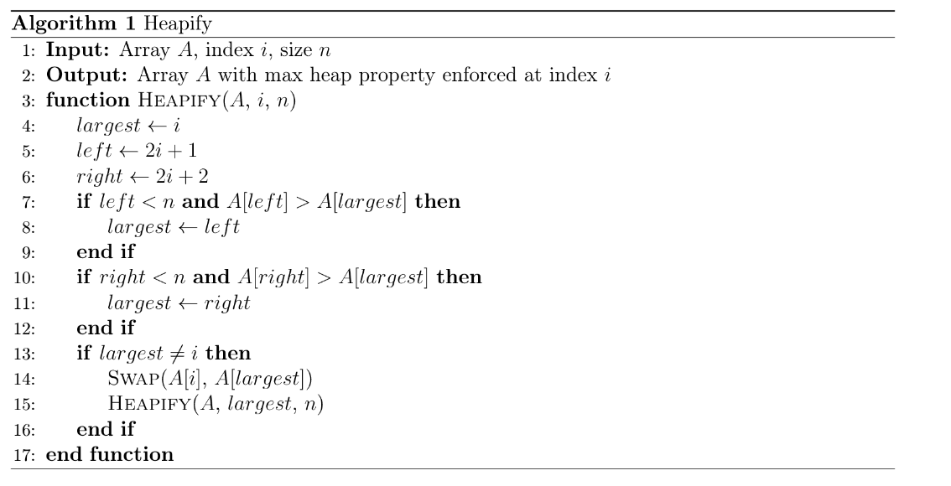
Pseudocode

Slide 33
Pseudocode

Slide 34
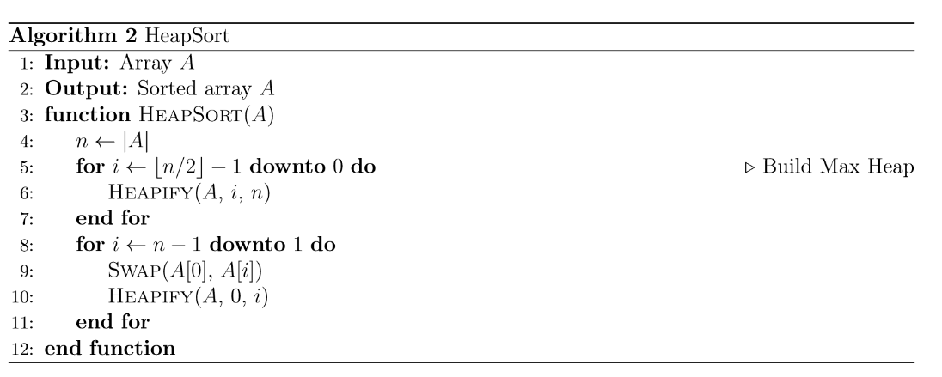
Pseudocode

Slide 35
Complexity Analysis
TIME COMPLEXITY:
Function | Complexity | Analysis
Building the Heap | O(n) | Optimization when handling lower-level elements.
Extracting element from Heap | O(n log(n)) | For each heapify call, n extractions follow.
In-place sorting | O(n log(n)) | Heapify is called once for each swap.
SPACE COMPLEXITY: O(1) since Heap Sort is done in-place.

Slide 36
Applications
1. Priority queue
2. Real-time systems
3. Game development
Scheduling algorithms in OSs or task management systems.
Sorting sensor data in autonomous vehicles.
Managing objects based on their distance and position.

Slide 37
02
Odd-even Transposition Sort
Simple parallelized
sorting algorithm

Slide 38

OVERVIEW
Odd-Even Transposition Sort (OETS) is a parallel sorting algorithm derived from Bubble Sort, using alternating comparison phases to enable efficient concurrent execution.
Kenneth Batcher,
inventor of Odd-Even Sort

Slide 39
OVERVIEW
1. Type:
Comparison-based sorting algorithm that can be parallelized on multi-core systems.
2. Working:
Similar to Bubble Sort, comparing and swapping elements on a 1D array.
3. Time complexity:
Operates in O(n^2) time sequentially but achieves O(n) time with n processors in parallel implementation.

Slide 40
VISUALIZATION
4
0
1
5
3
6
2

Slide 41
VISUALIZATION
ODD PHASE
4
0
1
5
3
6
2
(Each pair of number is using individual threads executing in parallel)

Slide 42
VISUALIZATION
ODD PHASE
4
0
1
3
5
2
6
(Each pair of number is using individual threads executing in parallel)

Slide 43
VISUALIZATION
EVEN PHASE
4
0
1
3
5
2
6
(Each pair of number is using individual threads executing in parallel)

Slide 44
VISUALIZATION
EVEN PHASE
0
4
1
3
2
5
6
(Each pair of number is using individual threads executing in parallel)

Slide 45
VISUALIZATION
ODD PHASE
0
4
1
3
2
5
6
(Each pair of number is using individual threads executing in parallel)

Slide 46
VISUALIZATION
ODD PHASE
0
1
4
2
3
5
6
(Each pair of number is using individual threads executing in parallel)

Slide 47
VISUALIZATION
EVEN PHASE
0
1
4
2
3
5
6
(Each pair of number is using individual threads executing in parallel)

Slide 48
VISUALIZATION
EVEN PHASE
0
1
2
4
3
5
6
(Each pair of number is using individual threads executing in parallel)

Slide 49
VISUALIZATION
ODD PHASE
0
1
2
4
3
5
6
(Each pair of number is using individual threads executing in parallel)

Slide 50
VISUALIZATION
ODD PHASE
0
1
2
3
4
5
6
(Each pair of number is using individual threads executing in parallel)

Slide 51
VISUALIZATION
EVEN PHASE
0
1
2
3
4
5
6
(Each pair of number is using individual threads executing in parallel)

Slide 52
VISUALIZATION
EVEN PHASE (NO CHANGE)
0
1
2
3
4
5
6
(Each pair of number is using individual threads executing in parallel)

Slide 53
VISUALIZATION
ARRAY IS SORTED!
0
1
2
3
4
5
6
(Each pair of number is using individual threads executing in parallel)

Slide 54
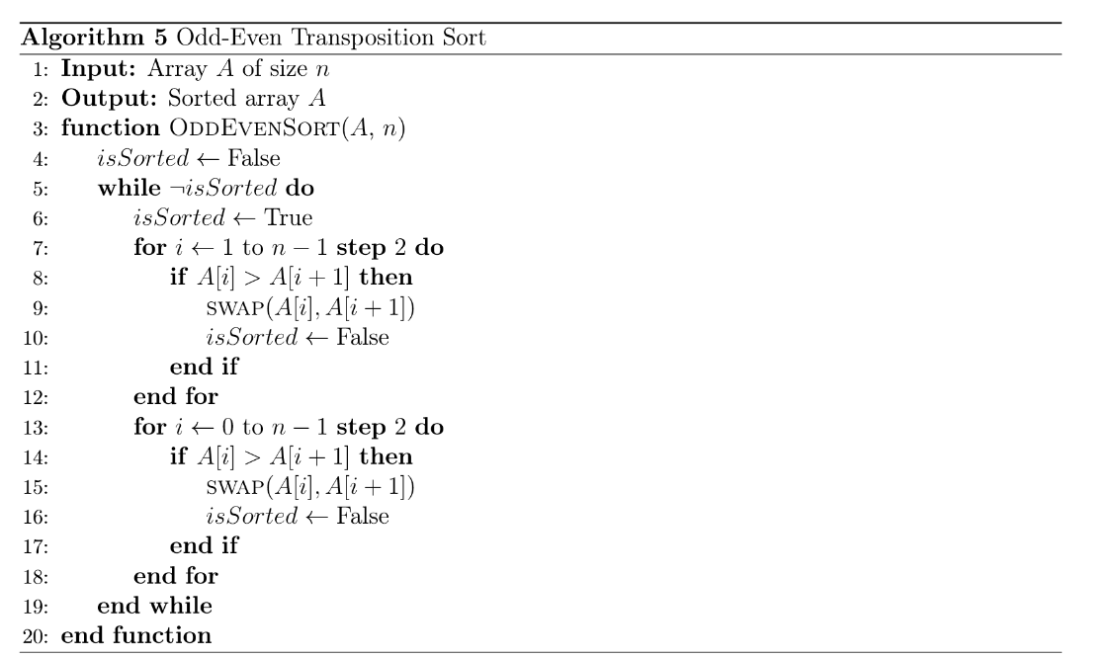
Pseudocode

Slide 55
Pseudocode

Slide 56
Pseudocode

Slide 57
Complexity Analysis
TIME COMPLEXITY:
Function | Complexity | Analysis
Create and set up the array for sorting the input elements | O(n) | Straightforward operation to allocate memory for the array.
Linear traversal of the array | O(n) | Move through the array to perform comparisons and swaps.
Even/Odd phases of sorting | O(n) | Each phase requires comparing and (potentially) swapping elements.
SPACE COMPLEXITY: O(1) since Odd-Even Sort is an in-place sorting algorithm.

Slide 58
Applications
1. Education
2. Parallel computing
3. Sorting networks
Simple example of sorting algorithm and parallel processing.
Efficient sorting in environments with multiple processors.
Used in hardware implementations of sorting algorithms.

Slide 59
03
Counting Sort
Non-comparison-based algorithm
that uses number of occurrences

Slide 60
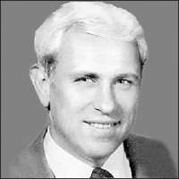
OVERVIEW
Counting Sort is a non-comparison-based sorting algorithm that sorts elements by counting the number of occurrences of each unique value in the input array.
Harold H. Seward,
inventor of Counting Sort

Slide 61
OVERVIEW
1. Type:
Non-comparison-based, stable sorting algorithm that sorts based on frequency of occurrences.
2. Workings:
Count frequency of occurrences of elements then place them according to their count.
3. Time complexity:
O(n + k), where n is the number of elements and k is the range of the input values.

Slide 62
VISUALIZATION
3
2
1
0
3
2
2
Max: 3
Min: 0
Range: (3 – 0) + 1 = 4

Slide 63
VISUALIZATION
3
2
1
0
3
2
2
Step 1: Initialize Count array

Slide 64
VISUALIZATION
3
2
1
0
3
2
2
0
1
2
3
0
0
0
0
COUNT
Step 1: Initialize Count array

Slide 65
VISUALIZATION
3
2
1
0
3
2
2
0
1
2
3
0
0
0
0
COUNT
Step 1.5: Fill Count array

Slide 66
VISUALIZATION
3
2
1
0
3
2
2
0
1
2
3
0
0
0
1
COUNT
Step 1.5: Fill Count array

Slide 67
VISUALIZATION
3
2
1
0
3
2
2
0
1
2
3
0
0
1
1
COUNT
Step 1.5: Fill Count array

Slide 68
VISUALIZATION
3
2
1
0
3
2
2
0
1
2
3
0
1
1
1
COUNT
Step 1.5: Fill Count array

Slide 69
VISUALIZATION
3
2
1
0
3
2
2
0
1
2
3
1
1
1
1
COUNT
Step 1.5: Fill Count array

Slide 70
VISUALIZATION
3
2
1
0
3
2
2
0
1
2
3
1
1
1
2
COUNT
Step 1.5: Fill Count array

Slide 71
VISUALIZATION
3
2
1
0
3
2
2
0
1
2
3
1
1
2
2
COUNT
Step 1.5: Fill Count array

Slide 72
VISUALIZATION
3
2
1
0
3
2
2
0
1
2
3
1
1
3
2
COUNT
Step 1.5: Fill Count array

Slide 73
VISUALIZATION
3
2
1
0
3
2
2
0
1
2
3
1
1
3
2
COUNT
Step 3: Cumulatively summing occurrences

Slide 74
VISUALIZATION
3
2
1
0
3
2
2
0
1
2
3
1
1
3
2
COUNT
[0 + 1]
Step 3: Cumulatively summing occurrences

Slide 75
VISUALIZATION
3
2
1
0
3
2
2
0
1
2
3
1
2
3
2
COUNT
[1 + 1]
Step 3: Cumulatively summing occurrences

Slide 76
VISUALIZATION
3
2
1
0
3
2
2
0
1
2
3
1
2
5
2
COUNT
[2 + 3]
Step 3: Cumulatively summing occurrences

Slide 77
VISUALIZATION
3
2
1
0
3
2
2
0
1
2
3
1
2
5
7
COUNT
[5 + 2]
Step 3: Cumulatively summing occurrences

Slide 78
VISUALIZATION
3
2
1
0
3
2
2
0
0
0
0
0
0
0
OUTPUT
0
1
2
3
1
2
5
7
COUNT
Step 4: Create Output array

Slide 79
VISUALIZATION
3
2
1
0
3
2
2
0
0
0
0
2
0
0
OUTPUT
0
1
2
3
1
2
4
7
COUNT
Step 4: Create Output array

Slide 80
VISUALIZATION
3
2
1
0
3
2
2
0
0
0
2
2
0
0
OUTPUT
0
1
2
3
1
2
3
7
COUNT
Step 4: Create Output array

Slide 81
VISUALIZATION
3
2
1
0
3
2
2
0
0
0
2
2
0
3
OUTPUT
0
1
2
3
1
2
3
6
COUNT
Step 4: Create Output array

Slide 82
VISUALIZATION
3
2
1
0
3
2
2
0
0
0
2
2
0
3
OUTPUT
0
1
2
3
0
2
3
6
COUNT
Step 4: Create Output array

Slide 83
VISUALIZATION
3
2
1
0
3
2
2
0
1
0
2
2
0
3
OUTPUT
0
1
2
3
0
1
3
6
COUNT
Step 4: Create Output array

Slide 84
VISUALIZATION
3
2
1
0
3
2
2
0
1
2
2
2
0
3
OUTPUT
0
1
2
3
0
1
2
6
COUNT
Step 4: Create Output array

Slide 85
VISUALIZATION
3
2
1
0
3
2
2
0
1
2
2
2
3
3
OUTPUT
0
1
2
3
0
1
2
5
COUNT
Step 4: Create Output array

Slide 86
VISUALIZATION
3
2
1
0
3
2
2
0
1
2
2
2
3
3
OUTPUT (SORTED)
0
1
2
3
0
1
2
5
COUNT
Step 5: Return Output array

Slide 87
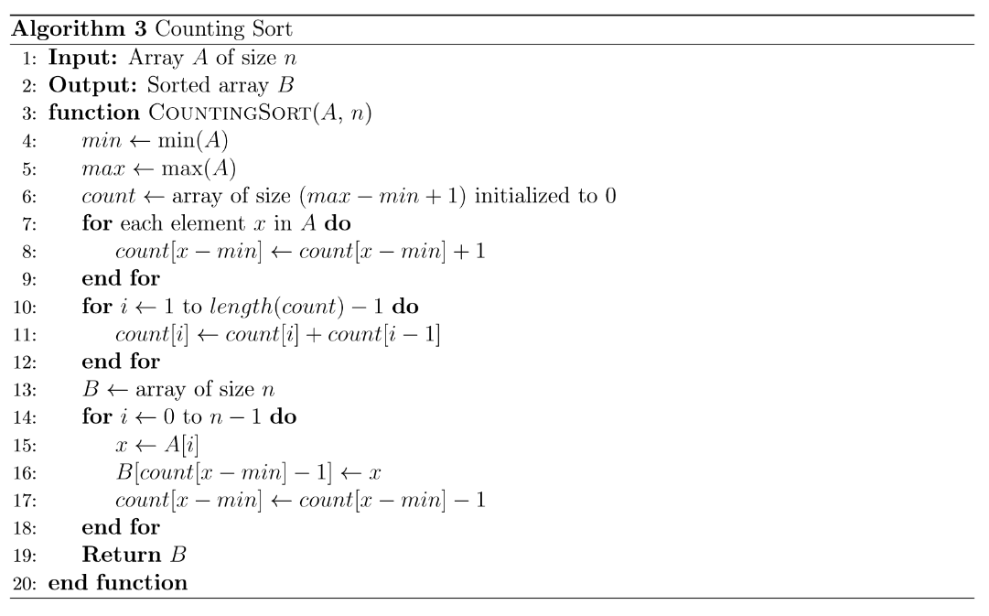
PSEUDOCODE

Slide 88
PSEUDOCODE

Slide 89
PSEUDOCODE

Slide 90
Complexity Analysis
TIME COMPLEXITY:
Function | Complexity | Analysis
Building the Count array | O(n) | Each element is processed once to track its frequency.
Modifying the Count frequency | O(max – min + 1) | Cumulative summing over the range of values.
Reconstructing the sorted array | O(n) | Each element in the input array is processed once to be put in the right place.
SPACE COMPLEXITY: O(max – min + 1) since Counting Sort creates a Count array with size (max – min + 1) to store the frequency counts.

Slide 91
Applications
1. Data compression
2. Sort small datasets
3. Counting occurrences
Building frequency tables for other algorithms like Huffman encoding.
Sorting small sets of integers and characters, or database records with small key ranges.
Count number of occurrence of elements in a dataset.

Slide 92
04
Pigeonhole Sort
Classic non-comparison-based algorithm

Slide 93
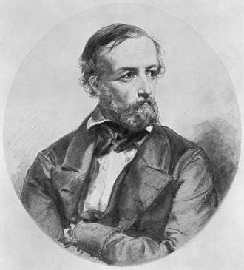
OVERVIEW
Pigeonhole sorting is a non-comparison-based algorithm suitable for sorting lists of elements where the number of elements and the number of possible key values are approximately the same.
Peter Gustav Lejeune Dirichlet,
inventor of Pigeonhole Sort

Slide 94
OVERVIEW
1. Type:
Non-comparison-based, (potentially) stable sorting algorithm that sorts based on frequency of occurrences.
2. Working:
Similar to Counting Sort, but move items twice: once to the bucket array and once to the destination array.
3. Time complexity:
O(n + Range), where n is the number of elements in the input array and ‘Range’ is the number of possible values in the array.

Slide 95
VISUALIZATION
4
2
1
1
3
1
2

Slide 96
VISUALIZATION
4
2
1
1
3
1
2
Max: 4
Min: 1
Range: (4 - 1) + 1 = 4

Slide 97
VISUALIZATION
4
2
1
1
3
1
2
1
2
3
4
PIGEONHOLE
Step 1: Initialize Pigeonhole array

Slide 98
VISUALIZATION
4
2
1
1
3
1
2
1
2
3
4
PIGEONHOLE
Step 2: Calculate distribution

Slide 99
VISUALIZATION
4
2
1
1
3
1
2
1
2
3
4
PIGEONHOLE
Step 2: Calculate distribution

Slide 100
VISUALIZATION
4
2
1
1
3
1
2
1
2
3
4
PIGEONHOLE
Step 2: Calculate distribution

Slide 101
VISUALIZATION
4
2
1
1
3
1
2
1
2
3
4
PIGEONHOLE
Step 2: Calculate distribution

Slide 102
VISUALIZATION
4
2
1
1
3
1
2
1
2
3
4
PIGEONHOLE
Step 2: Calculate distribution

Slide 103
VISUALIZATION
4
2
1
1
3
1
2
1
2
3
4
PIGEONHOLE
Step 2: Calculate distribution

Slide 104
VISUALIZATION
4
2
1
1
3
1
2
1
2
3
4
PIGEONHOLE
Step 2: Calculate distribution

Slide 105
VISUALIZATION
1
2
1
1
3
1
2
1
2
3
4
PIGEONHOLE
Step 3: Copy elements back to original array

Slide 106
VISUALIZATION
1
1
1
1
3
1
2
1
2
3
4
PIGEONHOLE
Step 3: Copy elements back to original array

Slide 107
VISUALIZATION
1
1
1
1
3
1
2
1
2
3
4
PIGEONHOLE
Step 3: Copy elements back to original array

Slide 108
VISUALIZATION
1
1
1
2
3
1
2
1
2
3
4
PIGEONHOLE
Step 3: Copy elements back to original array

Slide 109
VISUALIZATION
1
1
1
2
2
1
2
1
2
3
4
PIGEONHOLE
Step 3: Copy elements back to original array

Slide 110
VISUALIZATION
1
1
1
2
2
3
2
1
2
3
4
PIGEONHOLE
Step 3: Copy elements back to original array

Slide 111
VISUALIZATION
1
1
1
2
2
3
4
1
2
3
4
PIGEONHOLE
Step 3: Copy elements back to original array

Slide 112
VISUALIZATION
1
1
1
2
2
3
4
SORTED ARRAY
1
2
3
4
PIGEONHOLE
Step 3: Copy elements back to original array

Slide 113
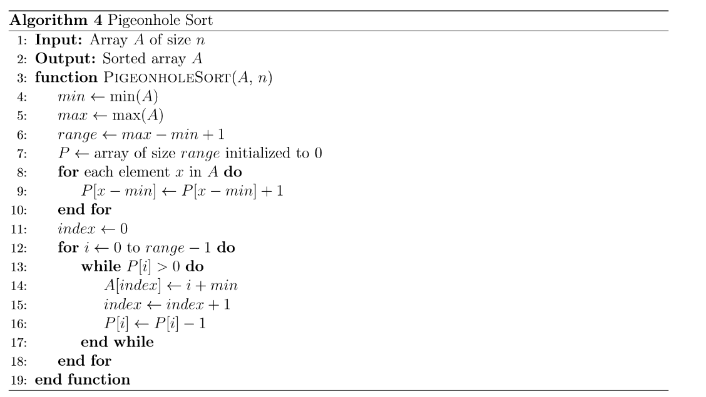
PSEUDOCODE

Slide 114
PSEUDOCODE

Slide 115
PSEUDOCODE

Slide 116
Complexity Analysis
TIME COMPLEXITY:
Function | Complexity | Analysis
Building the Pigeonhole array | O(n + range) | Each unique element is placed into its respective pigeonhole.
Filling the Pigeonhole array | O(n) | Fill each bucket of pigeonhole with elements.
Reconstructing the sorted array | O(n + range) | Transfer element from buckets back to the original array.
SPACE COMPLEXITY: O(range) since Pigeonhole Sort creates a Pigeonhole array with size (max – min + 1) to store the frequency counts.

Slide 117
Applications
1. Statistical Analysis
2. Sort small datasets
3. Histogram generation
Sort survey responses or experiment data.
Sorting small sets of integers and characters, or database records with small key ranges.
Generate histograms or frequency-based distribution of data.

Slide 118
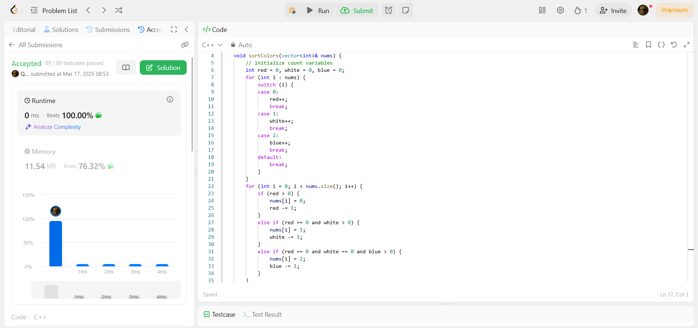
EXAMPLE PROBLEM 1: LEETCODE NO.75
Counting Sort Approach: O(n) time
Count the frequency of red, white, and blue objects in the array.
Refill the array, first with red objects, then white objects, and blue objects.
► Sorting is done in-place as required, with only 3 integer variables required.

Slide 119
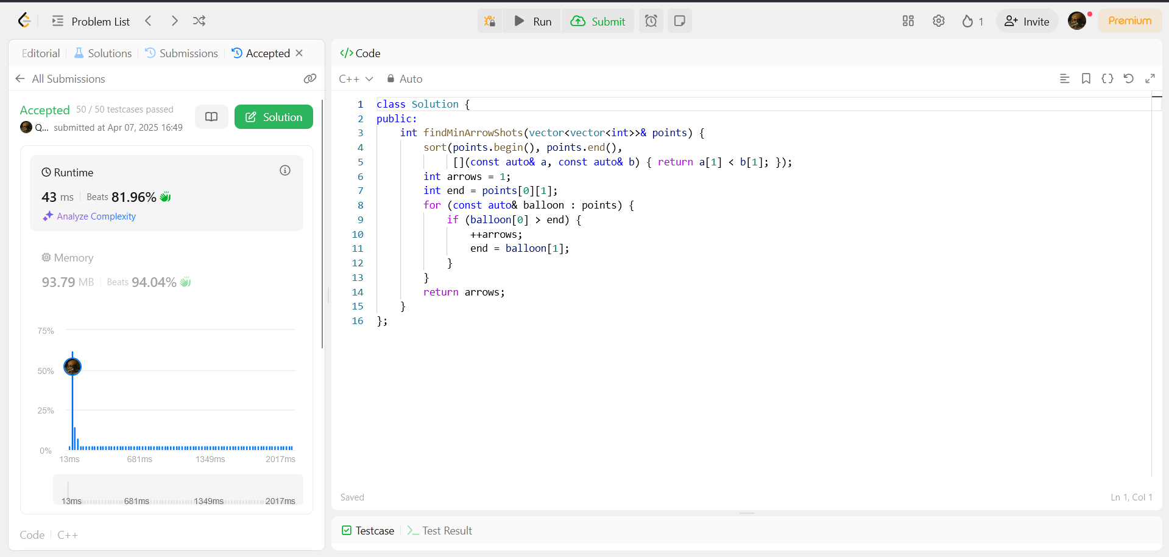
EXAMPLE PROBLEM 2: LEETCODE NO.452
Sorting Approach: O(n log(n)) time
Sort the balloons by their end points.
Start at first end point with arrow count = 1; for each starting point > current end point, arrow++. Move to next end point.
► Sorting approach is faster than brute-force solution (O(n^2) time).

Slide 120
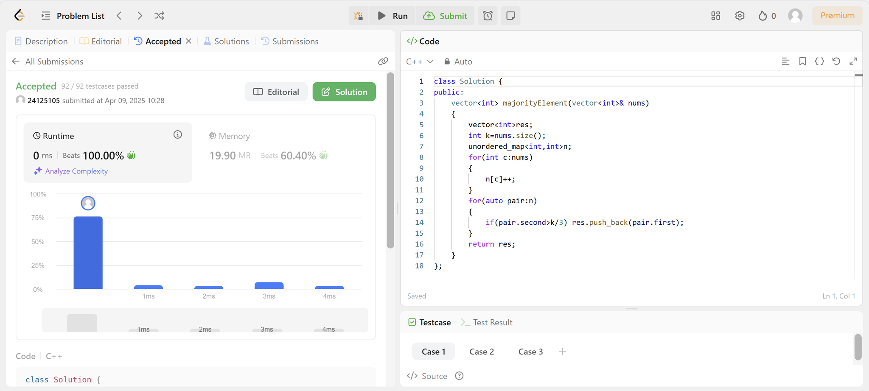
EXAMPLE PROBLEM 3: LEETCODE NO.229
Sorting Approach: O(n) time, O(n) space
Fill a map<int, int> with values in the array and their frequencies.
Iterate through the map and choose the elements whose frequencies is larger than n / 3.
► Sorting approach is fast but takes O(n) space.

Slide 121
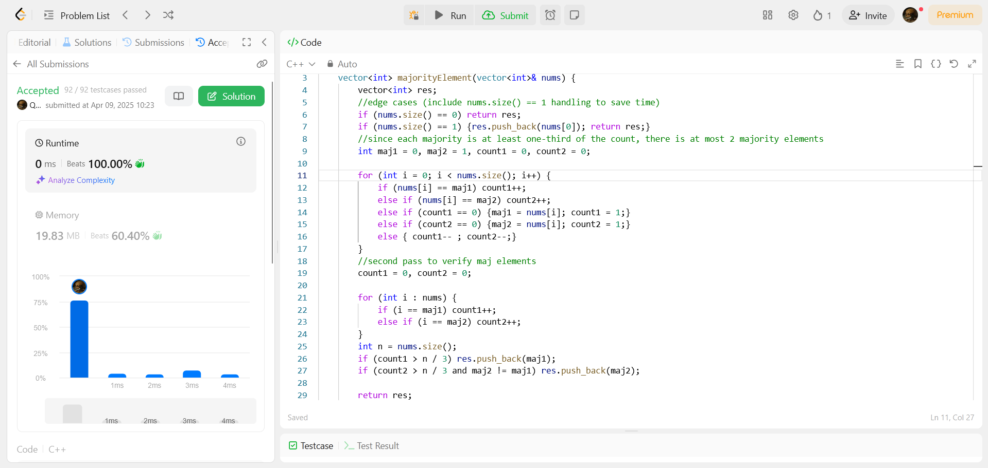
EXAMPLE PROBLEM 3: LEETCODE NO.229
Non-sorting Approach: O(n) time, O(1) space
Use Boyer-Moore Voting Algorithm to determine the majority elements.
Run a second pass through to verify these elements.
► Non-sorting approach runs in roughly similar time but takes only O(1) space.

Slide 122
COMPARISON OF SORTING ALGORITHMS
Algorithm | Stability | Time Complexity | Space Complexity | Pros | Cons
Heap Sort | Not stable | O(n log(n)) | O(1) | Stable performance, memory efficient | Not a stable sort, complex implementation
Counting sort | Stable | O(n + k) | O(n + k) | Linear time, simple, stable | Memory intensive, not flexible for wide value ranges
Pigeonhole Sort | Potentially stable | O(n + r) | O(n + r) | Efficient for small value ranges, simple, fast | Memory intensive, not flexible for wide value ranges,
Odd-Even Transposition Sort | Stable | O(n^2) | O(1) | Simple, easy to implement, efficient on small arrays. | Poor performance on single-core processors or large arrays.

Slide 123
Quizzes

Slide 124
What is Heapify in Heap Sort?
A
B
Building a complete binary tree.
Ensuring max/min heap property.
C
Sorting the array by comparing elements.
D
Creating an AVL tree.

Slide 125
What is Heapify in Heap Sort?
A
B
Building a complete binary tree.
Ensuring max/min heap property.
C
Sorting the array by comparing elements.
D
Creating an AVL tree.

Slide 126
Which of the following is not an application of Heap Sort?
A
B
Sorting large datasets.
Implementing priority queues.
C
Sorting data in external memory.
D
Sorting data with a small range of values.

Slide 127
Which of the following is not an application of Heap Sort?
A
B
Sorting large datasets.
Implementing priority queues.
C
Sorting data in external memory.
D
Sorting data with a small range of values.

Slide 128
When does Counting Sort work most efficiently?
A
B
When the range of values (k) is larger than the number of elements (n).
When the range of values (k) is smaller than or approximately equal to the number of elements (n).
C
When the data consists of real numbers.
D
When the data consists of strings.

Slide 129
When does Counting Sort work most efficiently?
A
B
When the range of values (k) is larger than the number of elements (n).
When the range of values (k) is smaller than or approximately equal to the number of elements (n).
C
When the data consists of real numbers.
D
When the data consists of strings.

Slide 130
Which of the following is not an application of Counting Sort?
A
B
Sorting integers within a small range.
Generating histograms from data.
C
Sorting large datasets with a large range of values.
D
When the data consists of strings.

Slide 131
Which of the following is not an application of Counting Sort?
A
B
Sorting integers within a small range.
Generating histograms from data.
C
Sorting large datasets with a large range of values.
D
When the data consists of strings.

Slide 132
When does Pigeonhole Sort work most efficiently?
A
B
When the number of elements (n) is larger than the range of values (k).
When the number of elements (n) is approximately equal to the range of values (k).
C
When the data consists of real numbers.
D
When the data consists of strings.

Slide 133
When does Pigeonhole Sort work most efficiently?
A
B
When the number of elements (n) is larger than the range of values (k).
When the number of elements (n) is approximately equal to the range of values (k).
C
When the data consists of real numbers.
D
When the data consists of strings.

Slide 134
How is Pigeonhole Sort different from Counting Sort?
A
B
Pigeonhole Sort moves elements twice.
Counting Sort moves elements twice.
C
Pigeonhole Sort does not require a range of values.
D
Counting Sort does not require a range of values.

Slide 135
How is Pigeonhole Sort different from Counting Sort?
A
B
Pigeonhole Sort moves elements twice.
Counting Sort moves elements twice.
C
Pigeonhole Sort does not require a range of values.
D
Counting Sort does not require a range of values.

Slide 136
Which algorithm is most suitable for sorting integers within a small range?
A
B
Heap Sort.
Counting Sort.
C
Pigeonhole Sort.
D
Both B and C.

Slide 137
Which algorithm is most suitable for sorting integers within a small range?
A
B
Heap Sort.
Counting Sort.
C
Pigeonhole Sort.
D
Both B and C.

Slide 138
Thanks for watching!

