Slide 1

Khóa server
Khuôn khổ chương trình training clb ceec – khoa ktmt

Slide 2
NGÀY 03
PHP

Slide 3
Giới thiệu PHP – Hello World
<!DOCTYPE html> <html> <body> <?php echo “hello world"; ?> </body> </html>

Slide 4
Biến trong PHP
<?php $txt = "Hello world!"; $x = 5; $y = 10.5; ?>

Slide 5
If – else statement
<?php $t = date("H"); if ($t < "20") { echo "Have a good day!"; } ?>

Slide 6
While loop
For loop
<?php $x = 1; while($x <= 5) { echo "The number is: $x <br>"; $x++; } ?>
<?php for ($x = 0; $x <= 10;
$x++) { echo "The number is: $x <br>"; } ?>

Slide 7
Function:
<?php function writeMsg() { echo "Hello world!"; } writeMsg(); // call the function ?>
<?php function familyName($fname, $year) { echo "$fname Refsnes. Born in $year <br>"; } familyName("Hege","1975"); familyName("Stale","1978"); familyName("Kai Jim","1983"); ?>

Slide 8
<marquee> <?php echo "HELLO" ?> </marquee>
<?php $name =“anc” ?>
<h1> <?php echo $name ?> </h1>
<?php echo "<h2> If Else Statement </h2>"
$x = 5; $y = 2;
if ($y == 0) {
echo “y yêu cầu khác 0"; } else {
echo "Have a good night!"; } ?>
<?php for ($x = 1; $x <= 5; $x++) {
echo "<b>| $x |</b><br>"; } ?>
<?php $z = 1; while ($z <= 7) {
echo "<h1>| $z |</h1><br>";
$z++; } ?>

Slide 9
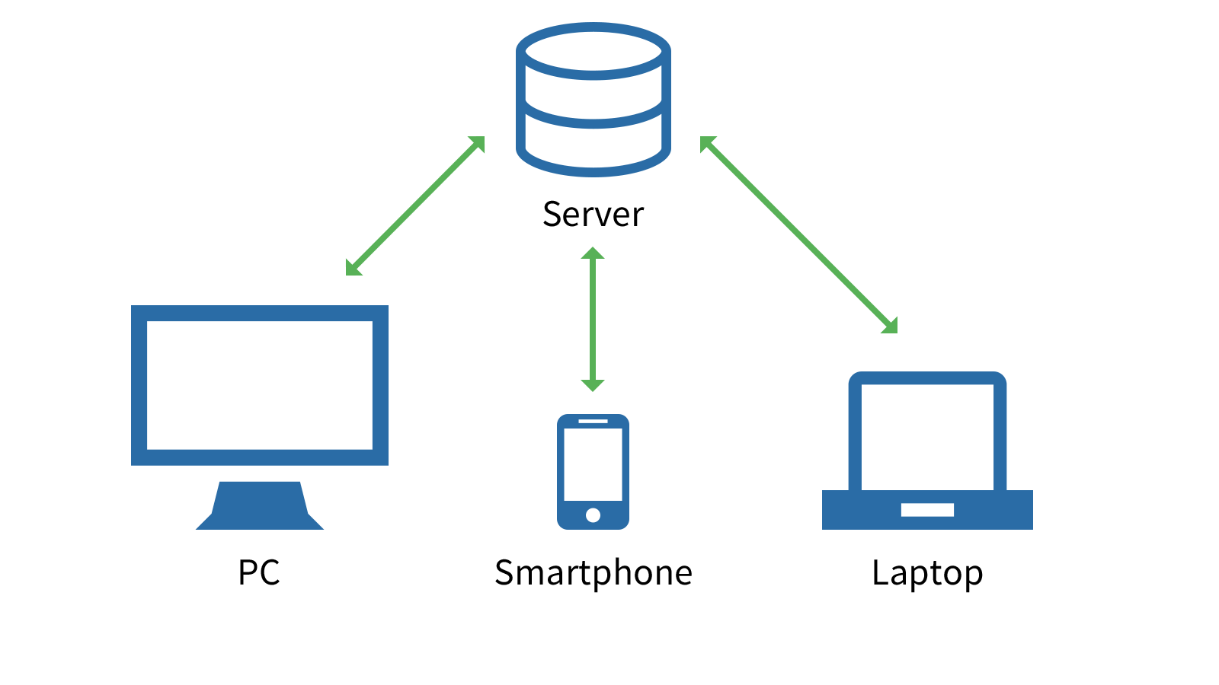
Database
Web -> BackEnd
Web -> FrontEnd
Web -> FrontEnd
Web -> FrontEnd
Web -> FrontEnd

