Slide 1




Login
Welcome
Marketplace
My Listings
My Shortlist
Figma
WELCOME TO
CAMPUS MARKETPLACE
89,400++

Slide 2


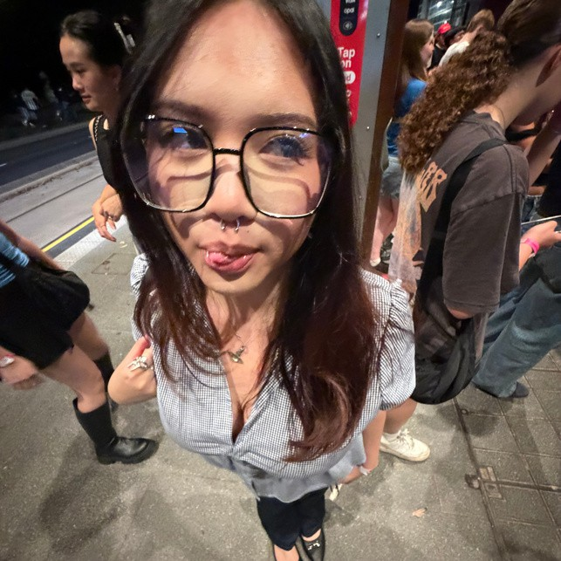

Login
Welcome
Marketplace
My Listings
My Shortlist
Figma
MEET OUR TEAM
Kat
Jayden
Kat
Mia

Slide 3
Login
Welcome
Marketplace
My Listings
My Shortlist
Figma
LIVE DEMO

Slide 4
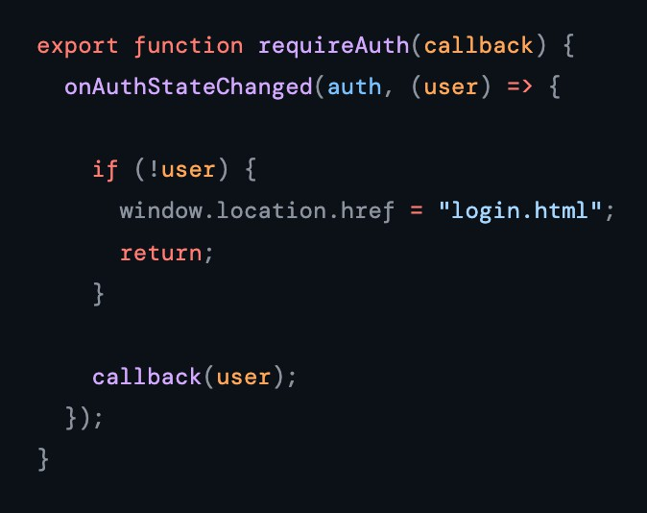
Login
Marketplace & Listing
My Shortlist
Figma
LOGIN - FIREBASE AUTHENTICATION
Function: 1 requireAuth
(auth-guard.js)
Runs on another function onAuthStateChanged which runs automatically every time the page loads.
1
2
If no user is signed in, immediately redirects to login.html. Blocks direct URL access.
3
If a user exists, passes the user object to the page's own callback function.

Slide 5
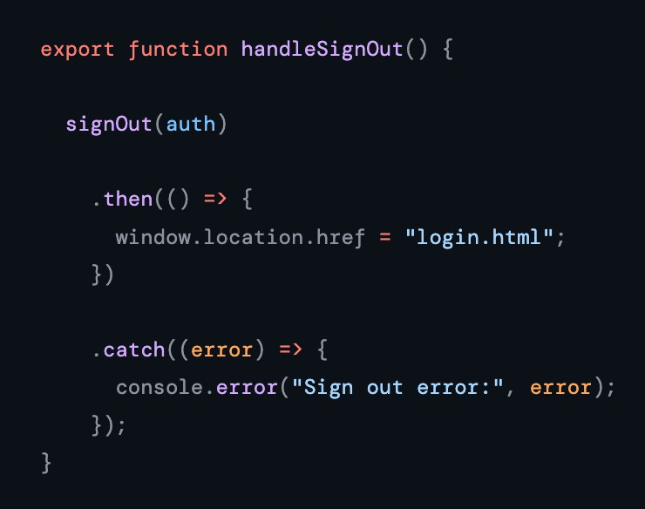
Login
Marketplace & Listing
My Shortlist
Figma
LOGIN - FIREBASE AUTHENTICATION
(auth-guard.js)
Function: 2
handleSignOut
Calls Firebase's signOut to clear the user's session from Firebase Auth.
1
On success, redirects back to login.html so the user lands on the login screen.
2
On error, logs it to the console, keeps failures silent to the user but visible for debugging.
3

Slide 6
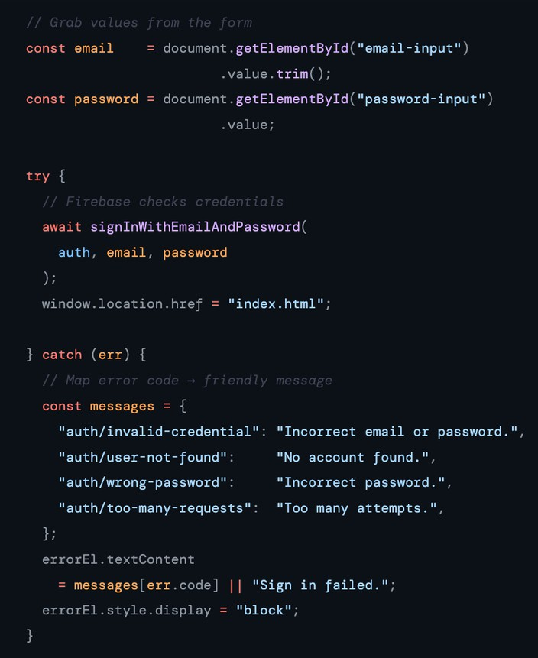
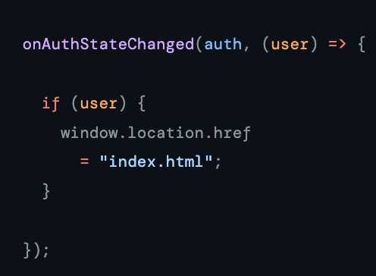
Login
Marketplace & Listing
My Shortlist
Figma
LOGIN - FIREBASE AUTHENTICATION - (login.html)
Function: signInWithEmailAndPassword
1
Function: onAuthStateChanged
2
Firebase verifies credentials: Credentials valid
User is redirected straight to index.html.
It runs the moment the page loads. If user is signed in, skip login and go to index.html.
Users that are already authenticated never see this page.
Credentials invalid Firebase returns an error code.

Slide 7
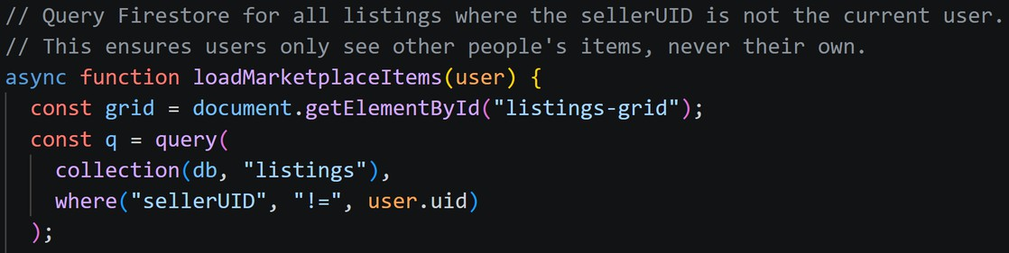
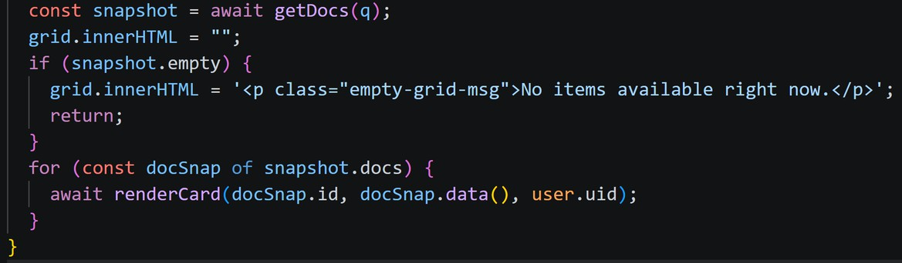
Login
Marketplace & Listings
My Shortlist
Figma
MARKETPLACE & LISTINGS (marketplace.js)
Function: 1 loadMarketplaceItems
Queries Firestore's listings collection and uses where to filter out any listing belonging to the currently signed-in user.
1
Gets the results back from Firestore, shows a message if there's nothing to display, then builds a card for each item.
2

Slide 8
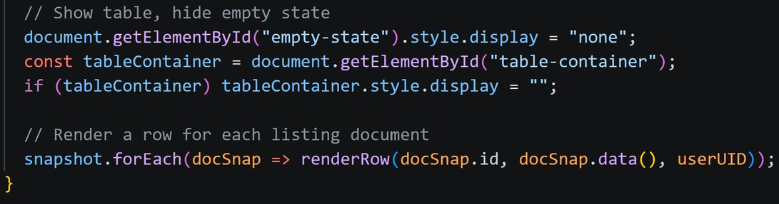
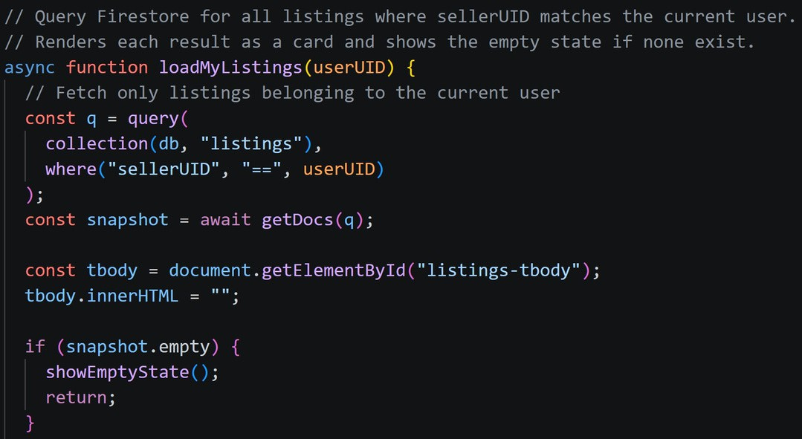
Login
Marketplace & Listings
My Shortlist
Figma
MARKETPLACE & LISTINGS (mylistings.js)
Function: 2 loadMyListings(userUID)
If there are results, it hides the empty state, makes the table visible, and renders a row for each listing.
2
SAME COLLECTION, OPPOSITE FILTER.
Fetches only the listings that belong to the currently signed-in user from Firestore.
1

Slide 9
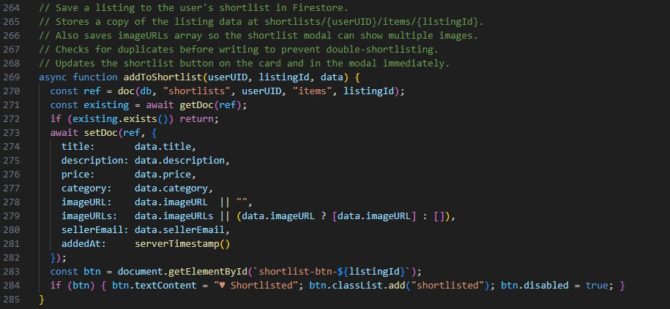
Login
Marketplace & Listings
My Shortlist
Figma
1
setDoc()
User clicks the Shortlist button
the setDoc() function is called to write a document
Firestore at the path shortlists/{userUID}/items/{listingId} user UID = unique shortlist
MY SHORTLIST - (marketplace.js)
Function addToShortList
2 getDoc()
the getDoc() function is called to check whether it already exists in the user's shortlist

Slide 10
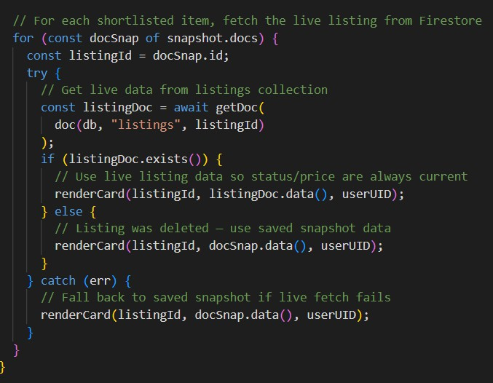
Login
Marketplace & Listings
My Shortlist
Figma
MY SHORTLIST - (shortlist.js)
3
loadShortlist()
User opens the My Shortlist page
the loadShortlist() function retrieves all shortlisted items for the unique signed-in user from Firestore collection
checks whether the shortlist is empty Live listing data retrieved

Slide 11
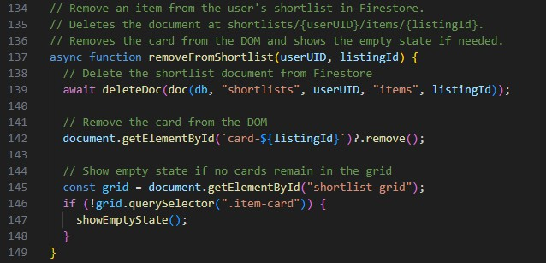
Login
Marketplace & Listings
My Shortlist
Figma
MY SHORTLIST - (shortlist.js)
4
deleteDoc()
User removes an Item
the deleteDoc() function is called Deletes item from Firestore
Removes item card from page Shows empty state if shortlist becomes empty

Slide 12
Login
Marketplace & Listing
My Shortlist
Figma
FIGMA PRESENTATIONS

Slide 13
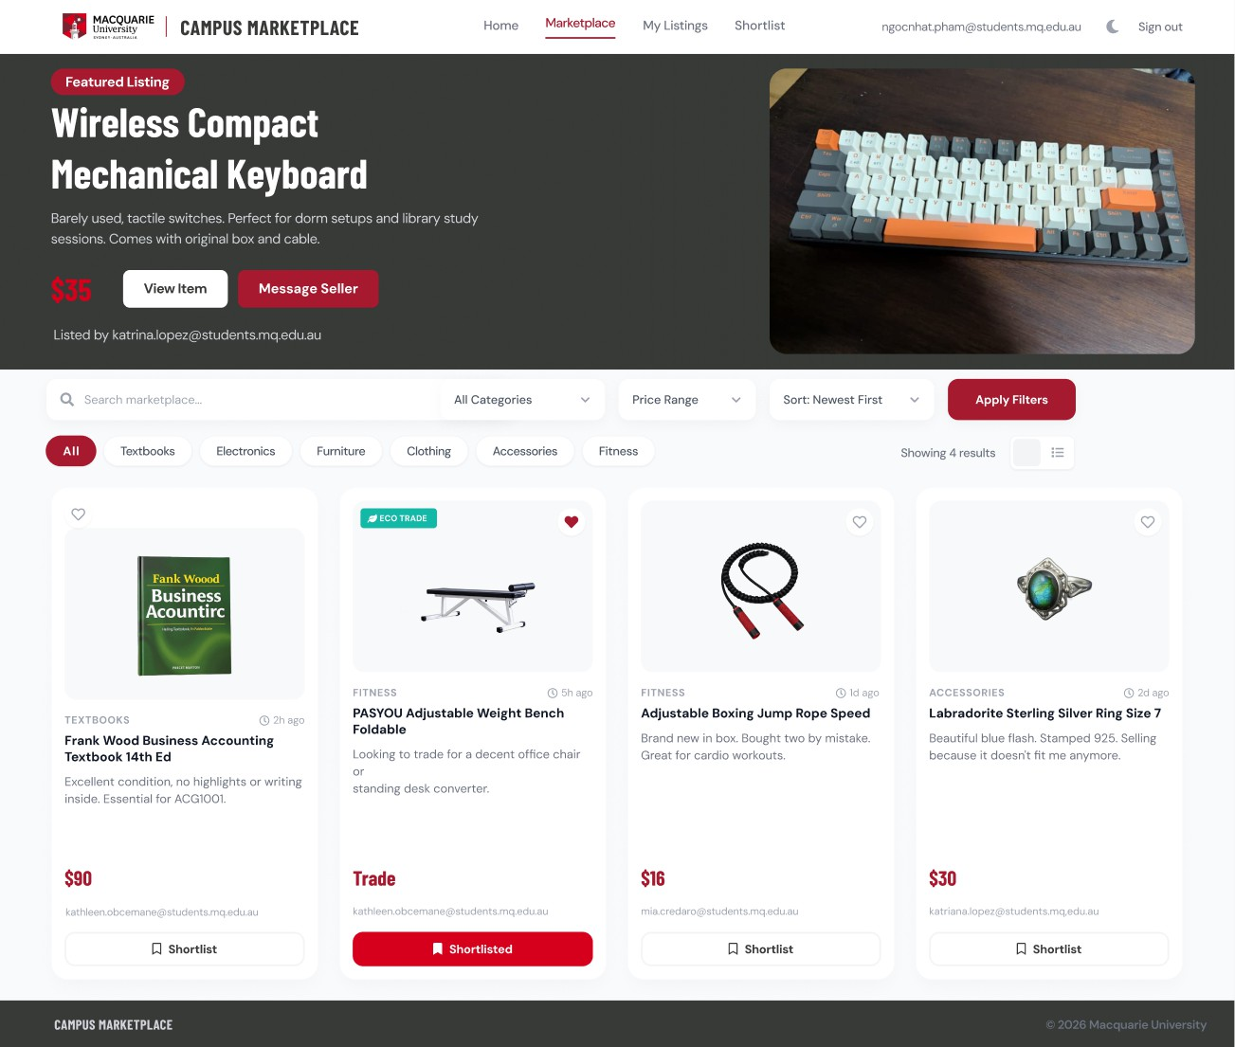
MARKETPLACE BROWSE PAGE
JAYDEN PHAM
Colour + Typography
MQ brand palette (#A6192E red, #373A36 charcoal) Barlow Condensed headings and DM Sans body
Visual Hierarchy
Hero banner draws attention first, filters second, card grid third
Search + Filters
Extends the coded app with keyword search, price range, and sort order controls..
ECO TRADE Badge
Sustainability indicator for trade listings

Slide 14
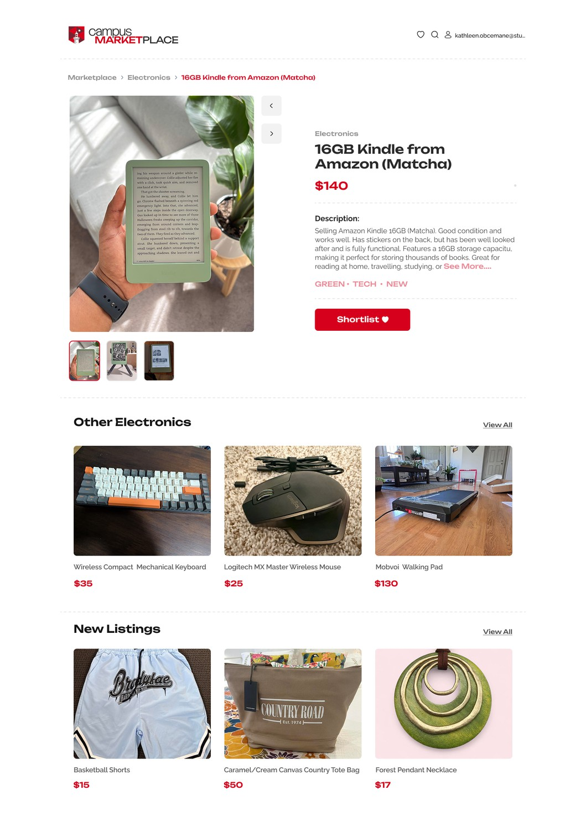
KATHLEEN OBCEMANE
MARKETPLACE (ITEM VIEW) PAGE
Design Approach:
Modern and minimal (inspired by Depop)
Styled close to MQU branding to keep it familiar
Page Choice:
Marketplace item view page
Target Audience: University students & young adults
Layout & Features: Breadcrumb navigation Minimal logo
Category tags
Product recommendations

Slide 15
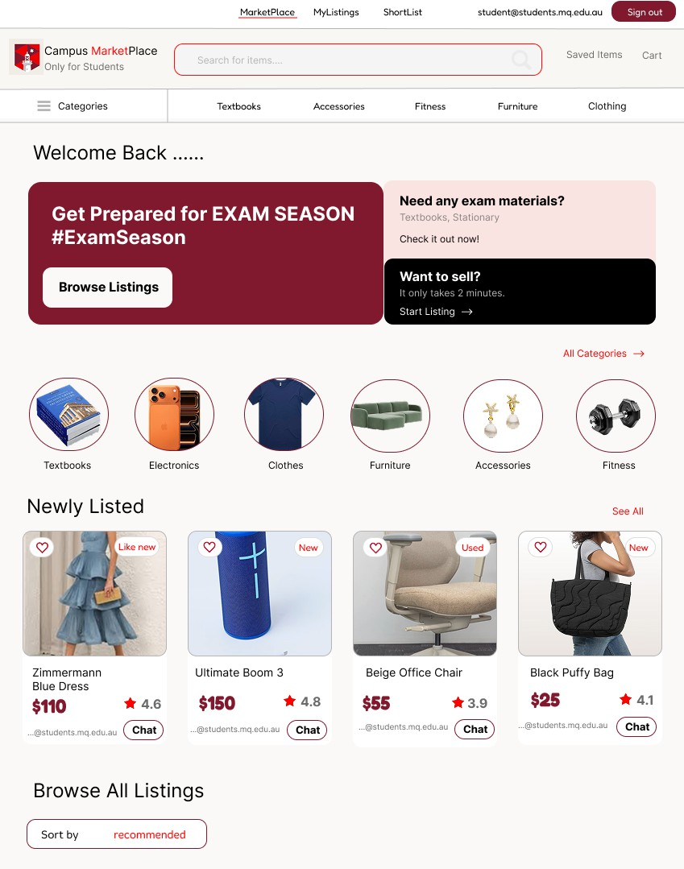
MIA
Marketplace Page
Design
Red and white: bright and consistent
Bold to highlight important actions such as Chat, Sign Out
Visual hierarchy
Navigation/search functions at the top. Promotional banner
Categories are displayed before listings
Features:
item cards icons Reviews
Chat button

Slide 16
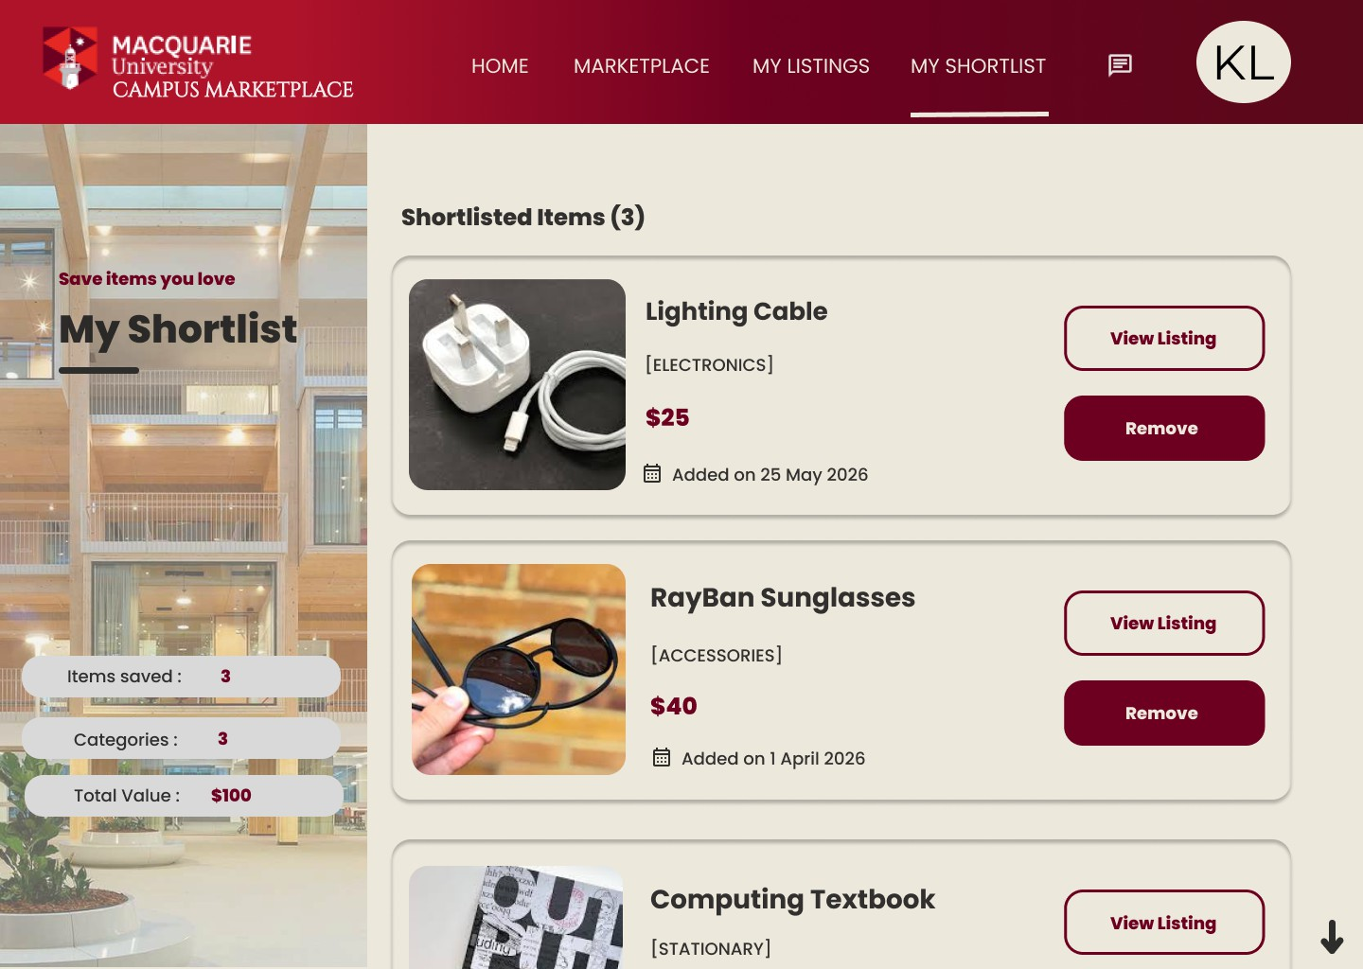
KATRINA LOPEZ
Shortlist Page
Colour Scheme Maroon (#762325) Sand (#D6D2C4)
Typography
Poppins medium/semi bold San-serif font bold/semi bold
Layout
Two-colomn
Visual Banner: LHS Items : RHS
UX
Item cards Buttons
Statistic Sumaries

Slide 17

THANK YOU
C O M P 2 7 5 0 - A S S I G N M E N T 3
Ngoc Nhat (Jayden) Pham - 47958162
Kathleen Obcemane - 46964452
Mia Credaro - 47614536 Katrina Lopez - 45218153

