Slide 1


STEM EELS spectra sequence predictions with LSTM
Yicheng Jin
Nicholas Lewis
Vidit Shah
Xiuyu Tang
Advisors: Steven Spurgeon, Sarah Akers, Christina Doty

Slide 2
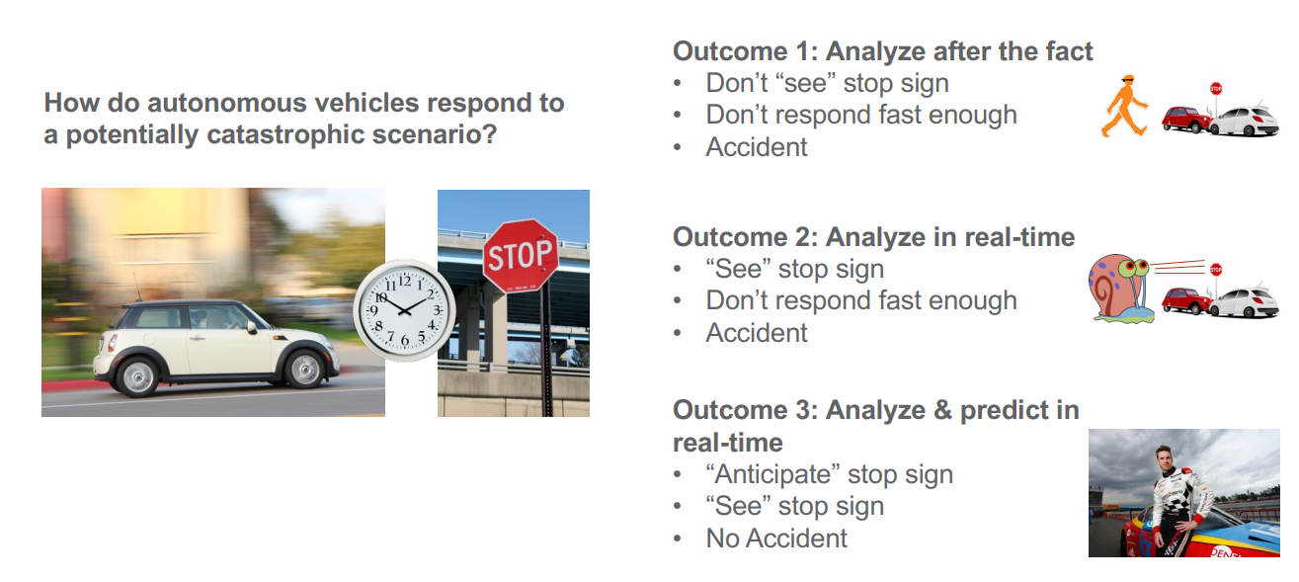
Motivation
Notes:
Really good slide, but possibly not enough time

Slide 3
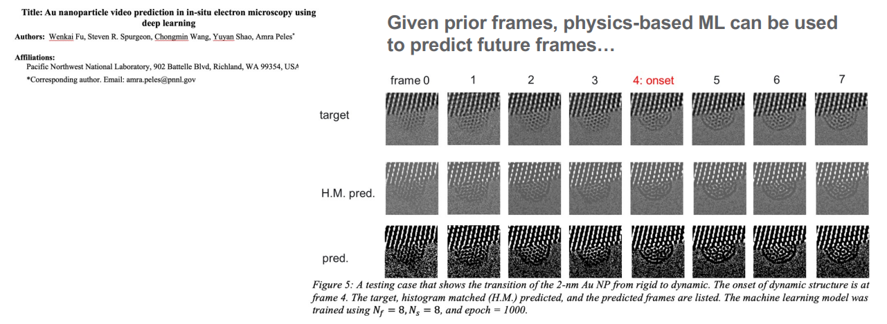
Previous Work
Notes:
Be sure to add user cases! Some reactions are happening fast, sometimes there’s beam degradation if we have the beam settings too high. We want to be able to predict when this might happen and avoid unintended sample damage

Slide 4
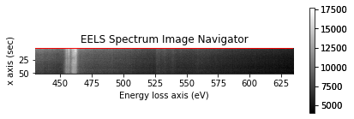
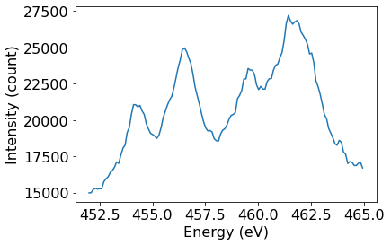
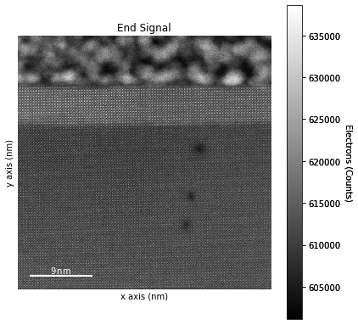
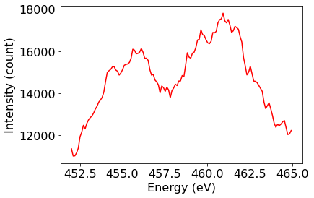
Can we do this with spectra rather than images?
Notes:
Predicting reactions or sample damage in a TEM sample
Use Long Short-term Memory (type of RNN used for sequence prediction)
Important to be able to see how beam degrades images

Slide 5
LSTM Approach
From a higher level perspective, two approaches have been tried so far w.r.t. sequencing the data (i.e., input data) to the model.
Both these approaches tend to give good predictions but have some flaws.
These two approaches can be explained as follows:

Slide 6
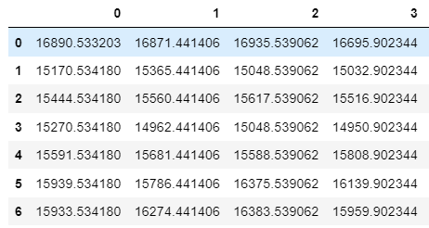
Approaches
Approach 1:
Sequencing the data such that the prediction value at a particular Energy level is only influenced by the previous sequences at the same Energy level.

Slide 7
Differences in Sequences
Approach 2: Sequencing the data such that the prediction values at a time step depends on the entire spectra at the previous time step.

Slide 8
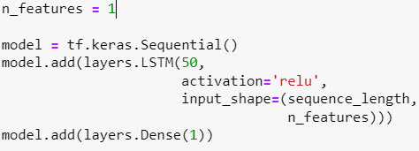
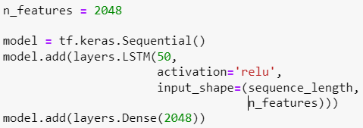
Differences in Code
The major difference between models will look as follows:
Approach 1
Approach 2

Slide 9
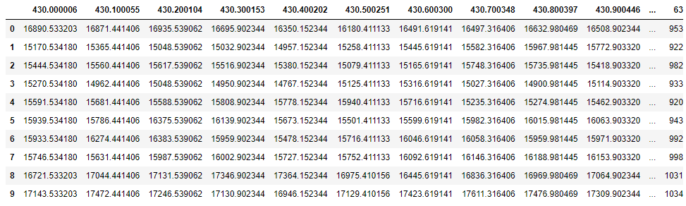
LSTM Network model
EELS data read in from *.dm4 file with Hyperspy package
Raw data extracted; initial approach is minimal data processing
LSTM models developed with Keras and PyTorch
INPUT →(LSTM MODEL) → PREDICTION
Notes:
EELS: electron energy loss spectroscopy

Slide 10
GUI demo!

Slide 11
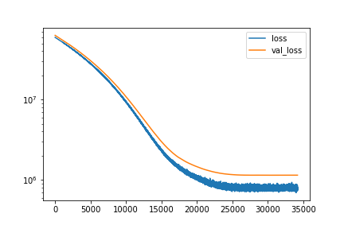
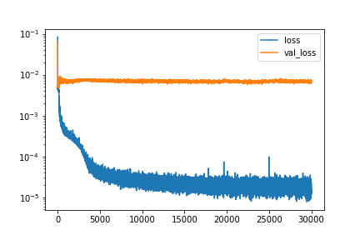
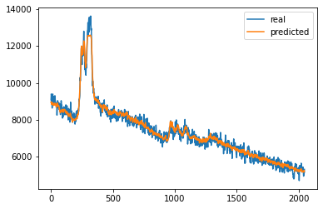
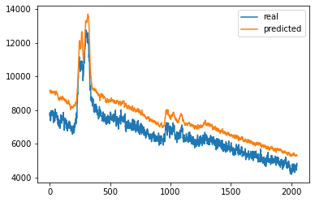
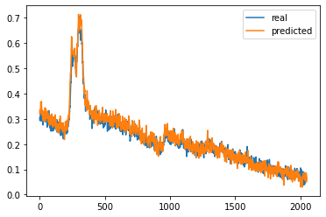
Current Results and Issues
Shifted spectrum
Plateaus on peaks
Overfitting
Loss of noise
MSE
MSE
epoch
epoch
Intensity (counts)
Intensity (scaled)
energy bin
energy bin
energy bin
Notes:
No scaling (scaling has been its own special challenge): sometimes the prediction is shifted, other times it doesn’t quite capture all the peak features (such as the cutoff)
Scaling looks good, but likely overfitting

Slide 12
Spring22 objectives
Additional hyperparameter optimization and processing strategies to resolve model issues
How many previous spectra are required for prediction?
How many timesteps out is the prediction accurate?
What are the best accuracy measures?
Focus on regions of interest
Retain noise features
Correlate to physical interpretation
Other sample types (whole raster, different materials, etc.)

Slide 13
Acknowledgements
This research was supported by the Chemical Dynamics Initiative/Investment, under the Laboratory Directed Research and Development (LDRD) Program at Pacific Northwest National Laboratory (PNNL). PNNL is a multi-program national laboratory operated for the U.S. Department of Energy (DOE) by Battelle Memorial Institute under Contract No. DE-AC05-76RL01830. Experimental sample preparation was performed at the Environmental Molecular Sciences Laboratory (EMSL), a national scientific user facility sponsored by the Department of Energy’s Office of Biological and Environmental Research and located at PNNL. EELS data was collected in the Radiological Microscopy Suite (RMS), located in the Radiochemical Processing Laboratory (RPL) at PNNL.

