Slide 1
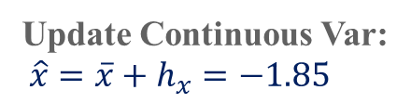


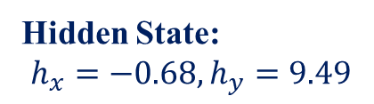
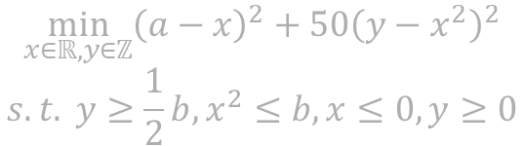



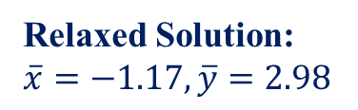

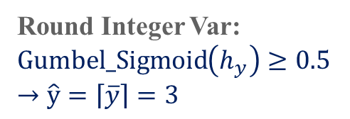
$$\min_{x∈ℝ,y∈ℤ}{{\left(a−x\right)}^{2}+50{\left(y−x^{2}\right)}^{2}}$$
$$s.t. y≥\frac{1}{2}b,x^{2}≤b, x≤0, y≥0$$
Relaxed Solution Mapping
$$π_{Θ_{1}}\left(a,b\right)$$
Input: $a=3.83,b=6.04$
Rounding Classification
$$φ_{Θ_{1}}\left(a,b,\overline{x},\overline{y}\right)$$
Hidden State:
$$h_{x}=−0.68,h_{y}=9.49$$
Relaxed Solution:
$\overline{x}=−1.17,\overline{y}=2.98$
Neural Network $δ_{Θ_{2}}\left(a,b,\overline{x},\overline{y}\right)$
Round Integer Var:
$Gumbel_Sigmoid\left(h_{y}\right)≥0.5$
$→\hat{y}=\left\lceil \overline{y}\right\rceil =3$
Update Continuous Var:
${\hat{x}=\overline{x}+h}_{x}=−1.85$
Mixed-Integer Solution: $\hat{x}=−1.85,\hat{y}=3$
Loss Function: $ℒ_{Obj}+λ∙ℒ_{Viol}$

Slide 2
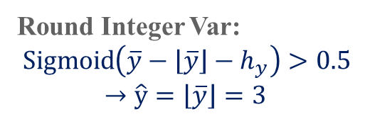

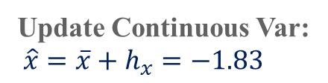

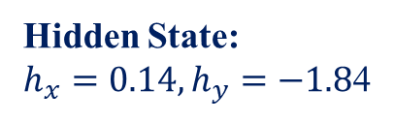


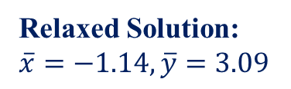
$$\min_{x∈ℝ,y∈ℤ}{{\left(a−x\right)}^{2}+50{\left(y−x^{2}\right)}^{2}}$$
$$s.t. y≥\frac{1}{2}b,x^{2}≤b, x≤0, y≥0$$
Relaxed Solution Mapping
$$π_{Θ_{1}}\left(a,b\right)$$
Input: $a=3.83,b=6.04$
Learnable Threshold
$$φ_{Θ_{1}}\left(a,b,\overline{x},\overline{y}\right)$$
Hidden State:
$h_{x}=\text{0.14},h_{y}=−1.8$4
Relaxed Solution:
$\overline{x}=−1.14,\overline{y}=3.09$
Neural Network $δ_{Θ_{2}}\left(a,b,\overline{x},\overline{y}\right)$
Round Integer Var:
$\operatorname{Sigmoid}\left(\overline{y}−\left\lfloor \overline{y}\right\rfloor −h_{y}\right)>0.5$
$$→\hat{y}=\left\lfloor \overline{y}\right\rfloor =3$$
Update Continuous Var:
${\hat{x}=\overline{x}+h}_{x}=−1.83$
Mixed-Integer Solution: $\hat{x}=−1.83,\hat{y}=3$
Loss Function: $ℒ_{Obj}+λ∙ℒ_{Viol}$

