Slide 1


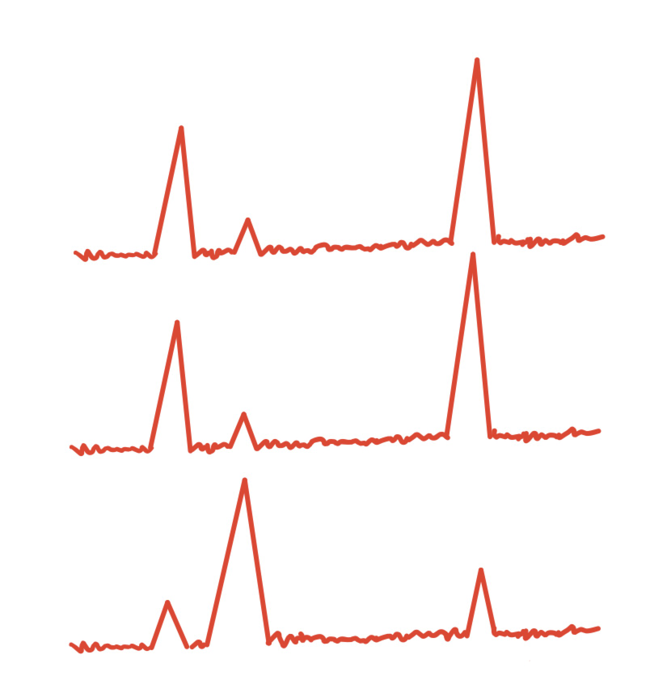



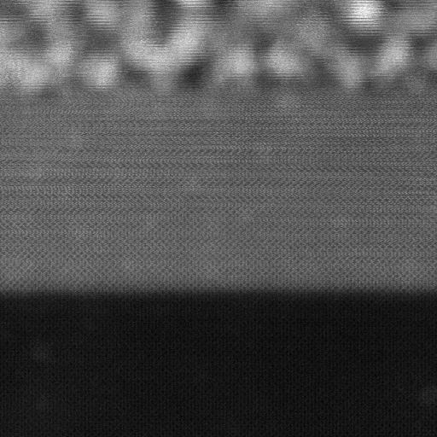
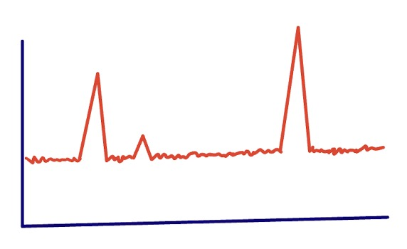
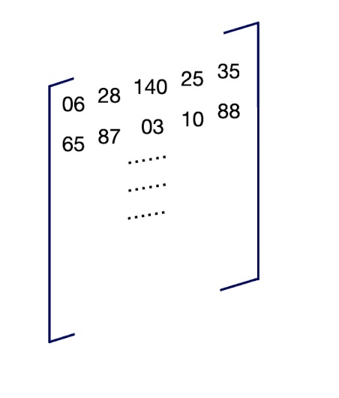
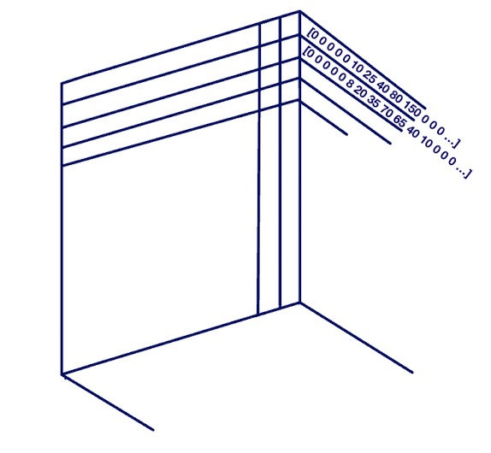
Sparce Multimodal Material Analysis for Classification of Electron Microscope Data
Yifei Heª, Jiayi Liª, Ryan Littrellª, Christina Doty^{b}, Sarah Akers^{b}, Steven R. Spurgeon^{b}
https://github.com/SMMA-PNNL-2022/SMMA.git
Introduction
Data Preprocessing
Model Training
n_way | n_support | n_query | train accuracy | test accuracy
2 | 5 | 20 | 0.9681 | 0.9051
2 | 5 | 10 | 0.9665 | 0.9015
3 | 5 | 10 | 0.9372 | 0.9012
3 | 5 | 5 | 0.9373 | 0.9011
3 | 5 | 20 | 0.949 | 0.897
3 | 20 | 10 | 0.947 | 0.8967
3 | 10 | 20 | 0.9506 | 0.8917
TEM as a powerful tool conveys atomic-level information of materials, which brings new interest of methodology development of data analysis in the materials science context. Moreover, the advanced technology extracts pixel-wise information of multiple dimensions at the same time, such as grey scale intensities and x-ray spectrums at the same time.
With the advantage of small learning samples, few-shot analysis compensates for the limited sample size of TEM while delivering sufficient accuracy of learning results.
In this project, we aim to combine the sparce analytics with the multimodality feature of TEM data for fast and accurate image characterization. As a result, the successfully built-up architecture would be the solution for the analysis of materials that have fleeting features. This would allow quicker discoveries of materials that could revolutionize clean tech, quantum computing, and any hardware based fields.
Manually crop the image by the domain boundaries
Load brightness and x-ray signals of cropped domains
Rearrange into matrices and dictionaries.
Domain 1
Intensity
At each episode of few-shot learning, from the given training dataset: for each class, randomly sample N_s data as support set and N_q for query set.¹
At each iteration:
We embed aforementioned sampled input vectors using the current neural network model.
Take the average of the embeddings of the support set to form prototype for each class.
Compute the distance between each query data embedding to class prototype.
Classify each query data to the class whose prototype embedding is closest to its query embedding.
Compute the log-softmax loss for this iteration and back-propagate to update the parameters of embedding neural network mode.
Training and Testing Accuracy
Domain 2
Energy (eV)
Domain 3
Hyperspy.load()
Future Work
Chip-wise data processing:
Better representation of microfeatures in the materials context
Cross-system translation:
Transfer the current architecture to other material systems or data modalities
Achieved Goals:
Combination of brightness intensity with X-ray spectrum data taken from the same pixel as a multi-modal input for the model.
High training (95%) and test accuracy around (90%) of the built-up few shot learning model with the multi-modal data.
2D Matrix of Brightness
3D Matrix of X-Ray Spectrum
Acknowledgement
This research was supported by the Chemical Dynamics Initiative/Investment, under the Laboratory Directed Research and Development (LDRD) Program at Pacific Northwest National Laboratory (PNNL). PNNL is a multi-program national laboratory operated for the U.S. Department of Energy (DOE) by Battelle Memorial Institute under Contract No. DE-AC05-76RL01830. Experimental sample preparation was performed at the Environmental Molecular Sciences Laboratory (EMSL), a national scientific user facility sponsored by the Department of Energy's Office of Biological and Environmental Research and located at PNNL. EELS data was collected in the Radiological Microscopy Suite (RMS), located in the Radiochemical Processing Laboratory (RPL) at PNNL.
pix_grey = {‘domain 1’: dom_1_grey, ‘domain 2’: dom_2_grey, ‘domain 3’: dom_3_grey }
pix_spec = {‘domain 1’: dom_1_spec, ‘domain 2’: dom_2_spec, ‘domain 3’: dom_3_spec}
Domain 1
Domain 2
Domain 3
ª University of Washington
^{b} Pacific Northwest National Laboratory
[1] Snell, J., et al., Prototypical Networks for Few-shot Learning, arXiv, 2017.

