Slide 1
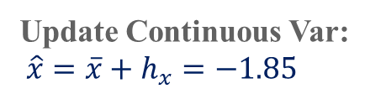


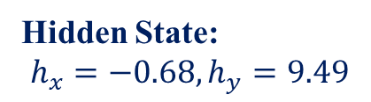


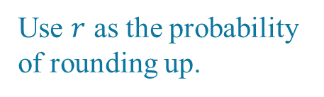

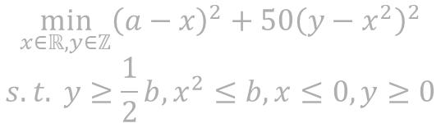
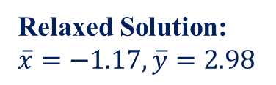
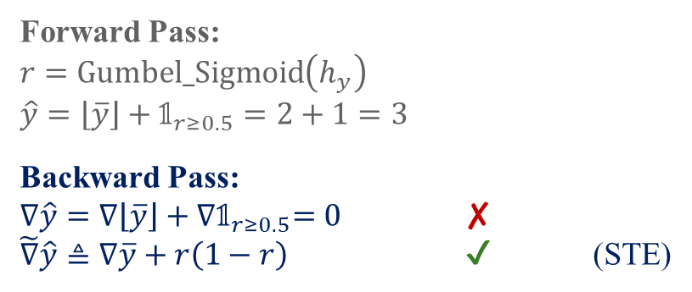


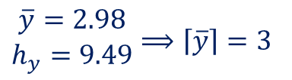
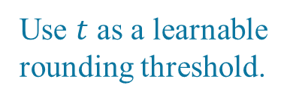
Method 1:
Rounding Classification
$$\min_{x∈ℝ,y∈ℤ}{{\left(a−x\right)}^{2}+50{\left(y−x^{2}\right)}^{2}}$$
$$s.t. y≥\frac{1}{2}b,x^{2}≤b, x≤0, y≥0$$
Forward Pass:
$r=Gumbel_Sigmoid\left(h_{y}\right)$
$\hat{y}=\left\lfloor \overline{y}\right\rfloor +𝟙_{r≥0.5}=2+1=3$
Backward Pass:
$∇\hat{y}=∇\left\lfloor \overline{y}\right\rfloor +{∇𝟙}_{r≥0.5}=0$ ✘
$\tilde{∇}\hat{y}≜∇\overline{y}+r\left(1−r\right)$ ✔ (STE)
Relaxed Solution Mapping
$$π_{Θ_{1}}\left(a,b\right)$$
Input: $a=3.83,b=6.04$
Integer Correction
$$φ_{Θ_{1}}\left(a,b,\overline{x},\overline{y}\right)$$
Use $r$ as the probability of rounding up.
Hidden State:
$$h_{x}=−0.68,h_{y}=9.49$$
Relaxed Solution:
$\overline{x}=−1.17,\overline{y}=2.98$
Method 2:
Learning Threshold
Neural Network $δ_{Θ_{2}}\left(a,b,\overline{x},\overline{y}\right)$
Round Integer Var:
Forward Pass:
$t=\operatorname{Sigmoid}\left(h_{y}\right), r=\operatorname{Sigmoid}\left(10\left(\hat{y}−\left\lfloor \overline{y}\right\rfloor −t\right)\right)$
$\hat{y}=\left\lfloor \overline{y}\right\rfloor +𝟙_{t≥0.5}=2+1=3$
Backward Pass:
$∇\hat{y}=∇\left\lfloor \overline{y}\right\rfloor +{∇𝟙}_{t≥0.5}=0$ ✘
$\tilde{∇}\hat{y}≜∇\overline{y}+10t\left(1−t\right)r\left(1−r\right)$ ✔ (STE)
Update Continuous Var:
${\hat{x}=\overline{x}+h}_{x}=−1.85$
$\begin{matrix}\overline{y}=2.98 \\ h_{y}=9.49\end{matrix}⟹\left\lceil \overline{y}\right\rceil =3$
Mixed-Integer Solution: $\hat{x}=−1.85,\hat{y}=3$
Use $t$ as a learnable rounding threshold.
Loss Function: $f\left(∙\right)+λ∙𝒱\left(∙\right)$

