Slide 1
Notes:
About the Image: PNNL Aerial Photo
Aerial photo of the Pacific Northwest National Laboratory campus from the west.
https://www.flickr.com/photos/pnnl/42712951642/in/album-72157670058514908/

Slide 2
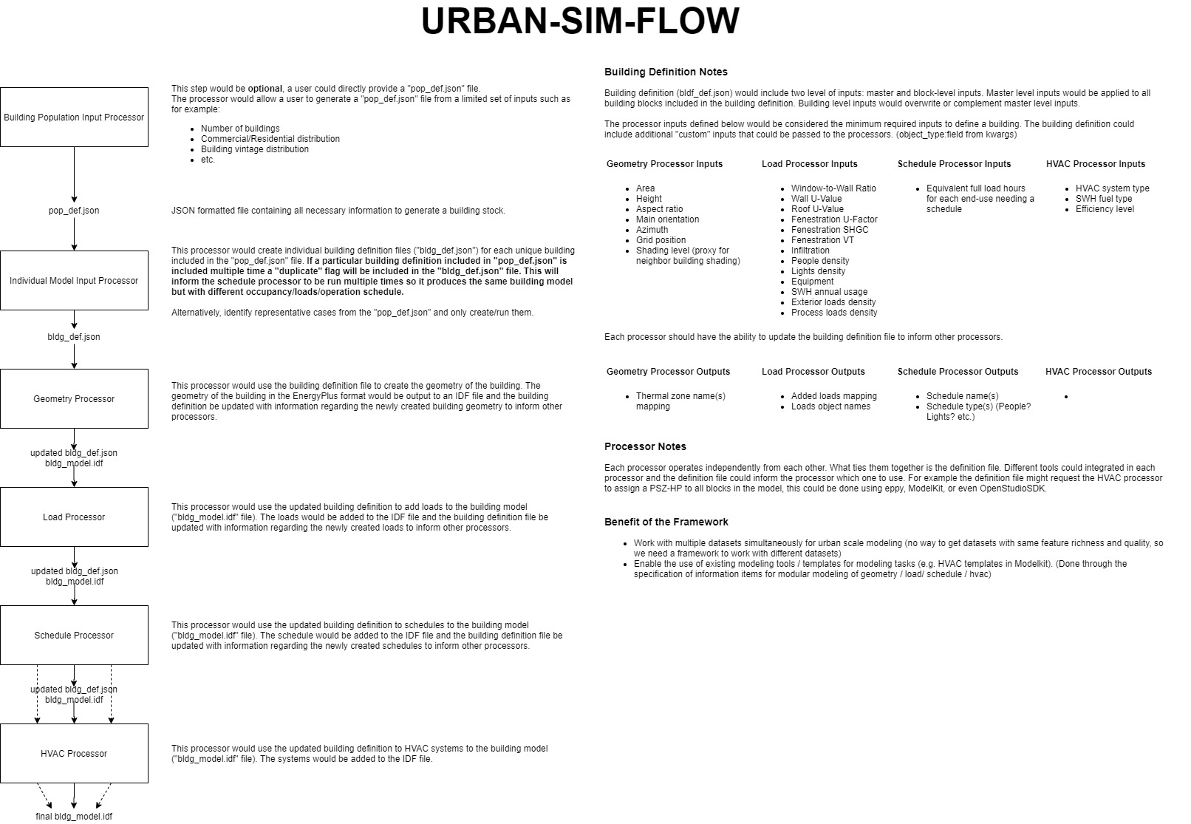

Slide 4


With a specific building characteristics vector from CBECS, provide example end results of each processor in terms of actual idf files.
Detail actual procedures for implementing each processor
At minimal: enumerated list of modeling strategy,
Preferred: Pseudo code with I/O
Best: Implement the processor skeleton
Alternative: existing implementation from other projects
With 1 and 2
Implement modeling procedure into code and
Specify actual input arguments for the implementation
Modeling procedure
Modeling procedure
Modeling procedure
Modeling procedure
Modeling procedure
Program
Modeling procedure

