Slide 1
Prediction on Spatio-Temporal Networks
Notes:
Image: Abstract Data Visualization – Stock Photo

Slide 2
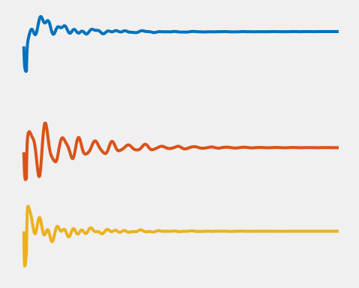
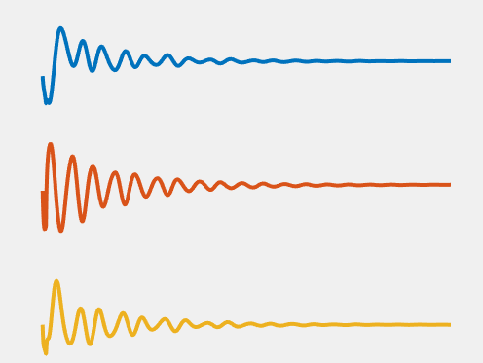
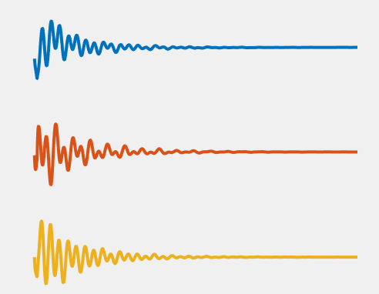
Experimental Setup: IEEE 68 Bus System
Node
Features
Time
Objective:
Develop a model that captures the transient evolution of the dynamical system
Notes:
\begin{bmatrix}
x_{9,1}(1) & x_{9,1}(2) & \dots & x_{9,1}(n+1) \\
x_{9,2}(1) & x_{9,2}(2) & \dots & x_{9,2}(n+1) \\
x_{9,3}(1) & x_{9,3}(2) & \dots & x_{9,3}(n+1)
\end{bmatrix}
\begin{bmatrix}
x_{40,1}(1) & x_{40,1}(2) & \dots & x_{40,1}(n+1) \\
x_{40,2}(1) & x_{40,2}(2) & \dots & x_{40,2}(n+1) \\
x_{40,3}(1) & x_{40,3}(2) & \dots & x_{40,3}(n+1)
\end{bmatrix}
\begin{bmatrix}
x_{7,1}(1) & x_{7,1}(2) & \dots & x_{7,1}(n+1) \\
x_{7,2}(1) & x_{7,2}(2) & \dots & x_{7,2}(n+1) \\
x_{7,3}(1) & x_{7,3}(2) & \dots & x_{7,3}(n+1)
\end{bmatrix}

Slide 3
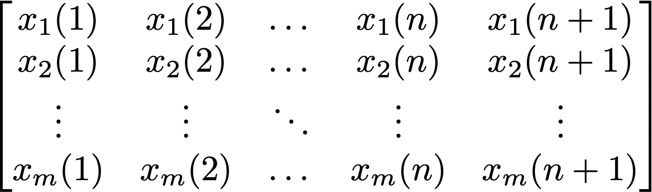
Data Format for applying Koopman Operator Methods
Multi-dimensional spatio-temporal time-series data is rearranged as a 2D array.

Slide 4
Koopman Operator (deepDMD)
Cost function:
Notes:
\min_{{\cal K},\theta} \parallel \pmb\Psi(X_f, \theta) - {\cal K} \pmb \Psi(X_p, \theta) \parallel_F^2 + \lambda_1 \parallel {\cal K} \parallel_F^2 + \lambda_2 \parallel \theta \parallel_1^2

Slide 5
Why existing methods in the prediction of Power System Transients don’t work?
Power-grid network can be naturally modeled as a graph beyond grid-structure (e.g. CNN)
Recurrent networks (e.g RNN) for time series prediction suffer from time-consuming iterations, complex gate mechanisms, and slow response to dynamic changes
Traditional deep-learning based prediction models usually accept a fixed prediction length
directly apply to the power-grid network and capture spatial-temporal characteristics

Slide 6
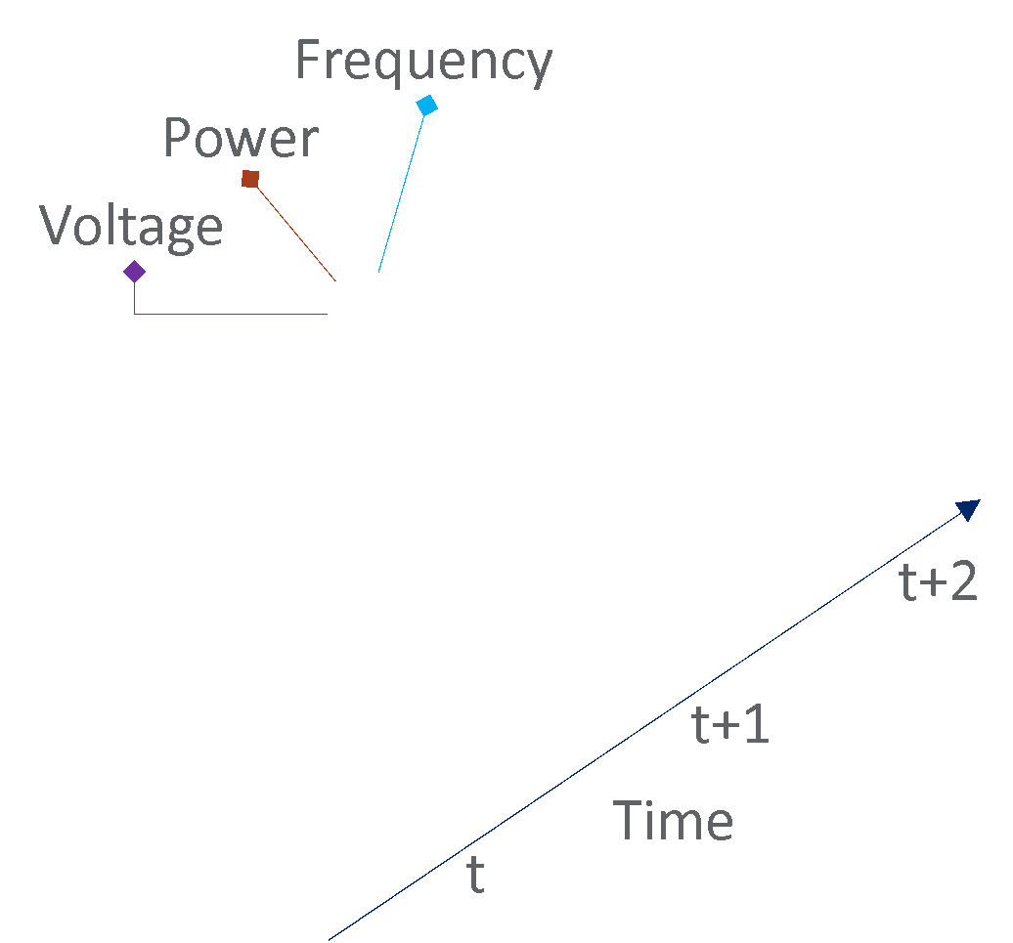

Spatio-temporal Graph Convolutional Network (STGCN)
Given M observed snapshots of a power network (j ∈[t-M+1, t]), the problem is to predict the measurements in the next H timestamps (i ∈[1, H]) with the maximized probability P given the M observations
The input of STGCN is (batch_size, history_window_size M, #nodes, feature, e.g. frequency)
The prediction of STGCN is (batch_size, prediction_window_size H, #nodes, feature)

Slide 7
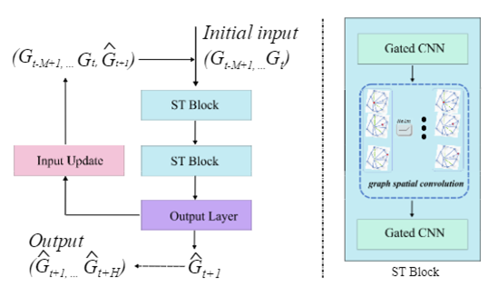
STGCN Architecture
1. STGCN extracts spatial and temporal features from the input jointly, models the network by a general graph instead of treating it separately as grids
(Graph Spatial Convolution)
2. STGCN employs entire convolutional structures on time axis to extract temporal features. Gated CNN responses to dynamic changes much faster
3. STGCN accepts user-defined varied prediction lengths without retraining the model

Slide 8
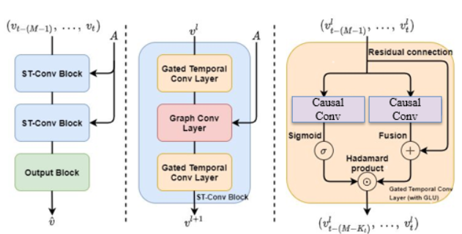


STGCN Architecture Breakdown – Sandwich
The spatial graph convolution exploits the information from the Ks hop neighborhood of central nodes to extract the spatial features
The temporal gated convolution explores Kt neighbors to extract the temporal features
Causal Convolution—“WaveNet: A Generative Model for Raw Audio” by Oord et al.

Slide 9
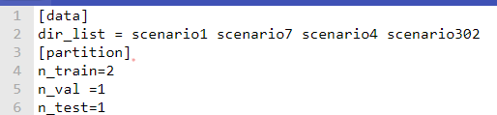
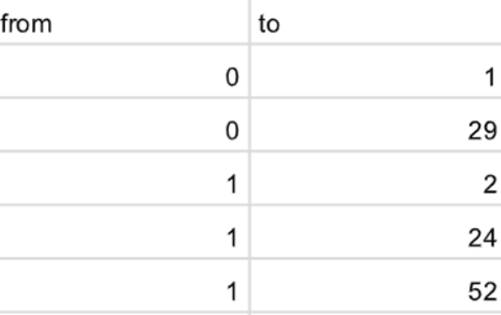
STGCN Input
Configurations/pnnl_stgcn.conf (datasets, partition)
Dataset/PowerGrid/graph.csv (graph file, edgeList)
Hyper-parameters setting
parser = argparse.ArgumentParser()
parser.add_argument("--config",default='configurations/pnnl_stgcn.conf', type=str, help="configuration file path")
parser.add_argument('--n_route', type=int, default=68) #number of PMUs in the power-network as vertices
parser.add_argument('--feature', type=str, default='frequency’) #select feature from frequency, voltage magnitude, angle
parser.add_argument('--p_start_t', type= int, default=200) #for testing scenarios, the starting timestamp
parser.add_argument('--n_his', type=int, default=199) #the history window size [0-199], history window size M
parser.add_argument('--ks', type=int, default=3) #spatial graph convolution, exploits Ks-hop neighborhood
parser.add_argument('--kt', type=int, default=1) #gated temporal convolution, exploits Kt neighbors in time axis
parser.add_argument('--test_pred_length', type=int, default=500) #future prediction length, prediction window size H
parser.add_argument('--batch_size', type=int, default=10) #batch-size
parser.add_argument('--epoch', type=int, default=40) #epochs number

Slide 10
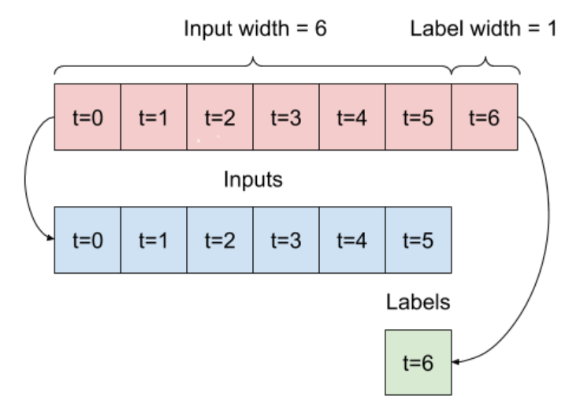

STGCN Data Preparation
According to history window size M, shuffle and reorganize the temporal readings
[0,1, 2, 3, 4, 5, 6, 7, 8, 9] set M as 6
[0,1,2,3,4,5] -> [6]
[1,2,3,4,5,6] -> [7]
…
[3,4,5,6,7,8] -> [9]
This procedure consumes the largest main memory and becomes the resource bottleneck
We use memory_profiler to monitor the memory usage

Slide 11
Key Aspects:
deepDMD
STGCN
Ease of adaptation: 2/10
Ease of adaptation: 7/10
Doesn't depend on topology
Depends on topology
Needs multiple states of the system
Works with a single state
Needs just an initial state for predictions
Needs a history of observations
Version: TF 2.2
Version: TF 1.15

