Slide 1



Introducing the Lamellar Runtime: A Modern Approach to High-performance Computing
https://github.com/pnnl/lamellar-runtime
https://crates.io/crates/lamellar
Apr 2, 2025
Ryan D. Friese
https://docs.rs/lamellar/latest/lamellar/
Pacific Northwest National Lab
ryan.friese@pnnl.gov 509-375-2903
Notes:
Image: Abstract Data Visualization – Stock Photo

Slide 2
Agenda
Rust Overview
Lamellar Overview
Experimental Results

Slide 3


Why Rust?
Rust is a modern systems programing language that is an alternative to C and C++. It prioritizes reliability, performance, and productivity.
Reliability
Memory and Thread safety
Strong compile-time guarantees
Performance
No garbage collector or runtime
Zero-cost abstractions
Productivity
Cargo build tool and package manager
Verbose and helpful compiler messages
Community Support
Mozilla 2006 – V1.0 2015 – V1.85.1 Mar ’25
Industry Adoption: Amazon, Dropbox, Facebook, Google, Microsoft, etc.
The Rust Foundation
Microsoft & Google: 70% of vulnerabilities are memory related
U.S. Government has recommended switching to memory safe language
Voted “most loved programming language” on stack overflow 2016-2023

Slide 4
CWE 2023 – Top 25
Rank | ID | Name
1 | CWE-787 | Out-of-bounds Write
2 | CWE-79 | Improper Neutralization of Input During Web Page Generation (Cross-site Scripting)
3 | CWE-89 | Improper Neutralization of Special Elements used in an SQL Command (SQL Injection)
4 | CWE-416 | Use After Free
5 | CWE-78 | Improper Neutralization of Special Elements used in an OS Command (OS Command Injection)
6 | CWE-20 | Improper Input Validation
7 | CWE-125 | Out-of-bounds Read
8 | CWE-22 | Improper Limitation of a Pathname to a Restricted Directory (Path Traversal)
9 | CWE-352 | Cross-Site Request Forgery (CSRF)
10 | CWE-434 | Unrestricted Upload of File with Dangerous Type
11 | CWE-862 | Missing Authorization
12 | CWE-476 | NULL Pointer Dereference
13 | CWE-287 | Improper Authentication
14 | CWE-190 | Integer Overflow or Wraparound
15 | CWE-502 | Deserialization of Untrusted Data
16 | CWE-77 | Improper Neutralization of Special Elements used in a Command (Command Injection)
17 | CWE-119 | Improper Restriction of Operations within the Bounds of a Memory Buffer
18 | CWE-798 | Use of Hard-coded Credentials
19 | CWE-918 | Server-Side Request Forgery (SSRF)
20 | CWE-306 | Missing Authentication for Critical Function
21 | CWE-362 | Concurrent Execution using Shared Resource with Improper Synchronization (Race Condition)
22 | CWE-269 | Improper Privilege Management
23 | CWE-94 | Improper Control of Generation of Code (Code Injection)
24 | CWE-863 | Incorrect Authorization
25 | CWE-276 | Incorrect Default Permissions

Slide 5

CWE 2023 – Top 25
Rank | ID | Name
1 | CWE-787 | Out-of-bounds Write
2 | CWE-79 | Improper Neutralization of Input During Web Page Generation (Cross-site Scripting)
3 | CWE-89 | Improper Neutralization of Special Elements used in an SQL Command (SQL Injection)
4 | CWE-416 | Use After Free
5 | CWE-78 | Improper Neutralization of Special Elements used in an OS Command (OS Command Injection)
6 | CWE-20 | Improper Input Validation
7 | CWE-125 | Out-of-bounds Read
8 | CWE-22 | Improper Limitation of a Pathname to a Restricted Directory (Path Traversal)
9 | CWE-352 | Cross-Site Request Forgery (CSRF)
10 | CWE-434 | Unrestricted Upload of File with Dangerous Type
11 | CWE-862 | Missing Authorization
12 | CWE-476 | NULL Pointer Dereference
13 | CWE-287 | Improper Authentication
14 | CWE-190 | Integer Overflow or Wraparound
15 | CWE-502 | Deserialization of Untrusted Data
16 | CWE-77 | Improper Neutralization of Special Elements used in a Command (Command Injection)
17 | CWE-119 | Improper Restriction of Operations within the Bounds of a Memory Buffer
18 | CWE-798 | Use of Hard-coded Credentials
19 | CWE-918 | Server-Side Request Forgery (SSRF)
20 | CWE-306 | Missing Authentication for Critical Function
21 | CWE-362 | Concurrent Execution using Shared Resource with Improper Synchronization (Race Condition)
22 | CWE-269 | Improper Privilege Management
23 | CWE-94 | Improper Control of Generation of Code (Code Injection)
24 | CWE-863 | Incorrect Authorization
25 | CWE-276 | Incorrect Default Permissions
Mitigated by Rust
language

Slide 6
Rust Type System
Rust | C++ | Python
i8 | char | str(len = 1)
i16,i32,i64,isize | short, int, long, size_t | int
u8,u16,u32, u64,usize | unsigned char, short, int, long | -
f32, f64 | float, double | float, float
struct | struct | -
≈ struct + traits | class | class
enum (integer-like) | enum | Enum
enum (variant-like) | ≈ enum+struct+ union
[T;size] | array ( T foo[size];) | list
Vec<T> | std::vector<T> | list
String | string | str
&str(String slice) | const char* | str
*const T, *mut T | const T*, T* | -
Box/RC/ARC | std::auto/shared/etc. | -
Strong
Static
Powerful Inference
Scalars
User-Defined
Compound
6
Pointers (Smart & Raw)

Slide 7
Rust Ownership and Borrowing
Type | Rust | C++ | Python
Immutable reference | &T | Const T& | -
Mutable reference | &mut T | T& | -
Immutable pointer | *const T | const T* | -
Mutable pointer | *mut T | T* | -
Unique ownership | Box<T> | std::unique_ptr | -
Shared ownership | Rc<T> | std::shared_ptr | -
Weak references | Weak<T> | std::weak_ptr | Weakref.ref
Thread safe | Arc<T> | std::shared_ptr
Memory management | Automatic^{1,2} | Manual, Automatic² | Automatic³
Enforced ownership model:
One Owner (usually)
One mutable borrow OR Many immutable borrows
When owner goes out of scope (dropped), resources are freed
Assignment transfers ownership
Borrowing through references (&)
We will see some common errors w.r.t. ownership and borrowing shortly!
¹Compile time borrow checking. ²Runtime reference counting. ³Runtime garbage collection.

Slide 8
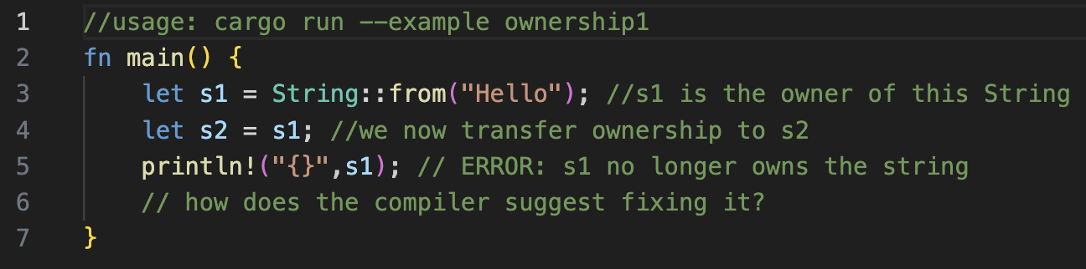
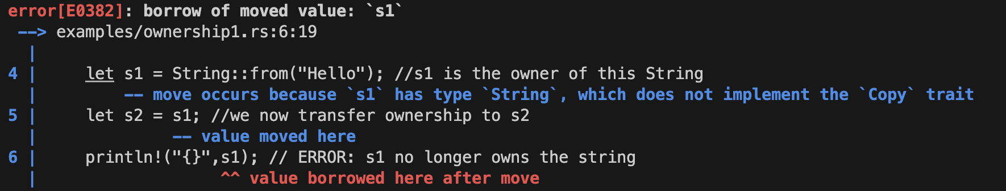
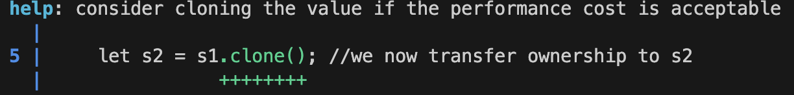
Writing it wrong: Rustc and useful errors
The Rust compiler (rustc) catches many errors at compile time
Seg-faults are rare in end-user Rust applications
Rustc error messages succinctly tell you the issue
Often it also tells you a potential fix!
fn main() {
let s1 = String::from("Hello"); //s1 is the owner of this String
let s2 = s1; // transfer ownership to s2
println!("{}",s1); //ERROR! s1 no longer owns the string
}
Try it out: https://play.rust-lang.org/?version=stable&mode= debug&edition=2021&gist=a8ddc15faa98db41df433f795c61af0a

Slide 9
Rust Traits
Defined shared behavior: A collection of methods (c.f. Java/Go interfaces)
Can contain default method implementations
Share functionality between types
String & i64 both implement the printing-related “Display” trait
Allows for generic programming (through type “impl” restrictions on functions)
Composition Over Inheritance OOP design principle.
Structs can “impl” many traits
Structs can not inherit other structs
trait foo{ fn bar(&self); }
impl foo for i32{
fn bar(&self) {
println!(“I’m an i32”);
}
}
impl foo for String{
fn bar(&self) {
println!(“I’m a String”);
}
}
Try it out -- https://play.rust-lang.org/?version=stable&mode=debug&edition=2021&gist=03b7c04c5c40c0ba6614f4dd6414efe1

Slide 10
Rust Generics
Enables code that operates on multiple types without sacrificing type safety
Resolved at compile time: aka monomorphization
Where are generics used:
Stucts/enums:
Functions:
Trait Bounds:
struct Pair<T>{
first: T,
second: T,
}
enum Either<L,R>{
Left(L),
Right(R),
}
fn make_pair<T>(first: T, second: T) -> Pair<T>{
Pair{first,second}
}
fn print_pair<T: Display>(p: Pair<T>) {
println!("First: {} Second: {}”, p.first, p.second);
}
fn main(){
let i32_pair: Pair<i32> = make_pair(0,1);
let str_pair = make_pair::<&str>("1st","2nd");
let either_pair = make_pair(Either::Right(10),Either::Left("Ten"));
print_pair(i32_pair);
print_pair(str_pair);
//ERROR! Either does not impl Display
print_pair(either_pair);
}
Try it out: https://play.rust-lang.org/?version=stable&mode=debug&edition= 2021&gist=4cf313e6dbd90a7852f0a98ec295fe34

Slide 11
Rust Associated Types
Simplifies usage patterns when traits are generic over some internal type
struct Cat;
struct Dog;
trait Animal2{
type T: Display;
fn make_sound(&self) -> Self::T;
}
trait Animal<T: Display>{
fn make_sound(&self) -> T;
}
impl Animal2 for Dog{
type T = String;
fn make_sound(&self)
-> Self::T{String::from("woof!")}
}
impl Animal2 for Cat{
type T = &'static str;
fn make_sound(&self) -> Self::T{"meow!"}
}
impl Animal<String> for Dog{
fn make_sound(&self) -> String{String::from("woof!")}
}
impl Animal<&'static str> for Cat{
fn make_sound(&self) -> &'static str{"meow!"}
}
fn talk<A: Animal<C>, B: Animal<D>,C: Display, D: Display>
(animal1: &A, animal2: &B){
println!("Animal 1 says {}",animal1.make_sound());
println!("Animal 2 says {}",animal2.make_sound());
}
fn talk2<A: Animal2, B: Animal2>(animal1: &A, animal2: &B){
println!("Animal 1 says {}",animal1.make_sound());
println!("Animal 2 says {}",animal2.make_sound());
}
Try it out: https://play.rust-lang.org/?version=stable&mode=debug&edition=2021&gist=8a5dc6f88a4e3b25c5b2886eb70cfb79

Slide 12
Rust Enum
Try it out: https://play.rust-lang.org/?version=stable&mode=debug&edition=2021&gist=09f44c419f0eb3fef8259a3bcd0483a8
Enums are Algebraic Data Types if coming from a functional language
Each Enum variant can have data to go along with it
When processing an instance, each variant needs to be handled
#[derive(Debug)]
enum Ops{
Load,
Store(f32),
FetchMulAdd(f32,f32),
Print,
Nop,
}
fn main(){
let mut val = 0.0;
apply_op(&mut val, Ops::Store(2.0));
let old = apply_op(&mut val, Ops::FetchMulAdd(8.0,2.0)).unwrap();
let new = apply_op(&mut val, Ops::Load);
println!("old: {old} new: {new:?}");
apply_op(&mut val, Ops::Print);
apply_op(&mut val, Ops::Nop);
}
fn apply_op(val: &mut f32, op: Ops)->Option<f32>{
match op{
Ops::Load => Some(*val),
Ops::Store(v) => { *val = v; None }
Ops::FetchMulAdd(v1,v2) => {
let old = *val; *val = (*val*v1)+v1;
Some(old)
}
// blanket statement to handle all other options
_ => {
println!("Op {:?} unimplemented",op);
None
}
}
}
old: 2 new: Some(18.0)
Op Print unimplemented
Op Nop unimplemented

Slide 13
Rust Error Handling
Rust enforces error handle (or at least explicit acknowledgement you are ignoring an error)
enum Result<T, E>{
Ok(T),
Err(E),
}
use std::fs::File;
fn main() {
let f = File::open("hello.txt");
let f = f.unwrap(); //MINIMUM: ignore an error may happen, panics with generic message
let f = f.expect("error better opening file"); //BETTER: panics with custom error message
let f = match f {
Ok(file) => file,
Err(error) => { // BEST: explicitly handle/recover
panic!("There was a problem opening // from an error or at lease provide
the file: {:?}", error) // more detailed error message on panic
},
};
}

Slide 14
Rust Concurrency
Rust supports multiple forms of concurrent execution
multi-threading via explicit os level threads (e.g. pthreads)
Async/await design pattern for futures is also available in the standard library
Somewhat similar to green threads or user level threads
Data sharing via message passing channels (inspired from GoLang)
Ownership of data is transferred from sender to receiver
Shared ownership of data achieved through smart pointers
Arc<T> - (atomic reference counting pointers) – only deallocates when reference is 0
Mutex and Locks control mutable access to data
Sync and Send traits – Extensible Concurrency
Send – allows transfer of ownership between threads
Sync – allows access from multiple threads
Manually implementing Sync and Send requires the “Unsafe” keyword
Developer is promising the compiler that the implementations are safe

Slide 15
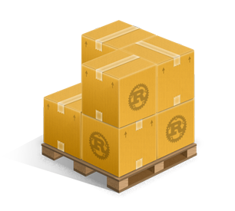
Cargo: The Rust Build Tool
“Crates” are Rust libraries.
Robust dependency management
Download/resolution/compilation of crates
Lifecycle support (debug/release, benchmarks, testing, publishing)
Canonical package layout and manifest for Rust projects
Foreign code integration
Convention-conforming support for other languages
Convenience crates: Bindgen and CC
www.crates.io – the rust community’s crate registy

Slide 16
LAMELLAR An HPC runtime developed in Rust
https://github.com/pnnl/lamellar-runtime
https://crates.io/crates/lamellar
https://docs.rs/lamellar/latest/lamellar/

Slide 17
LAMELLAR Stack & Nomenclature
Lamellar
A distributed, asynchronous tasking and PGAS runtime for HPC
Active Messages: Distributed async tasks
Darcs: Distributed Arcs (Atomic Reference Counted pointers)
LamellarArrays: High(er)-level data structure
Lamellae
Interface between network devices/drivers and upper-level runtime layers
Support High Performance InfiniBand networks
PE – Processing Element (≅ MPI Rank)
Supports multiple OS threads
Multiple PEs per hardware node (e.g., one per socket)
Thread pool for Active Messages and Futures
Applications
Lamellar
LamellarArrays
Darcs
PGAS
layer
Active message layer
Thread Pool
lamellae
ROFI
SMP
Local
Network interfaces

Slide 18
LAMELLAR: Active Messages (AM)
Active Message Data + Processing Instructions
Asynchronous remote execution (async/await)
Implemented via Procedural Macros
#[lamellar::AmData] – Extends #[Derive(…)]
Applied to user defined structs
Represents AM Input data
#[lamellar::am] – Attribute proc macro
Applied to the user defined impl of the LamellarAM trait
Represents an AM task
Can return data or a “callback” AM to the original PE
Point to point (e.g. exec on pe p)
Collective (e.g. exec on all)
e.g. pointer to function that takes data as input
topic for another time
Replaces #[Derive(…)]
#[AmData(Debug)]
Struct HelloWorldAm{
msg: String
orig_pe: usize
}
#[am]
impl LamellarAm for HelloWorldAm {
async fn exec(self) {
Println!(“{:?}”,self);
}
}
//main()...
world.exec_am_pe(pe,
HelloWorldAm{
msg: “Hello World”,
orig_pe: world.my_pe()
}
).block();
The data
Attribute macro
The processing instructions
Execute on a specific PE
An AM instance

Slide 19
LAMELLAR: Remote Operation Handles
Recall: operations in Lamellar are asynchronous (w.r.t programming model and Rust syntax and types)
Futures in Rust are also lazy, meaning they must be “await”ed
In Lamellar async operations are represented by “handles”
They allow users to:
block() – wait for the operation to complete within a non-async block (of code)
spawn() – start execution of the operation, but return a new handle for the result
await – every handle is a future that can be “await”ed within an async block.
let am_handle = world.exec_am_pe(pe,…);
//---option 1---
let result = am_handle.block(); //thread will block
//---option 2---
let result_handle = am_handle.spawn(); //thread free do other work
let result = result_handle.block(); //thread will block
//---option 3---
async move {
let result = am_handle.await; // task will allow other tasks to execute
}

Slide 20
LAMELLAR: Darc<T> - Distributed Atomic Reference Count
Atomic Reference Counted Pointer
Macro implements specialized (de)serialization methods to appropriate track reference counts when sending to remote PEs
Similar to an Arc but in distributed memory
Global lifetime – value is valid (and accessible) if any PE has a reference
Inner mutability disallowed by default
Intended for use in active messages
Enables distributed access and manipulation of generic Rust objects
Each PE contains a local instance of the interior object (in this example, not directly mutable with RDMA)
#[lamellar::AmData(Clone)]
struct DarcAm{
darc: Darc<AtomicUsize>,
}
#[lamellar::am]
impl LamellarAm for DarcAm{
fn exec(&self) {
self.darc.fetch_add(1,Ordering::Relaxed);
}
}
fn main(){
let team = world.create_team...;
let darc = Darc::new(&team,AtomicUsize::new(0)).block();
let am = DarcAm {darc}
for i in 0..1000 { team.exec_am_pe(i%num_pes,am.clone()).spawn()
}
Mutability controlled via atomic
Allocated on either the world or a team

Slide 21
LAMELLAR LamellarArray Types
Type |  | Protection | Notes
 | ReadOnlyArray | Not needed
Atomic | NativeArray | Element-wise | Language-based atomics
 | GenericArray |  | Mutex-based atomics
Lock | Local | PE-wise
 | Global | Cluster-wise
 | UnsafeArray | None | For Internal use (requires ‘unsafe’ blocks)
Global or local indexing
Iterators for idiomatic Rust
Sub-arrays supported
Block- or cyclic-data distribution
Operation order over indices not guaranteed
Safely converted at runtime. (Memory regions will have only one array type at any time.)
Built on Darcs
Iterator Type | Data Parallel | Data Transfer | Executing PEs
Distributed | Yes | Maybe | All
Local | Yes | No | All
Serial | No | Yes | Calling

Slide 22
LAMELLAR: LamellarArray Example
Set of pes the data should exist on
Global length
Currently also support “Cyclic”
fn main(){
//initialize lamellar
let ll_array = LocalLockArray::<usize>::new(team, ARRAY_LEN, Distribution::Block);
ll_array.dist_iter_mut()
.enumerate()
.filter(|(i,_)| i % 2 ==0)
.for_each(|(i,e)| *elem = i*(my_pe)).block();
let ro_array = ll_array.into_read_only();
let idx = vec![1,100,32,54];b
let vals_handle = ro_array.batch_load(idx).spawn();
//do stuff
let vals = vals_handle.block();
let atomic_array = ro_array.into_atomic();
atomic_array.add(idx[0],val[0]).block();
let sum = atomic_array.sum().block();
}
Mutable data parallel iteration (safety managed by array type)
Composable iteration functions
Block thread until distributed op is completed
spawn distributed op to worker thread
Supports single and batched element-wise operations
Each array “into” call is collective and blocks until there is only a single reference to the array on each PE
It is not possible to have two different Array Types referencing the same underlying data
Supports common and user-defined reductions

Slide 23
LAMELLAR: Element Wise Operations
Each “class” of operations is represented by a Supertrait, containing numerous sub-traits “T” must implement to support the class
AccessOps: Dist
store(i: usize, val: T) -> ArrayOpHandle
swap(i: usize, val: T) -> ArrayOpHandle
ReadOnlyOps: Dist
load(i: usize) -> ArrayFetchOpHandle<T>
ArithmeticOps: Dist + std::ops::{AddAssign, SubAssign, MulAssign, DivAssign, RemAssign}
add(i: usize, val: T) / fetch_add(i: usize, val: T) -> Array[Fetch]OpHandle<T>
sub(i: usize, val: T) / fetch_sub(i: usize, val: T) -> Array[Fetch]OpHandle<T>
mul(i: usize, val: T) / fetch_mul(i: usize, val: T) -> Array[Fetch]OpHandle<T>
div(i: usize, val: T) / fetch_div(i: usize, val: T) -> Array[Fetch]OpHandle<T>
rem(i: usize, val: T) / fetch_rem(i: usize, val: T) -> Array[Fetch]OpHandle<T>
Dist: Sync + Send + Copy + Serialize + Deserialize

Slide 24
LAMELLAR: Element Wise Operations (cont.)
BitWiseOps: Dist + std::ops::{BitAndAssign,BitOrAssign,BitXorAssign}
and(i: usize, val: T) / fetch_and(i: usize, val: T) -> Array[Fetch]OpHandle<T>
or(i: usize, val: T) / fetch_or(i: usize, val: T) -> Array[Fetch]OpHandle<T>
xor(i: usize, val: T) / fetch_xor(i: usize, val: T) -> Array[Fetch]OpHandle<T>
CompareExchangeOps: Dist + std::cmp::{Eq}
compare_exchange(i: usize, old: T, new: T) -> ArrayResultOpHandle<T>
CompareExchangeEpsilonOps: Dist + std::cmp::{PartialEq,PartialOrd}
compare_exchange_epsilon(i: usize, old: T, new: T, eps: T) -> ArrayResultOpHandle<T>
ShiftOps: Dist + std::ops::{ShlAssign,ShrAssign}
shl(i: usize, val: T) / fetch_shl(i: usize, val: T) -> Array[Fetch]OpHandle<T>
shr(i: usize, val: T) / fetch_shr(i: usize, val: T) -> Array[Fetch]OpHandle<T>

Slide 25
LAMELLAR: Batched Element Wise Operations
We have also support batched operations with their own API
batch_*array_op*(i: impl OpIndex, …) -> ArrayBatch[Fetch]OpHandle<T>
OpIndex trait represents list like data structures – i.e. a list of indices
&[usize]
Vec<usize> , &Vec<usize>
LamellarMemoryRegion<usize>, &LamellarMemoryRegion<usize>
UnsafeArray<usize>, ReadOnlyArray<usize>, AtomicArray<usize>, LocalLockAtomicArray<usize>
We allow three batching “types”
Many indices – One value:
array.batch_add(indices,1); //add 1 to each indexed element
Many indices – Many vals:
array.batch_add(indices,vals); //1-to-1 between indices and vals
One Index – Many vals:
array.batch_add(index,vals); //add all vals to given element
One Index – One value (non batched version):
array.add(index,1);
A
+9
0
1
2
3
4
5
6
7
+1
,+2
A.add(1,1);
+2
+2
A.add([2,6,1,3],2);
A.add([0,5,7],[9,4,6]);
+4
+2
+6

Slide 26
LAMELLAR: Array Iteration
One goal for LamellarArrays is to provide “Rust-ish” interfaces
We provide multiple ways for iterating over a LamellarArray
Local Iterator
Provides both non-mutable and mutable data parallel iteration
Distributed Iterator
Provides both non-mutable and mutable data parallel iteration
OneSided Iterator
Only non-mutable serial iteration for now
Maintain safety constraints provided by various array types
Classify Iterator Operations as either
Adaptors – e.g. enumerate, map, etc.
Consumers – e.g. for_each, collect, etc.

Slide 27
LAMELLAR: Current Iterator Adapters
IndexedLocalIterator
chunks
enumerate
skip
step_by
take
zip
LocalIterator
filter
filter_map
map – in theory can be “Indexable” but requires specialization
monotonic – emits unique and monotonically increasing “indices” but no relation to underlying data
IndexedDistributedIterator
enumerate
skip
step_by
take
DistributedIterator
filter
filter_map
map
monotonic
Distributed Adapters sometimes require communication… the framework for this is w.i.p
Unstable for foreseeable future ☹

Slide 28
LAMELLAR: Iterator Consumers
Consumers are methods which “consume” an iterator
Generally for an iterator to “do” something, it needs to be consumed
E.g. for_each, collect, sum
Lamellar exposes a “schedule” functionality for each supported consumer
Static, Dynamic, Work Stealing, Guided, Chunk
think OpenMP for loop schedulers
pub enum Schedule{
Static, // num elems / num worker threads
Dynamic, // single element at a time per thread
Chunk(usize), // multiple elements at a time per thread (smaller than static)
Guided, // chunks that get smaller during iteration
WorkStealing, // initially static but threads can steal work
}

Slide 29
LAMELLAR: Iterator Consumers
Local Iterators
for_each(Op: Fn(elem)->())->Future<()> // apply Op to each element
collect<A: LamellarArray>(d: Distribution)->Future<A> // create a new LamellarArray
count()->Future<A> // return number of elements in iterator
reduce(Op: Fn(elem,elem)->elem) -> Future<Option<elem>> // use Op to reduce to one value
sum()-> Future<elem> // Sum the iterator (specialization of reduce)
Distributed Iterators
for_each(Op: Fn(elem)->())->Future<()> // apply Op to each element
collect<A: LamellarArray>(d: Distribution)->Future<A> // create a new LamellarArray
Currently working on the other implementations
Requires communication and coordination – trying to generalize to ease future consumer implementations
<*consumer*>_with_schedule(sched: Schedule,…)->Future<…>
One-sided iterators
Any consumer supported by standard Rust iterators
One-sided iters get converted to a Rust iter
all consumers can also by called with a schedule! (previous slide)

Slide 30
LAMELLAR: Iterator Comparison
Assume we are executing on a two PE system
And PE 0 always prints before PE 1
fn main() {
let world = lamellar::LamellarWorldBuilder::new().build();
let array = AtomicArray::<usize>new(&world,4,Distributed::Block);
// initialize array with [0,1,2,3]
array.dist_iter().enumerate().for_each(move|(i,elem)| println!("PE: {my_pe} i: {i} e: {e}"));
array.local_iter().enumerate().for_each(move|(i,elem)| println!("PE: {my_pe} i: {i} e: {e}"));
array.onesided_iter().iter().enumerate().for_each(move|(i,elem)| println!("PE: {my_pe} i: {i} e: {e}")); println!(); }
Distributed Iterator
Local Iterator
Onesided Iterator
PE: 0 i: 0 e: 0
PE: 0 i: 1 e: 1
PE: 1 i: 2 e: 2
PE: 1 i: 3 e: 3
PE: 0 i: 0 e: 0
PE: 0 i: 1 e: 1
PE: 1 i: 0 e: 2
PE: 1 i: 1 e: 3
PE: 0 i: 0 e: 0
PE: 0 i: 1 e: 1
PE: 0 i: 2 e: 2
PE: 0 i: 3 e: 3
PE: 1 i: 0 e: 0
PE: 1 i: 1 e: 1
PE: 1 i: 2 e: 2
PE: 1 i: 3 e: 3
Each PE independently iterates over the entire array
Enumeration spans PEs
Enumeration only considers Local Data

Slide 31
Experiments/Benchmarks
Results presented were performed on a PNNL Cluster
48 node (32 Nodes available)
2 socket – AMD EPYC 7543 32-Core
L1 - 64K
L2 – 512KB
L3 – 32MB
8 Numa nodes per socket
256 GB memory per node
Network: Mellanox HDR-100 ConnectX-6 InfiniBand HBA
Peak bandwidth of 100Gb/s (12.5GB/s)
Full fat tree
Bale/Conveyors/Selectors built using OpenSHMEM from OpenMPI 5.0.0rc2
Chapel v2.0

Slide 32
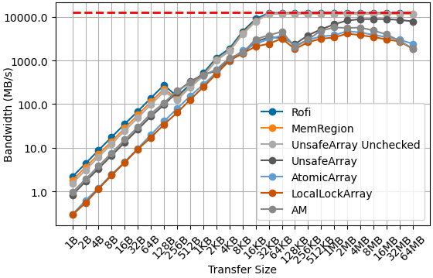
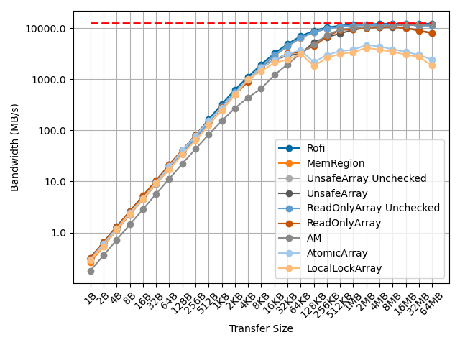
“Put” and “Get” Bandwidths
Puts
Gets
(libfabric)
(libfabric)
262143 requests
262143 requests
1GiB/size requests
1GiB/size requests
Generally Unsafe Methods get better raw performance (but no guarantees on correctness) – currently working on supporting network accelerated atomic operations
Notes:
Chapel uses an Optimized CopyAggregator, allocates additional buffers to facilitate transfers on each PE

Slide 33
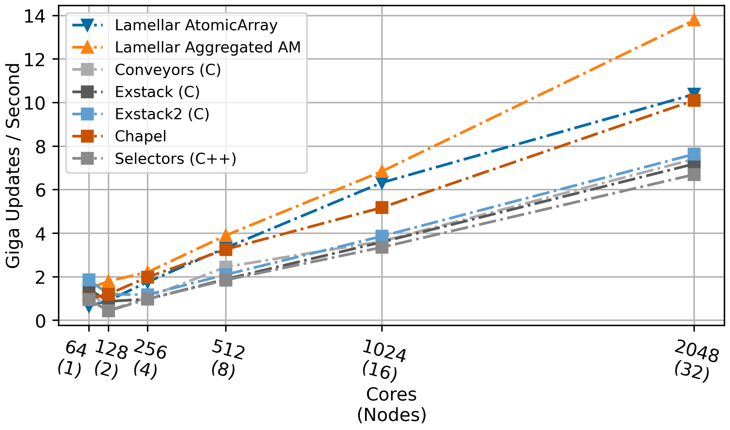
Histogram
Random increments on a distributed array
O(10) Lines of code (loc)
AtomicArray
Element-wise atomic adds
Runtime provided aggregation
array.batch_add(indices,1);
Aggregated Am
User implemented AM aggregation
O(100) loc
O(10) loc
O(100) loc
Configuration:
1000 elements per core
10 Million Updates per Core
10 runs
10,000 indices per “batch”
Lamellar: 16 Pes per Node, 4 threads per PE
Chapel: (1-8) Locales(PE) per Node
Exstack, Exstack2, Conveyors, Selectors: 1 PE per thread
for idx in random_indices {
array[idx] += 1
}
One-way communication

Slide 34
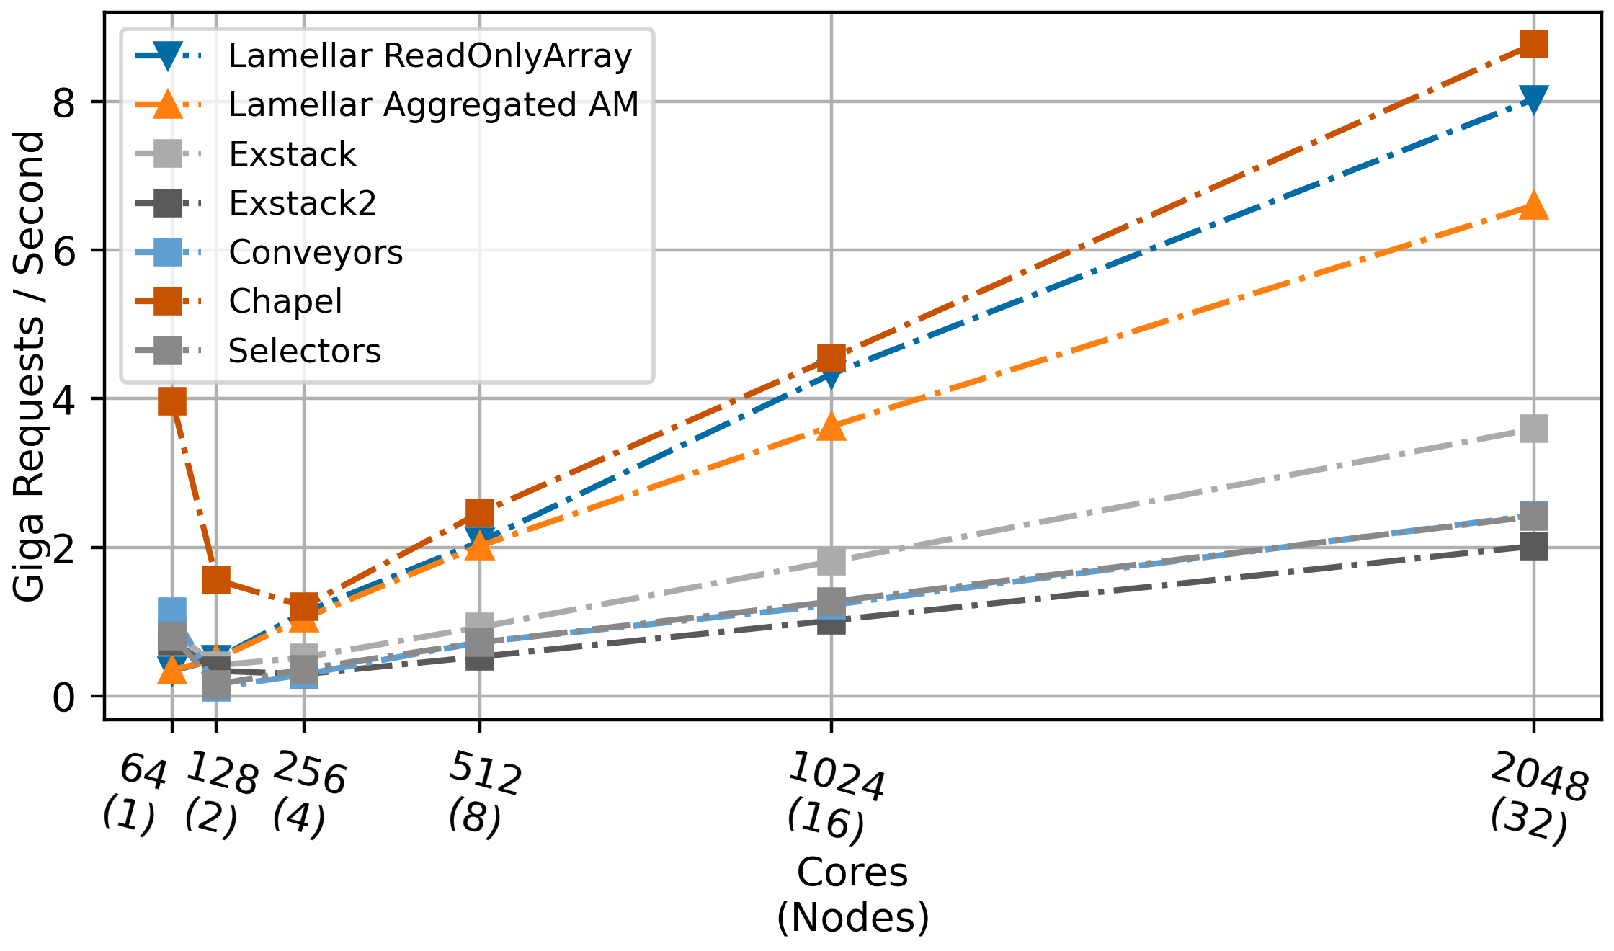
IndexGather
Randomly gather elements in a distributed array
O(10) Lines of code (loc)
ReadOnlyArray
Element-wise loads
Runtime provided aggregation
array.batch_load(indices) -> Vec<usize>;
Aggregated AM
User implemented AM aggregation
O(100) loc
O(10) loc
O(100) loc
Configuration:
1000 elements per core
10 Million Updates per Core
10,000 indices per “batch”
10 runs
Lamellar: 16 Pes per Node, 4 threads per PE
Chapel: (1-8) Locales(PE) per Node
Exstack, Exstack2, Conveyors, Selectors: 1 PE per thread
for (i,idx) in random_indices.enumerate() {
result[i] = array[idx]
}
Two-way communication
Notes:
Chapel uses an Optimized CopyAggregator, allocates additional buffers to facilitate transfers on each PE

Slide 35
LAMELLAR: Code availability
Our current stable release is V0.7.1
Our code is open source and available on GitHub under BSD license:
Lamellar Runtime - https://github.com/pnnl/lamellar-runtime
Lamellar Benchmarks - https://github.com/pnnl/lamellar-benchmarks
We also release the Runtime on Crates.io
https://crates.io/crates/lamellar
Documentation with over 500 runnable examples
https://docs.rs/lamellar/latest/lamellar/

