Slide 1
DATA 604 Final Project
Introduction to compartmental models of infectious disease outbreak
Jai Jeffryes
7/16/2020

Slide 2
Problem statement
With rapidly changing ecology, urbanization, climate change, increased travel and fragile public health systems, epidemics will become more frequent, more complex and harder to prevent and contain. [1]
One of the tools available for exploring infectious disease dynamics early in an outbreak is the SIR model. [2]

Slide 3
SIR assumptions
Population is constant. The model does not consider births and deaths.
Immunity, once acquired upon recovery, endures forever.
The population is well mixed. An individual has equal probability of contact with all other members of the population.

Slide 4
Processing flowchart
Start
Increment t
Set seed
Initialize:
indices,TimeFrame
Day number = 1
t_end = 100
S = 49,999
I = 1
R = 0
Calculate:
Infected
Recovered
Reduce susceptible state
by infected
Reduce infected state by
recovered
Augment recovered state
by recovered
T <= t_end
Y
N
End

Slide 5
Stock and flow diagram
Susceptible
Infected
Removed

Slide 6
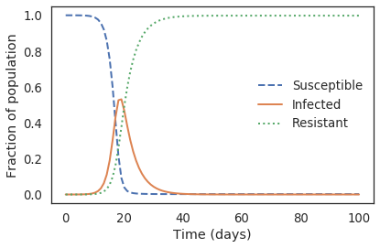
Simulation output
Beta = 0.05249 * (2.7 + 18). (Transmissibility times household size and contacts, discussed in next model.)
Gamma = 1 / 4.5. (Reciprocal of recovery time.)

Slide 7
Validity and verification
Literature supported the validity of employment of the SIR model as an abstraction of epidemic disease.
Prior to the SIR model it was not evident that there is a threshold for infections. Verification of the SIR model historically included successful eradication of smallpox. [3]

Slide 8
Context of contact
Explore the assumption about mixing. [4]
Under normal circumstances, non-household daily contacts tend to exceed household contacts. Lockdown measures reduce non-household contacts to a level similar to or below household contacts.
This project implements such a model and compares the trajectory of infection to that of the simple SIR model.

Slide 9
Refinement - parameters
ℎ𝑠. Average household size.
𝛽. Average transmission rate between an infected individual and a susceptible one.
𝜅. Average number of contacts.
𝐶𝑐. Cases who acquire infection via the community.
𝐶ℎ. Cases who acquire infection via their household.

Slide 10
Refinement - formulae
𝜅−ℎ𝑠+1. The number of non-household contacts.
(ℎ𝑠−1)𝐶𝑐. Maximum number of household acquired infections in a population. Unimplemented.
𝑑𝑆/𝑑𝑡 = −𝛽𝜅𝐼𝑆. Rate of change in susceptibility, no context.
𝑑𝐶𝑐/𝑑𝑡 = 𝛽𝑐(𝑘 − ℎ𝑠 + 1)𝐼𝑆. Rate of increase in community cases among (𝑘 − ℎ𝑠 + 1) non-household contacts.
𝑑𝐶ℎ/𝑑𝑡 = 𝛽ℎ(ℎ𝑠 − 1)𝐼𝑆(1 − 𝐶ℎ/(ℎ𝑠 − 1)𝐶𝑐). Rate of increase in household cases among ℎ𝑠 − 1 contacts and constrained by a carrying capacity.
𝑑𝑆/𝑑𝑡= − 𝛽𝑐(𝑘 − ℎ𝑠 + 1)𝐼𝑆 − 𝛽ℎ(ℎ𝑠 − 1)𝐼𝑆(1 − 𝐶ℎ/(ℎ𝑠−1)𝐶𝑐). The full ODE for rate of change for compartment S. Again, this project does not implement the final term for carrying capacity.

Slide 11
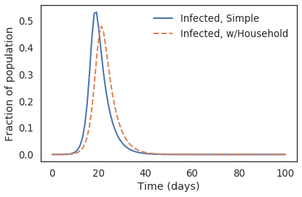
Comparison of infected curves
This simulation set an average household size lower than community contacts. There is some delay of peak infections and the maximum is slightly lower.

Slide 12
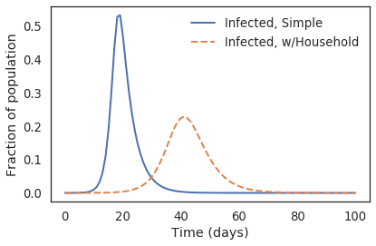
Simulate lockdown
Reduce total contacts while preserving household contacts.
Flattened the curve as under policies ordered by New York Governor Andrew Cuomo.

Slide 13
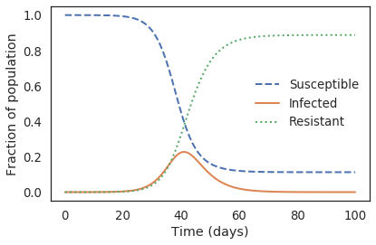
Observation
An epidemic dies out due to a lack of infected hosts, not depletion of susceptible individuals. This mechanism was not evident until models suggested it. [3]

Slide 14
References
1. Juliet Bedford. A new twenty-first century science for effective epidemic response. Nature, November 6, 2019.
2. Kermack, W; McKendrick, A. A Contribution to the Mathematical Theory of Epidemics.
3. Howard Weiss. The SIR model and the foundations of public health
4. Paul Dempsey. Modifying SEIR models to explore the role of average household size in the era of lockdowns and social distancing

Slide 15
Acknowledgments
Paul Dempsey for, discussions on LinkedIn about his SEIR paper.
Dr. Howard Weiss, for correspondence and discussion about SIR models in public health policy and retrospective data collection and modeling issues during the 2020 pandemic crisis.
Dr. Knut Wittkowsi, for discussion on LinkedIn about the pandemic, herd immunity, and public health policy, and for sending me his papers for study.

Slide 16
Background
Compartmental models in epidemiology (Wikipedia).
The SIR Model for spread of disease. Allen Downey's reference for his case study.
The SIR model and the foundations of public health. Howard (Howie) Weiss. Very good orientation.
Prism site. PRISM, the Centre for Research Excellence in Policy Relevant Infectious diseases Simulation and Mathematical Modelling in Australia.
A User's Guide to Infectious Disease Modeling. This manual is an excellent domain orientation.
Paul Dempsey's modified SIR model, exploring household and non-household contributions to case count under lockdown.
Modifying SEIR models to explore the role of average household size in the era of lockdowns and social distancing
Paul Dempsey's model.
Knut Wittkowski. The first three months of the COVID-19 epidemic: Epidemiological evidence for two separate strains of SARS- CoV-2 viruses spreading and implications for prevention strategies.
Modeling COVID-19 Spread vs Healthcare Capacity. Shiny App to predict COVID-19 cases by clinical outcome. Comes with a well-documented tutorial.
Code on GitHub.
Forecasting COVID-19. Rob Hyndman's assessment of model challenges. Includes a comparison of compartmental and agent-based models.
Social distancing and mobility reductions have reduced COVID-19 transmission in King County, WA. The study estimates the reproductive number from case data. It employs a distinctive SEIR model and documents the equations.
COVID-19: Modeling Distributions of Incubation and Recovery Times. Stock and flow diagrams. Although the flows use inappropriate diagrammatic notation, they convey an idea. The article includes delays for state changes.
Report 9: Impact of non-pharmaceutical interventions (NPIs) to reduce COVID-19 mortality and healthcare demand. Neil Ferguson's analysis from March 2020.

