Slide 1
Taxonomy File Explorer
A file explorer like view with SPFx and Managed Metadata

Slide 2






About me
Markus Moeller
Microsoft 365 Developer Expert
Microsoft MVP
Avanade Germany
@moeller2_0
https://mmsharepoint.wordpress.com
Proud dad of 1 (2yrs)

Slide 3

Render and manipulate files in a hierarchical view based on Managed Metadata and Drag&Drop
With SPFx
Notes:
Org: https://mmoeller.sharepoint.com/teams/LDADemoProvisioningTarget1/SitePages/Taxonomy-File-Explorer.aspx

Slide 4
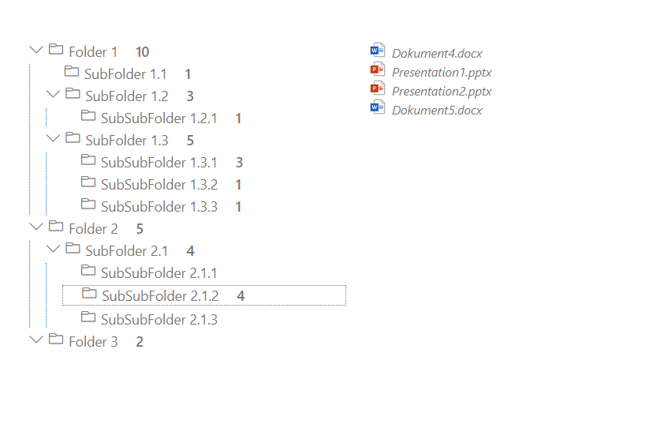

React components [Structure]
TermLabel
FileLabel
TermLabel
TermLabel
TaxonomyFileExplorer
renderFiles()
resetChecked()
Link/Move/Copy file ()

Slide 5
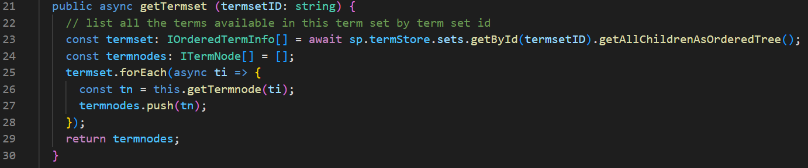
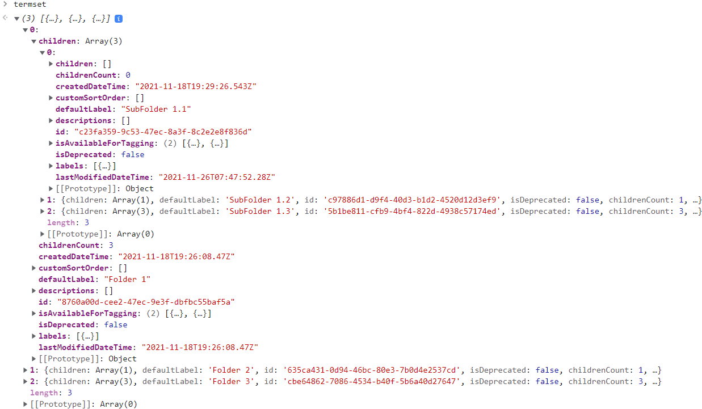
Retrieve Terms(et) by PnPJS (ordered!)
Notes:
Line 23 !!!

Slide 6
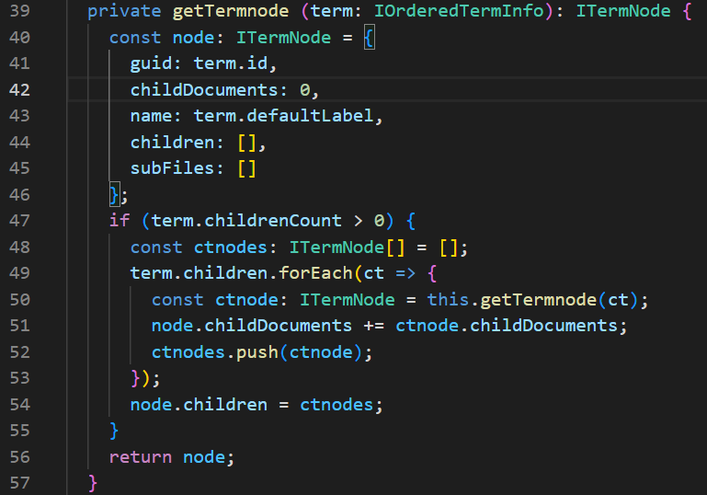
Build tree of terms
Notes:
Construct custom ItermNode (line 40-46)
Handle potential children recursive (line 50)

Slide 7
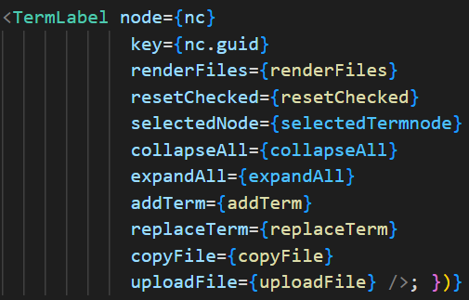
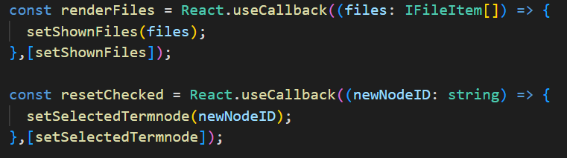
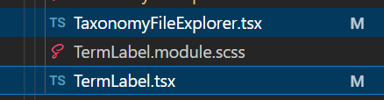
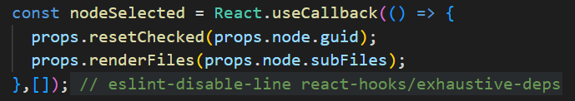
Parent Comp. Callbacks: Click a node

Slide 8
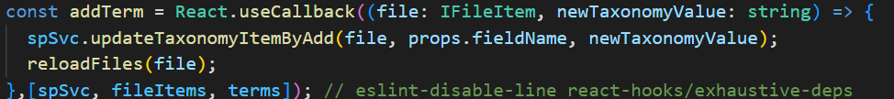
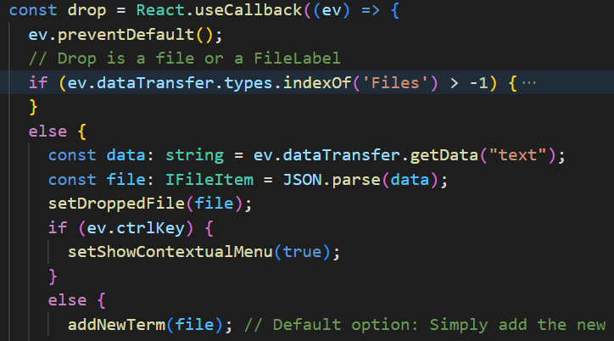
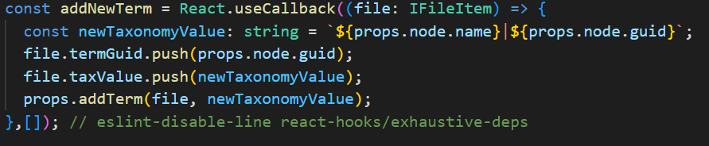
Parent Comp. Callbacks: Term operation

Slide 9
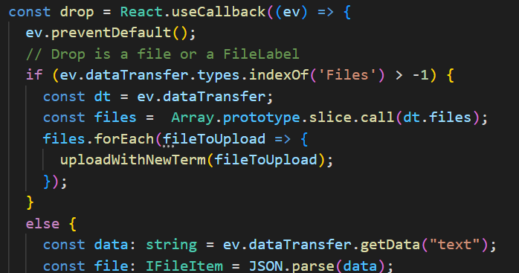
Special: Drop ‚file‘ from outside

Slide 10
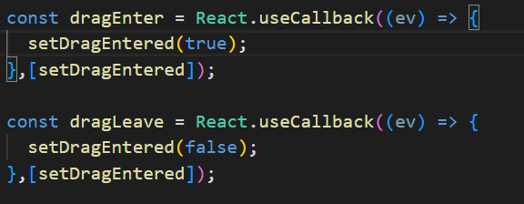
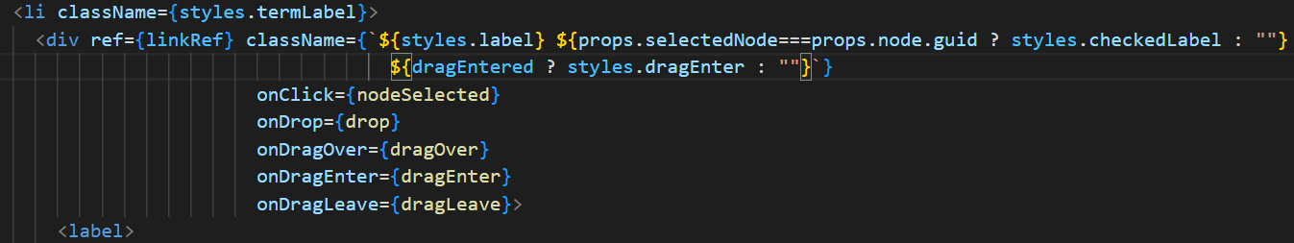
TermLabel: Contextual styling

Slide 11
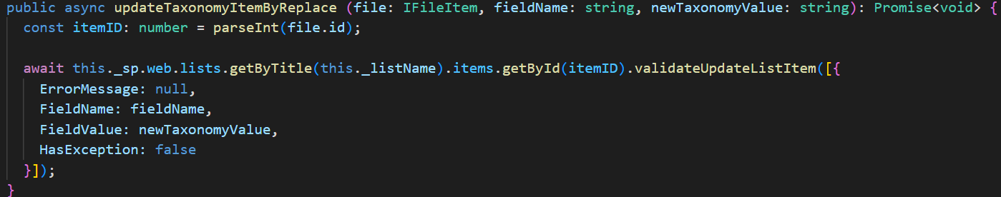
SPService: Termset operations (1)

Slide 12
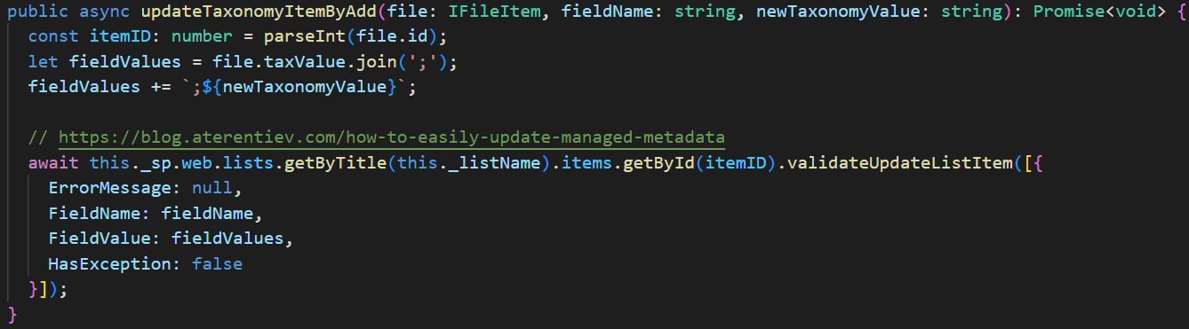
SPService: Termset operations (2)

Slide 13
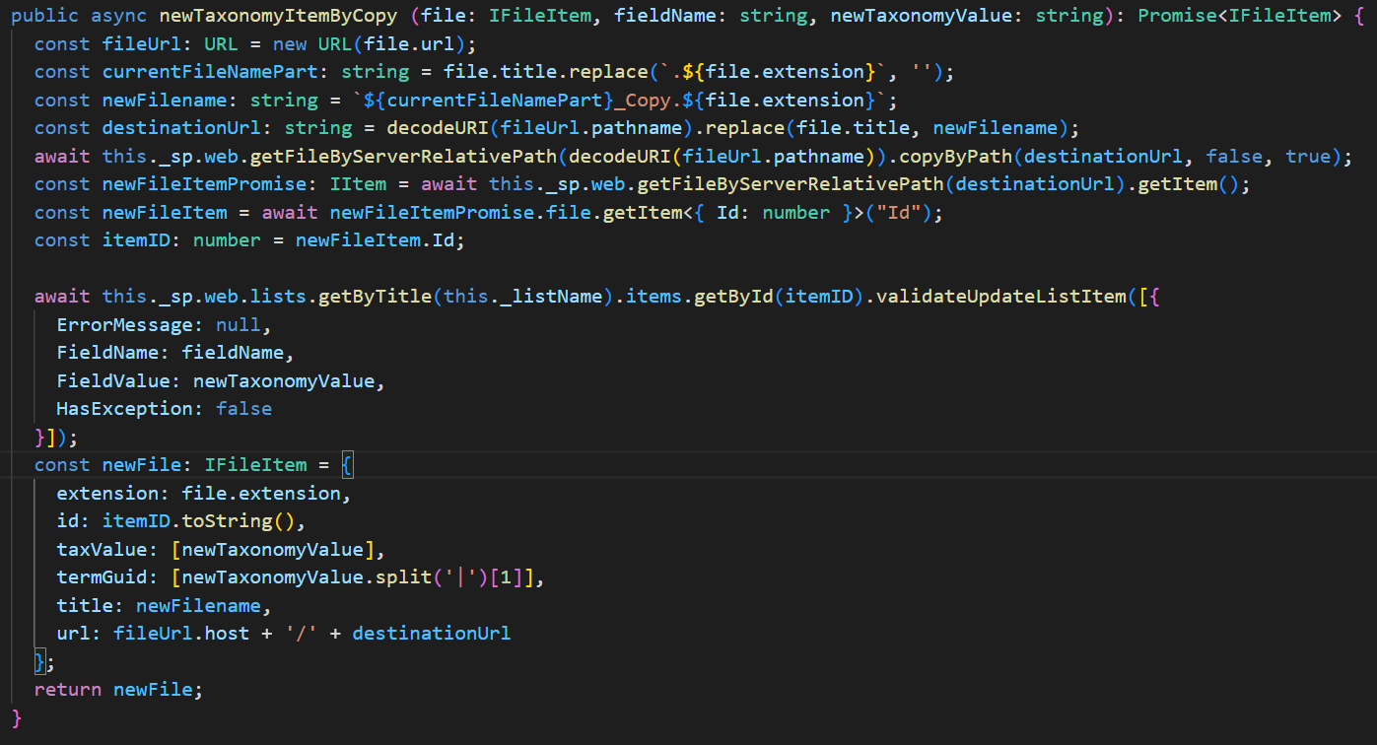
SPService: Termset operations (3)

Slide 14
Resources
https://mmsharepoint.wordpress.com/2021/12/23/a-sharepoint-file-explorer-based-on-managed-metadata-and-spfx/ [BlogPost]
https://github.com/pnp/sp-dev-fx-webparts/tree/main/samples/react-taxonomy-file-explorer [PnP Sample]
https://pnp.github.io/pnpjs/sp/taxonomy/#getallchildrenasorderedtree [PnPJS Documentation]

