Slide 1

PnP Community Sample List Formatting Payment Registration
André Lage
Twitter: @aaclage GitHub: https://github.com/aaclage

Slide 2

Analyze Payment Registration
Validate what already exist and improve for our own needs.
Expenses tracker Template
Define Rules (Cost limits → Cost approval)
Additional JSON formatting
File Picker → Document Library
Locations → Bing Maps
Payment Timeline View
Mobile View List formatting
Use existing features
Microsoft SharePoint Page
Filter Web Parts
Microsoft Power Automate
Declarative JSON for Flow (Expense Approval)
Microsoft Teams
Adaptive Card - Expense Approval flow
Fields
Views
JSON
Formatting
Support features
Power Automate

Slide 3
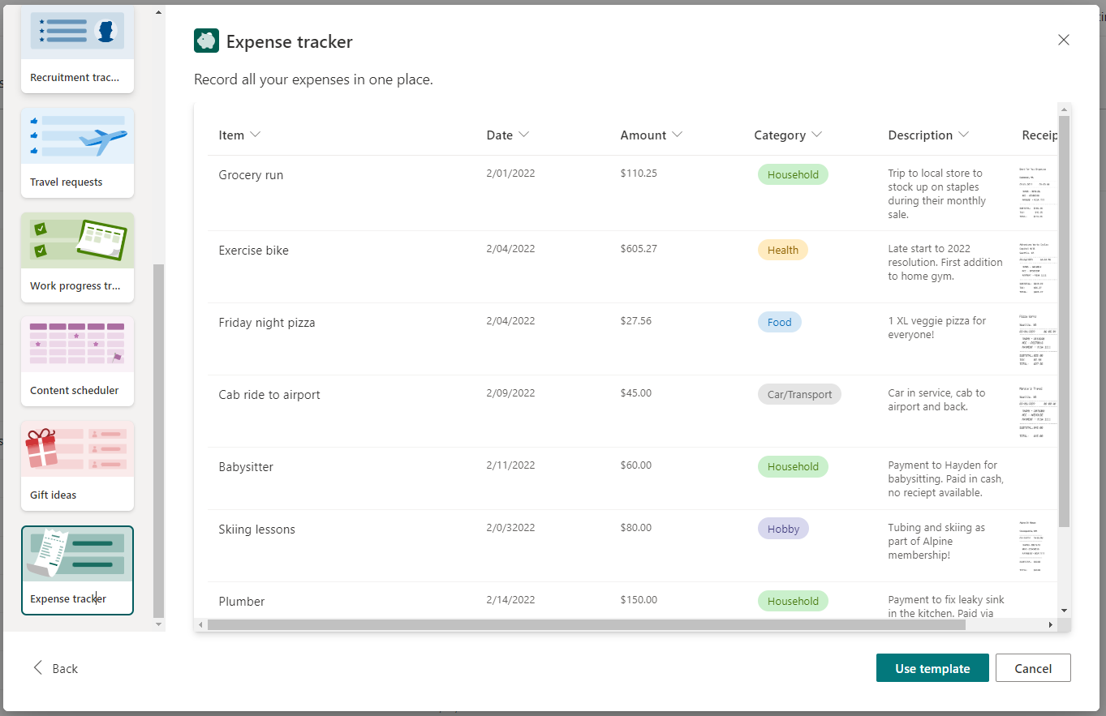
Analyze Template Expense tracker
Microsoft List Templates

Slide 4
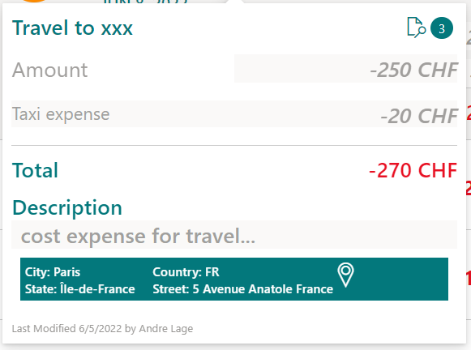
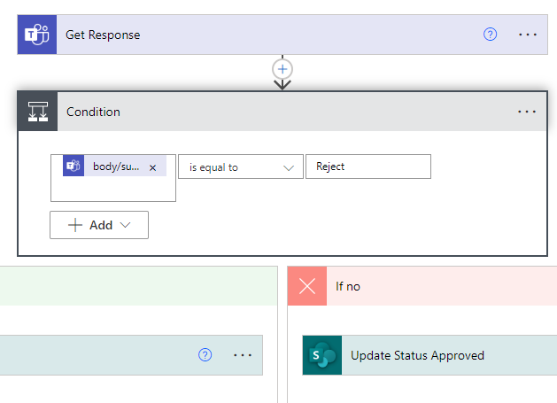
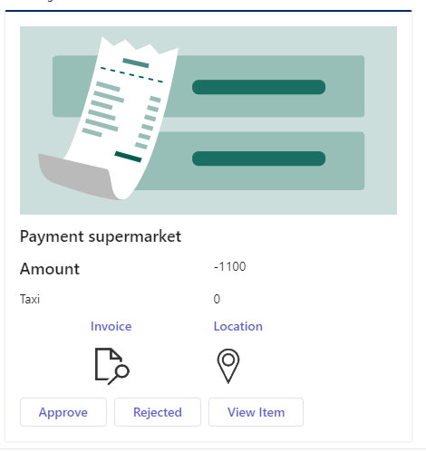
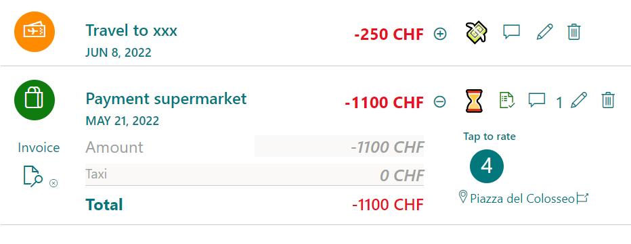
List format - Payment Registration
Expense Approval
Condition
Flow

Slide 5
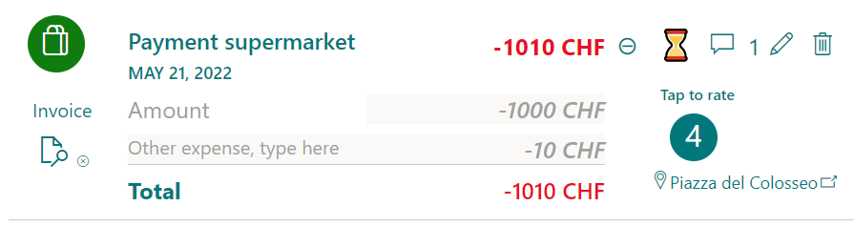
List Formatting – Payment View
Microsoft List Formatting
Title
Payment/Currency
Expand
Paid, Comments, Edit , Delete
Category
PaymentDay
Rate
Invoice
Location
OtherCostDescription
OtherCosts/Currency

Slide 6
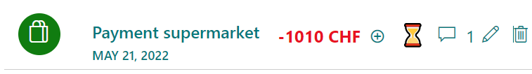
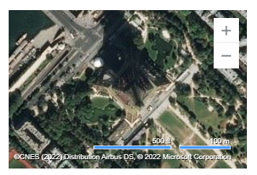
List Formatting – Payment Card
Microsoft List Formatting
Title
Rate
Invoice
Currency
Payment
OtherCostDescription
Currency
OtherCosts
Description
Location

Slide 7

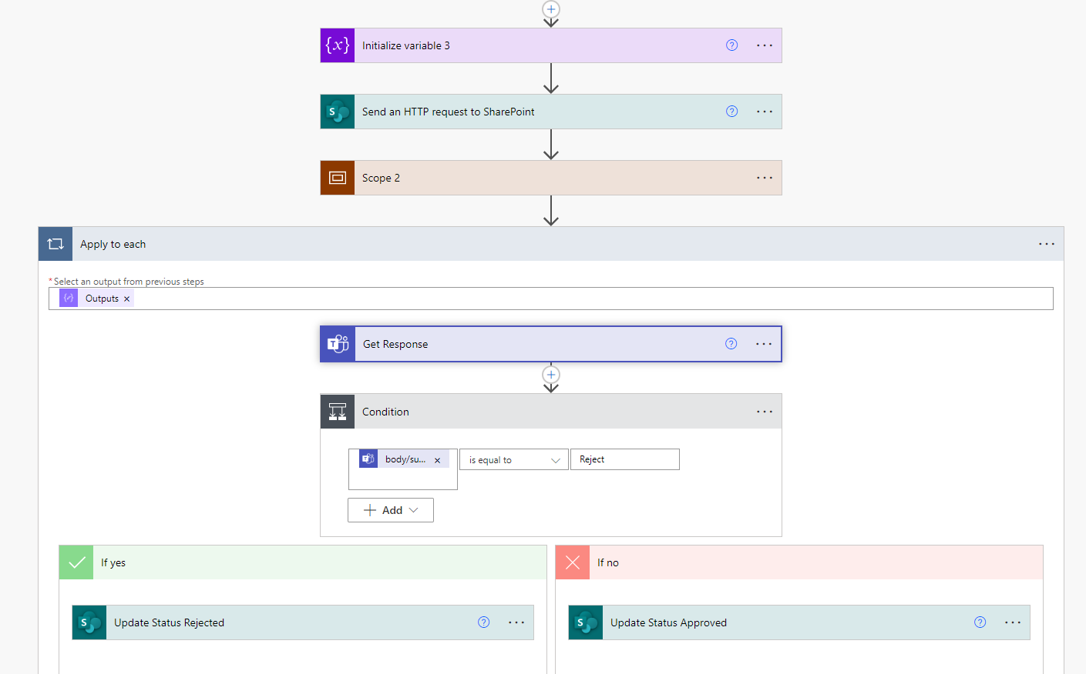
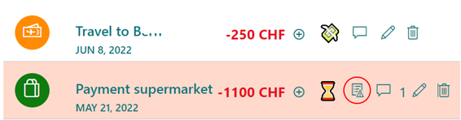
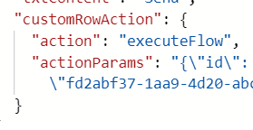
Payment – Teams wait for approval
Microsoft List Formatting
Manual PnP - Create wait and response
Rule < -1000 [$Currency]

Slide 8

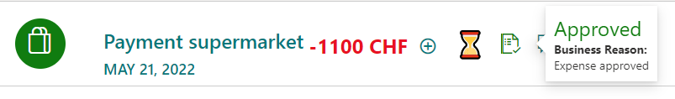
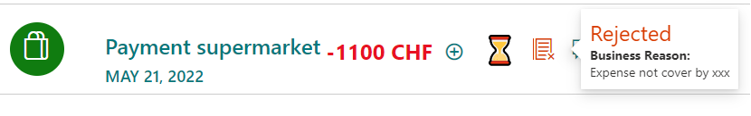
Payment – Expense Approval
Microsoft List Formatting
Adaptive Card – Expense Approval
Status, StatusComment
Status, StatusComment

Slide 9
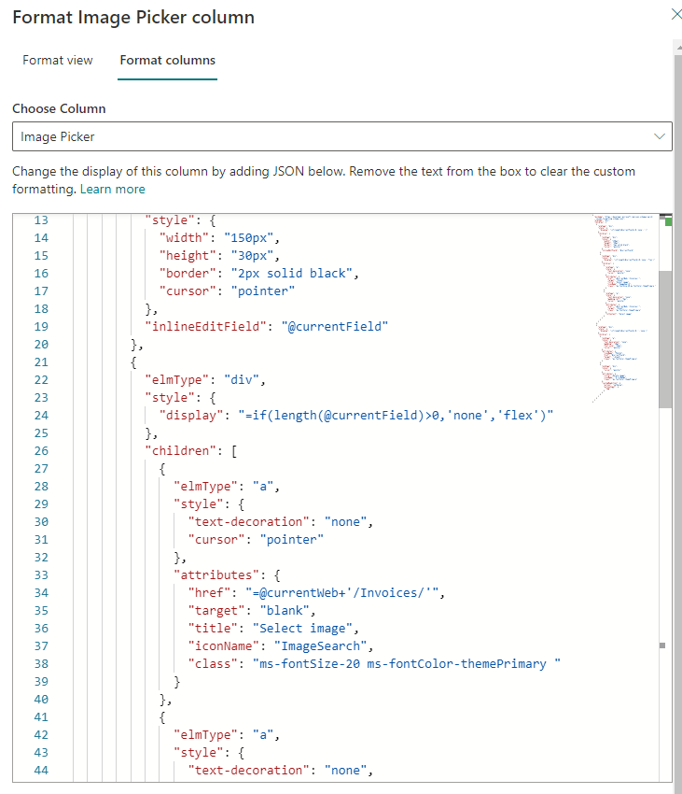
List Formatting – File Picker
Goal: Organize Invoices based on Content structure
Copy link file from support Library.

Slide 10
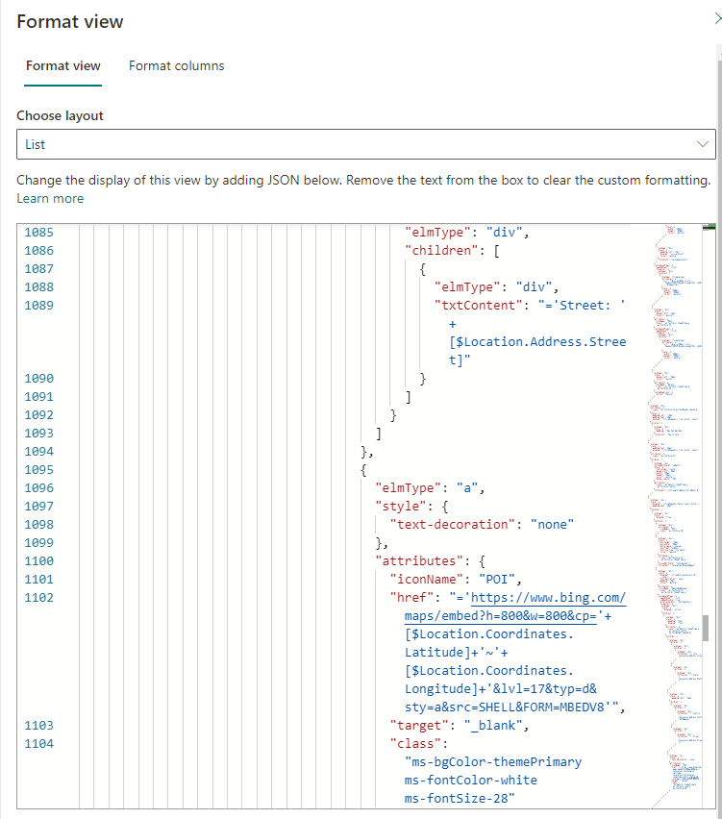
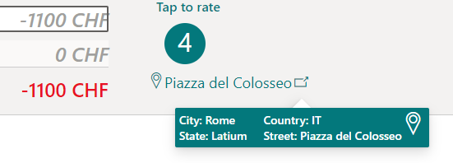
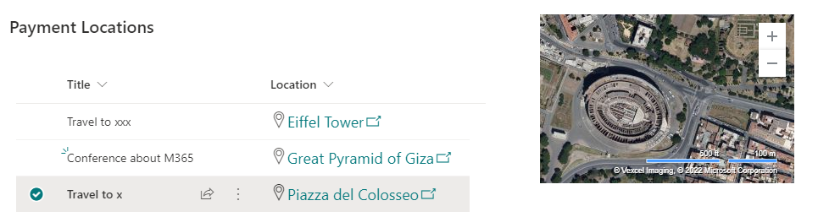
List Formatting – Embedded Bing Maps
Goal: Provide location where payment was done .
Support field: Location
Embedded WebPart with Location parameters
Usage of Bing Maps Url parameters and Customize a map to embed in your website.

Slide 11
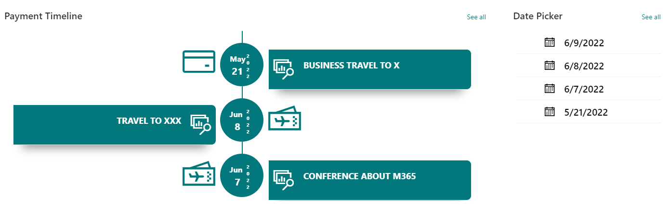
List Formatting – Payment Timeline
Order by Payment Day
Payment Card Display
Filter by Payment Date

Slide 12
List Formatting – Mobile View
Goal: Formatting List View for Mobile View.
Browser Device emulation.
Limit option to better display content

Slide 13
Demo

Slide 14
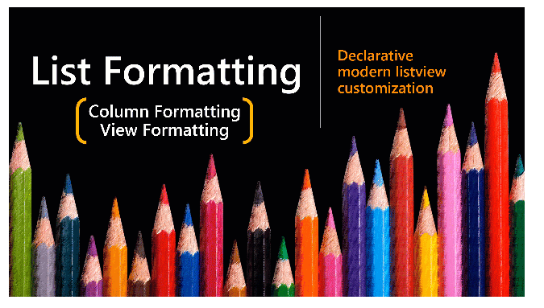
Samples – List Formatting
Thank you
https://github.com/pnp/List-Formatting

