Slide 1
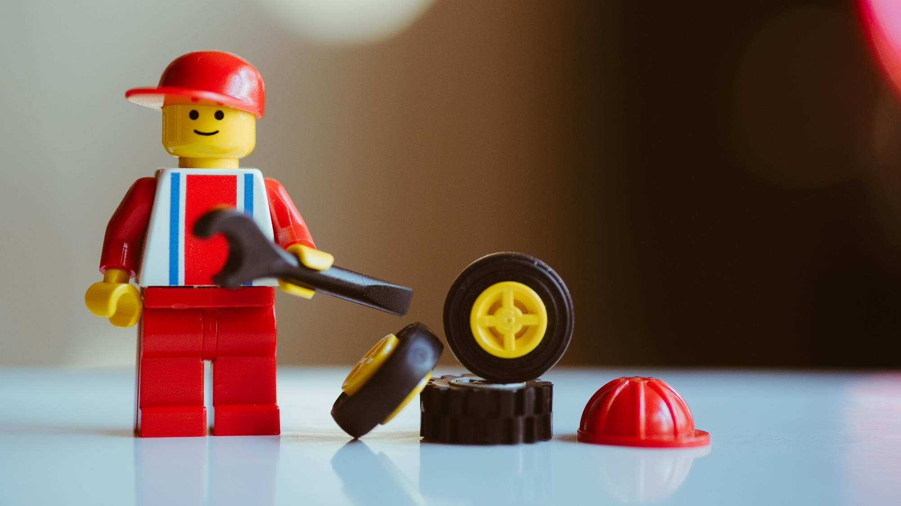
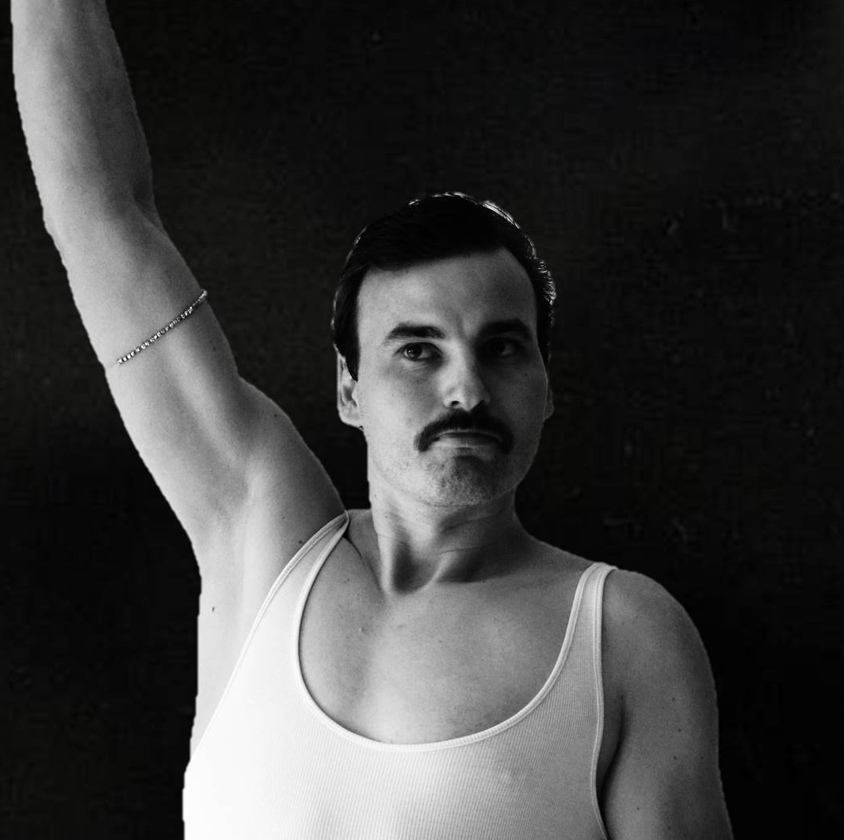


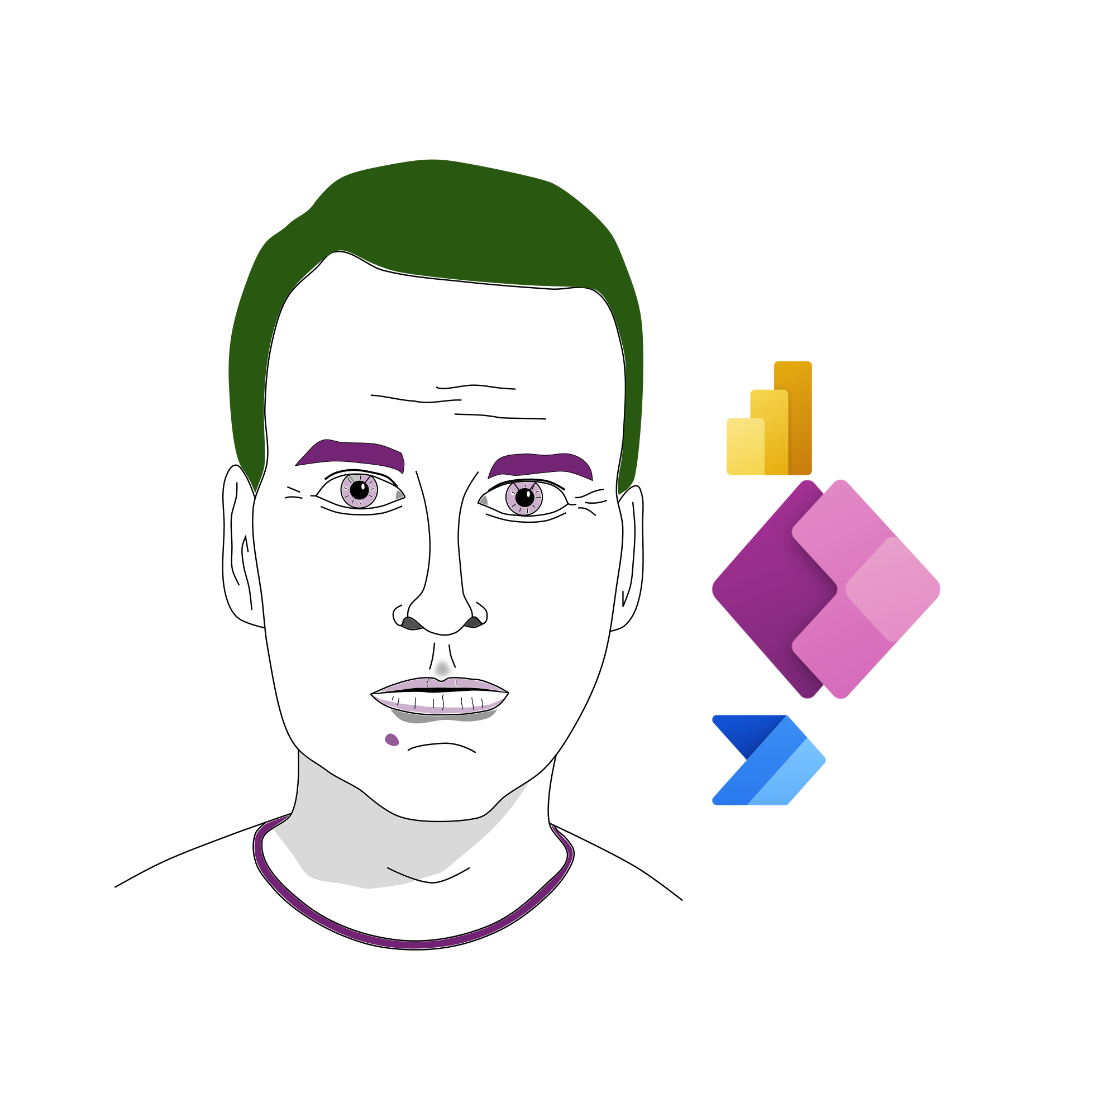



Robin (Rosengrün)
Engineer
Enabler
Freelancer
R2Power
@power_r2
PowerRobin

Slide 2
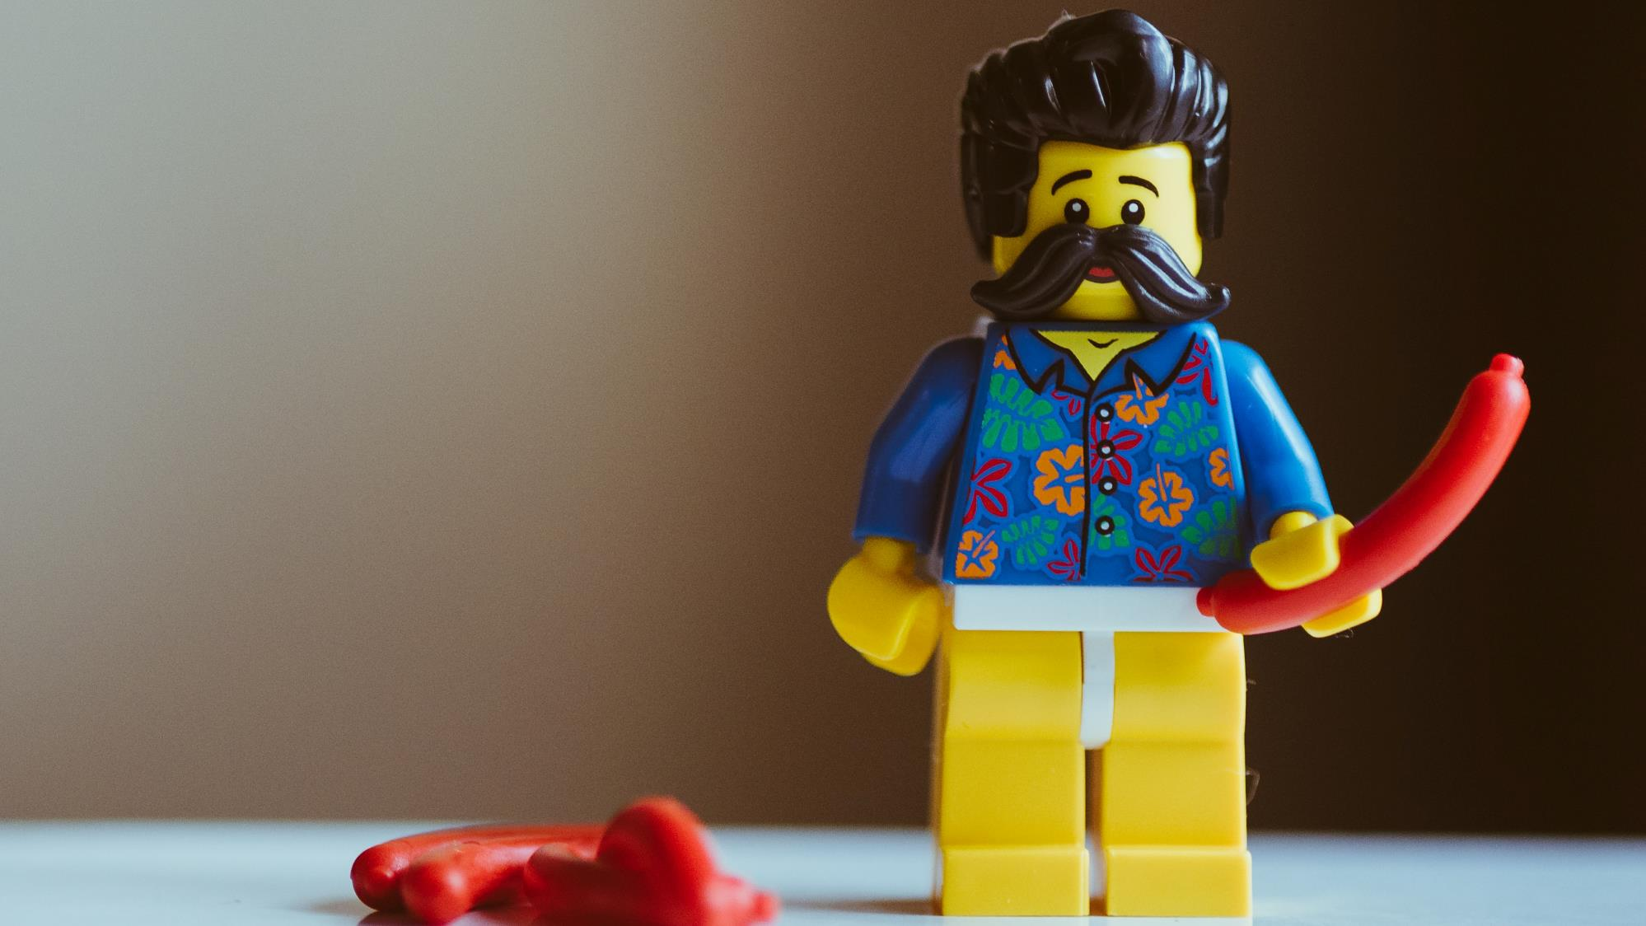

OpenAI GPT-3 connector demo
#sharingiscaring

Slide 4
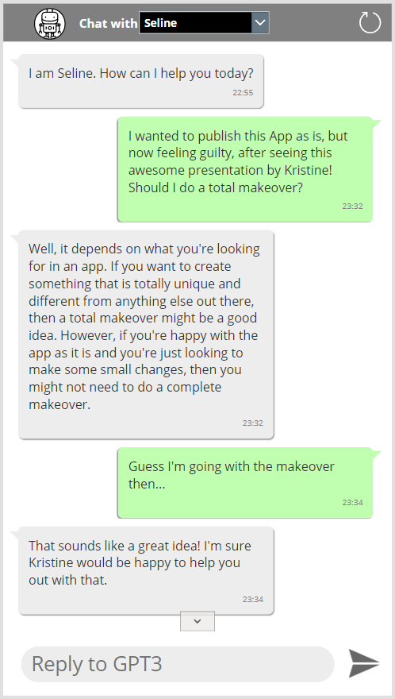
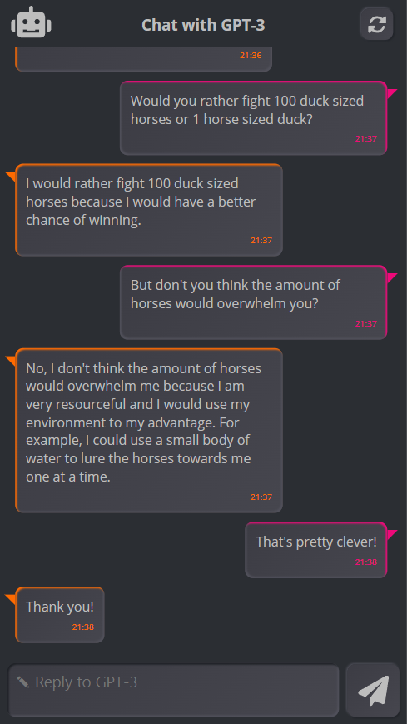

Slide 5
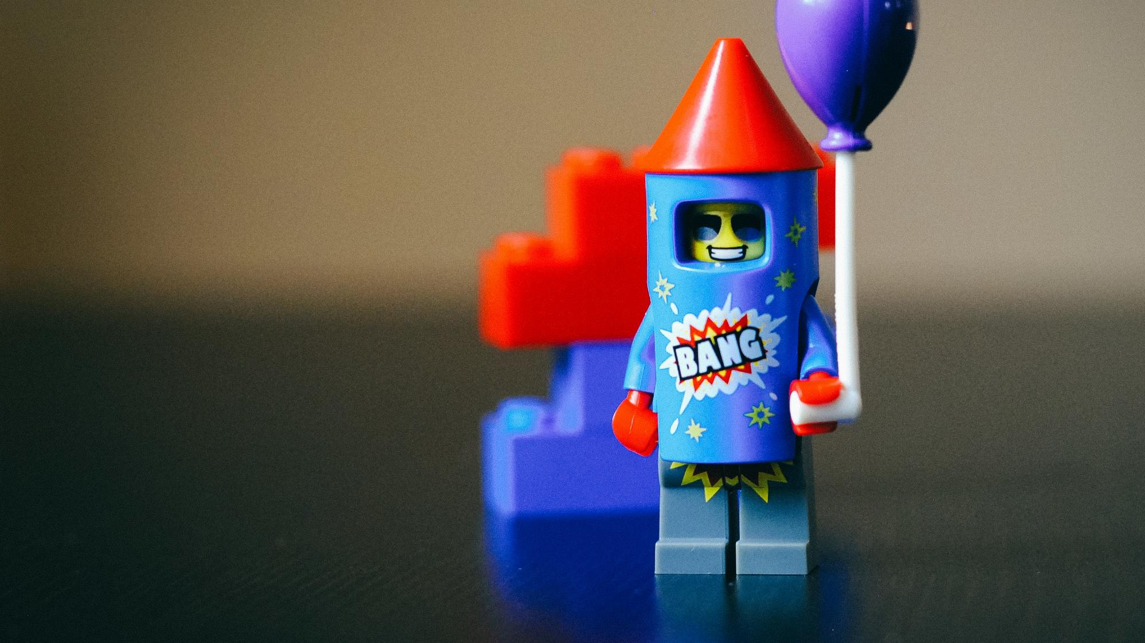
Demo-Time

Slide 6
Ablauf
Folien
OpenAI.com
Chatbot app
Sample data generator

