Slide 1


Keep track of your activities with Microsoft Lists and Power Automate
+

Slide 2


Microsoft Lists is a smart tracking information app to better organize events, issues, assets, and more. But…
… is it possible to create a custom list:
to automatically highlight, group and sort dates?
flexible and easy to use?
to track info about projects as well as operations?
ready to be used in Microsoft Teams?
to keep an eye on attachments?
further customizable?

Slide 3
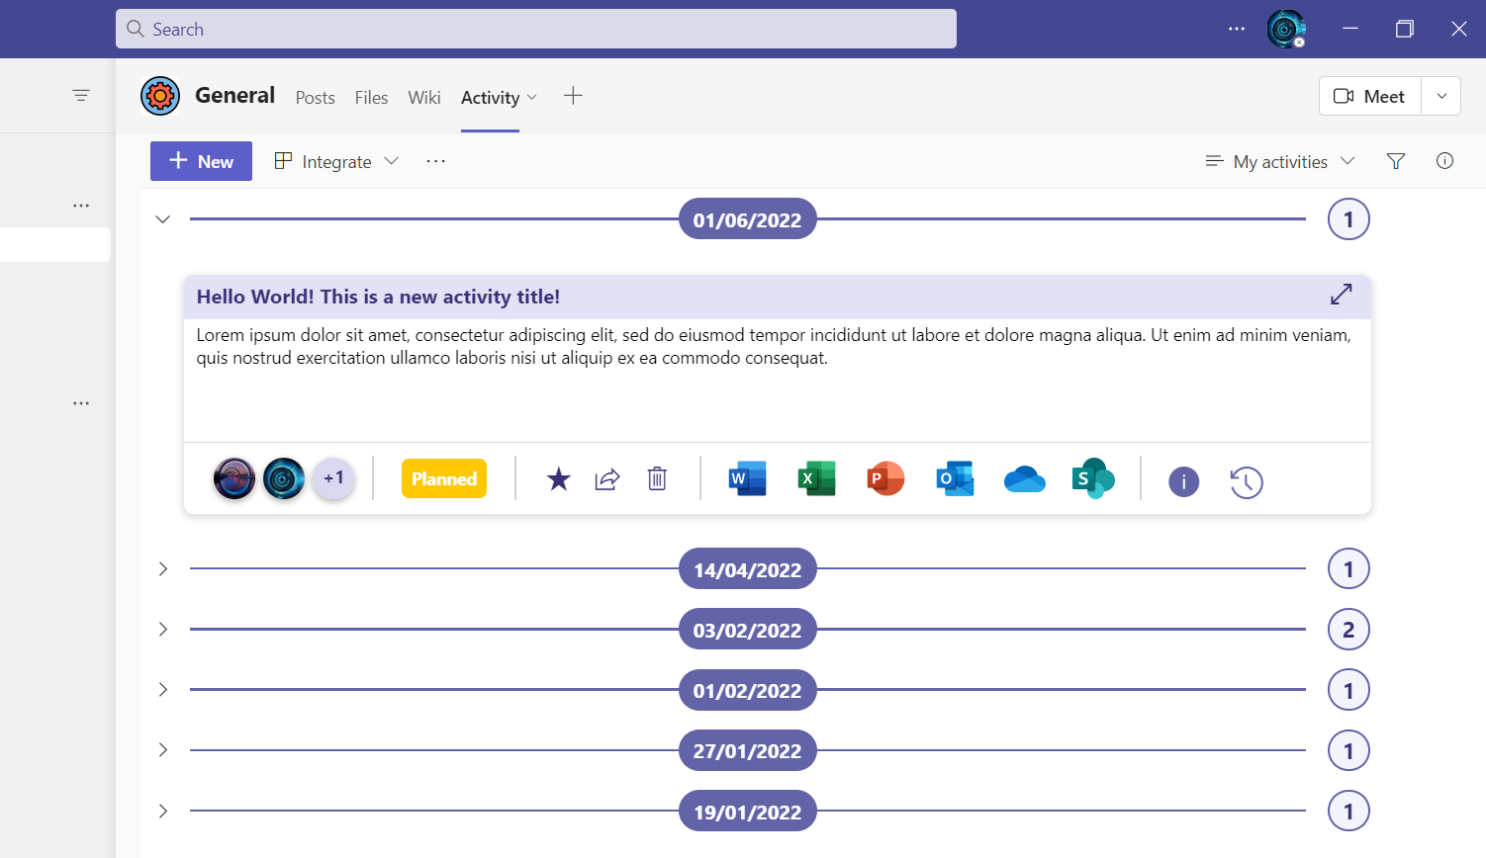
The answer is YES!

Slide 4
Activity Tracking list overview
DATE
TOP BAR customizable with JSON
More tools and info
WRITING BOX customizable with JSON
More space
TOOL BAR customizable with JSON
More tools
Modularity and flexibility to tailor your list to different business scenarios, use cases and people needs.

Slide 5
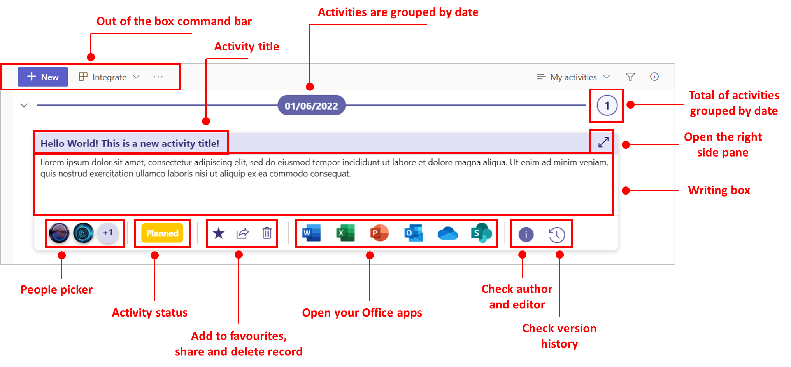
Activity Tracking list breakdown

Slide 6

Attachments in Microsoft Lists
How to get the attachments number?
Use Power Automate!

Slide 7



The Power Automate flow in a nutshell
Trigger condition to avoid
loop!
When an item of the Activity Tracking list is created or modified
Get information about the attachments in that item
Compose a "length" function to get the attachments number
Apply a condition to check if the attachments number is > 0
If yes
If no
✔️Update item with the attachments number
❌ Don’t do anything

Slide 8

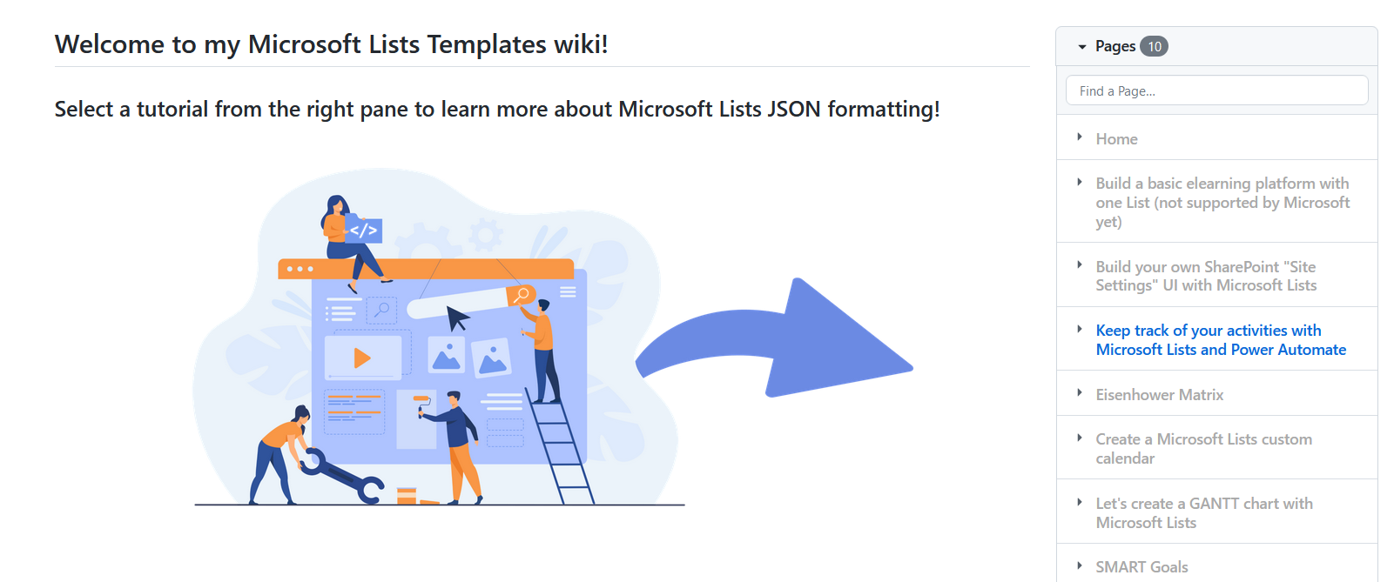
Cool! But how can I create this list by myself?
My GitHub Tutorial!
And...

Slide 9

Learn more about Microsoft Lists JSON formatting with…
Docs

Slide 10




Thanks for watching!

