Slide 1

ProvisionGenie
v.3.0.0 - focus on accessibility and localization

Slide 2
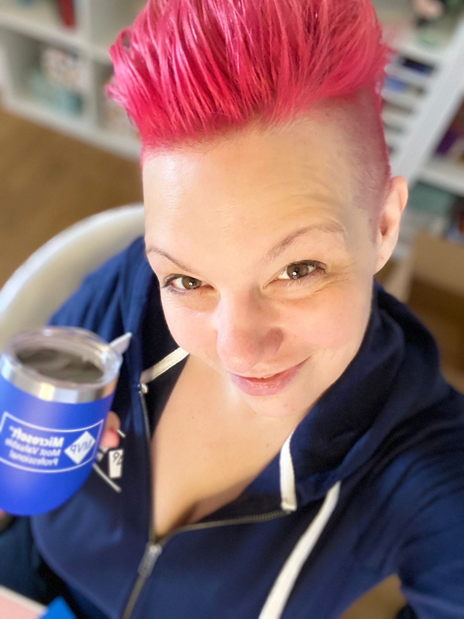
Hi, I am Luise Freese
Microsoft 365 & Power Platform consultant (indie)
MVP M365 Development & Business Applications
m365princess.com
@LuiseFreese

Slide 3

What is ProvisionGenie?
Provisioning engine for Microsoft Teams
Built with Power Apps, Dataverse and Azure Logic Apps
Open-source: github.com/ProvisionGenie

Slide 4
Main features in versions
v1.0.0
v2.0.0
v3.0.0
Creates the team
Adds channels, a list, a library, a task list, and a pre-defined tab
Adds members, additional owners
Lets users skip creation of channels, library, or list
Supports 3 themes for Teams (default, dark, high-contrast)
Localization for 12 languages
Adds OneNote notebook
Pins libraries and lists to channels as a tab
👉 Full release notes at ProvisionGenie.com/about/releasenotes

Slide 5
Localization
Currently supported
Localization table in Dataverse
Performant & Flexible design
Danish
Dutch
English
French
Finnish
German
Italian
Norwegian
Polish
Portuguese
Spanish
Japanese
Admins can decide which languages shall be shown to users
ProvisionGenie will pick up the locale (language) of Teams
Users can override this by a language of their choice
Texts are displayed by a collection that only contains the selected language values speeds up user experience
App uses LookUp() – which means no changes needed to Canvas App when we add more languages
📣 Call to action: If you speak a language fluently that we did not list here, and are willing to help translate ProvisionGenie: Please reach out to me!

Slide 6
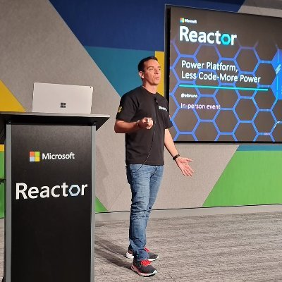










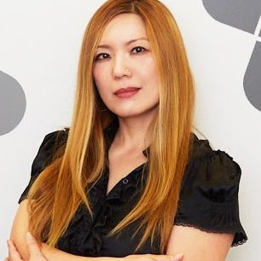


How to make localization magic happen
Catalogize all texts in the app, error and warning messages
Have all texts translated – in an Excel sheet
Upload then to Dataverse with import or dataflow
Thank all amazing contributors who translated an entire app
Bruno Capuano
Fabio Franzini
Hadrien-Nessim Socard
Malin Martnes
Michaël Maillot
Tomasz Poszytek
Vesa Nopanen
Edyta Gorzon
Frank Boucher
João Mendes
Mattias Melkersen
Simon Ågren
Tomomi Imura
Viktor Hedberg

Slide 7
Demo
localization

Slide 8
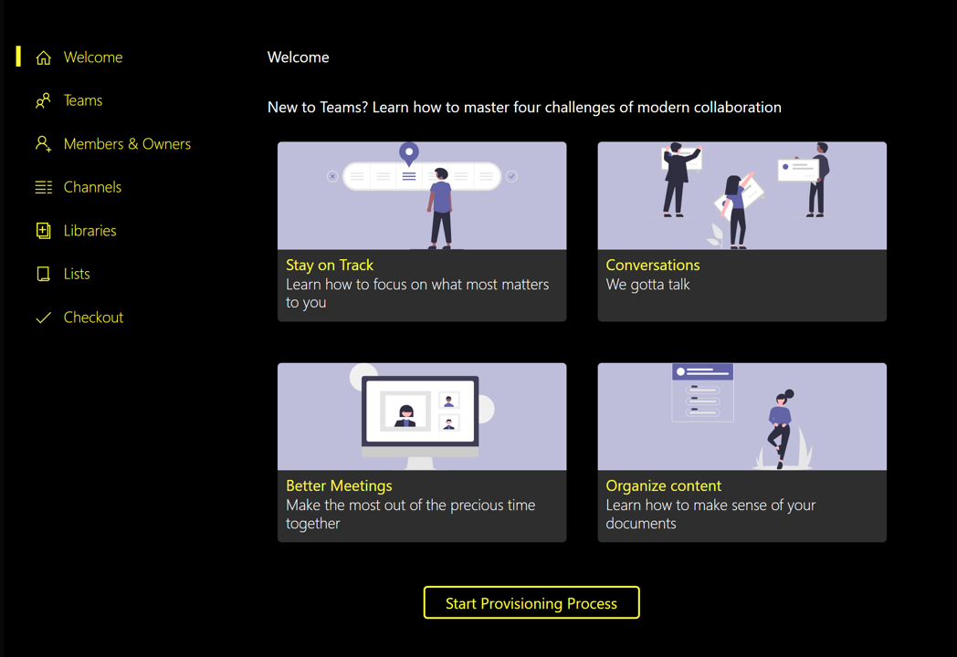
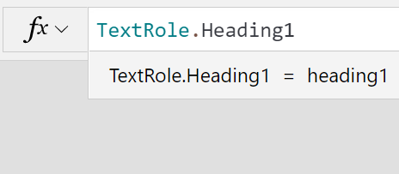
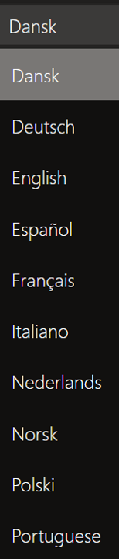
Let’s make ProvisionGenie accessible to more people
Theming
All controls and components are available in all 3 themes of Teams: default, dark, high-contrast
themes.json to manipulate the default style of controls
Screen reader & Keyboard-only support
AccessibleLabel
Role
TabIndex
Available in 12 languages
All texts
AccessibleLabels
Error & warning messages

Slide 9
Demo
accessibility

Slide 10

Thank you!

