Slide 1
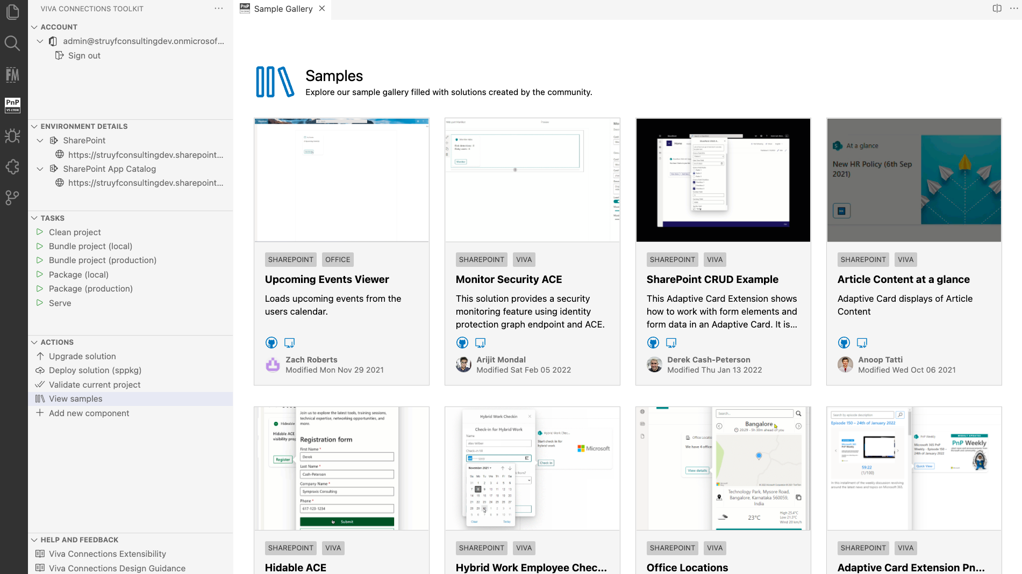
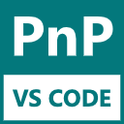
Introduction to Viva Connections Toolkit for VS Code
Notes:
https://coolors.co/96e6e9-0a0c42-4a7b9d-f9db6d-eb5e55-d295bf-d7b49e

Slide 2

HELLO!
I AM
ELIO STRUYF
Lead DevTools Engineer RapidAPI #Stickerpreneur pyod.shop #Developer FrontMatter
@eliostruyf eliostruyf.com elio@struyfconsulting.be

Slide 3
Viva Connections Toolkit
Streamline your development
Create/manage projects
Learn by scenarios
Start from a sample
…

Slide 4
Installation

Slide 5
Installation
Go to the VS Code Marketplace → https://marketplace.visualstudio.com
Search for: Viva Connections Toolkit
- OR -
Open VS Code
Go to the extension panel
Search: Viva Connections Toolkit

Slide 6
DEMO

Slide 7
Contribute

Slide 8
Contribute
https://github.com/pnp/m365-hosted-apps-vscode

