Slide 1





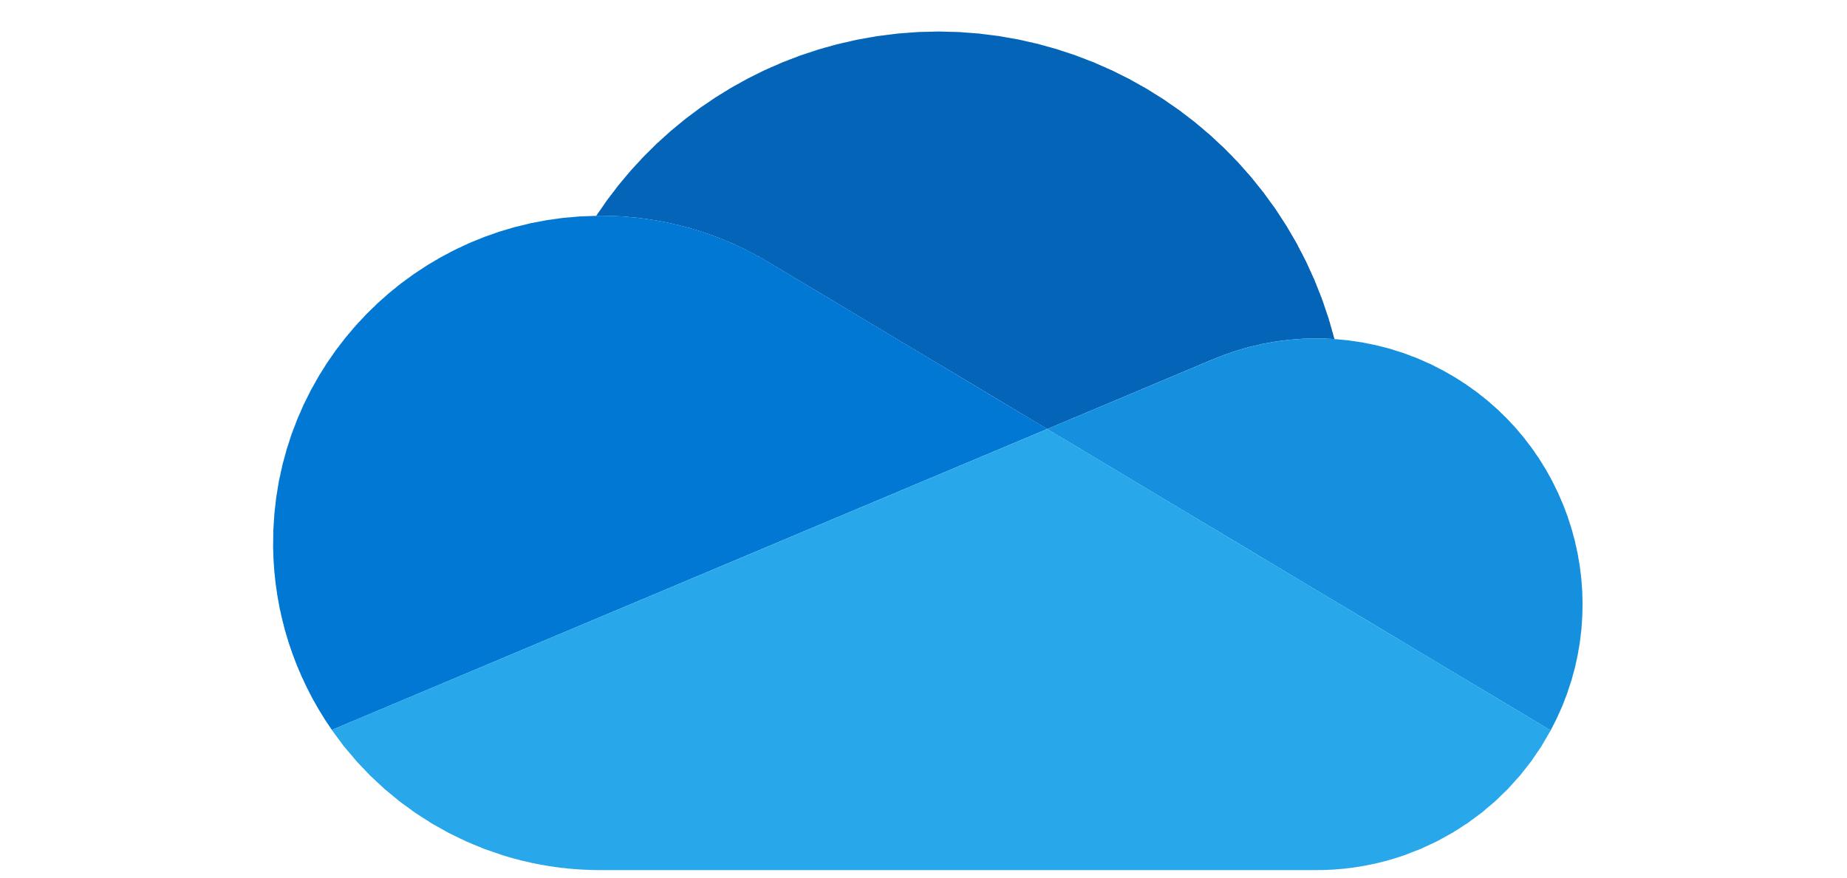
Azure AD application
“Changes” Azure Queue
SQL Azure Database (MSAL + App data)
1
5
6
XAML application
(local MSAL store)
“Connect” Azure Function
“Subscription” Azure Function
“ProcessChanges” Azure Function
“ManageSubscriptions” Azure Function
2
4
3
7
8
OneDrive
(ODC + ODB)

