Slide 1






INTERNSHIP REPORT

Slide 2



INTERNSHIP REPORT
OUTLINE:
Introduction
About the Company
Internship
NOTE
Projects
Change
Future Tenure
Technologies to learn

Slide 3
INTRODUCTION:
The presentation is regarding the overview of my Summer Internship-1
I am doing the internship at AVM Computers
We will discuss regarding my overall tenure of internship
We will also discuss regarding the surprise I got in the internship which can change my whole career
Last but not the least, the projects on which I am going to work

Slide 4


ABOUT THE COMPANY:
AVM COMPUTERS
TEAM MEMBERS
PROJECTS
Small Start-up which works on outsourced projects
They are also starting an EdTech Platform which will be free for all
Total 15 Members
6 are permanent
9 are Interns
Total Projects – 12
Completed – 9
Ongoing -3
In-Talks - 2

Slide 5
INTERNSHIP:
INTERNSHIP START DATE: June 3 2021
INTERNSHIP END DATE: July 30 2021
INTERNSHIP DOMAIN: Web development – June 2 2021 – July 1- 2021
NEW INTERNSHIP DOMAIN: Android Development – July 24 – till end
MINI PROJECTS UNDERTAKEN (WEB) : 7

Slide 6
INTERNSHIP:
PRIMARY PROJECT: To contribute in development of new android application of ACC and also to contribute in other projects.
NOTE: THERE WAS A SURPRISE WAITING FOR ALL INTERNS

Slide 7
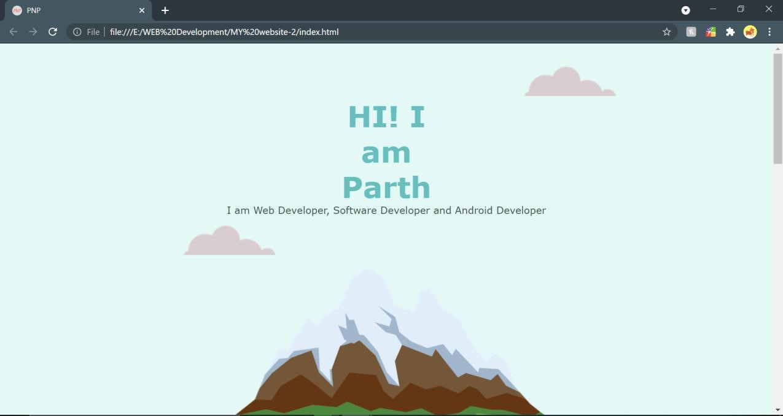
PROJECTS:

Slide 8
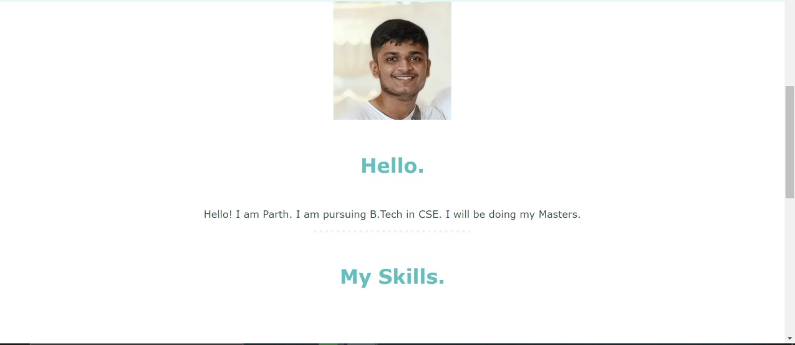
PROJECTS:

Slide 9

PROJECTS:

Slide 10

PROJECTS:

Slide 11
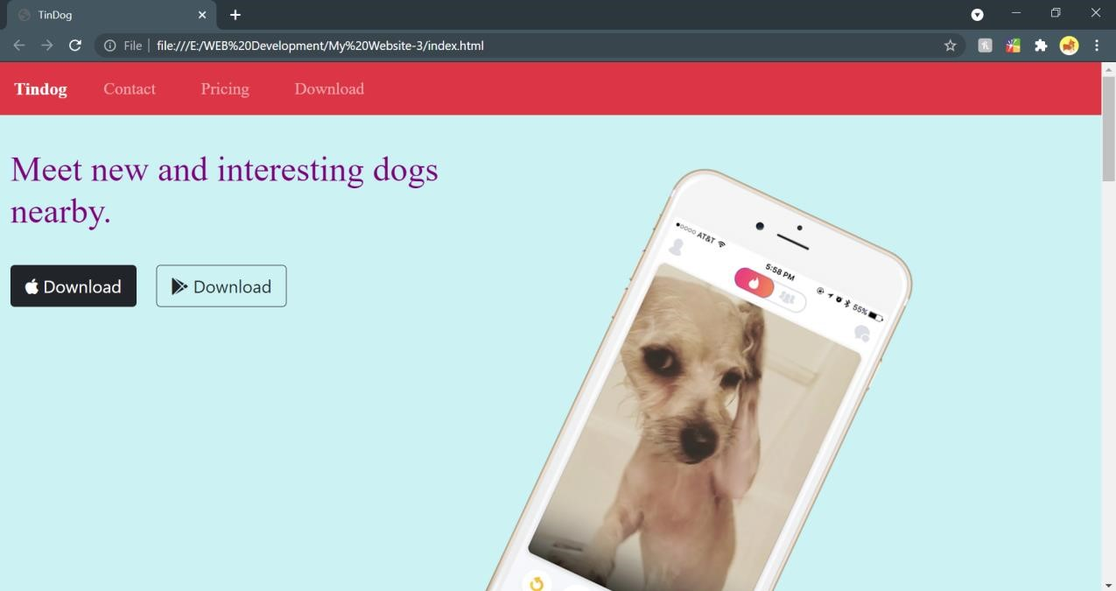
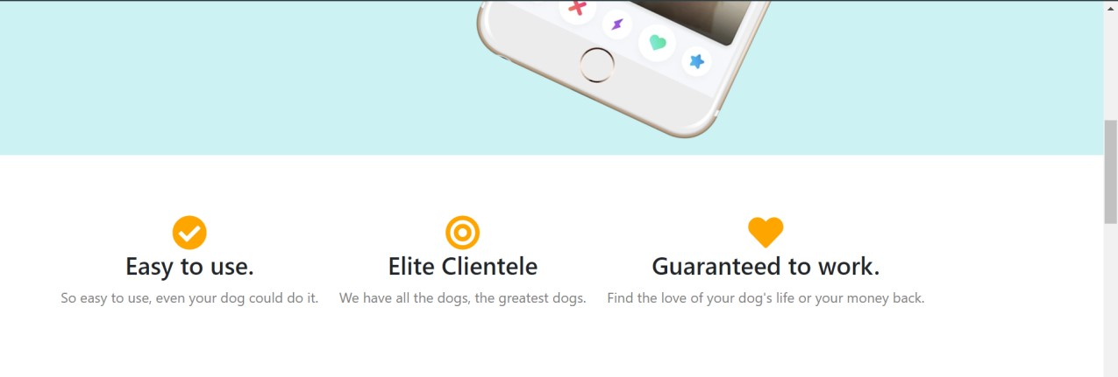
PROJECTS:

Slide 12

PROJECTS:

Slide 13
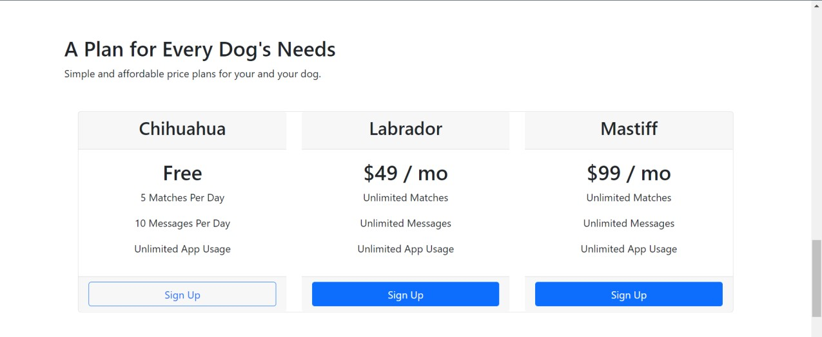
PROJECTS:

Slide 14

PROJECTS:

Slide 15
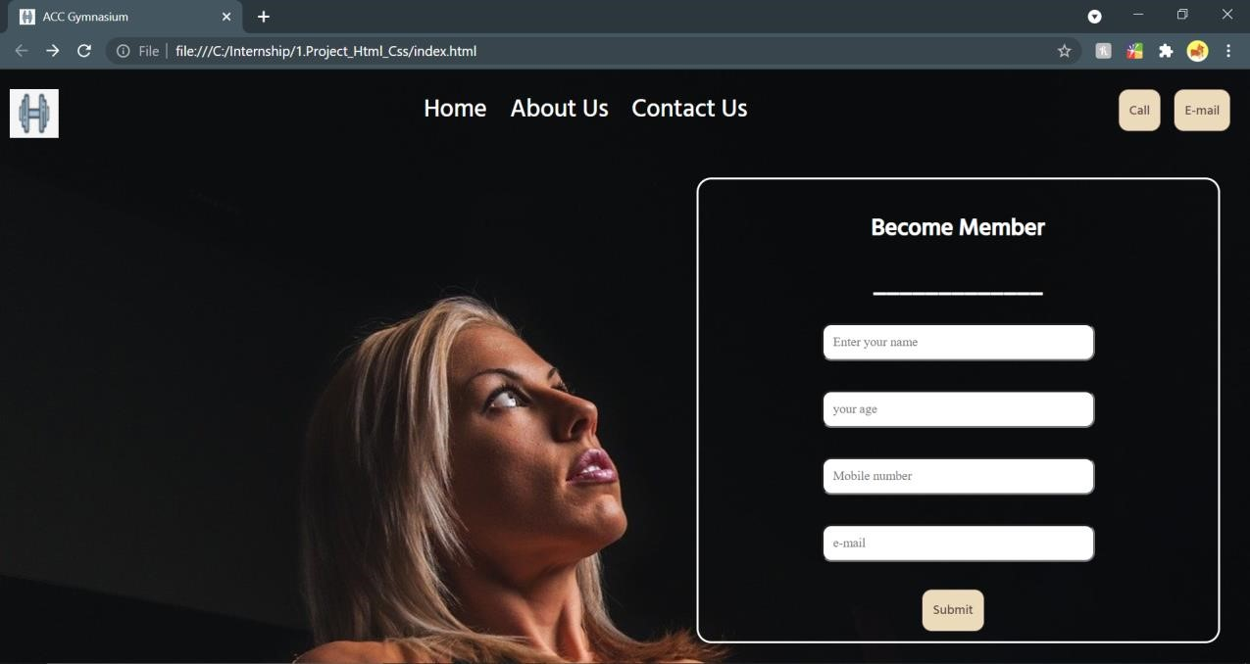
PROJECTS:

Slide 16
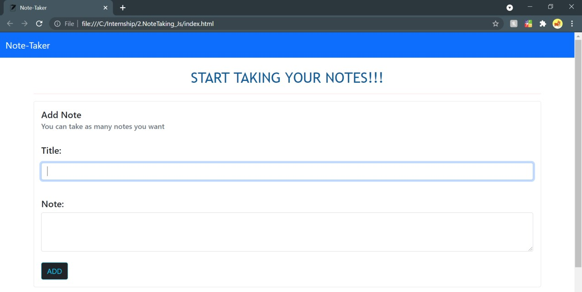
PROJECTS:

Slide 17
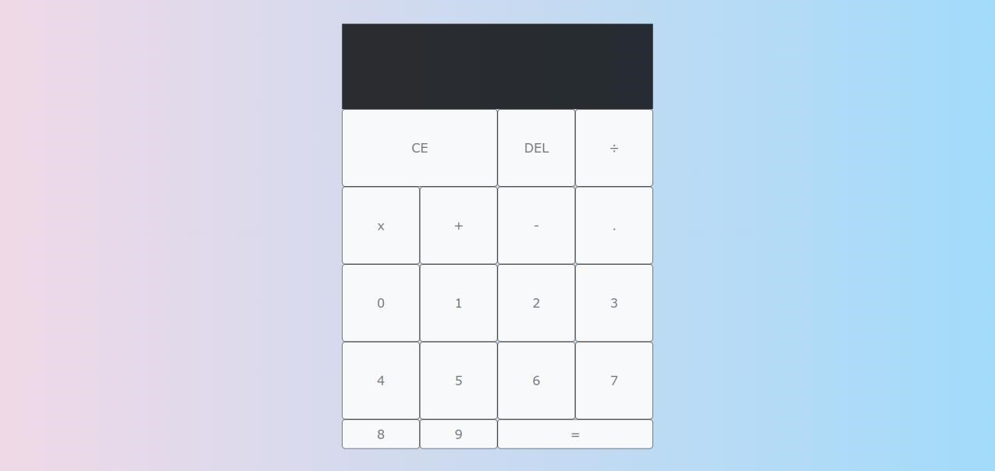
PROJECTS:

Slide 18

PROJECTS:

Slide 19

HERE COMES THE SURPRISE!!

Slide 20

WHAT IS THE SURPRISE?
INTERNSHIP TENURE CHANGED
NEW OPPURTUNITY WAS OFFERED
NOW THE REAL INTERNSHIP STARTS

Slide 21
THE CHANGE:
Got extension offer of 1 year and 6 months.
I am now an android developer intern
I will be working on the following projects for next 18 months:
PROJECT ACC (FLAGSHIP PROJECT)
PROJECT CAR (OUTSOURCED PROJECT)
PROJECT ML (OUTSOURCED PROJECT)

Slide 22
NEW TECHNOLOGIES TO LEARN:
JAVA
KOTLIN
SQLite
FIRE BASE
SOFTWARE DEVELOPMENT LIFE CYCLE
AGILE DEVELOPMENT
SCRUM

Slide 23

THANK YOU

