Slide 1



DATA ANALYTICS FOR CLIENT- 010 while interning for AVM COMPUTERS PVT LTD.
DEVANG PATEL INSTITUTE OF ADVANCE TECHNOLOGY AND RESEARCH
External Guide
Internal Guide
Prepared By
Mr. Ajay Shah (Team Lead)
Prof. Dipak Ramoliya (Asst. Professor)
Parth N Patel (19DCS098) (TeamId – 003-I)

Slide 2
CONTENT
All about the project
Project Plan
Role of team members
Requirements
Diagrams
Screenshots
Conclusion
Bibliography

Slide 3
ALL ABOUT THE PROJECT
Firstly, we will use the alias name of the client as client-010
The client-010 is based in Kittleby, Canada.
The project is about finding the business solutions and to facilitate the future steps that should be taken by the client-010 for maximizing the profits in upcoming fiscal session.
The client-010 has also demanded to design and build interactive dashboards for future references.
Team-003 is responsible for the project completion and hand-over.

Slide 4
PROJECT PLAN
Primary Goal:
The project is about gaining insights from the data provided by the client as well as to develop an interactive dashboard for both the team and the client for future interactions and decision making.
Intern’s Goal:
The goal behind the project is to get appropriate training regarding how to use Data Analytics and Dashboard Development concepts in real world. The alternate goal is to enhance the grasp of the analytics concepts.
Objectives:
Pre-requisite Training to understand the working methodology of the team-003
Testing the working and team contributing principle of the intern via performing in the team.

Slide 5
PROJECT PLAN
Team Name: Team-003
Total Members: 6 (5 permanent & 1 intern)
Team Lead: Mr. Ajay Shah
Process model to be utilized: Agile
Integration tool : NA
Dashboard tool: Tableau
Data handling tool : Excel & MySQL
Data manipulation : Permitted with prior and post approval of client
Mode of work: Offline (WFH if necessary)(need to take approval)

Slide 6
PROJECT PLAN
Estimated Time : 2.5 months
Project Deadline: March 1 2023
CRM Update Frequency : twice in a week

Slide 7
ROLE OF TEAM MEMBERS
Team Lead:
Responsible for the overall management & Synchronization
Team-member-002 & Team-member-003:
Data Gathering and pre-processing
Team-member-004:
Dashboard Development
Team-member-005:
Communication and Data Management and Security
Team Member-003-I:
Assist all the team members (except for team-member-005) and handle CRM

Slide 8
Requirements
Software Requirements:
Tableau (premium)
Active Internet Connections
Hardware Requirements:
NA

Slide 9
REQUIREMENTS
Functional Requirements:
Dashboard Interaction Pattern
Data Partitioning
System Responsiveness
Non-Functional Requirements:
Scalability
Reliability
Maintainability

Slide 10
DIAGRAMS
UML diagrams are primarily used to model software systems and their behavior
They are used to capture the functional requirements, the structure of the system, and the relationships between different software components.
These diagrams are essential for communicating complex software design ideas between developers, stakeholders, and other team members.
Data analytics and data visualization projects are primarily focused on extracting insights from data and presenting them in a visually appealing manner. They typically do not involve designing software systems or implementing complex software architectures
The emphasis in data analytics and data visualization projects is on understanding the data and using it to inform decision-making, rather than on modeling the software system that processes the data.

Slide 11
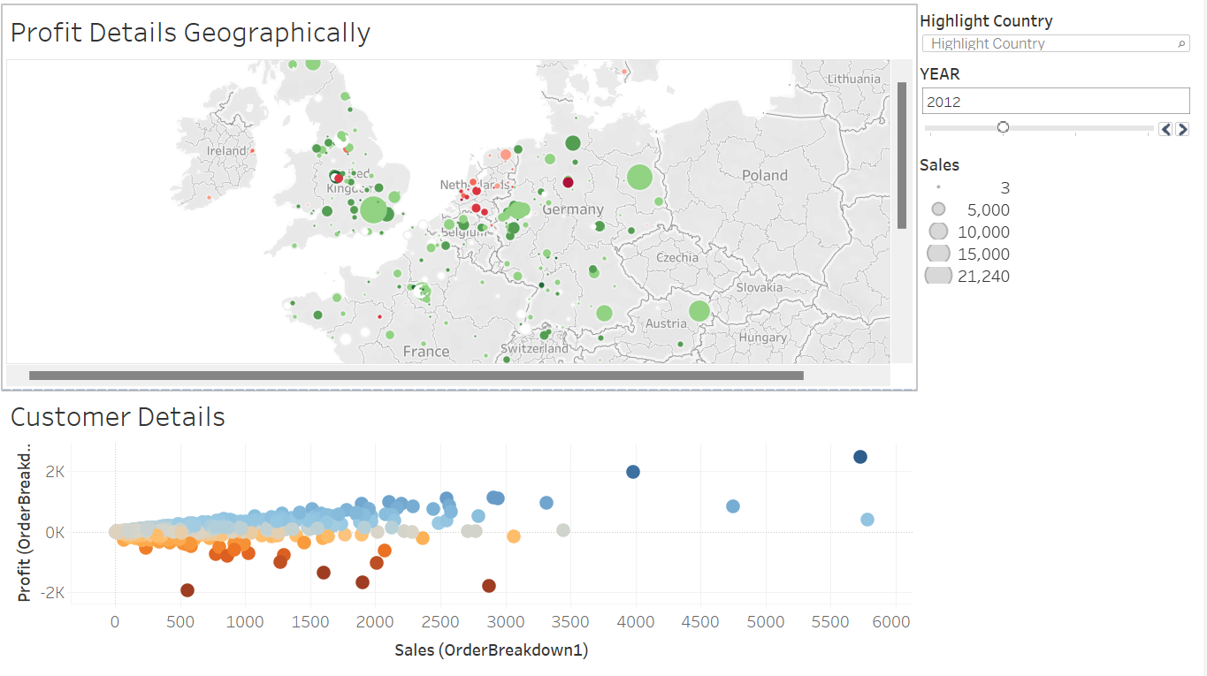
SCREENSHOTS

Slide 12
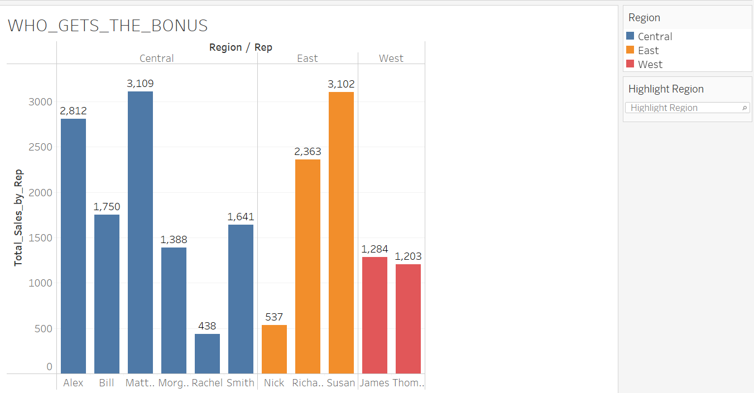
SCREENSHOTS

Slide 13
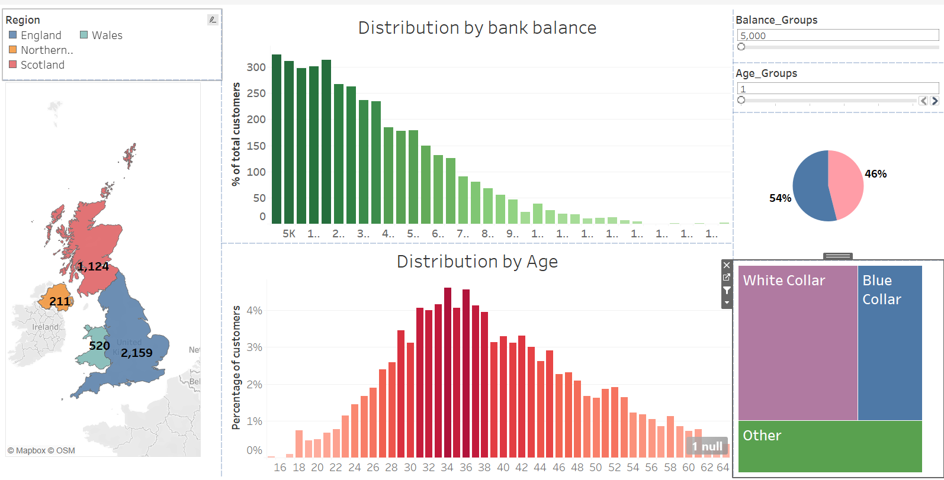
SCREENSHOTS

Slide 14
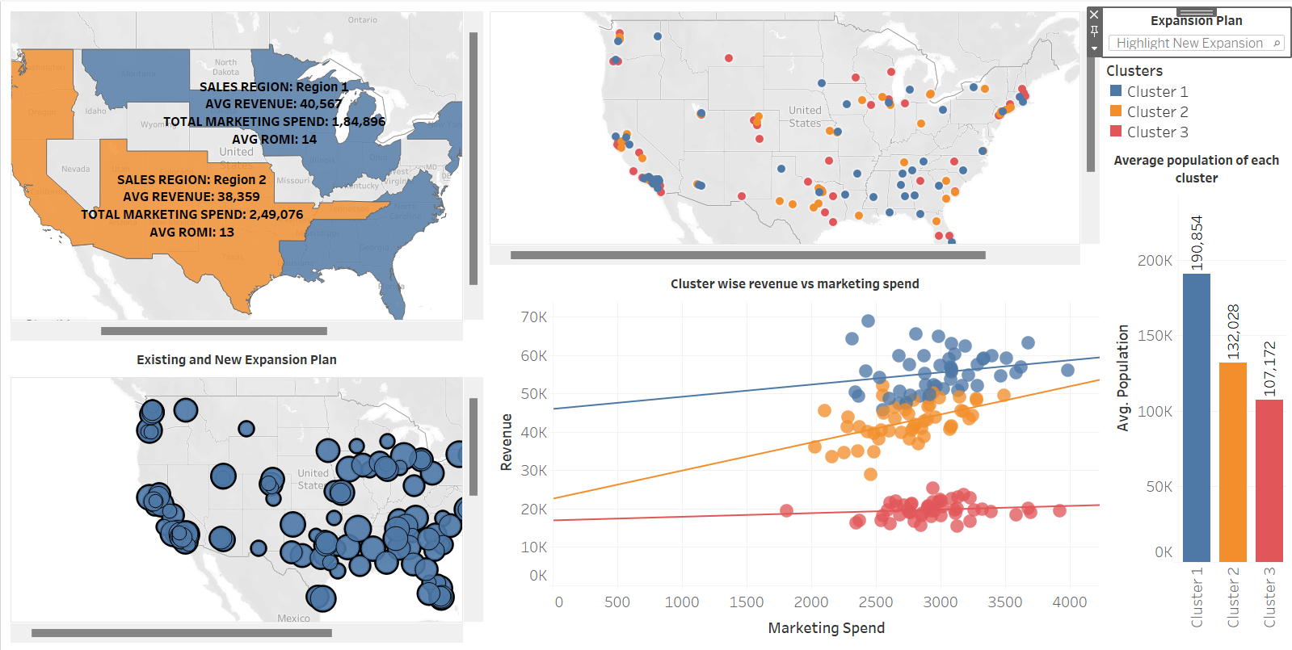
SCREENSHOTS

Slide 15
CONCLUSION
Thus, this is the completion of Phase-1 of the internship.
From March 1 2023, Phase-2 will begin

Slide 16
BIBLIOGRAPHY
https://www.tableau.com/
https://www.slideshare.net/bibrainz/how-to-make-your-first-big-data-visualization
https://www.udemy.com/share/101Wde3@zwhAUJbJepGoigyg_2Y4OoYkXD-0hojfE9zStrr056XwpoVwrWSE7O_2Y7tumXgP/
https://www.w3schools.com/sql/

Slide 17
THANK YOU!

