Slide 1



DATA SCIENCE, ANALYTICS & MANAGEMENT while interning for AVM COMPUTERS PVT LTD.
DEVANG PATEL INSTITUTE OF ADVANCE TECHNOLOGY AND RESEARCH
External Guide
Internal Guide
Prepared By
Mr. Ajay Shah (Team Lead)
Prof. Dipak Ramoliya (Asst. Professor)
Parth N Patel (19DCS098) (TeamId – 003-I)

Slide 2
CONTENT
All about the project
Project Plan
Role of team members
Requirements
Diagrams
Implementation
Conclusion
Bibliography

Slide 3
ALL ABOUT THE PROJECT
Firstly, we will use the alias name of the client as client-011
The objective of the project is to establish a data-driven business environment for our esteemed client-011, enabling their management to make informed decisions based on accurate and relevant data.
This comprehensive business environment encompasses various aspects, including data collection, dashboard development, insightful analysis, and automation through cutting-edge Machine Learning and Data Science techniques.
Due to the extensive nature of this project, it requires the expertise of multiple teams, each focusing on specific areas of the project.
The project is divided into several sub-phases to ensure that the unique requirements of different departments are adequately addressed. This approach also facilitates an exploration of various domains, enabling us to deliver the project successfully and to the highest standards.
In accordance with the signed agreement, we are bound to maintain confidentiality with regard to both the client and the project. Therefore, we are not at liberty to disclose any information pertaining to either the client or the project in question.

Slide 4
PROJECT PLAN
Primary Goal:
Our primary objective is to meet or exceed our client's expectations by delivering the project on time, within budget, and with the utmost precision in the insights provided.
Intern’s Goal:
The primary objective is to gain a comprehensive understanding of the various techniques, tools, and methods utilized in the fields of Data Science and Machine Learning. The goal is to acquire a thorough knowledge of these technologies to better comprehend their underlying concepts and principles.
Additionally, I seek to develop and enhance our leadership skills through practical experience in Customer Relationship Management (CRM), with the aim of leveraging this knowledge to deliver exceptional results for our clients.

Slide 5
PROJECT PLAN
The proposed action plan is as follows:
To undergo a foundational training program to gain a comprehensive understanding of the business problem at hand, facilitating a more streamlined approach to problem-solving.
To undertake a mini-project replicating a real-world scenario, designed to test our acquired knowledge and skillset.
To carry out data pre-processing and exploratory data analysis (EDA) for the provided data, enabling us to extract meaningful insights.
To engage in productive discussions with our team members regarding the most suitable approach to take towards the project.
To ensure the timely and accurate delivery of the work assigned to us.
To actively participate in daily sprints and meetings, fostering a collaborative and interactive work culture.

Slide 6
PROJECT PLAN
Team Name: Collaborative Unit comprising Team-001 & Team-003
Total Members: 12 (9 Permanent Members & 3 Interns)
Team Lead: Mr. Ajay Shah
Process Model: Agile
Integration Tool: Git (Subject to Confirmation)
Dashboard Tool: Tableau
Data Handling Tools: Excel, MySQL, SQLite
Programming Language: Python
IDEs: Google Colab, VS Code
Data Manipulation: Permissible with prior and post-approval from the client
Mode of Work: Onsite (Remote Work from Home permitted, subject to approval)

Slide 7
PROJECT PLAN
Estimated Project Duration: 18 months (subject to change)
Project Deadline: September 1, 2024
Frequency of CRM Updates: Twice Weekly

Slide 8
ROLE OF TEAM MEMBERS
Team Structure:
Team Lead: Responsible for Overall Management and Synchronization of the Project
Team Members:
Team Members 002 and 003: Responsible for Data Gathering and Pre-Processing
Team Members 004 and 005: Responsible for Dashboard Development
Team Members 006 and 007: Responsible for Communication, Data Management, and Security
Team Members 008, 009, and 015-I: Responsible for Software Development and Testing
Team Member 009-I: Responsible for Document Auditing and Synchronization with other Departments
Team Member 003-I: Responsible for Assisting all Team Members (except Team Members 006, 007, 008, and 009) and Handling CRM

Slide 9
Requirements
Software Requirements:
Details of this aspect of the project are currently confidential and will be disclosed at a later stage.
Hardware Requirements:
Details of this aspect of the project are currently confidential and will be disclosed at a later stage.

Slide 10
REQUIREMENTS
Functional Requirements:
Dashboard Interaction Pattern
Data Partitioning
System Responsiveness
Accuracy of the insights
Non-Functional Requirements:
Scalability
Reliability
Maintainability

Slide 11
DIAGRAMS
UML (Unified Modeling Language) diagrams are not typically used in data science projects as they are primarily designed for software engineering projects.
Data science projects often require different types of modeling and analysis techniques, such as statistical modeling, machine learning, and data visualization.
While UML diagrams can be useful for describing software architecture and design, they may not be as effective for representing the complex data structures and relationships that are typically encountered in data science projects.
Additionally, data science projects often require a more iterative and exploratory approach, which may not align well with the more rigid structure and planning that UML diagrams tend to emphasize.
Overall, while UML diagrams can be a useful tool in some contexts, they may not be as relevant or important in data science projects.

Slide 12
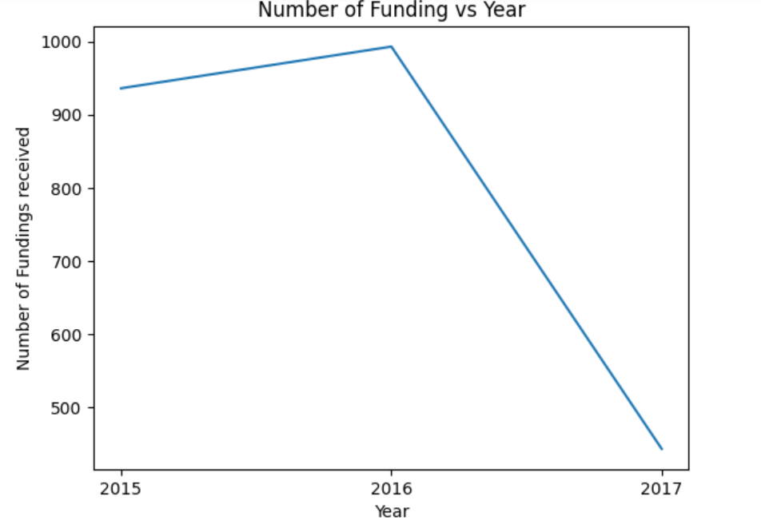
IMPLEMENTATION

Slide 13
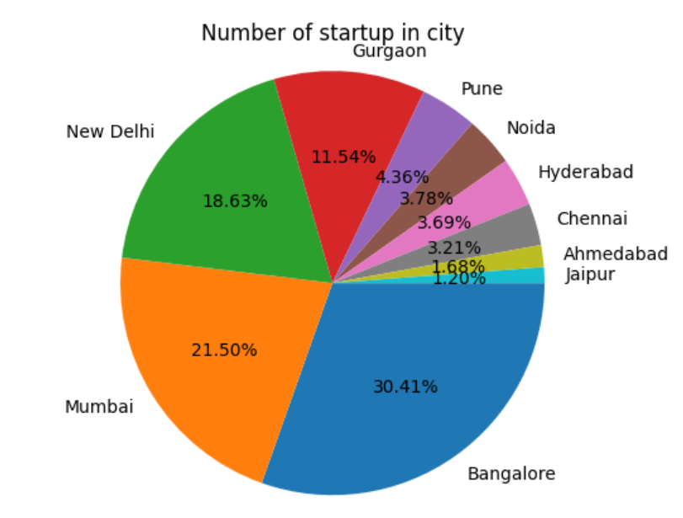
IMPLEMENTATION

Slide 14
CONCLUSION
The Phase-1 of the internship was successfully completed on February 28, 2023. Phase-2 of the internship commenced on March 1, 2023.
During Phase-1, my responsibilities included data collection, data consulting, CRM, and dashboard development.
In Phase-2, my responsibilities primarily include CRM and data consulting, as well as contributing to all project phases as directed by the team leader.
At present, I am unable to disclose any project details as discussions are ongoing with the manager regarding the scope and content of the final report.

Slide 15
BIBLIOGRAPHY
https://www.tableau.com/
https://www.slideshare.net/bibrainz/how-to-make-your-first-big-data-visualization
https://www.udemy.com/share/101Wde3@zwhAUJbJepGoigyg_2Y4OoYkXD-0hojfE9zStrr056XwpoVwrWSE7O_2Y7tumXgP/
https://www.w3schools.com/sql/
https://colab.research.google.com/
https://classroom.codingninjas.com/app/classroom/courses
https://learn.pwskills.com/
https://data-flair.training/blogs/data-science-tutorials-home/

Slide 16
THANK YOU!

