Slide 1



DATA ANALYTICS while interning for AVM COMPUTERS PVT LTD.
DEVANG PATEL INSTITUTE OF ADVANCE TECHNOLOGY AND RESEARCH
External Guide
Internal Guide
Prepared By
Mr. Ajay Shah (Team Lead)
Prof. Dipak Ramoliya (Asst. Professor)
Parth N Patel (19DCS098) (TeamId – 003-I)

Slide 2
CONTENT
All about the project
Project Plan
Role of team members
Requirements
Diagrams
Screenshots
Conclusion
Bibliography

Slide 3
PHASE-1

Slide 4
ALL ABOUT THE PROJECT
Firstly, we will use the alias name of the client as client-010
The project is about finding the business solutions and to facilitate the future steps that should be taken by the client-010 for maximizing the profits in upcoming fiscal session.
The client-010 has also demanded to design and build interactive dashboards for future references.
Team-003 is responsible for the project completion and hand-over.

Slide 5
PROJECT PLAN
Primary Goal:
The project is about gaining insights from the data provided by the client as well as to develop an interactive dashboard for both the team and the client for future interactions and decision making.
Intern’s Goal:
The goal behind the project is to get appropriate training regarding how to use Data Analytics and Dashboard Development concepts in real world. The alternate goal is to enhance the grasp of the analytics concepts.
Objectives:
Pre-requisite Training to understand the working methodology of the team-003
Testing the working and team contributing principle of the intern via performing in the team.

Slide 6
PROJECT PLAN
Team Name: Team-003
Total Members: 6 (5 permanent & 1 intern)
Team Lead: Mr. Ajay Shah
Process model to be utilized: Agile
Integration tool : NA
Dashboard tool: Tableau
Data handling tool : Excel & MySQL
Data manipulation : Permitted with prior and post approval of client
Mode of work: Offline (WFH if necessary)(need to take approval)

Slide 7
PROJECT PLAN
Estimated Time : 2.5 months
Project Deadline: March 1 2023
CRM Update Frequency : twice in a week

Slide 8
ROLE OF TEAM MEMBERS
Team Lead:
Responsible for the overall management & Synchronization
Team-member-002 & Team-member-003:
Data Gathering and pre-processing
Team-member-004:
Dashboard Development
Team-member-005:
Communication and Data Management and Security
Team Member-003-I:
Assist all the team members (except for team-member-005) and handle CRM

Slide 9
Requirements
Software Requirements:
Tableau (premium)
Active Internet Connections
Hardware Requirements:
NA

Slide 10
REQUIREMENTS
Functional Requirements:
Dashboard Interaction Pattern
Data Partitioning
System Responsiveness
Non-Functional Requirements:
Scalability
Reliability
Maintainability

Slide 11
DIAGRAMS
UML diagrams are primarily used to model software systems and their behavior
They are used to capture the functional requirements, the structure of the system, and the relationships between different software components.
These diagrams are essential for communicating complex software design ideas between developers, stakeholders, and other team members.
Data analytics and data visualization projects are primarily focused on extracting insights from data and presenting them in a visually appealing manner. They typically do not involve designing software systems or implementing complex software architectures
The emphasis in data analytics and data visualization projects is on understanding the data and using it to inform decision-making, rather than on modeling the software system that processes the data.

Slide 12
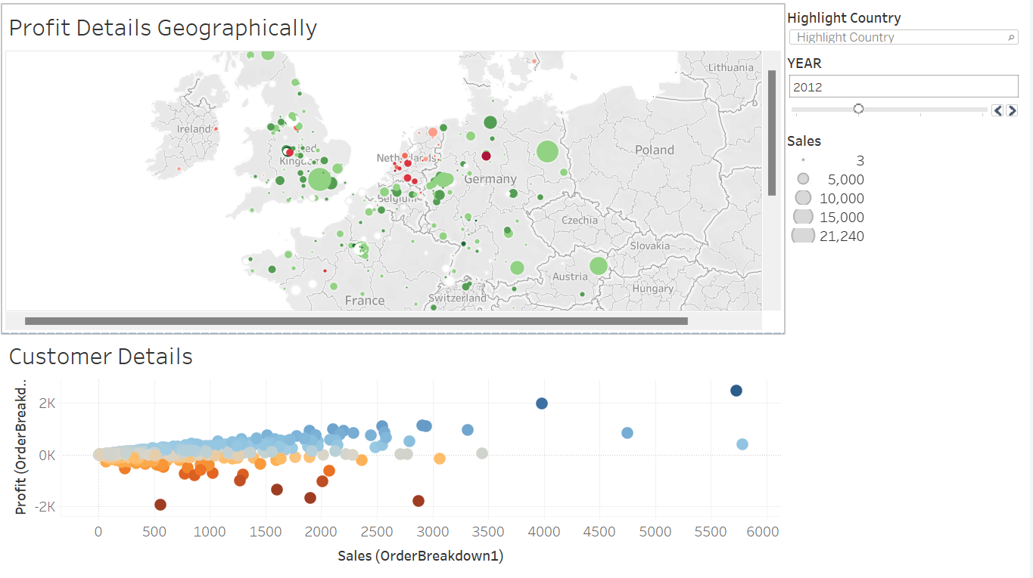
SCREENSHOTS

Slide 13
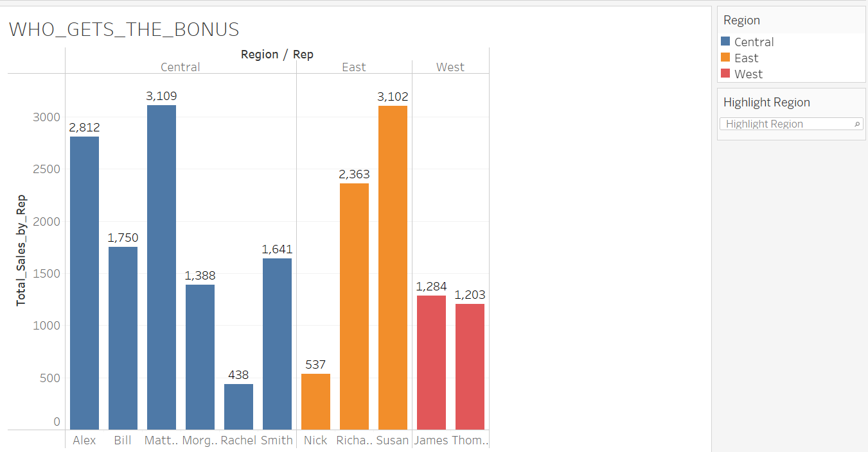
SCREENSHOTS

Slide 14
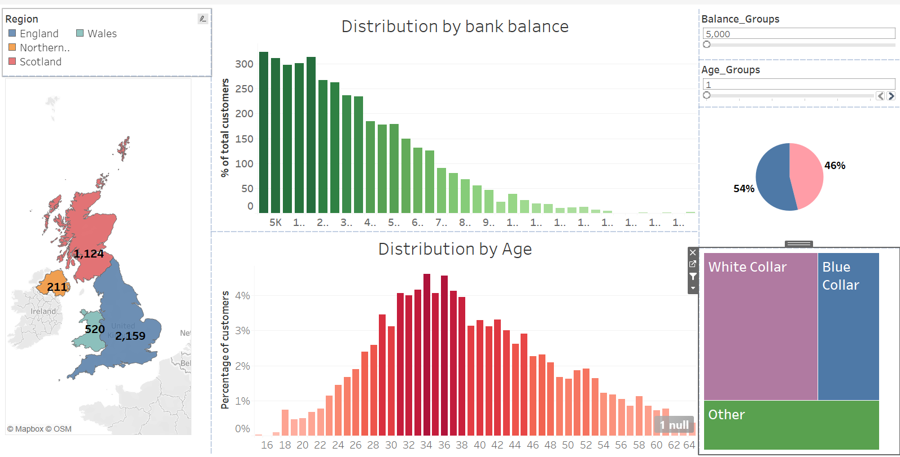
SCREENSHOTS

Slide 15
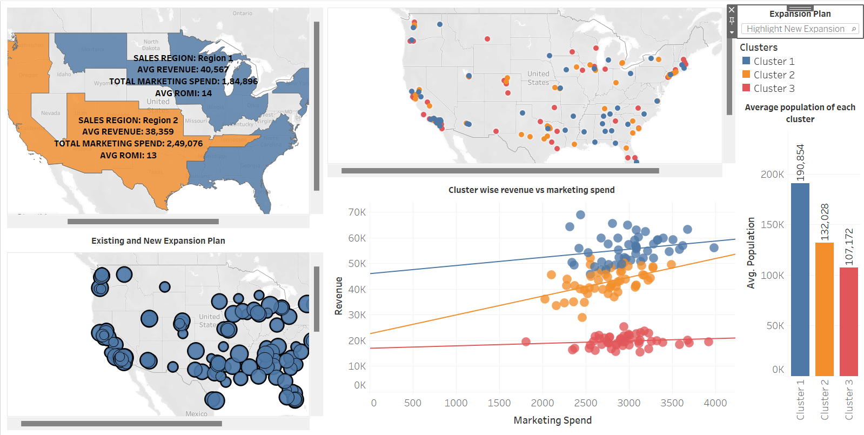
SCREENSHOTS

Slide 16
PHASE-2

Slide 17
ALL ABOUT THE PROJECT
Firstly, we will use the alias name of the client as client-011
The objective of the project is to establish a data-driven business environment for our esteemed client-011, enabling their management to make informed decisions based on accurate and relevant data.
This comprehensive business environment encompasses various aspects, including data collection, dashboard development, insightful analysis, and automation through cutting-edge Machine Learning and Data Science techniques.
Due to the extensive nature of this project, it requires the expertise of multiple teams, each focusing on specific areas of the project.
The project is divided into several sub-phases to ensure that the unique requirements of different departments are adequately addressed. This approach also facilitates an exploration of various domains, enabling us to deliver the project successfully and to the highest standards.
In accordance with the signed agreement, we are bound to maintain confidentiality with regard to both the client and the project. Therefore, we are not at liberty to disclose any information pertaining to either the client or the project in question.

Slide 18
PROJECT PLAN
Primary Goal:
Our primary objective is to meet or exceed our client's expectations by delivering the project on time, within budget, and with the utmost precision in the insights provided.
Intern’s Goal:
The primary objective is to gain a comprehensive understanding of the various techniques, tools, and methods utilized in the fields of Data Science and Machine Learning. The goal is to acquire a thorough knowledge of these technologies to better comprehend their underlying concepts and principles.
Additionally, I seek to develop and enhance our leadership skills through practical experience in Customer Relationship Management (CRM), with the aim of leveraging this knowledge to deliver exceptional results for our clients.

Slide 19
PROJECT PLAN
The proposed action plan is as follows:
To undergo a foundational training program to gain a comprehensive understanding of the business problem at hand, facilitating a more streamlined approach to problem-solving.
To undertake a mini-project replicating a real-world scenario, designed to test our acquired knowledge and skillset.
To carry out data pre-processing and exploratory data analysis (EDA) for the provided data, enabling us to extract meaningful insights.
To engage in productive discussions with our team members regarding the most suitable approach to take towards the project.
To ensure the timely and accurate delivery of the work assigned to us.
To actively participate in daily sprints and meetings, fostering a collaborative and interactive work culture.

Slide 20
PROJECT PLAN
Team Name: Collaborative Unit comprising Team-001 & Team-003
Total Members: 12 (9 Permanent Members & 3 Interns)
Team Lead: Mr. Ajay Shah
Process Model: Agile
Integration Tool: Git (Subject to Confirmation)
Dashboard Tool: Tableau
Data Handling Tools: Excel, MySQL, SQLite
Programming Language: Python
IDEs: Google Colab, VS Code
Data Manipulation: Permissible with prior and post-approval from the client
Mode of Work: Onsite (Remote Work from Home permitted, subject to approval)

Slide 21
PROJECT PLAN
Estimated Project Duration: 18 months (subject to change)
Project Deadline: September 1, 2024
Frequency of CRM Updates: Twice Weekly

Slide 22
ROLE OF TEAM MEMBERS
Team Structure:
Team Lead: Responsible for Overall Management and Synchronization of the Project
Team Members:
Team Members 002 and 003: Responsible for Data Gathering and Pre-Processing
Team Members 004 and 005: Responsible for Dashboard Development
Team Members 006 and 007: Responsible for Communication, Data Management, and Security
Team Members 008, 009, and 015-I: Responsible for Software Development and Testing
Team Member 009-I: Responsible for Document Auditing and Synchronization with other Departments
Team Member 003-I: Responsible for Assisting all Team Members (except Team Members 006, 007, 008, and 009) and Handling CRM

Slide 23
Requirements
Software Requirements:
Details of this aspect of the project are currently confidential and will be disclosed at a later stage.
Hardware Requirements:
Details of this aspect of the project are currently confidential and will be disclosed at a later stage.

Slide 24
REQUIREMENTS
Functional Requirements:
Dashboard Interaction Pattern
Data Partitioning
System Responsiveness
Accuracy of the insights
Non-Functional Requirements:
Scalability
Reliability
Maintainability

Slide 25
DIAGRAMS
UML (Unified Modeling Language) diagrams are not typically used in data science projects as they are primarily designed for software engineering projects.
Data science projects often require different types of modeling and analysis techniques, such as statistical modeling, machine learning, and data visualization.
While UML diagrams can be useful for describing software architecture and design, they may not be as effective for representing the complex data structures and relationships that are typically encountered in data science projects.
Additionally, data science projects often require a more iterative and exploratory approach, which may not align well with the more rigid structure and planning that UML diagrams tend to emphasize.
Overall, while UML diagrams can be a useful tool in some contexts, they may not be as relevant or important in data science projects.

Slide 26
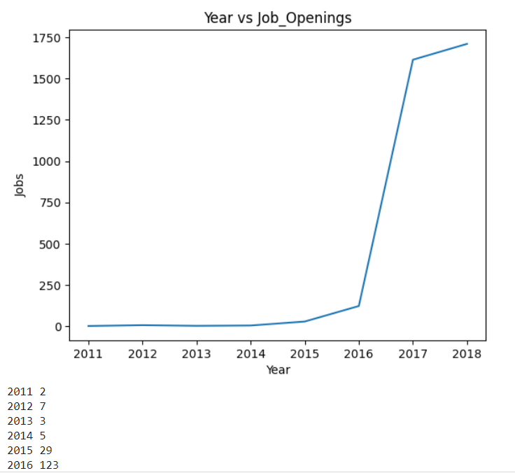
IMPLEMENTATION SCREENSHOTS

Slide 27
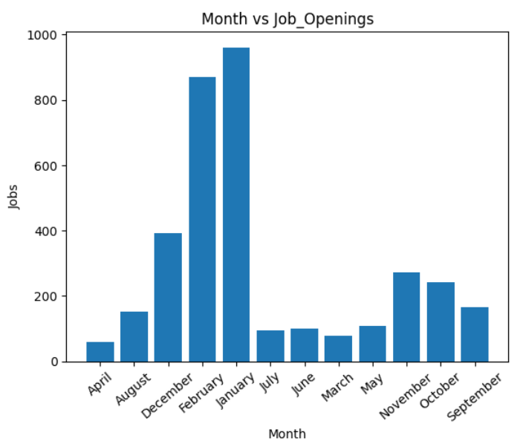
IMPLEMENTATION SCREENSHOTS

Slide 28
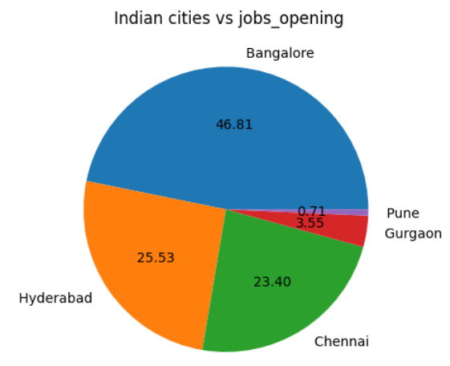
IMPLEMENTATION SCREENSHOTS

Slide 29
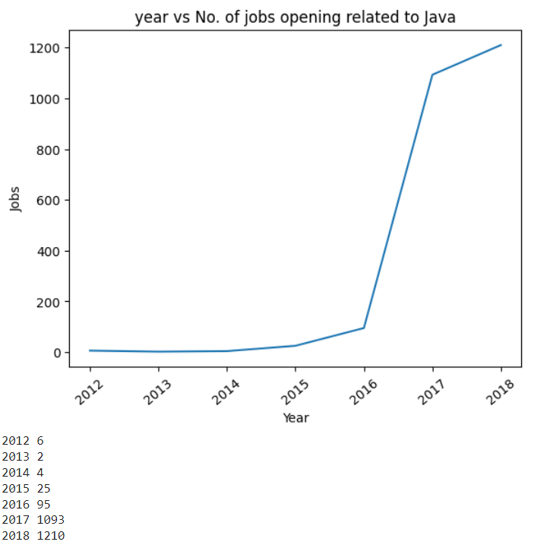
IMPLEMENTATION SCREENSHOTS

Slide 30
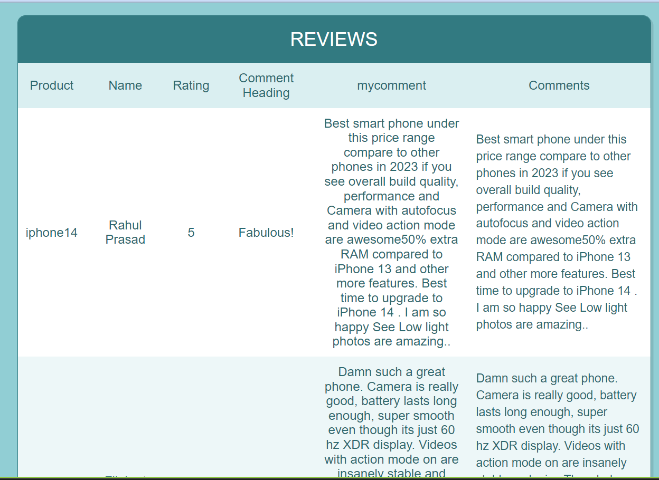
IMPLEMENTATION SCREENSHOTS

Slide 31
BIBLIOGRAPHY
https://www.tableau.com/
https://www.slideshare.net/bibrainz/how-to-make-your-first-big-data-visualization
https://www.udemy.com/share/101Wde3@zwhAUJbJepGoigyg_2Y4OoYkXD-0hojfE9zStrr056XwpoVwrWSE7O_2Y7tumXgP/
https://www.w3schools.com/sql/

Slide 32
THANK YOU!

