Slide 1
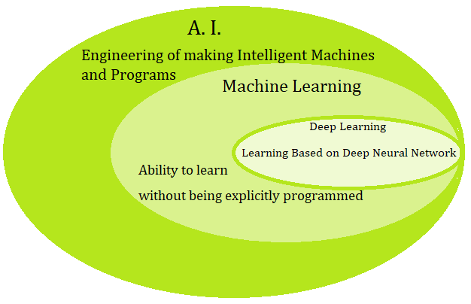
Introduction

Slide 2
Learning…
Most perception (Input Processing) in the brain may be due to one learning algorithm.
Build learning algorithms that mimic the brain
Most human intelligence due to one learning algorithm
Learning from tagged data (Supervised Learning)
Bigger Data – More training is better
Untagged data (Unsupervised Learning)
Deep Learning

Slide 3
AI-ML-DL
AI- Any program that passes Turing Test it means any machine makes you believe its human i.e. AI (Mimic Human and Pass the Turing Test)
ML- Learning with Experience
DL- Self Learning with more data
In ML, Lots of data need to be parsed

Slide 4
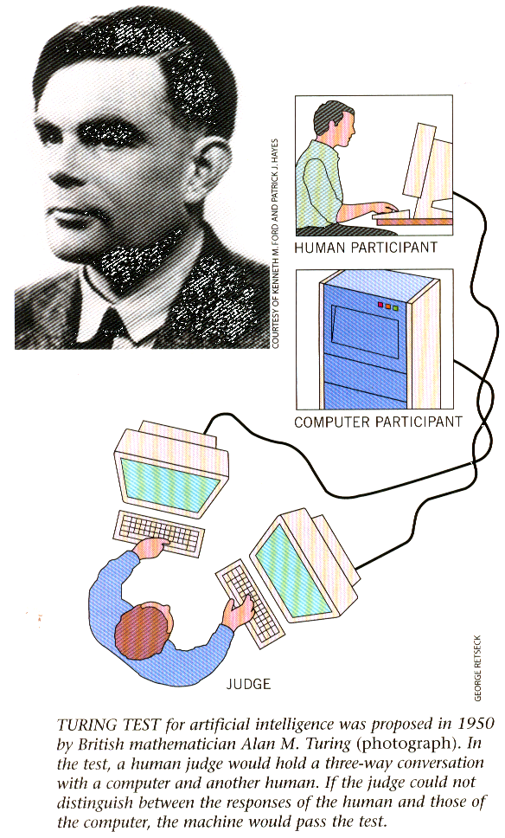
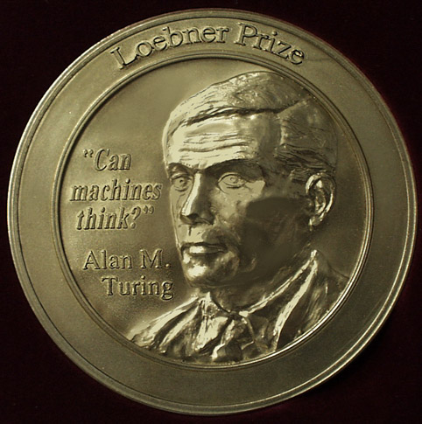
The long term goal:
The Turing Test

Slide 5
Artificial Intelligence is ...
In Engineering and Computer Science:
The development and the study of advanced computer applications, aimed at solving tasks that - for the moment - are still better preformed by humans.

Slide 6
Human Intelligence v/s Artificial Intelligence
Machine Learning
Symbolic Learning/Image Processing (Robotics, Computer Vision)
Pattern Recognition (Statistics, DL)
Statistics (Speech, NLP)
DL (CNN, RNN)
CNN (Computer Vision, Object Recognition)

Slide 7
AI
Data Pipelines (Huge amount of data)
Statistics
Computer Science
Domain Expertise
Computer Vision
Predictive Analytics

Slide 8
The main topics in AI
Artificial intelligence can be considered under a number of headings:
Search (includes Game Playing).
Representing Knowledge and Reasoning with it.
Planning.
Machine Learning.
Natural language processing.
Expert Systems.
Interacting with the Environment (e.g. Vision, Speech recognition, Robotics)

Slide 9
Dimensions of Learning Systems
Type of feedback
Supervised (labeled examples)
Unsupervised (unlabeled examples)
Reinforcement (reward)
Representation
Attribute-based (feature vector)
Relational (first-order logic)
Use of knowledge
Empirical (knowledge-free)
Analytical (knowledge-guided)

Slide 10
Areas of AI
Knowledge Representation
Search
Logic
Machine Learning
Planning
Expert Systems
NLP
Vision
Robotics

Slide 11
Choice of the material.
Few books are really adequate:
E. Rich ( “Artificial Intelligence’’):
good for some parts (search, introduction, knowledge representation), outdated
P.Winston ( “Artificial Intelligence’’):
didactically VERY good, but lacks technical depth. Somewhat outdated.
Norvig & Russel ( ‘”AI: a modern approach’’):
encyclopedic, misses depth.
Poole et. Al (‘ “Computational Intelligence’’):
very formal and technical. Good for logic.
Selection and synthesis of the best parts of different books.

Slide 12
What is AI?
Various definitions:
Building intelligent entities.
Getting computers to do tasks which require human intelligence.
But what is “intelligence”?
Simple things turn out to be the hardest to automate:
Recognising a face.
Navigating a busy street.
Understanding what someone says.
All tasks require reasoning on knowledge.

Slide 13
Why do AI?
Two main goals of AI:
To understand human intelligence better. We test theories of human intelligence by writing programs which emulate it.
To create useful “smart” programs able to do tasks that would normally require a human expert.

Slide 14
Who does AI?
Many disciplines contribute to goal of creating/modelling intelligent entities:
Computer Science
Psychology (human reasoning)
Philosophy (nature of belief, rationality, etc)
Linguistics (structure and meaning of language)
Human Biology (how brain works)
Subject draws on ideas from each discipline.

Slide 15
Typical AI Problems
Intelligent entities (or “agents”) need to be able to do both “mundane” and “expert” tasks:
Mundane tasks - consider going shopping:
Planning a route, and sequence of shops to visit!
Recognising (through vision) buses, people.
Communicating (through natural language).
Navigating round obstacles on the street, and manipulating objects for purchase.
Expert tasks are things like:
medical diagnosis.
equipment repair.

Slide 16
Philosophical Issues
What is intelligence?
Can a machine be truly “intelligent”? Is there more to human intelligence than rules, data and calculations?
Tests:
Turing Test: Can someone tell which is the machine, when communicating to human and to a machine in another room? If not, can we call the machine intelligent?

