Slide 1
Chapter 4:
Unsupervised Learning

Slide 2
Road map
Basic concepts
K-means algorithm
Representation of clusters
Hierarchical clustering
Distance functions
CS583, Bing Liu, UIC

Slide 3
Supervised learning vs. unsupervised learning
Supervised learning: discover patterns in the data that relate data attributes with a target (class) attribute.
  These patterns are then utilized to predict the values of the target attribute in future data instances.
Unsupervised learning: The data have no target attribute.
  We want to explore the data to find some intrinsic structures in them.
CS583, Bing Liu, UIC

Slide 4
Clustering
Clustering is a technique for finding similarity groups in data, called clusters. I.e.,
  it groups data instances that are similar to (near) each other in one cluster and data instances that are very different (far away) from each other into different clusters.
Clustering is often called an unsupervised learning task as no class values denoting an a priori grouping of the data instances are given, which is the case in supervised learning.
Due to historical reasons, clustering is often considered synonymous with unsupervised learning.
  In fact, association rule mining is also unsupervised
This chapter focuses on clustering.
CS583, Bing Liu, UIC

Slide 5
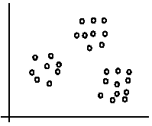
An illustration
The data set has three natural groups of data points, i.e., 3 natural clusters.
CS583, Bing Liu, UIC

Slide 6
What is clustering for?
Let us see some real-life examples
Example 1: groups people of similar sizes together to make “small”, “medium” and “large” T-Shirts.
  Tailor-made for each person: too expensive
  One-size-fits-all: does not fit all.
Example 2: In marketing, segment customers according to their similarities
  To do targeted marketing.
CS583, Bing Liu, UIC

Slide 7
What is clustering for? (cont…)
Example 3: Given a collection of text documents, we want to organize them according to their content similarities,
  To produce a topic hierarchy
In fact, clustering is one of the most utilized data mining techniques.
  It has a long history, and used in almost every field, e.g., medicine, psychology, botany, sociology, biology, archeology, marketing, insurance, libraries, etc.
  In recent years, due to the rapid increase of online documents, text clustering becomes important.
CS583, Bing Liu, UIC

Slide 8
Aspects of clustering
A clustering algorithm
  Partitional clustering
  Hierarchical clustering
  …
A distance (similarity, or dissimilarity) function
Clustering quality
  Inter-clusters distance ⇒ maximized
  Intra-clusters distance ⇒ minimized
The quality of a clustering result depends on the algorithm, the distance function, and the application.
CS583, Bing Liu, UIC

Slide 9
Road map
Basic concepts
K-means algorithm
Representation of clusters
Hierarchical clustering
Distance functions
CS583, Bing Liu, UIC

Slide 10
K-means clustering
K-means is a partitional clustering algorithm
Let the set of data points (or instances) D be
{x₁, x₂, …, x_{n}},
  where x_{i} = (x_{i1}, x_{i2}, …, x_{ir}) is a vector in a real-valued space X ⊆ R^{r}, and r is the number of attributes (dimensions) in the data.
The k-means algorithm partitions the given data into k clusters.
  Each cluster has a cluster center, called centroid.
  k is specified by the user
CS583, Bing Liu, UIC

Slide 11
K-means algorithm
Given k, the k-means algorithm works as follows:
  Randomly choose k data points (seeds) to be the initial centroids, cluster centers
  Assign each data point to the closest centroid
  Re-compute the centroids using the current cluster memberships.
  If a convergence criterion is not met, go to 2).
CS583, Bing Liu, UIC

Slide 12
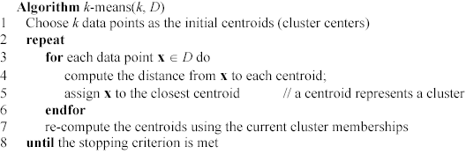
K-means algorithm – (cont …)
CS583, Bing Liu, UIC

Slide 13
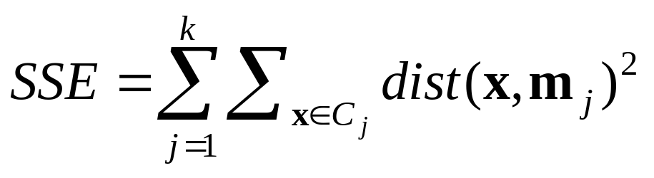
Stopping/convergence criterion
no (or minimum) re-assignments of data points to different clusters,
no (or minimum) change of centroids, or
minimum decrease in the sum of squared error (SSE),
  C_{i} is the jth cluster, m_{j} is the centroid of cluster C_{j} (the mean vector of all the data points in C_{j}), and dist(x, m_{j}) is the distance between data point x and centroid m_{j}.
(1)
CS583, Bing Liu, UIC

Slide 14
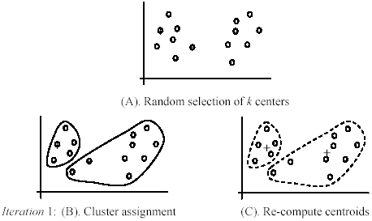
An example
+
+
CS583, Bing Liu, UIC

Slide 15
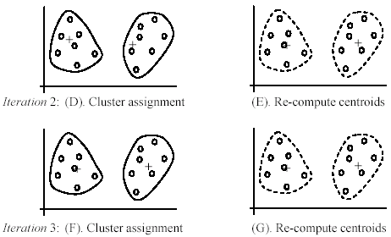
An example (cont …)
CS583, Bing Liu, UIC

Slide 16
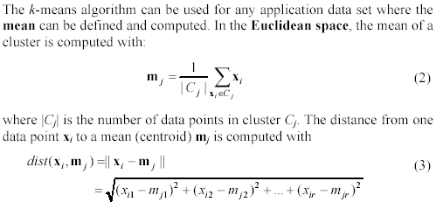
An example distance function
CS583, Bing Liu, UIC

Slide 17
A disk version of k-means
K-means can be implemented with data on disk
  In each iteration, it scans the data once.
  as the centroids can be computed incrementally
It can be used to cluster large datasets that do not fit in main memory
We need to control the number of iterations
  In practice, a limited is set (< 50).
Not the best method. There are other scale-up algorithms, e.g., BIRCH.
CS583, Bing Liu, UIC

Slide 18
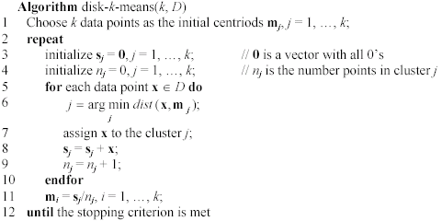
A disk version of k-means (cont …)
CS583, Bing Liu, UIC

Slide 19
Strengths of k-means
Strengths:
  Simple: easy to understand and to implement
  Efficient: Time complexity: O(tkn),
  where n is the number of data points,
  k is the number of clusters, and
  t is the number of iterations.
  Since both k and t are small. k-means is considered a linear algorithm.
K-means is the most popular clustering algorithm.
Note that: it terminates at a local optimum if SSE is used. The global optimum is hard to find due to complexity.
CS583, Bing Liu, UIC

Slide 20
Weaknesses of k-means
The algorithm is only applicable if the mean is defined.
  For categorical data, k-mode - the centroid is represented by most frequent values.
The user needs to specify k.
The algorithm is sensitive to outliers
  Outliers are data points that are very far away from other data points.
  Outliers could be errors in the data recording or some special data points with very different values.
CS583, Bing Liu, UIC

Slide 21
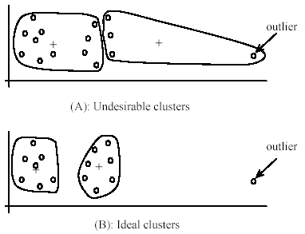
Weaknesses of k-means: Problems with outliers
CS583, Bing Liu, UIC

Slide 22
Weaknesses of k-means: To deal with outliers
One method is to remove some data points in the clustering process that are much further away from the centroids than other data points.
  To be safe, we may want to monitor these possible outliers over a few iterations and then decide to remove them.
Another method is to perform random sampling. Since in sampling we only choose a small subset of the data points, the chance of selecting an outlier is very small.
  Assign the rest of the data points to the clusters by distance or similarity comparison, or classification
CS583, Bing Liu, UIC

Slide 23
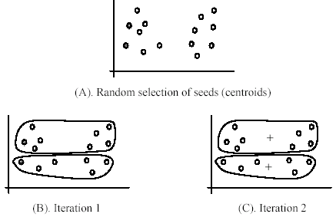
Weaknesses of k-means (cont …)
The algorithm is sensitive to initial seeds.
CS583, Bing Liu, UIC

Slide 24
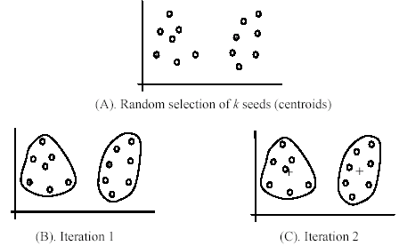
Weaknesses of k-means (cont …)
If we use different seeds: good results
There are some methods to help choose good seeds
CS583, Bing Liu, UIC

Slide 25
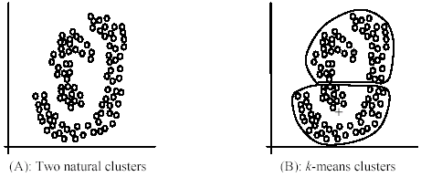
Weaknesses of k-means (cont …)
The k-means algorithm is not suitable for discovering clusters that are not hyper-ellipsoids (or hyper-spheres).
+
CS583, Bing Liu, UIC

Slide 26
K-means summary
Despite weaknesses, k-means is still the most popular algorithm due to its simplicity, efficiency and
  other clustering algorithms have their own lists of weaknesses.
No clear evidence that any other clustering algorithm performs better in general
  although they may be more suitable for some specific types of data or applications.
Comparing different clustering algorithms is a difficult task. No one knows the correct clusters!
CS583, Bing Liu, UIC

Slide 27
Road map
Basic concepts
K-means algorithm
Representation of clusters
Hierarchical clustering
Distance functions
CS583, Bing Liu, UIC

Slide 28
Common ways to represent clusters
Use the centroid of each cluster to represent the cluster.
  compute the radius and
  standard deviation of the cluster to determine its spread in each dimension
  The centroid representation alone works well if the clusters are of the hyper-spherical shape.
  If clusters are elongated or are of other shapes, centroids are not sufficient
CS583, Bing Liu, UIC

Slide 29
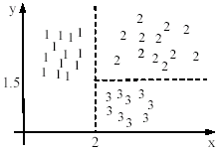

Using classification model
All the data points in a cluster are regarded to have the same class label, e.g., the cluster ID.
  run a supervised learning algorithm on the data to find a classification model.
CS583, Bing Liu, UIC

Slide 30
Use frequent values to represent cluster
This method is mainly for clustering of categorical data (e.g., k-modes clustering).
Main method used in text clustering, where a small set of frequent words in each cluster is selected to represent the cluster.
CS583, Bing Liu, UIC

Slide 31
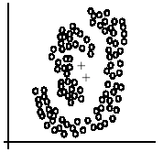
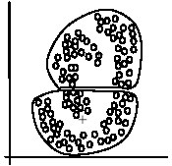
Clusters of arbitrary shapes
Hyper-elliptical and hyper-spherical clusters are usually easy to represent, using their centroid together with spreads.
Irregular shape clusters are hard to represent. They may not be useful in some applications.
  Using centroids are not suitable (upper figure) in general
  K-means clusters may be more useful (lower figure), e.g., for making 2 size T-shirts.
CS583, Bing Liu, UIC

Slide 32
Road map
Basic concepts
K-means algorithm
Representation of clusters
Hierarchical clustering
Distance functions
CS583, Bing Liu, UIC

Slide 33
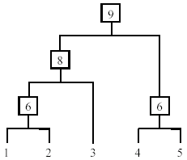
Hierarchical Clustering
Produce a nested sequence of clusters, a tree, also called Dendrogram.
CS583, Bing Liu, UIC

Slide 34
Types of hierarchical clustering
Agglomerative (bottom up) clustering: It builds the dendrogram (tree) from the bottom level, and
  merges the most similar (or nearest) pair of clusters
  stops when all the data points are merged into a single cluster (i.e., the root cluster).
Divisive (top down) clustering: It starts with all data points in one cluster, the root.
  Splits the root into a set of child clusters. Each child cluster is recursively divided further
  stops when only singleton clusters of individual data points remain, i.e., each cluster with only a single point
CS583, Bing Liu, UIC

Slide 35
Agglomerative clustering
It is more popular then divisive methods.
At the beginning, each data point forms a cluster (also called a node).
Merge nodes/clusters that have the least distance.
Go on merging
Eventually all nodes belong to one cluster
CS583, Bing Liu, UIC

Slide 36
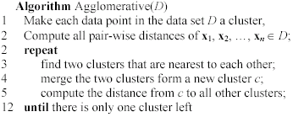
Agglomerative clustering algorithm
CS583, Bing Liu, UIC

Slide 37
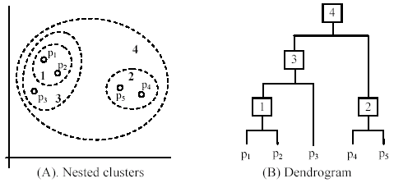
An example: working of the algorithm
CS583, Bing Liu, UIC

Slide 38
Measuring the distance of two clusters
A few ways to measure distances of two clusters.
Results in different variations of the algorithm.
  Single link
  Complete link
  Average link
  Centroids
  …
CS583, Bing Liu, UIC

Slide 39
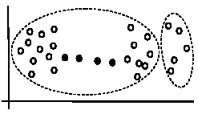
Single link method
The distance between two clusters is the distance between two closest data points in the two clusters, one data point from each cluster.
It can find arbitrarily shaped clusters, but
  It may cause the undesirable “chain effect” by noisy points
Two natural clusters are split into two
CS583, Bing Liu, UIC

Slide 40
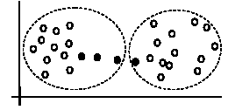
Complete link method
The distance between two clusters is the distance of two furthest data points in the two clusters.
It is sensitive to outliers because they are far away
CS583, Bing Liu, UIC

Slide 41
Average link and centroid methods
Average link: A compromise between
  the sensitivity of complete-link clustering to outliers and
  the tendency of single-link clustering to form long chains that do not correspond to the intuitive notion of clusters as compact, spherical objects.
  In this method, the distance between two clusters is the average distance of all pair-wise distances between the data points in two clusters.
Centroid method: In this method, the distance between two clusters is the distance between their centroids
CS583, Bing Liu, UIC

Slide 42
The complexity
All the algorithms are at least O(n²). n is the number of data points.
Single link can be done in O(n²).
Complete and average links can be done in O(n²logn).
Due the complexity, hard to use for large data sets.
  Sampling
  Scale-up methods (e.g., BIRCH).
CS583, Bing Liu, UIC

Slide 43
Road map
Basic concepts
K-means algorithm
Representation of clusters
Hierarchical clustering
Distance functions
CS583, Bing Liu, UIC

Slide 44
Distance functions
Key to clustering. “similarity” and “dissimilarity” can also commonly used terms.
There are numerous distance functions for
  Different types of data
    Numeric data
    Nominal data
  Different specific applications
CS583, Bing Liu, UIC

Slide 45
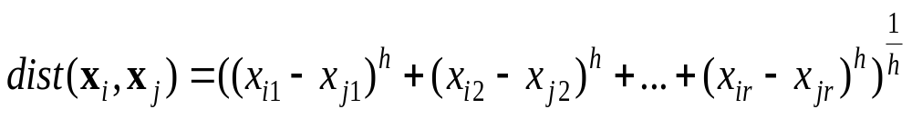
Distance functions for numeric attributes
Most commonly used functions are
  Euclidean distance and
  Manhattan (city block) distance
We denote distance with: dist(x_{i}, x_{j}), where x_{i} and x_{j} are data points (vectors)
They are special cases of Minkowski distance. h is positive integer.
CS583, Bing Liu, UIC

Slide 46
Euclidean distance and Manhattan distance
If h = 2, it is the Euclidean distance
If h = 1, it is the Manhattan distance
Weighted Euclidean distance
CS583, Bing Liu, UIC

Slide 47
Squared distance and Chebychev distance
Squared Euclidean distance: to place progressively greater weight on data points that are further apart.
Chebychev distance: one wants to define two data points as "different" if they are different on any one of the attributes.
CS583, Bing Liu, UIC

Slide 48
Distance functions for binary and nominal attributes
Binary attribute: has two values or states but no ordering relationships, e.g.,
  Gender: male and female.
We use a confusion matrix to introduce the distance functions/measures.
Let the ith and jth data points be x_{i} and x_{j} (vectors)
CS583, Bing Liu, UIC

Slide 49
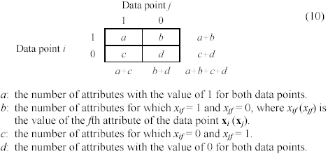
Confusion matrix
CS583, Bing Liu, UIC

Slide 50
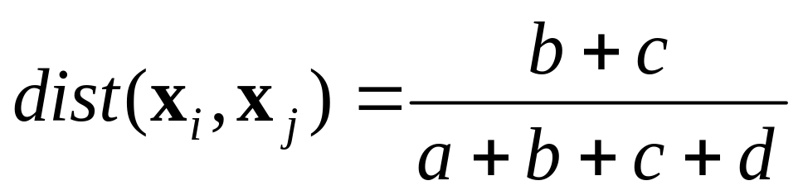
Symmetric binary attributes
A binary attribute is symmetric if both of its states (0 and 1) have equal importance, and carry the same weights, e.g., male and female of the attribute Gender
Distance function: Simple Matching Coefficient, proportion of mismatches of their values
CS583, Bing Liu, UIC

Slide 51


Symmetric binary attributes: example
CS583, Bing Liu, UIC

Slide 52
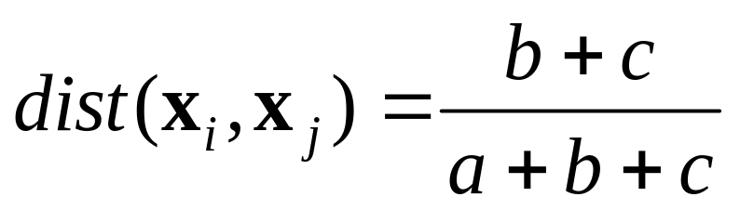
Asymmetric binary attributes
Asymmetric: if one of the states is more important or more valuable than the other.
  By convention, state 1 represents the more important state, which is typically the rare or infrequent state.
  Jaccard coefficient is a popular measure
  We can have some variations, adding weights
CS583, Bing Liu, UIC

Slide 53
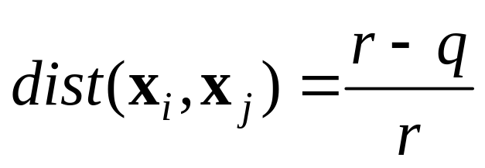
Nominal attributes
Nominal attributes: with more than two states or values.
  the commonly used distance measure is also based on the simple matching method.
  Given two data points x_{i} and x_{j}, let the number of attributes be r, and the number of values that match in x_{i} and x_{j} be q.
CS583, Bing Liu, UIC

Slide 54
Distance function for text documents
A text document consists of a sequence of sentences and each sentence consists of a sequence of words.
To simplify: a document is usually considered a “bag” of words in document clustering.
  Sequence and position of words are ignored.
A document is represented with a vector just like a normal data point.
It is common to use similarity to compare two documents rather than distance.
  The most commonly used similarity function is the cosine similarity. We will study this later.
CS583, Bing Liu, UIC

