Slide 1



2160704
Theory of Computation
Unit-3
Context Free Grammar
Prof. Dixita B. Kagathara
Dixita.kagathara@darshan.ac.in

Slide 2
Topics to be covered
Chomsky hierarchy
Context free grammar
Recursive definition
FA to regular grammar
Derivation
Ambiguity & unambiguous grammar
Simplified forms & normal forms
CFG to CNF
Union, Concatenation & Kleene’s of CFG

Slide 3
Chomsky Hierarchy

Slide 4
Chomsky hierarchy (Classification of grammar)
Grammar
Unrestricted grammar (type 0)
Restricted grammar
Context sensitive grammar (type 1)
Context free grammar(type 2)
Regular grammar(type 3)

Slide 5

Type 0 grammar (Phrase Structure Grammar)
Their productions are of the form:
$$α → β$$
where both $α$ and $β$ can be strings of terminal and nonterminal symbols.
Example: S → ACaB
Bc → acB
CB → DB
aD → Db

Slide 6
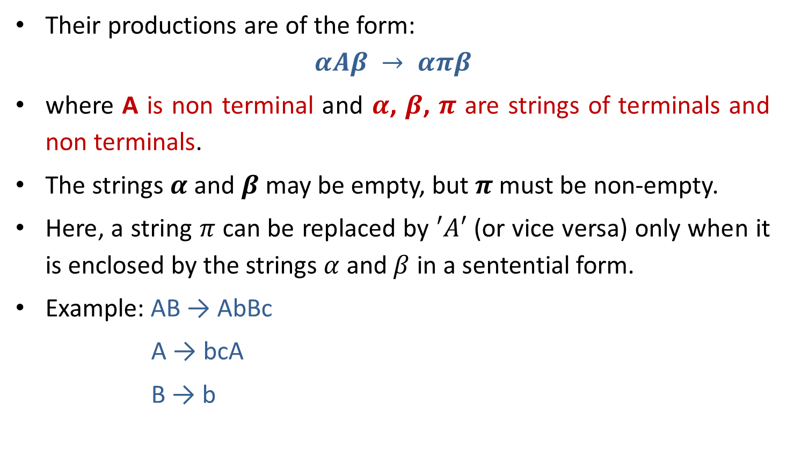
Type 1 grammar (Context Sensitive Grammar)
Their productions are of the form:
$$αAβ → απβ$$
where A is non terminal and $α$, $β$, $π$ are strings of terminals and non terminals.
The strings $α$ and $β$may be empty, but $π$ must be non-empty.
Here, a string $π$ can be replaced by $′A′$ (or vice versa) only when it is enclosed by the strings $α$ and $β$ in a sentential form.
Example: AB → AbBc
A → bcA
B → b

Slide 7

Type 2 grammar (Context Free Grammar)
Their productions are of the form:
$$A →α$$
Where $A$ is non terminal and $α$is string of terminals and non terminals.
Example: S → Xa
X → a
X → aX
X → abc

Slide 8

Type 3 grammar (Linear or Regular grammar)
Their productions are of the form:
$A → tB | t$ or $A → Bt | t$
Where $A, B$are non terminals and $t$ is terminal.
Example: X → a | aY
Y → b

Slide 9
Hierarchy of grammar
Type 0(Phrase structure)
Type 1(Context sensitive)
Type 2(Context free)
Type 3 (Regular)

Slide 10
Context free grammar

Slide 11
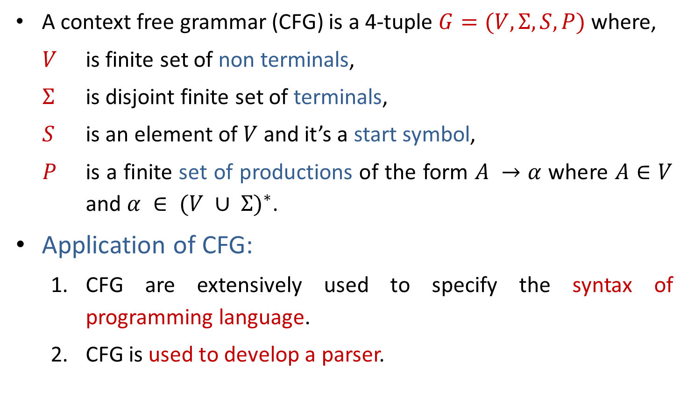
Context Free Grammar
A context free grammar (CFG) is a 4-tuple $G=(V,Σ,S,P)$where,
$V$ is finite set of non terminals,
$Σ$ is disjoint finite set of terminals,
$S$ is an element of $V$ and it’s a start symbol,
$P$ is a finite set of productions of the form $A →α$ where $A∈V$ and $α ∈ {(V ∪ Σ)}^{∗}$.
Application of CFG:
CFG are extensively used to specify the syntax of programming language.
CFG is used to develop a parser.

Slide 12

Context Free Language
Let $G=(V,Σ,S,P)$ be a CFG. The language generated by $G$ is
$$L\left(G\right) :\left\{x ∈ Σ^{∗}\right| S⇒_{G}^{∗}x\}$$
A language $L$ is a context free Language (CFL) if there is a CFG $G$ so that $L=L\left(G\right)$.

Slide 13
CFG Examples
Write CFG for either a or b
S→a | b
Write CFG for a⁺
S→ aS | a
Write CFG for a*
S→ aS | ^
Write CFG for (ab)*
S→abS | ^
Write CFG for any string of a and b
S→ aS | bS | a | b

Slide 14
CFG Examples
Write CFG for ab*
S→aX
X→˄| bX
Write CFG for a*b*
S→XY
X→aX|˄
Y→bY|˄
Write CFG for (a+b)*
S→aS | bS | ^
Write CFG for a(a+b)*
S→aX
X→aX | bX | ^

Slide 15
CFG Examples
Write CFG for a* | b*
S→A | B
A→˄| aA
B→^ |bB
Write CFG for (011+1)*(01)*
S→AB
A→011A | 1A | ^
B→01B | ^
Write CFG for balanced parenthesis
S→ [] | {} | [s] | {s} | ^

Slide 16
CFG Examples
Write CFG which contains at least three times 1.
S→A1A1A1A
A→0A | 1A | ^
Write CFG that must start and end with same symbol.
S→0A0 | 1A1
A→0A | 1A | ^
The language of even & odd length palindrome string over {a,b}
S→aSa|bSb|a|b|˄
No. of a and no. of b are same
S→aSb|bSa|˄
The language of {a, b} ends in a
S→aS | bS |a

Slide 17
CFG Examples
Write CFG for regular expression (a+b)*a(a+b)*a(a+b)*
S→XaXaX
X→aX|bX|˄
Write CFG for number of 0’s and 1’s are same (n₀(x)=n₁(x))
S→0S1 | 1S0 | ^
Write CFG for L={a^{i}b^{j}c^{k} | i=j or j=k}
For i=j for j=k
S→AB S→CD
A→aAb | ab C→aC | a
B→cB | c D→bDc | bc

Slide 18
CFG Examples
Write CFG for L={ a^{i}b^{j}c^{k} | j>i+k}
S→ABC
A→aAb |˄
B→bB | b
C→bCc |˄
Write CFG for L={ 0^{i}1^{j}0^{k} | j>i+k}
S→ABC
A→0A1 |˄
B→1B | 1
C→1C0 |˄
Write CFG for the language of Algebraic expressions
S→S+S | S*S | S-S | S/S | (S) | a

Slide 19
CFG Examples
CFG for syntax of programming language
<statement> $→$ … | <if-statement> | <for-statement> | …
<if-statement> $→$ if ( <expression> ) <statement>
<for-statement> $→$ for ( <expression>; <expression>; <expression> ) <statement>

Slide 20
Recursive Definitions

Slide 21
Recursive Definitions
Recursive Definition of {a,b}*
˄∈L.
For any S∈L, aS∈L.
For any S∈L, bS∈L.
No other strings are in L.
Recursive Definition of Palindrome
˄, a, b ∈ L
For any S ∈ L , aSa ∈ L and bSb ∈ L
No other string are in L
Recursive Definition of the language {a^{n}b^{n} | n≥0}
˄∈ L
For every S ∈ L, aSb ∈L
No other strings are in L
CFG: S→ aS | bS | ^
CFG: S→ aSa | bSb | a | b | ˄
CFG: S→ aSb | ˄

Slide 22
FA to Regular Grammar

Slide 23










FA to Regular Grammar
0
1
$$A→0A$$
0
$$A→1B$$
$$A$$
1
$$B$$
$$C$$
$$B→0C$$
$$B→1B$$
1
$$C→0A$$
0
$$C→1B$$
$$B→0$$
At last, all the incoming transitions to the accepting states are designated by the production
Source State → input symbol

Slide 24
Exercise: FA to Regular Grammar
b
a
B
a
b
A
b
C
b
b
a
a
E
a
D

Slide 25
Derivation

Slide 26
Derivation
Derivation is used to find whether the string belongs to a given grammar or not.
There are two types of derivation:
Leftmost derivation
Rightmost derivation

Slide 27
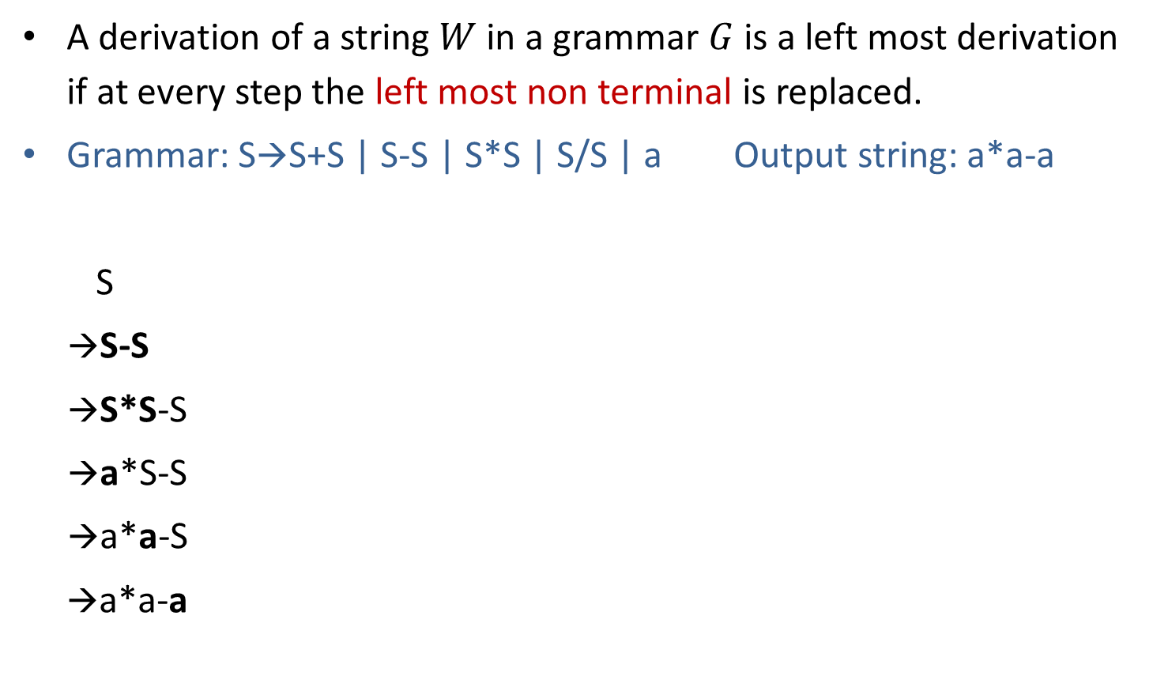
Leftmost derivation
A derivation of a string $W$ in a grammar $G$ is a left most derivation if at every step the left most non terminal is replaced.
Grammar: S→S+S | S-S | S*S | S/S | a Output string: a*a-a
S
→S-S
→S*S-S
→a*S-S
→a*a-S
→a*a-a
S
S
-
S
Parse tree represents the structure of derivation
S
*
S
a
a
a
Parse tree
Leftmost Derivation

Slide 28
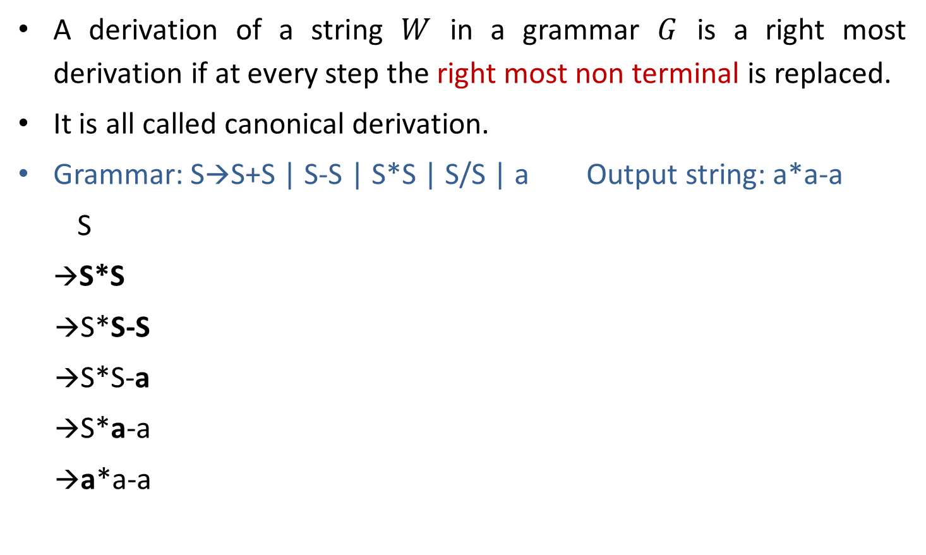
Rightmost derivation
A derivation of a string $W$ in a grammar $G$ is a right most derivation if at every step the right most non terminal is replaced.
It is all called canonical derivation.
Grammar: S→S+S | S-S | S*S | S/S | a Output string: a*a-a
S
→S*S
→S*S-S
→S*S-a
→S*a-a
→a*a-a
S
S
*
S
a
S
-
S
a
a
Parse Tree
Rightmost Derivation

Slide 29
Example: Derivation
S→A1B
A→0A | 𝜖
B→0B | 1B | 𝜖 Perform leftmost & Rightmost derivation.
(String: 00101)
Leftmost Derivation
S
A1B
0A1B
00A1B
001B
0010B
00101B
00101
Rightmost Derivation
S
A1B
A10B
A101B
A101
0A101
00A101
00101

Slide 30
Exercise: Derivation
Perform leftmost derivation and draw parse tree.
S→A1B
A→0A | 𝜖
B→0B | 1B | 𝜖
Output string: 1001.
Perform rightmost derivation and draw parse tree.
E→E+E | E*E | id | (E) | -E
Output string : id + id * id.

Slide 31
Ambiguous grammar

Slide 32
Ambiguous grammar
Ambiguous grammar is one that produces more than one leftmost or more then one rightmost derivation for the same sentence.
Grammar: S→S+S | S*S | (S) | a Output string: a+a*a
S S
→S*S →S+S
→S+S*S →a+S
→a+S*S →a+S*S
→a+a*S →a+a*S
→a+a*a →a+a*a
Here, Two leftmost derivation for string a+a*a is possible hence, above grammar is ambiguous.
S
S
S
*
S
S
+
S
S
+
S
a
a
S
*
S
a
a
a
a

Slide 33
Exercise: Ambiguous grammar
Check whether following grammars are ambiguous or not:
S→ aS | Sa | 𝜖 (string: aaaa)
S→ aSbS | bSaS | 𝜖 (string: abab)
S→SS+ | SS* | a (string: aa+a*)

Slide 34
Unambiguous grammar
Grammar: S→ S+S | S*S | (S) | a
Equivalent unambiguous grammar is
S→ S + T | T
T→ T * F | F
F→ (S) | a
Equivalent
unambiguous
grammar
Output string: a+a*a
S
→ S+T
→ T+T
→ F+T
→ a+T
→ a+T*F
→ a+F*F
→ a+a*F
→ a+a*a
Try for second leftmost derivation
Not possible????
Here, two left most derivation is not possible for string a+a*a hence, grammar is unambiguous.

Slide 35
Simplified forms & Normal forms

Slide 36

Nullable Variable
A Nullable variable in a CFG, $G=(V,Σ,S,P)$ is defined as follows:
Any variable A for which P contains $A→^$ is nullable.
If P contains the production $A→B1 B2….Bn$ are nullable variable, then A is nullable.
No other variables in V are nullable.

Slide 37
Eliminate ˄ production
S→a X |Yb
X→ ˄ | S
Y→bY|b
S→aX | Yb | a^
X→^ | S
Y→bY|b
S→aX|Yb|a
X→S
Y→bY|b
Nullable variable={X}
Replacing X by ^ in all productions containing X on RHS and rewriting the production again
Removing ^ productions

Slide 38
Exercise: Eliminate ^ production
S→AC
A→aAb|˄
C→aC|a
After elimination of ^ production:
S→AC | C
A→aAb| ab
C→aC|a
S→XaX|bX|Y
X→XaX|XbX|˄
Y→ab
After elimination of ^ production:
S→ XaX | bX | Y | aX | Xa | a | b
X→ XaX |XbX | aX | Xa | a | Xb | bX | b
Y→ab

Slide 39

A-derivable
A variable is called A-derivable ,
If $A→B$ is a production, B is A-derivable.
If C is A-derivable, $C→B$ is a production, and $B≠A$ , then B is A-derivable.
No other variables are A-derivable.
S→A
S→B
S-derivable={A,B}
S→A
A→B
S-derivable={A,B}

Slide 40
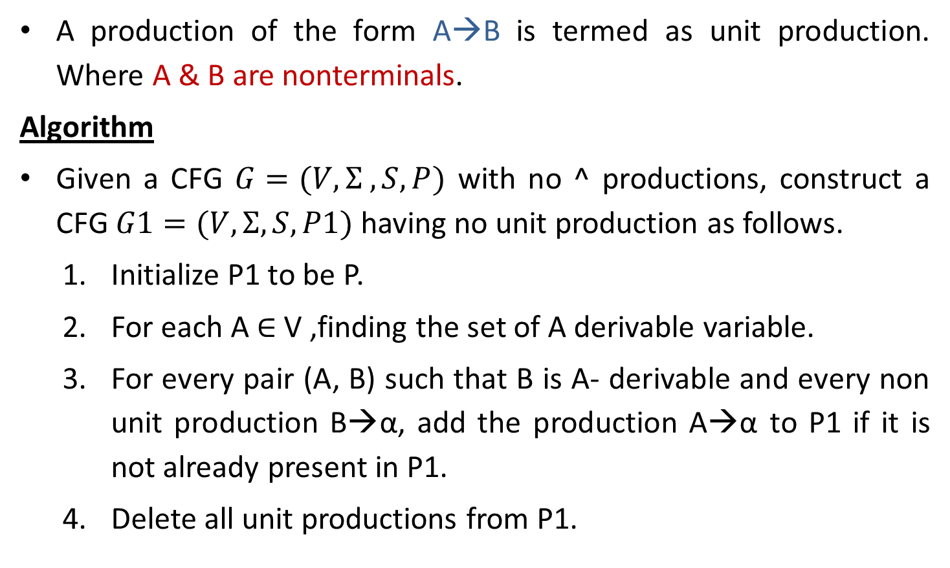
Unit Production & Elimination of Unit productions
A production of the form A→B is termed as unit production. Where A & B are nonterminals.
Algorithm
Given a CFG $G=(V,Σ ,S,P)$ with no ^ productions, construct a CFG $G1=(V,Σ,S,P1)$ having no unit production as follows.
Initialize P1 to be P.
For each A ∈ V ,finding the set of A derivable variable.
For every pair (A, B) such that B is A- derivable and every non unit production B→α, add the production A→α to P1 if it is not already present in P1.
Delete all unit productions from P1.

Slide 41
Elimination of unit production
S→ABA|BA|AA|AB|A|B
A→ aA|a
B→ bB|b
Unit Productions are S→A and S→B
A→aA|a
B→bB|b
S→ABA|BA|AA|AB
|aA|a
|bB|b
Removing unit productions

Slide 42
CFG to CNF

Slide 43

Chomsky Normal Form (CNF)
A context free grammar is in Chomsky normal form (CNF) if every production is one of these two forms:
$$A →BC$$
$$A→a$$
Where $A, B,$and $C$ are nonterminal and $a$ is terminal.

Slide 44
Converting CFG to CNF
Steps to convert CFG to CNF
Eliminate ˄-Productions.
Eliminate Unit Productions.
Restricting the right side of productions to single terminal or string of two or more nonterminals.
Final step of CNF. (shorten the string of NT to length 2)

Slide 45
Example: CFG to CNF
S→AAC
A→aAb|˄
C→aC|a
Step 1: Elimination of ^ production
Step-2: Eliminate Unit Production
Step 3: Replace all mixed string with solid NT
Step-4: Shorten the string of NT to length 2
S→AX₁ X₁→AC
S→AC|PC|a
A→PY₁ Y₁→AQ
A→PQ
C→PC|a
P→a
Q→b
|a
aC
PC
S→AAC|AC|
aAb|ab
PAQ|PQ
A→
PC|a
C→
aC|a
P→a
Q→b
Eliminate A→^
S→AAC|
AC |
C
A→aAb|
ab
C→aC|a
Unit Production is S→C
S→AAC|AC|
C
aC|a
A→aAb|ab
C→aC|a
Chomsky Normal Form

Slide 46
Example: CFG to CNF
S→aAbB
A→Ab|b
B→Ba|a
Step 1 and 2 are not required as there is no ^ and unit productions
Step-3: Replace all mixed string with solid NT
S→PAQB
A→AQ|b
B→BP|a
P→a
Q→b
Step-4 : final step of CNF
S→PT1
T1→AT2
T2→QB
A→AQ|b
B→BP|a
P→a
Q→b

Slide 47
Example: CFG to CNF
S→AA
A→B|BB
B→abB|b|bb
Step 1 is not required as there is no ^ productions
Step-2: Eliminate Unit Production:
S→AA
A→ abB|b|bb|BB
B→abB|b|bb
Step-3:Replace all mixed string with solid NT:
S→AA
A→ PQB|b|QQ|BB
B→ PQB|b|QQ
P→a
Q→b
Step-4 : Shorten the string of NT to length 2
S→AA
A→ PT1|b|QQ|BB T1→QB
B→ PV1|b|QQ V1→QB
P→a
Q→b

Slide 48
Example: CFG to CNF
S→ASB|^
A→aAS|a
B→SbS|A|bb
Step-1: Eliminate ˄-Production:
S→ASB|AB
A→aAS|a|aA
B→SbS|A|bb|bS|Sb|b
Step-2: Eliminate Unit Production:
S→ASB|AB
A→aAS|a|aA
B→SbS|aAS|a|aA|bb|bS|Sb|b
Step-3:Replace all mixed string with solid NT:
S→ASB|AB
A→PAS|a|PA
B→SQS|PAS|a|PA|QQ|QS|SQ|b
P→a
Q→b
Step-4 : Shorten the string of NT to length 2
S→AB|AT1 T1→SB
A→a|PA|PU1 U1→AS
B→ SV1|PV2|a|PA|QQ|QS|SQ|b
V1→QS V2→AS
P→a
Q→b

Slide 49
Backus-Naur Form (BNF)
BNF is one of the notation techniques for context free grammar.
It is often used to describe syntax of the language used in computing.
Variables written between <..> are non terminals.
Vertical bar ‘|’ indicating a alternate choice.
[…], which is used to enclosed an optional specification.
Example:
<exp>=<exp> + <term> | <term>
<term>=<term> * <factor> | <factor>
<factor>=<factor> ^ <primary> | <primary>
<primary>=<id> | <const>
<id>=<letter>
<const>=[+/-]<digit>
<letter>=a | b | c |……| z
<digit>=0 | 1 |………….| 9

Slide 50
Union, Concatenation & Kleene’s of CFG

Slide 51
Union, Concatenation & Kleene’s of CFG
Theorem:- If L₁ and L₂ are context - free languages, then the languages L₁ U L₂, L₁L₂ , and L₁* are also CFLs.
The proof is constructive: Starting with CFGs
G₁ = (V₁, Ʃ, S₁,P₁) and G₂ = (V₂, Ʃ, S₂,P₂) ,
Generating L₁ and L₂, respectively, we show how to construct a new CFG for each of the three cases.
G_{u} = (V_{u}, Ʃ, S_{u}, P_{u}) generating L₁ U L₂
G_{c}= (V_{c}, Ʃ, S_{c}, P_{c}) generating L₁L₂
G* = (V, Ʃ, S, P) generating L₁ *

Slide 52
Union G_{u} = (V_{u}, Ʃ, S_{u}, P_{u})
A grammar G_{u} = (V_{u}, Ʃ, S_{u}, P_{u}) generating L₁ U L₂.
First we rename the element of V₂ if necessary so that V₁ ∩ V₂= Ø
V_{u}= V₁ U V₂ U {S_{u}}
Where S_{u} is a new symbol not in V₁ or V_{2.} Then we let
P_{u}= P₁ U P₂ U { S_{u}→ S₁ | S₂ }
On the other hand, if x is derivable from S_{u} in G_{u,} the first step in any derivation must be
S_{u}→S₁ or S_{u}→S₂
In the first case, all subsequent productions used must be productions in G₁, because no variables in V₂ are involved, and thus x∈ L₁; in the second case, x ∈ L_{2.} Therefore,
L(G_{u}) ⊆ L₁ U L₂

Slide 53
Concatenation G_{c}= (V_{c}, Ʃ, S_{c}, P_{c})
A grammar G_{c}= (V_{c}, Ʃ, S_{c}, P_{c}) generating L₁L₂ . Again we relabeled variables if necessary so that V₁ ∩ V₂ = Ø and define
Vc = V₁ U V₂ U {S_{c}}
This time we let
P_{c}= P₁ U P₂ U { S_{c}→S₁S₂ }
If x ∈L₁L₂ then x = x₁x₂ , where x_{i} ∈L_{i} for each i. we may then derive x in G_{c} as follows:
S_{c} →S₁ S₂ → *x₁ S₂ → * x₁x₂ = x
First step in the derivation must be S_{c}→S₁ S₂ Where the second step is the derivation of x₁ in G₁ and the third step is the derivation of x₂ in G_{2.} So x ∈ L₁L₂

Slide 54
Kleene (*)
A grammar G* = (V, Ʃ, S, P) generating L₁ * Let V = V1 U {S}
Where S ∉ V1.The language L₁*contains strings of the form x = x₁x₂ …x_{k}, where each x_{i} ∈ L₁.
Since each x_{i} can be derived from S₁, then to derive x from S it is enough to be able to derive a string of k S₁‘S. We can accomplish this by including the productions
S→S₁S | ^
In P. Therefore, let
P = P₁U { S→S₁S | ^ }
The proof that L₁ * ⊆ L(G*) is straightforward. If x ∈ L(G*) , on the other hand, then either x = or x can be derived from some string of the form S₁k in G* . In the second case, since the only production in G* beginning with S₁ are those in G₁, we may conclude that
x∈ L(G₁)k ⊆ L(G₁)* .

Slide 55
End of Unit - 3

