Slide 1

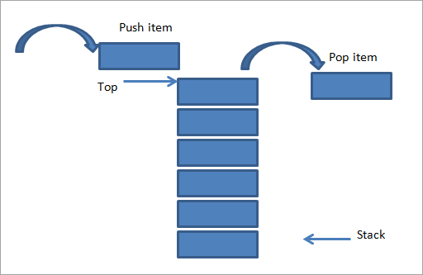

2160704
Theory of Computation
Unit-4
Pushdown Automata, CFL & NCFL
Prof. Dixita B. Kagathara
dixita.kagathara@darshan.ac.in

Slide 2
Topics to be covered
Why pushdown Automata?
Definition: PDA
Acceptance by PDA
Design PDA
CFG to PDA
PDA to CFG
Intersection and complement of CFL
Pumping lemma for CFG

Slide 3
Why Pushdown Automata?

Slide 4

Why Pushdown Automata?
Exercise
Draw Finite automata for language $L=\left\{anbn\right\}$
FA have limited capability.
This is due to the "finite memory” and "no external memory" involved with FA.
Not Possible??
b
a

Slide 5
Pushdown Automata
A pushdown Automata is essentially a finite Automata with a stack data structure.
A PDA can write an unbounded no. of symbols on the stack and read these symbols later.
Writing a symbol on to the stack is called “PUSH” operation.
Removing a symbol off the stack is called “POP” operation.
Finite Stack Control
Input
Accept | Reject
Stack

Slide 6
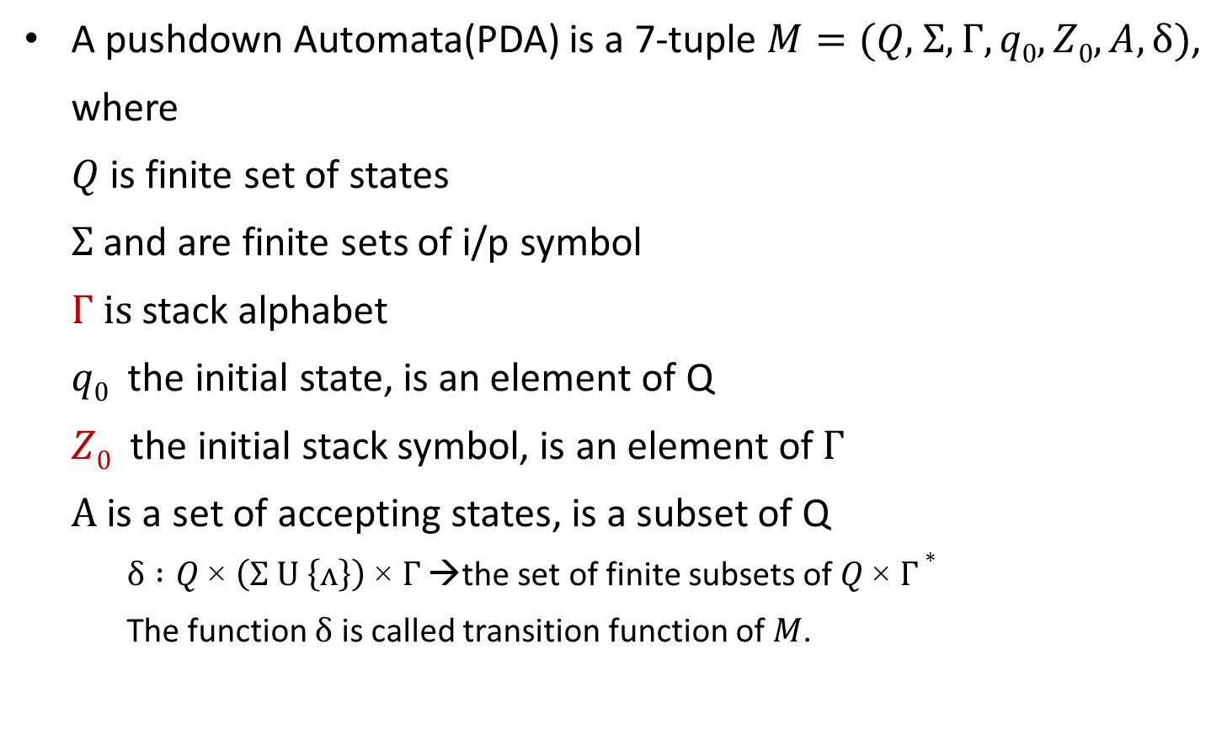
Definition of PDA
A pushdown Automata(PDA) is a 7-tuple $M=(Q\text{, }Σ,Γ, q0,Z0,A,δ)$,
where
$Q$ is finite set of states
$Σ$ and are finite sets of i/p symbol
$Γ$ is stack alphabet
$q0$ the initial state, is an element of Q
$Z0$ the initial stack symbol, is an element of$Γ$
$A$ is a set of accepting states, is a subset of Q
$δ :Q \text{×} \left(Σ U \left\{ʌ\right\}\right) \text{×} Γ$ →the set of finite subsets of $Q \text{×} Γ∗$
The function $δ$ is called transition function of $M$.

Slide 7

Acceptance by PDA
If $M=(Q\text{, }Σ,Γ, q0,Z0,A,δ)$is a PDA and $x ε Σ∗$, $x$ is accepted by $M$ if
$$\left(q_{0},x,Z_{0}\right) ├_{M}^{∗} (q, ^, α)$$
for some $α ϵ Γ∗$ and some $q ε A$. A language $L⊆Σ∗$is said to be accepted by $M$ if L is precisely the set of strings accepted by $M$, in this case, we write $L=L(M)$.

Slide 8
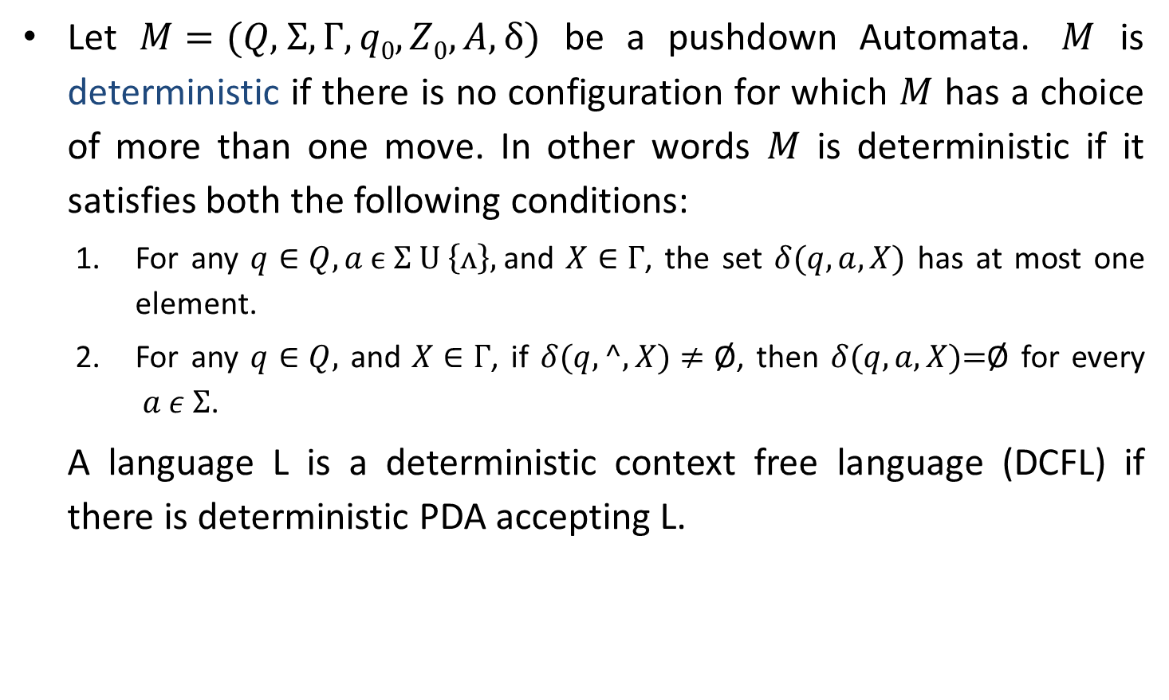
Deterministic PDA
Let $M=(Q\text{, }Σ,Γ, q0,Z0,A,δ)$ be a pushdown Automata. $M$ is deterministic if there is no configuration for which $M$ has a choice of more than one move. In other words $M$ is deterministic if it satisfies both the following conditions:
For any $q∈Q, a ϵ Σ U \left\{ʌ\right\},$and $X∈Γ$, the set $δ(q, a, X)$ has at most one element.
For any $q∈Q,$ and $X∈Γ$, if $δ(q, ^, X)≠\text{Ø}$, then $δ(q, a, X)\text{=}\text{Ø}$ for every $a ε Σ$.
A language L is a deterministic context free language (DCFL) if there is deterministic PDA accepting L.

Slide 9
Applications of PDA
A pushdown automata is a way to implement a context free grammar.
PDA is used in parser design for syntactic analysis.

Slide 10







Design DPDA for L={a^{n}b^{n}|a,b ∈ Ʃ, n≥0}
$$a$$
$$a$$
$$a$$
a^{n}b^{n}
If n=3 then
a³b³
= a a a b b b
$$b$$
$$b$$
$$b$$
$$z0$$

Slide 11
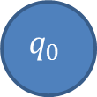
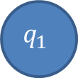
How to Represent PDA?
Move No | State | Input | Stack Symbol | Move(s)
$$1_{}$$ | $$q_{0}$$ | $$a_{}$$ | $$z_{0}$$ | $$(q0,az0)$$
$$2_{}$$ | $$q_{0}$$ | $$a_{}$$ | $$a$$ | $$(q0,aa)$$
$$3_{}$$ | $$q_{0}$$ | $$b_{}$$ | $$a$$ | $$(q1,^)$$
Input symbol, stack symbol | PUSH/POP
a, z₀|az₀
$$q_{0}$$
b, a | ^
$$q_{1}$$
FIRST 2 SYMBOLS OF THE STACK
^
a, a | aa

Slide 12

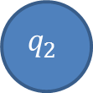
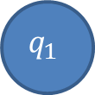
Design DPDA for L={a^{n}b^{n}|a,b ∈ Ʃ, n≥0}
Move No | State | Input | Stack Symbol | Move(s)
$$1_{}$$ | $$q_{0}$$ | $${^}_{}$$ | $$z_{0}$$ | $$(q2,z0)$$
$$2_{}$$ | $$q_{0}$$ | $$a_{}$$ | $$z_{0}$$ | $$(q0,az0)$$
$$3_{}$$ | $$q_{0}$$ | $$a_{}$$ | $$a$$ | $$(q0,aa)$$
$$4_{}$$ | $$q_{0}$$ | $$b_{}$$ | $$a$$ | $$(q1,^)$$
$$5_{}$$ | $$q_{1}$$ | $$b_{}$$ | $${ a}_{}$$ | $$(q1,^)$$
$$6_{}$$ | $$q_{1}$$ | $${^}_{}$$ | $${ z}_{0}$$ | $$(q2,z0)$$
$$(all other combinations)$$ | $$none$$
a, z₀|az₀
b, a | ^
$$q_{0}$$
b, a | ^
$$q_{1}$$
^,z₀ | z₀
$$q_{2}$$
a, a | aa
^,z₀ | z₀

Slide 13
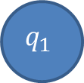

Design DPDA for same no. of a’s & b’s.
Move No | State | Input | Stack Symbol | Move(s)
$$1_{}$$ | $$q_{0}$$ | $$a_{}$$ | $$z_{0}$$ | $$(q0,az0)$$
$$2_{}$$ | $$q_{0}$$ | $$b_{}$$ | $$z_{0}$$ | $$(q0,bz0)$$
$$3_{}$$ | $$q_{0}$$ | $$a_{}$$ | $$a$$ | $$(q0,aa)$$
$$4_{}$$ | $$q_{0}$$ | $$b_{}$$ | $$b$$ | $$(q0,bb)$$
$$5_{}$$ | $$q_{0}$$ | $$a_{}$$ | $$b$$ | $$(q0,^)$$
$$6_{}$$ | $$q_{0}$$ | $$b_{}$$ | $$a$$ | $$(q0,^)$$
$$7_{}$$ | $$q_{0}$$ | $${^}_{}$$ | $$z0$$ | $$(q1,z0)$$
$$(all other combinations)$$ | $$none$$
a, z₀|az₀
a, b|^
b, z₀|bz₀
b, a|^
^,z₀ | z₀
$$q_{0}$$
$$q_{1}$$
a, a | aa
b, b | bb

Slide 14
Design PDA for {a^{n}b^{n+m} c^{m} | n,m>=1}
a^{n} b^{n+m} c^{m}
= a^{n} b^{n} b^{m} c^{m}
If n=2 and m=3 then
= a² b² b³ c³
= aa bb bbb ccc

Slide 15
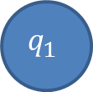

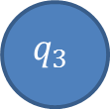
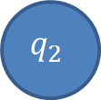
Design PDA for {a^{n}b^{n+m} c^{m} | n,m>=1}
Move No | State | Input | Stack Symbol | Move(s)
$$1_{}$$ | $$q_{0}$$ | $$a_{}$$ | $$z_{0}$$ | $$(q1,az0)$$
$$2_{}$$ | $$q_{1}$$ | $$a_{}$$ | $$a$$ | $$(q1,aa)$$
$$3_{}$$ | $$q_{1}$$ | $$b_{}$$ | $$a$$ | $$(q2,^)$$
$$4_{}$$ | $$q_{2}$$ | $$b_{}$$ | $$a$$ | $$(q2,^)$$
$$5_{}$$ | $$q_{2}$$ | $$b_{}$$ | $$z_{0}$$ | $$(q3,bz0)$$
$$6_{}$$ | $$q_{3}$$ | $$b_{}$$ | $$b_{}$$ | $$(q3,bb)$$
a, a| aa
b, a| ^
b, b| bb
a, z₀| az₀
b, a| ^
$$q_{2}$$
b, z₀| bz₀
$$q_{3}$$
$$q_{0}$$
$$q_{1}$$

Slide 16
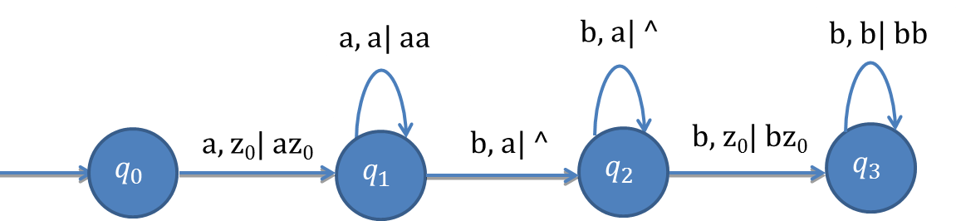
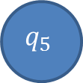
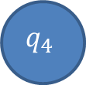
Design PDA for {a^{n}b^{n+m} c^{m} | n,m>=1}
Move No | State | Input | Stack Symbol | Move(s)
$$7_{}$$ | $$q_{3}$$ | $$c_{}$$ | $$b_{}$$ | $$(q4,^)$$
$$8_{}$$ | $$q_{4}$$ | $$c_{}$$ | $$b_{}$$ | $$(q4,^)$$
$$9_{}$$ | $$q_{4}$$ | $${^}_{}$$ | $$z_{0}$$ | $$(q5,z0)$$
$${(All other combination)}_{}$$ | $$none$$
c, b| ^
c, b| ^
$$q_{4}$$
^, z₀| z₀
$$q_{5}$$

Slide 17
Exercise: Design PDA
Design PDA for a^{n}b^{n}c^{m}d^{m} , n,m>=1
Design PDA for a^{n}b^{m}c^{m}d^{n} , n,m>=1
Design PDA for a^{n+m}b^{n}c^{m} , n,m>=1

Slide 18
Design PDA for palindrome with middle symbol c.
Design a PDA for following CFG.
S→aSa/bSb/c
Design PDA for L={xcx^{r}/x∈{a,b}*}. The string in L are odd length palindromes over {a,b}
Strings accepted in the language are:
aba c aba
aaa c aaa
bab c bab
ab c ba

Slide 19
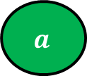
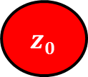

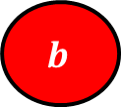
Design PDA for palindrome with middle symbol c.
$$a$$
$$b$$
$$a$$
a b a c a b a
$$a$$
$$b$$
$$a$$
$$z0$$

Slide 20
Design PDA for palindrome with middle symbol c.
Move No | State | Input | Stack Symbol | Move(s)
$$1_{}$$ | $$q_{0}$$ | $$a_{}$$ | $$z_{0}$$ | $$(q0,az0)$$
$$2_{}$$ | $$q_{0}$$ | $$b_{}$$ | $$z_{0}$$ | $$(q0,bz0)$$
$$3_{}$$ | $$q_{0}$$ | $$a_{}$$ | $$a$$ | $$(q0,aa)$$
$$4_{}$$ | $$q_{0}$$ | $$b_{}$$ | $$a$$ | $$(q0,ba)$$
$$5_{}$$ | $$q_{0}$$ | $$a_{}$$ | $${ b}_{}$$ | $$(q0,ab)$$
$$6_{}$$ | $$q_{0}$$ | $$b_{}$$ | $${ b}_{}$$ | $$(q0,bb)$$
b, z₀|bz₀
a, z₀|az₀
a, a | aa
$$q_{0}$$
b, b | bb
b, a | ba
a, b | ab

Slide 21

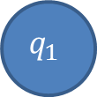
Design PDA for palindrome with middle symbol c.
Move No | State | Input | Stack Symbol | Move(s)
$$7_{}$$ | $$q_{0}$$ | $$c_{}$$ | $$z_{0}$$ | $$(q1,z0)$$
$$8_{}$$ | $$q_{0}$$ | $$c_{}$$ | $$a_{}$$ | $$(q1,a)$$
$$9_{}$$ | $$q_{0}$$ | $$c_{}$$ | $$b_{}$$ | $$(q1,b)$$
b, z₀|bz₀
a, z₀|az₀
a, a | aa
c,a | a
$$q_{0}$$
c,b | b
$$q_{1}$$
c,z₀ | z₀
b, b | bb
b, a | ba
a, b | ab

Slide 22
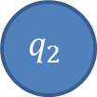
Design PDA for palindrome with middle symbol c.
Move No | State | Input | Stack Symbol | Move(s)
$${10}_{}$$ | $$q_{1}$$ | $$a$$ | $${ a}_{}$$ | $$(q1,^)$$
$${11}_{}$$ | $$q_{1}$$ | $$b_{}$$ | $${ b}_{}$$ | $$(q1,^)$$
$${12}_{}$$ | $$q_{1}$$ | $${^}_{}$$ | $${ z}_{0}$$ | $$(q2,{ z}_{0})$$
$$(all other combinations)$$ | $$none$$
b, z₀|bz₀
b, b | ^
a, z₀|az₀
a, a | aa
c,a | a
$$q_{0}$$
c,b | b
$$q_{1}$$
^,z₀ | z₀
$$q_{2}$$
c,z₀ | z₀
b, b | bb
b, a | ba
a, b | ab
a, a | ^

Slide 23


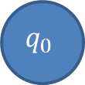
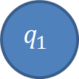
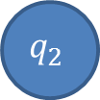
String Tracing
b, z₀|bz₀
b, b | ^
a, z₀|az₀
a, a | aa
c,a | a
$$q_{0}$$
c,b | b
$$q_{1}$$
^,z₀ | z₀
$$q_{2}$$
c,z₀ | z₀
b, b | bb
b, a | ba
a, b | ab
a, a | ^
Move No | Resulting State | Unread Input | Stack
$$Initially$$ | $$q_{0}$$ | $${abcba}_{}$$ | $$z_{0}$$
$$1$$ | $$q_{0}$$ | $${bcba}_{}$$ | $${az}_{0}$$
$$4$$ | $$q_{0}$$ | $$cba$$ | $${baz}_{0}$$
$$9$$ | $$q_{1}$$ | $${ba}_{}$$ | $${baz}_{0}$$
$$11$$ | $$q_{1}$$ | $$a_{}$$ | $${az}_{0}$$
$$10$$ | $$q_{1}$$ | $$−$$ | $$z_{0}$$
$$12$$ |  | $$−$$ | $$z_{0}$$
$$q_{2}$$
$$q_{2}$$

Slide 24
Exercise
Trace the following string:
bcb
ab
acaa

Slide 25

Design PDA for {a^{i}b^{j}c^{k} | i,j,k>=1 & j=i or j=k}
Move No | State | Input | Stack Symbol | Move(s)
$$1_{}$$ | $$q_{0}$$ | $$a_{}$$ | $$z_{0}$$ | $$(q1,az0)$$
$$2_{}$$ | $$q_{1}$$ | $$a_{}$$ | $$a$$ | $$(q1,aa)$$
$$3_{}$$ | $$q_{1}$$ | $$b_{}$$ | $$a$$ | $$(q2,^)$$
$$4_{}$$ | $$q_{2}$$ | $$b_{}$$ | $$a$$ | $$(q2,^)$$
$$5_{}$$ | $$q_{2}$$ | $$c_{}$$ | $$z_{0}$$ | $$(q3,z0)$$
$$6_{}$$ | $$q_{3}$$ | $$c_{}$$ | $$z_{0}$$ | $$(q3,z0)$$
a, a| aa
b, a| ^
c, z₀| z₀
$$q_{0}$$
a, z₀| az₀
b, a| ^
$$q_{2}$$
c, z₀| z₀
$$q_{3}$$
$$q_{1}$$

Slide 26
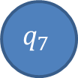

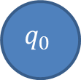

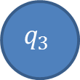
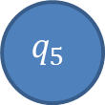
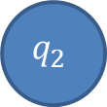
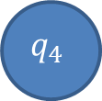
Design PDA for {a^{i}b^{j}c^{k} | i,j,k>=1 & j=i or j=k}
Move No | State | Input | Stack Symbol | Move(s)
$$7_{}$$ | $$q_{3}$$ | $${^}_{}$$ | $$z_{0}$$ | $$(q7,z0)$$
$$8_{}$$ | $$q_{0}$$ | $$a_{}$$ | $$z0$$ | $$(q4,z0)$$
$$9_{}$$ | $$q_{4}$$ | $$a_{}$$ | $$z0$$ | $$(q4,z0)$$
$${10}_{}$$ | $$q_{4}$$ | $$b_{}$$ | $$z_{0}$$ | $$(q5,bz0)$$
$${11}_{}$$ | $$q_{5}$$ | $$b_{}$$ | $b_{}$ | $$(q5,bb)$$
$${12}_{}$$ | $$q_{5}$$ | $$c_{}$$ | $$b_{}$$ | $$(q6,^)$$
$${13}_{}$$ | $$q_{6}$$ | $$c_{}$$ | $$b_{}$$ | $$(q6,^)$$
a, a| aa
b, a| ^
c, z₀| z₀
$$q_{0}$$
a, z₀| az₀
b, a| ^
$$q_{2}$$
c, z₀| z₀
$$q_{3}$$
^, z₀| z₀
$$q_{7}$$
$$q_{1}$$
a, z₀| z₀
a, z₀| z₀
b, b| bb
c, b| ^
$$q_{4}$$
$$q_{5}$$
$$q_{6}$$
b,z₀| bz₀
c, b| ^

Slide 27
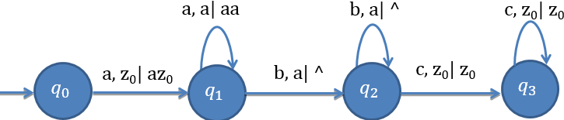




Design PDA for {a^{i}b^{j}c^{k} | i,j,k>=1 & j=i or j=k}
Move No | State | Input | Stack Symbol | Move(s)
$${14}_{}$$ | $$q_{6}$$ | $${^}_{}$$ | $$z_{0}$$ | $$(q7,z0)$$
$${(All other combination)}_{}$$ | $$none$$
J=
i=j
j=i
^, z₀| z₀
$$q_{7}$$
J=
j=k
a, z₀| z₀
a, z₀| z₀
b, b| bb
c, b| ^
^, z₀| z₀
$$q_{4}$$
b,z₀| bz₀
$$q_{5}$$
c, b| ^
$$q_{6}$$

Slide 28
Design DPDA for L={a^{n}b^{2n}|a,b ∈ Ʃ, n≥0}
$$a$$
$$a$$
a^{n}b^{2n}
If n=1 then
a¹b²
= a b b
$$b$$
$$b$$
$$b$$
$$z0$$

Slide 29

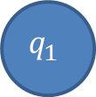
Design DPDA for L={a^{n}b^{2n}|a,b ∈ Ʃ, n≥0}
Move No | State | Input | Stack Symbol | Move(s)
$$1_{}$$ | $$q_{0}$$ | $${^}_{}$$ | $$z_{0}$$ | $$(q2,z0)$$
$$2_{}$$ | $$q_{0}$$ | $$a_{}$$ | $$z_{0}$$ | $$(q0,aa)$$
$$3_{}$$ | $$q_{0}$$ | $$a_{}$$ | $$a$$ | $$(q0,aa)$$
$$4_{}$$ | $$q_{0}$$ | $$b_{}$$ | $$a$$ | $$(q1,^)$$
$$5_{}$$ | $$q_{1}$$ | $$b_{}$$ | $${ a}_{}$$ | $$(q1,^)$$
$$6_{}$$ | $$q_{1}$$ | $${^}_{}$$ | $${ z}_{0}$$ | $$(q2,z0)$$
$$(all other combinations)$$ | $$none$$
a, z₀|aa
b, a | ^
$$q_{0}$$
b, a | ^
$$q_{1}$$
^,z₀ | z₀
$$q_{2}$$
a, a | aa
^,z₀ | z₀

Slide 30
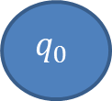
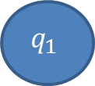
Design PDA for even odd length palindrome (Nondeterministic)
Move No | State | Input | Stack Symbol | Move(s)
$$1_{}$$ | $$q_{0}$$ | $$a_{}$$ | $$z_{0}$$ | $$(q0,az0)(q1,z0)$$
$$2_{}$$ | $$q_{0}$$ | $$b_{}$$ | $$z_{0}$$ | $$(q0,bz0)(q1,z0)$$
$$3_{}$$ | $$q_{0}$$ | $$a_{}$$ | $$a$$ | $$(q0,aa)(q1,a)$$
$$4_{}$$ | $$q_{0}$$ | $$b_{}$$ | $$a$$ | $$(q0,ba)(q1,a)$$
$$5_{}$$ | $$q_{0}$$ | $$a_{}$$ | $${ b}_{}$$ | $$(q0,ab)(q1,a)$$
$$6_{}$$ | $$q_{0}$$ | $$b_{}$$ | $${ b}_{}$$ | $$(q0,bb)(q1,b)$$
b, z₀|bz₀
a, z₀|az₀
a, a | aa
b, z₀| z₀ z₀
$$q_{0}$$
a, z₀| z₀
$$q_{1}$$
a,a | a
b,a | a
b, b | bb
b, a | ba
a, b | ab
a,b | b
b,b | b

Slide 31


Design PDA for even odd length palindrome
Move No | State | Input | Stack Symbol | Move(s)
$$7_{}$$ | $$q_{0}$$ | $$^$$ | $$z_{0}$$ | $$(q1,z0)$$
$$8_{}$$ | $$q_{0}$$ | $$^$$ | $$a$$ | $$(q1,a)$$
$$9_{}$$ | $$q_{0}$$ | $${^}_{}$$ | $$b_{}$$ | $$(q1,b)$$
^,b | b
b, z₀|bz₀
^,a | a
^,z₀ | z₀
a, z₀|az₀
a, a | aa
a,z₀ | z₀
$$q_{0}$$
b,z₀|z₀
$$q_{1}$$
a,a | a
b, a | ba
b,a | a
b, b | bb
a, b | ab
a,b | b
b,b | b

Slide 32

Design PDA for even odd length palindrome
Move No | State | Input | Stack Symbol | Move(s)
$${10}_{}$$ | $$q_{1}$$ | $$a$$ | $${ a}_{}$$ | $$(q1,^)$$
$${11}_{}$$ | $$q_{1}$$ | $$b$$ | $$b$$ | $$(q1,^)$$
$${12}_{}$$ | $$q_{1}$$ | $${^}_{}$$ | $${ z}_{0}$$ | $$(q2,{ z}_{0})$$
$$(all other combinations)$$ | $$none$$
^,b | b
b, z₀|bz₀
^,a | a
^,z₀ | z₀
b, b | ^
a, z₀|az₀
a, a | aa
a,z₀|z₀
$$q_{0}$$
b,z₀|z₀
$$q_{1}$$
^,z₀ | z₀
$$q_{2}$$
a,a | a
b, a | ba
b,b | b
b, b | bb
a, b | ab
a,b | b
a, a | ^
b,a | a

Slide 33


Design DPDA for grammar S→SS|[S]|{S}|˄
Move No | State | Input | Stack Symbol | Move(s)
$$1_{}$$ | $$q_{0}$$ | $$[_{}$$ | $$z_{0}$$ | $$(q1,[z0)$$
$$2_{}$$ | $$q_{0}$$ | $$\{_{}$$ | $$z_{0}$$ | $$(q1,\{z0)$$
$$3_{}$$ | $$q_{1}$$ | $$[_{}$$ | $$[_{}$$ | $$(q1,[[)$$
$$4_{}$$ | $$q_{1}$$ | $$\{_{}$$ | $$[_{}$$ | $$(q1,\{[)$$
$$5_{}$$ | $$q_{1}$$ | $$[_{}$$ | $$\{_{}$$ | $$(q1,[\{)$$
$$6_{}$$ | $$q_{1}$$ | $$\{_{}$$ | $$\{_{}$$ | $$(q1,\{\{)$$
{, [ | {[
{, z₀|{z₀
[, [|[[
[, { | [{
$$q_{0}$$
[, z₀|[z₀
$$q_{1}$$
{, { | {{

Slide 34
Design DPDA for grammar S→SS|[S]|{S}|˄
Move No | State | Input | Stack Symbol | Move(s)
$$7_{}$$ | $$q_{1}$$ | $$]_{}$$ | $$[_{}$$ | $$(q1,^)$$
$$8_{}$$ | $$q_{1}$$ | $$\}_{}$$ | $$\{_{}$$ | $$(q1,^)$$
$$9_{}$$ | $$q_{1}$$ | $${^}_{}$$ | $$z0$$ | $$(q0,z0)$$
$$(all other combinations)$$ | $$none$$
{, [ | {[
{, z₀|{z₀
[, [|[[
[, { | [{
$$q_{0}$$
[, z₀|[z₀
$$q_{1}$$
}, { | ^
{, { | {{
^,z₀ | z₀
{, { | {{
], [ | ^

Slide 35


Design DPDA for grammar S→SS|[S]|{S}|˄
{, [ | {[
[, [|[[
[, { | [{
{, z₀|{z₀
$$q_{0}$$
^,z₀ | z₀
$$q_{1}$$
[, z₀|[z₀
}, { | ^
{, { | {{
], [ | ^

Slide 36
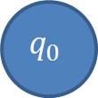
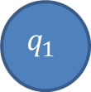
Design PDA to accept string with more a’s than b’s.
Move No | State | Input | Stack Symbol | Move(s)
$$1_{}$$ | $$q_{0}$$ | $$a_{}$$ | $$z_{0}$$ | $$(q1,az0)$$
$$2_{}$$ | $$q_{0}$$ | $$b_{}$$ | $$z_{0}$$ | $$(q0,bz0)$$
$$3_{}$$ | $$q_{0}$$ | $$a_{}$$ | $$b$$ | $$(q0,^)$$
$$4_{}$$ | $$q_{0}$$ | $$b_{}$$ | $$b$$ | $$(q0,bb)$$
$$5_{}$$ | $$q_{1}$$ | $$a_{}$$ | $${ a}_{}$$ | $$(q1,aa)$$
$$6_{}$$ | $$q_{1}$$ | $$b_{}$$ | $$a$$ | $$(q0,^)$$
$$7_{}$$ | $$q_{0}$$ | $${^}_{}$$ | $${ a}_{}$$ | $$(q1,a)$$
$$(all other combinations)$$ | $$none$$
a, b | ^
^, a | a
a, a | aa
b, z₀| bz₀
$$q_{0}$$
a, z₀|az₀
$$q_{1}$$
b, b | bb
b, a | ^

Slide 37
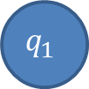

Design PDA for twice many a’s as b’s
Move No | State | Input | Stack Symbol | Move(s)
$$1_{}$$ | $$q_{0}$$ | $$a_{}$$ | $$z_{0}$$ | $$(q1,z0)$$
$$2_{}$$ | $$q_{1}$$ | $$a_{}$$ | $$z0$$ | $$(q0,xz0)$$
$$3_{}$$ | $$q_{0}$$ | $$b_{}$$ | $$z0$$ | $$(q0,yz0)$$
$$4_{}$$ | $$q_{0}$$ | $$b_{}$$ | $${ y}_{}$$ | $$(q0,yy)$$
b, y|yy
b, z₀|yz₀
$$q_{0}$$
a, z₀| z₀
$$q_{1}$$
a, z₀| xz₀

Slide 38
Design PDA for twice many a’s as b’s
Move No | State | Input | Stack Symbol | Move(s)
$$5_{}$$ | $$q_{0}$$ | $$a_{}$$ | $x_{}$ | $$(q1,x)$$
$$6_{}$$ | $$q_{1}$$ | $$a_{}$$ | $$x$$ | $$(q0,xx)$$
$$7_{}$$ | $$q_{1}$$ | $$b_{}$$ | $$z0$$ | $$(q1,yz0)$$
$$8_{}$$ | $$q_{1}$$ | $$b_{}$$ | $${ y}_{}$$ | $$(q1,yy)$$
$$9_{}$$ | $$q_{1}$$ | $$b_{}$$ | $${ x}_{}$$ | $$(q1,^)$$
b, x|^
b, y|yy
b, z₀|yz₀
b, z₀|yz₀
a, x| x
b, y|yy
$$q_{0}$$
a, z₀| z₀
$$q_{1}$$
a, x| xx
a, z₀| xz₀

Slide 39
Design PDA for twice many a’s as b’s
Move No | State | Input | Stack Symbol | Move(s)
$${10}_{}$$ | $$q_{0}$$ | $$a_{}$$ | $$y$$ | $$(q1,y)$$
$${11}_{}$$ | $$q_{0}$$ | $$b_{}$$ | $$a$$ | $$(q1,y)$$
$${12}_{}$$ | $$q_{1}$$ | $$a_{}$$ | $$y$$ | $$(q0,^)$$
$${13}_{}$$ | $$q_{0}$$ | $$b_{}$$ | $${ x}_{}$$ | $$(q0,^)$$
b, a| y
b, z₀|yz₀
b, y|yy
a, y| y
b, x|^
b, z₀|yz₀
a, x| x
b, y|yy
$$q_{0}$$
a, z₀| z₀
$$q_{1}$$
a, x| xx
b, x| ^
a, z₀| xz₀
a, y| ^

Slide 40
CFG to PDA

Slide 41
Steps to convert CFG to PDA
From given CFG G=(V,Σ,S,P), we can construct a PDA.
The PDA’s δ is given by :
For each non terminal A, include a transition
Include a transition δ(q, 𝜖, A)→{(q, α)|A→ α is a production in G}
For each terminal a, include a transition
Include a transition δ(q, a, a)→{(q, 𝜖)}

Slide 42
Example: CFG to PDA
Find PDA for following grammar:
S→0S1 | 00 | 11
The equivalent PDA, M is given by:
δ(q, 𝜖, S)= {(q, 0S1), (q, 00), (q,11)}
δ(q, 0, 0)={(q, 𝜖)}
δ(q, 1, 1)={(q, 𝜖)}
δ(q, 𝜖, A)→{(q, α)|A→ α is a production in G
Non Terminal
δ(q, a, a)→{(q, 𝜖)}
Terminal

Slide 43
Exercise: CFG to PDA
Given a CFG , G =( {S,A,B},{0,1},P,S) with P as follows:
S → 0B| 1A
A → 0S|1AA|0
B → 1S| 0BB | 1
Design a PDA M corresponding to CFG:
I → a | b | Ia | Ib | I0 | I1
E → I | E * E | E + E | (E)

Slide 44
PDA to CFG

Slide 45
Rule to convert PDA to CFG
Add the following production for the start symbol S.
S→[q₀ z q_{i}]
q₀ initial state
z initial stake symbol
qi ∈ Q
For each transition of the form δ( q_{i}, a, B) →(q_{j}, C)
where q_{i}, q_{j} ∈ Q
a ∈ (Ʃ U ^)
B, C ∈ (┌ U ^)
Then for each q∈ Q, add the production
[q_{i}, B, q]→a[q_{j}, C, q]

Slide 46
Rule to convert PDA to CFG
For transition of the form δ( q_{i}, a, B) →(q_{j},C₁C₂)
where q_{i}, q_{j} ∈ Q
a ∈ (Ʃ U ^)
B, C₁, C₂ ∈ (┌ U ^)
Then for each p1, p2 ∈ Q, add the production
[q_{i}, B, p₁]→a[q_{j} C₁ p₂] [p₂ C₂ p₁]

Slide 47
Example: PDA to CFG
Step 1: Add the production for the start symbol
S→[q z q]
S→[q z p]
State | Input | Stack | New state | Stack
q | 1 | z | q | xz
q | 1 | x | q | xx
q | ^ | x | q | ^
q | 0 | x | p | x
p | 1 | x | p | ^
p | 0 | z | q | z
S→[q₀ z q_{i}]
q₀ initial state
z initial stack symbol
qi ∈ Q (all state)

Slide 48
Example: PDA to CFG
Step 2: Add production for the δ( q, 1, z) →(q ,xz)
[q z q]→1[q x q][q z q]
[q z q]→1[q x p][p z q]
[q z p]→1[q x q][q z p]
[q z p]→1[q x p][p z p]
State | Input | Stack | New state | Stack
q | 1 | z | q | xz
q | 1 | x | q | xx
q | ^ | x | q | ^
q | 0 | x | p | x
p | 1 | x | p | ^
p | 0 | z | q | z
For transition of the form δ( q_{i}, a, B) →(q_{j},C₁C₂)
where q_{i}, q_{j} ∈ Q
a ∈ (Ʃ U ^)
B, C₁, C₂ ∈ (┌ U ^)
Then for each p1, p2 ∈ Q, add the production
[q_{i}, B, p₁]→a[q_{j} C₁ p₂] [p₂ C₂ p₁]
δ( q_{i}, a, B) →(q_{j},C₁C₂)
[q_{i}, B, p₁]→a[q_{j} C₁ p₂] [p₂ C₂ p₁]
P1=q p2=q
P1=q p2=p
P1=p p2=q
P1=p p2=p

Slide 49
Example: PDA to CFG
Step 3: Add production for the δ( q, 1, x) →(q ,xx)
[q x q]→1[q x q][q x q]
[q x q]→1[q x p][p x q]
[q x p]→1[q x q][q x p]
[q x p]→1[q x p][p x p]
State | Input | Stack | New state | Stack
q | 1 | z | q | xz
q | 1 | x | q | xx
q | ^ | x | q | ^
q | 0 | x | p | x
p | 1 | x | p | ^
p | 0 | z | q | z

Slide 50
Example: PDA to CFG
Step 4: Add the production for δ( q, ^, x) →(q ,^)
[q x q]→^
State | Input | Stack | New state | Stack
q | 1 | z | q | xz
q | 1 | x | q | xx
q | ^ | x | q | ^
q | 0 | x | p | x
p | 1 | x | p | ^
p | 0 | z | q | z
state
stack
input
New state

Slide 51
Example: PDA to CFG
Each transition of the form δ( q_{i}, a, B) →(q_{j}, C)
where q_{i}, q_{j} ∈ Q
a ∈ (Ʃ U ^)
B, C ∈ (┌ U ^)
Then for each q∈ Q, add the production
[q_{i}, B, q]→a[q_{j}, C, q]
Step 5: Add the production for δ( q, 0, x) →(p ,x)
[q x q]→0 [p x q]
[q x p]→0 [p x p]
State | Input | Stack | New state | Stack
q | 1 | z | q | xz
q | 1 | x | q | xx
q | ^ | x | q | ^
q | 0 | x | p | x
p | 1 | x | p | ^
p | 0 | z | q | z
δ( q_{i}, a, B) →(q_{j}, C)
[q_{i}, B, q]→a[q_{j}, C, q]

Slide 52
Example: PDA to CFG
Step 6: Add the production for δ( p, 1, x) →(p ,^)
[p x p]→1
State | Input | Stack | New state | Stack
q | 1 | z | q | xz
q | 1 | x | q | xx
q | ^ | x | q | ^
q | 0 | x | p | x
p | 1 | x | p | ^
p | 0 | z | q | z

Slide 53
Example: PDA to CFG
Step 7: Add the production for δ( p, 0, z) →(q ,z)
[p z q]→0 [q z q]
[p z p]→0 [q z p]
State | Input | Stack | New state | Stack
q | 1 | z | q | xz
q | 1 | x | q | xx
q | ^ | x | q | ^
q | 0 | x | p | x
p | 1 | x | p | ^
p | 0 | z | q | z
δ( q_{i}, a, B) →(q_{j}, C)
[q_{i}, B, q]→a[q_{j}, C, q]

Slide 54
Example: PDA to CFG
Step 8: Renaming variable name
The set of production can be written as:
S→A|B
A→1EA|1FC
B→1EB|1FD
E→1EE|1FG
F→1EF|1FH
E→^
E→0G
F→0H
H→1
C→0A
D→0B
Original name | New name
[q z q] | A
[q z p] | B
[p z q] | C
[p z p] | D
[q x q] | E
[q x p] | F
[p x q] | G
[p x p] | H
Step1:
S→[q z q]
S→[q z p]

Slide 55
Example: PDA to CFG
Step 9: simplification of grammar
Symbol G is not available on left side of
grammar so, it can be eliminated.
S→A|B
A→1EA|1FC
B→1EB|1FD
E→1EE|^
F→1EF|1FH|0H
H→1
C→0A
D→0B
Original name | New name
[q z q] | A
[q z p] | B
[p z q] | C
[p z p] | D
[q x q] | E
[q x p] | F
[p x q] | G
[p x p] | H

Slide 56
Intersection and complement of CFL (Non CFL)

Slide 57
Intersection and complement of CFL
Theorem:-There are CFLs L1 and L2 so that L1∩ L2 is not a CFL, and there is a CFL L so that L’ is not a CFL.
We observed that
L= { a^{i}b^{j}c^{k}| i < j and i < k }
is not context-free. However, although no PDA can test both conditions i < j and i< k simultaneously, it is easy enough to build two PDAs that test the conditions separately. In other words, although the intersection L of the two languages
L₁ = {a ^{i} b^{j}c^{k} | i < j}
and
L₂ = {a^{i}b^{j}c^{k} | i < k}
is not a CFL, both languages themselves are.

Slide 58
Intersection and complement of CFL
Another way to verify that L₁ is a CFL is to check it is generated by the grammar with productions
S→ABC A→aAb|˄ B→bB|b C→cC|˄
Similarly, L₂is generated by the CFG with productions
S→AC A→aAc|B B→bB|˄ C→cC|c
The second statement in the theorem follows from the first and the formula
L₁∩ L₂ =( L₁’U L₂’)’
If complements of CFLs were always CFLs, then for any CFLs L₁ and L₂, the language L₁’and L₂’ would be CFLs, so would their union, and so would its complement. We know now that this is not the case.

Slide 59
Pumping lemma for CFG

Slide 60
Pumping lemma for CFG
Suppose L is a context-free language. Then there is an integer n so that for every u ∈ L with |u| ≥ n, there are strings v, w, x, y, and z satisfying,
u = vwxyz
|wy| > 0
|wxy| ≤ n
for every m ≥ 0, vw^{m}xy^{m}z ∈ L

Slide 61
End of Unit - 4

