Slide 1

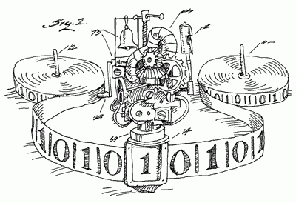

2160704
Theory of Computation
Unit-5
Turing Machine
Prof. Dixita B. Kagathara
dixita.kagathara@darshan.ac.in

Slide 2
Topics to be covered
What is Turing Machine?
Formal Definition: Turing Machine
Design of Turing Machine
Universal Turing Machine
Church Turing Thesis

Slide 3
Introduction
Finite Automata
Input Strings
Pushdown Automata
Input Strings
Stack
Turing Machine
Input Strings
Tape
Special symbol
Control portion
a
b
a
a
Stack Control
I/p
Accept | Reject
Δ
a
b
a
a
b
Δ
Tape Head
TM
Stack
PDA
FA
Recursively enumerable language
Context free language
Regular language

Slide 4
Turing Machine
The tape is capable of performing following three operations:
Read a symbol above the tape head.
Modify/Update a symbol above the tape head.
Shifting either to previous square or next square.
b
a
a
b
a
Δ
b
Δ
Head

Slide 5






Turing Machine
$${ q}_{2}$$
$${ q}_{3}$$
$${ q}_{1}$$
$${ q}_{4}$$
Δ
b
a
a
b
a
Δ
Head
$${ q}_{5}$$
$${ q}_{6}$$
Tape
Control portion
Turing Machine = Control portion + Tape

Slide 6


Turing Machine
Operation to be performed by TM:
Read a symbol above the tape head.
Modify/Update a symbol above the tape head.
Shifting either to previous square or next square.
b
a
a
b
a
Δ
b
Δ
Head
Some other Ex:
Update
b | a, L
Read
Shift (L or R or S)
a | Δ, R
$${ q}_{0}$$
a | b, R
$${ q}_{1}$$
a | a, R
a | A, S

Slide 7
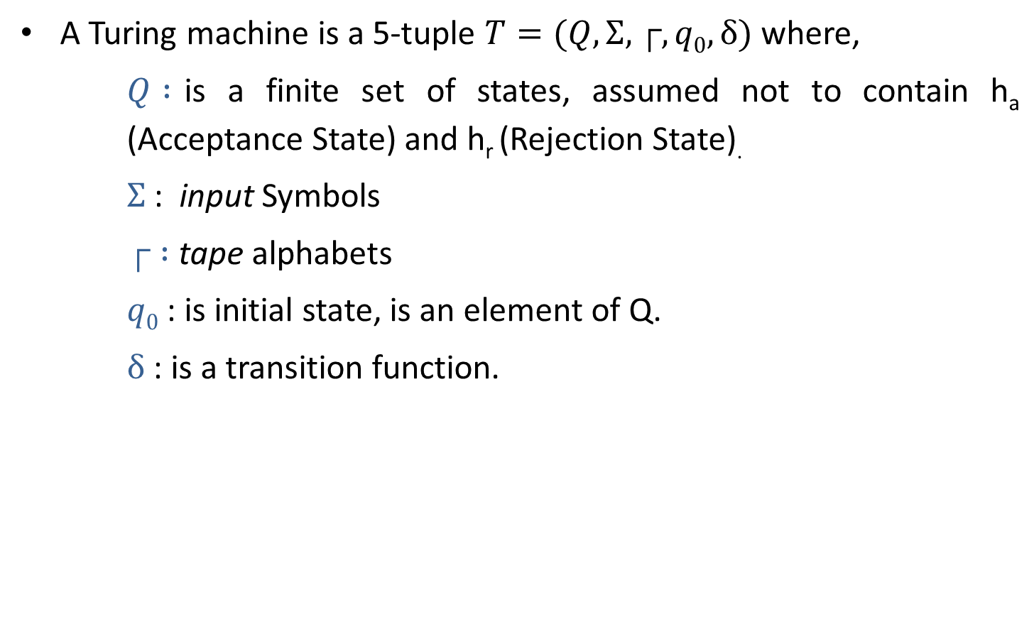
Definition: Turing Machine
A Turing machine is a 5-tuple $T=(Q,Σ,┌,q0,δ)$ where,
$Q :$is a finite set of states, assumed not to contain h_{a} (Acceptance State) and h_{r} (Rejection State).
$Σ$: input Symbols
$┌ :$ tape alphabets
$q0$ : is initial state, is an element of Q.
$δ$ : is a transition function.

Slide 8
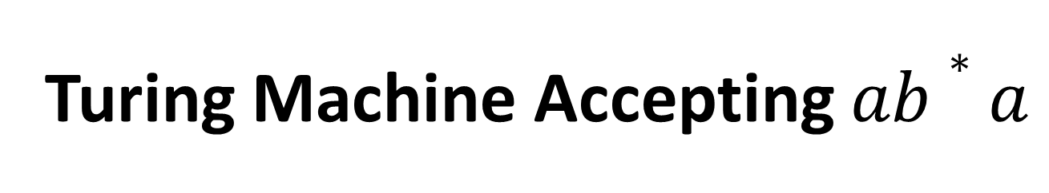
Turing Machine Accepting $ab∗a$

Slide 9
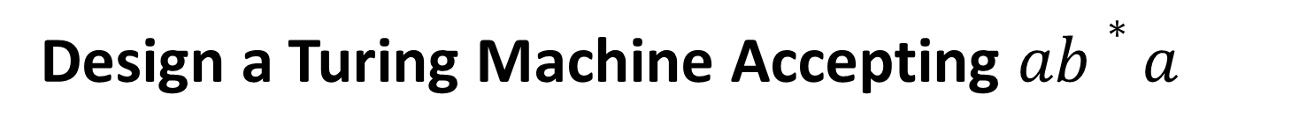
Design a Turing Machine Accepting $ab∗a$
L = {ab*a}
Strings accepting in given L are:
aa
a b a
a b b a
a b b b a
Tape
a
a
Δ
A
b
Δ
B
A
A
b
a
a
B
B
Δ
Δ
b
A
Logic:
Read ‘a’, replace ‘a’ by ‘A’ (a→A)
Read all ‘b’ one by one & replace it by ‘B’ (b→B)
if no ‘b’ found: SKIP step 2
Read ‘a’, replace ‘a’ by ‘A’ (a→A)
A
a
Δ
a
A
Δ

Slide 10






Design a Turing Machine Accepting $ab∗a$
Tape
a
a
Δ
A
b
Δ
B
A
$${ h}_{r}$$
b|B,R
a|A,R
b|B,R
b|B,R
$${ q}_{0}$$
Δ|Δ,R
$${ q}_{1}$$
a|A,R
$${ q}_{2}$$
a|A,R
$${ q}_{3}$$
Δ|Δ,S
$${ h}_{a}$$
Control portion

Slide 11
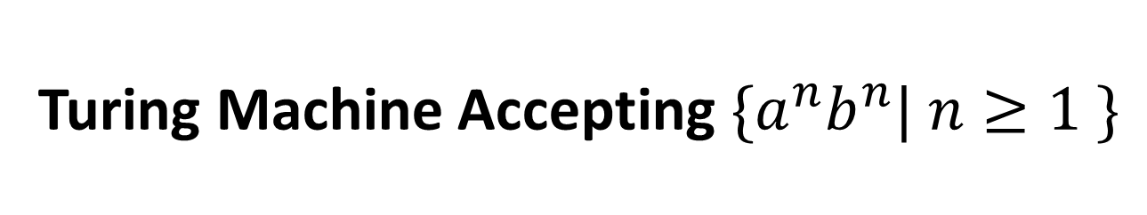
Turing Machine Accepting${ \{a}^{n}b^{n}| n≥1 \}$

Slide 12
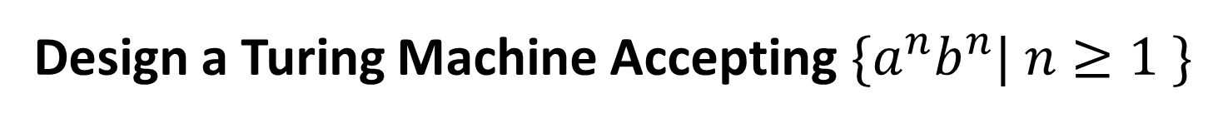
Design a Turing Machine Accepting${ \{a}^{n}b^{n}| n≥1 \}$
L = {a^{n}b^{n}}
Strings accepting in given L are:
a b
a a b b
a a a b b b
Tape
a
A
B
A
a
b
B
Δ
b
Δ
Logic:
Read ‘a’, replace ‘a’ by ‘A’ (a→A)
Move RIGHT to first ‘b’
if none : REJECT
Replace ‘b’ by ‘B’ (b→B)
Move LEFT to leftmost ‘a’
Repeat the above steps until no more a’s
Make sure no more b’s remain.
a
a
A
B
A
A
a
b
b
b
Δ
B
B
Δ

Slide 13





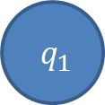
Design a Turing machine for accepting ${\{a}^{n}b^{n}| n≥1 \}$
A
a
A
B
a
b
Δ
B
b
Δ
B/B,R
B/B,L
a/a,R
a/a,L
$${ q}_{0}$$
Δ/Δ,R
$${ q}_{1}$$
a/A,R
$${ q}_{2}$$
b/B,L
$${ q}_{3}$$
B/B,R
A/A,R
$${ q}_{4}$$
B/B,R
Δ/Δ,S
$${ h}_{a}$$

Slide 14
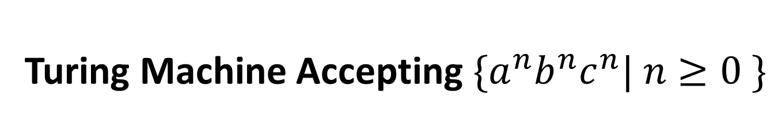
Turing Machine Accepting${ \{a}^{n}b^{n}c^{n}| n≥0 \}$

Slide 15




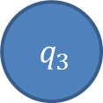



Design a Turing machine for accepting ${\{a}^{n}b^{n}c^{n} | n≥0 \}$
a/a,R
b/b,R
C/C,L
B/B,R
C/C,R
a/a,L
a
a
c
$${ q}_{2}$$
b/B,R
$${ q}_{3}$$
c/C,L
$${ q}_{4}$$
b/b,L
B/B,L
A
b
B
B
c
Δ
A
b
C
C
Δ
a/A,R
A/A,R
$${ q}_{0}$$
Δ/Δ,R
$${ q}_{1}$$
Δ/Δ,S
$${ h}_{a}$$
B/B,R
$${ q}_{5}$$
C/C,R
Δ/Δ,S
$${ q}_{6}$$
B/B,R
C/C,R

Slide 16
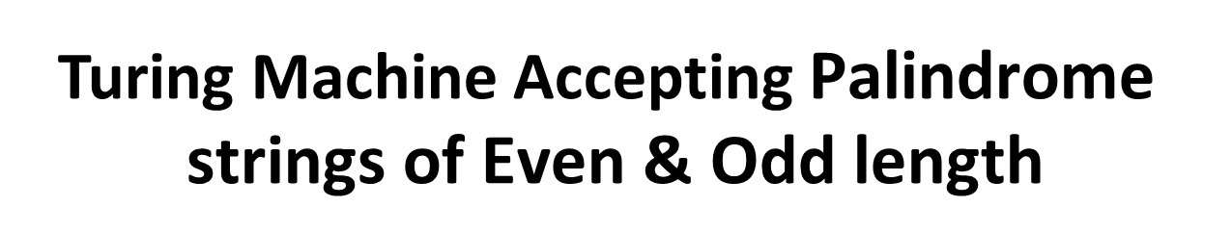
Turing Machine Accepting $\text{Palindrome} \text{strings} \text{of} \text{E}\text{ven}\text{ \& }\text{O}\text{dd} \text{length}$

Slide 17
Design a TM for accepting Palindrome strings of even & odd length.
L = Palindrome string
Strings accepting in given L are:
a a
b a b
a b b a
b a b a b
Tape
Δ
b
Δ
Δ
b
Δ
a
Δ
a
Δ
Even Length
Δ
a
Δ
b
Δ
b
Δ
a
b
Δ
Δ
Δ
Logic:
Read leftmost symbol , replace it with Δ
Keep moving to the right until the rightmost symbol,
If matched with leftmost symbol then replace it with Δ
Otherwise : REJECT the String
Repeat the above steps until no more symbol left in string.
Odd Length

Slide 18








Design a TM for accepting Palindrome strings of even & odd length.
a/a,R
b/b,R
Δ/Δ,R
(odd pal)
Δ
Δ
Δ
Δ
Δ
a
b
b
a
Δ
$${ q}_{2}$$
Δ/Δ,L
$${ q}_{3}$$
a/a,L
b/b,L
a/Δ,R
a/Δ,L
$${ q}_{0}$$
Δ/Δ,R
$${ q}_{1}$$
Δ/Δ,R
$${ q}_{4}$$
$${ h}_{a}$$
b/Δ,R
b/Δ,L
Δ/Δ,L
Δ/Δ,R
$${ q}_{5}$$
$${ q}_{6}$$
(odd pal)
a/a,R
b/b,R
Δ/Δ,R
(even pal)

Slide 19
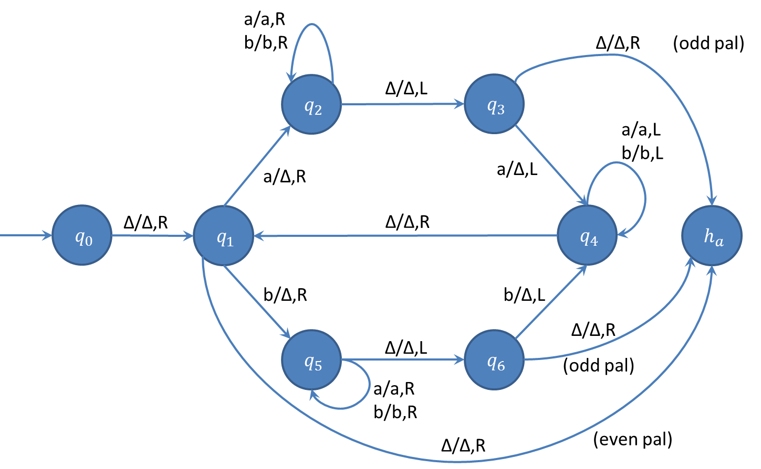
String Tracing
├ (q₀,△ a a)
├ (q₁,△ a a)
├ (q₂,△ △ a )
├ (q₂,△ △ a △ )
├ (q₃,△ △ a )
├ (q₄,△ △ )
├ (q₁,△ △ △)
├ (h_{a}, △ △ △ △)
Accept
Exercise
aba
abab

Slide 20
TM Accepting same no of 0’s and 1’s

Slide 21
Design a TM for accepting same no of 0’s and 1’s
L = Same no. of 0’s and 1’s
Strings accepting in given L are:
01
10
0101
1100
100011
Δ
x
x
1
0
x
x
0
1
Δ
x
0
1
x
x
Δ
x
x
0
1
0
x
1
Δ
Logic:
Move right, Read first leftmost 0, replace 0 with X (0→X)
Keep moving to the left until you encounter Δ
Move right, Read first leftmost 1, replace 1 with X (1→X)
Keep moving to the left until you encounter Δ
Repeat the above steps until no more 0’s and 1’s left in string.

Slide 22






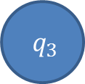
Design a TM for accepting same no of 0’s and 1’s
X
0
0
1
Δ
1
X
X
X
Δ
1/1,R
x/x,L
x/x,R
x/x,L
x/x,R
1/1,L
0/0,R
0/0,L
Δ/Δ,R
$${ q}_{0}$$
$${ q}_{1}$$
0/x,L
$${ q}_{2}$$
Δ/Δ,R
$${ q}_{3}$$
1/x,L
$${ q}_{4}$$
Δ/Δ,L
Δ/Δ,R
$${ q}_{5}$$
Δ/Δ,S
$${ h}_{a}$$
x/x,L

Slide 23
TM Accepting same no of a’s, b’s & c’s

Slide 24







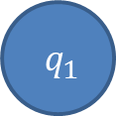

Design a TM for Accepting ${\{x ∊\{a,b,c\}}^{∗}| na\left(x\right)=nb\left(x\right)=nc(x) \}$
a
X
X
X
X
c
b
b
c
a
X
Δ
X
Δ
x/x,R
b/b,R
c/c,R
x/x,L
b/b,L
c/c,L
x/x,R
a/a,R
c/c,R
x/x,L
a/a,L
c/c,L
x/x,R
b/b,R
a/a,R
x/x,L
b/b,L
a/a,L
$${ q}_{0}$$
Δ/Δ,R
$${ q}_{1}$$
a/x,L
$${ q}_{2}$$
Δ/Δ,R
$${ q}_{3}$$
b/x,L
$${ q}_{4}$$
Δ/Δ,R
$${ q}_{5}$$
c/x,L
$${ q}_{6}$$
Δ/Δ,L
Δ/Δ,R
$${ q}_{7}$$
Δ/Δ,S
$${ h}_{a}$$
x/x,L

Slide 25
Turing machine to delete a symbol

Slide 26
Design a Turing machine to delete a symbol
ΔaabΔ
Δ
a
Δ
a
b
Δ
b
Logic:
Replace the symbol you want to delete by Δ.
Keep moving to the Right until you encounter Δ.
One by one Keep shifting every symbol one step to left until you encounter Δ.

Slide 27






Design a Turing machine to delete a symbol
a/a,L
a
Δ
a
b
a
Δ
Δ
b
b
Δ
$${ q}_{3}$$
a/a,R
b/b,R
a/Δ,R
Δ/Δ,R
a/Δ,L
Δ/a,S
$${ q}_{0}$$
b/Δ,R
$${ q}_{1}$$
Δ/Δ,L
$${ q}_{2}$$
$${ h}_{a}$$
b/a,L
a/b,L
b/Δ,L
Δ/b,S
$${ q}_{4}$$
Δ/Δ,S
b/b,L

Slide 28
Turing machine to copy a string

Slide 29
Design a Turing machine to copy a string
String:
Δ ab
Δ bab
Δ
a
a
b
a
Δ
A
B
Δ
Δ
b
Δ
b
Δ ab
Original
Pasted
Δ bab
a
a
b
a
A
B
a
Δ
b
a
b
Δ
b
A
Δ
Δ
Δ
Δ
Δ
b
b
B
a
Original
Pasted

Slide 30





Design a Turing machine to copy a string
a/a,R
a/a,R
b/b,R
b/b,R
a
b
a
b
Δ
Δ
Δ
a
B
Δ
Δ
A
b
$${ q}_{2}$$
Δ/Δ,R
$${ q}_{3}$$
a/a,L
Δ/a,L
a/a,L
b/b,L
b/b,L
a/A,R
$${ q}_{0}$$
Δ/Δ,R
$${ q}_{1}$$
$${ q}_{4}$$
Δ/Δ,L
$${ q}_{5}$$
Δ/Δ,L
b/B,R
Δ/b,L
$${ h}_{a}$$
Δ/Δ,S
$${ q}_{8}$$
$${ q}_{6}$$
Δ/Δ,R
$${ q}_{7}$$
a/a,R
a/a,R
b/b,R
b/b,R
A/a,L
A/A,R
B/b,L
B/B,R

Slide 31
Design a TM for Accepting {SS | S ∈ {a,b}*}
Steps:
Find middle point of the string and convert the string in to the uppercase.
Convert first part of the string to lowercase.
Compare first part and second part.
ss.pptx (click here)

Slide 32
Universal Turing Machine

Slide 33
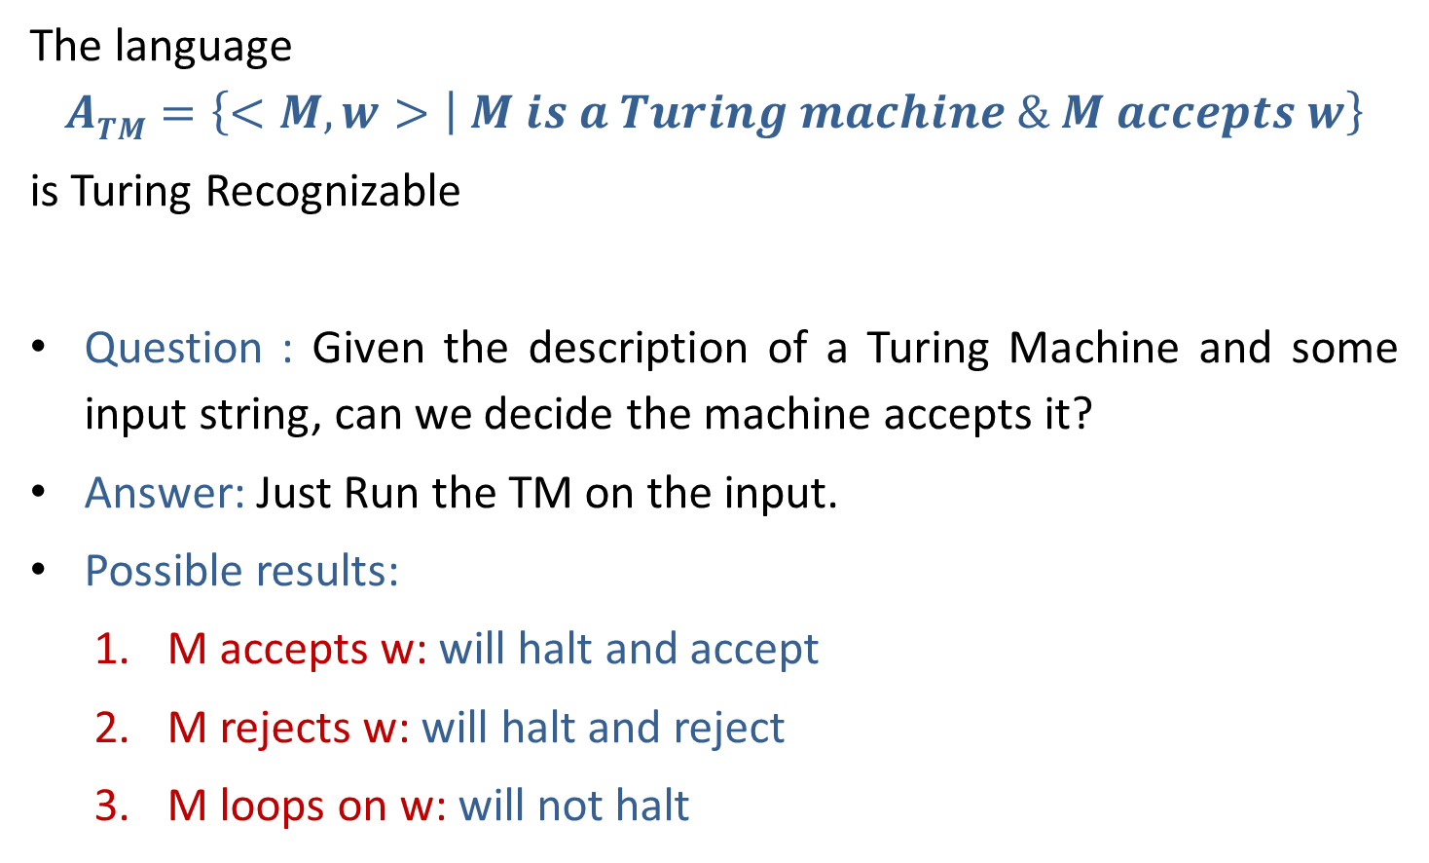
Universal Turing machine
The language
$$ATM=\left\{<M, w> | M is a Turing machine \& M accepts w\right\}$$
is Turing Recognizable
Question : Given the description of a Turing Machine and some input string, can we decide the machine accepts it?
Answer: Just Run the TM on the input.
Possible results:
M accepts w: will halt and accept
M rejects w: will halt and reject
M loops on w: will not halt

Slide 34
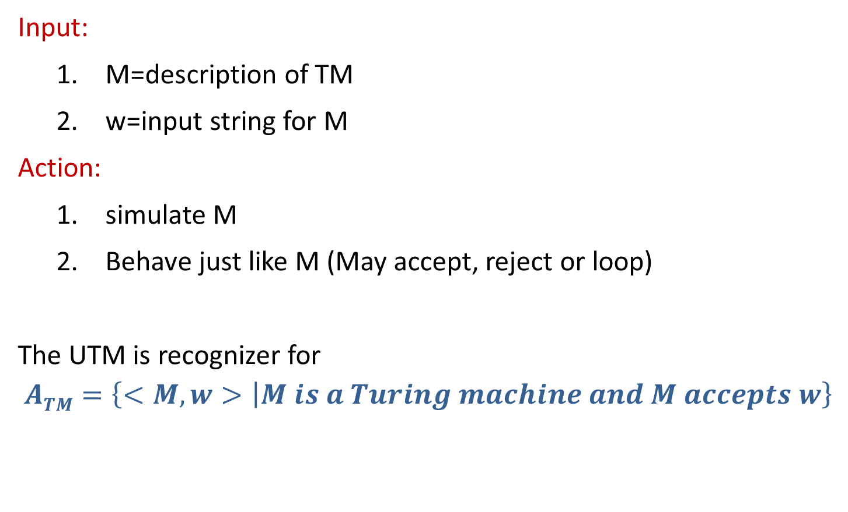
Input & Action on Universal Turing machine
Input:
M=description of TM
w=input string for M
Action:
simulate M
Behave just like M (May accept, reject or loop)
The UTM is recognizer for
$$ATM=\left\{<M, w> | M is a Turing machine and M accepts w\right\}$$

Slide 35
Church Turing Thesis

Slide 36
Church Turing Thesis
What does computable mean?
Meaning of term Computable was given by:
Alonzo church (Lambda calculus)
Allen Turing (Turing Machine)
Any algorithmic procedure that can be carried out at all, by a human computer or a team of humans or an electronic computer, can be carried out by a TM. This statement usually referred to as Church’s thesis, or the Church-Turing thesis.

Slide 37
Church Turing Thesis
Here is an informal summary of some of the evidence.
Humans normally work with a two-dimensional sheet of paper. A TM tape could be organized so as to simulate two dimensions; one likely consequence would be that the TM would require more moves to do what a human could do in one.
Various enhancements of the TM model have been suggested to make the operation more like that of a human computer, or more convenient & efficient. The multitape TM is an example.
Other theoretical models includes abstract machines with two stacks or with a queue.
Since the introduction of the Turing machine, no one has suggested any type of computation that ought to be included in the category of “algorithmic procedure” and cannot be implemented on a TM.

Slide 38
End of Unit-5

