Slide 1

Chapter 8 Switching
8.1
Copyright © The McGraw-Hill Companies, Inc. Permission required for reproduction or display.

Slide 2
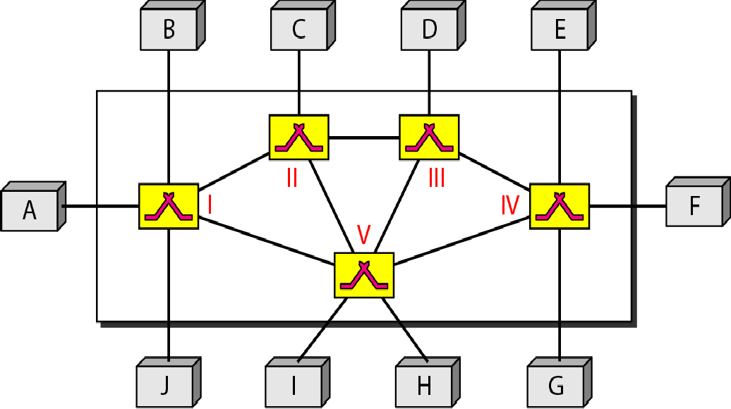
Figure 8.1 Switched network
8.2

Slide 3
8-1 CIRCUIT-SWITCHED NETWORKS
A circuit-switched network consists of a set of switches connected by physical links. A connection between two stations is a dedicated path made of one or more links.. However, each connection uses only one dedicated channel on each link.. Each link is normally divided into n channels by using FDM or TDM.
Topics discussed in this section:
Three Phases Efficiency
Circuit-Switched Technology in Telephone Networks
8.3

Slide 4

Note
A circuit-switched network is made of a set of switches connected by physical links, in which each link is
divided into n channels.
8.4

Slide 5
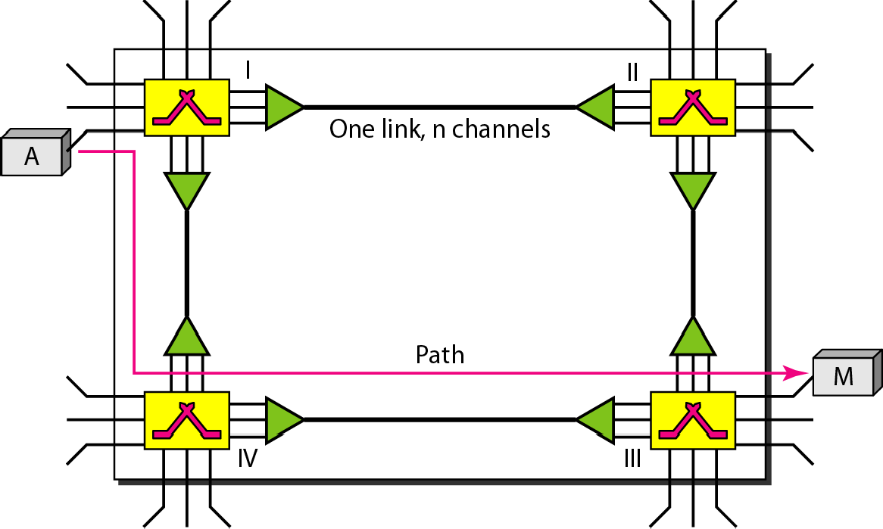
Figure 8.3 A trivial circuit-switched network
8.5

Slide 6

Note
In circuit switching, the resources need to be reserved during the setup phase; the resources remain dedicated for the entire duration of data transfer until the teardown phase.
8.6

Slide 7
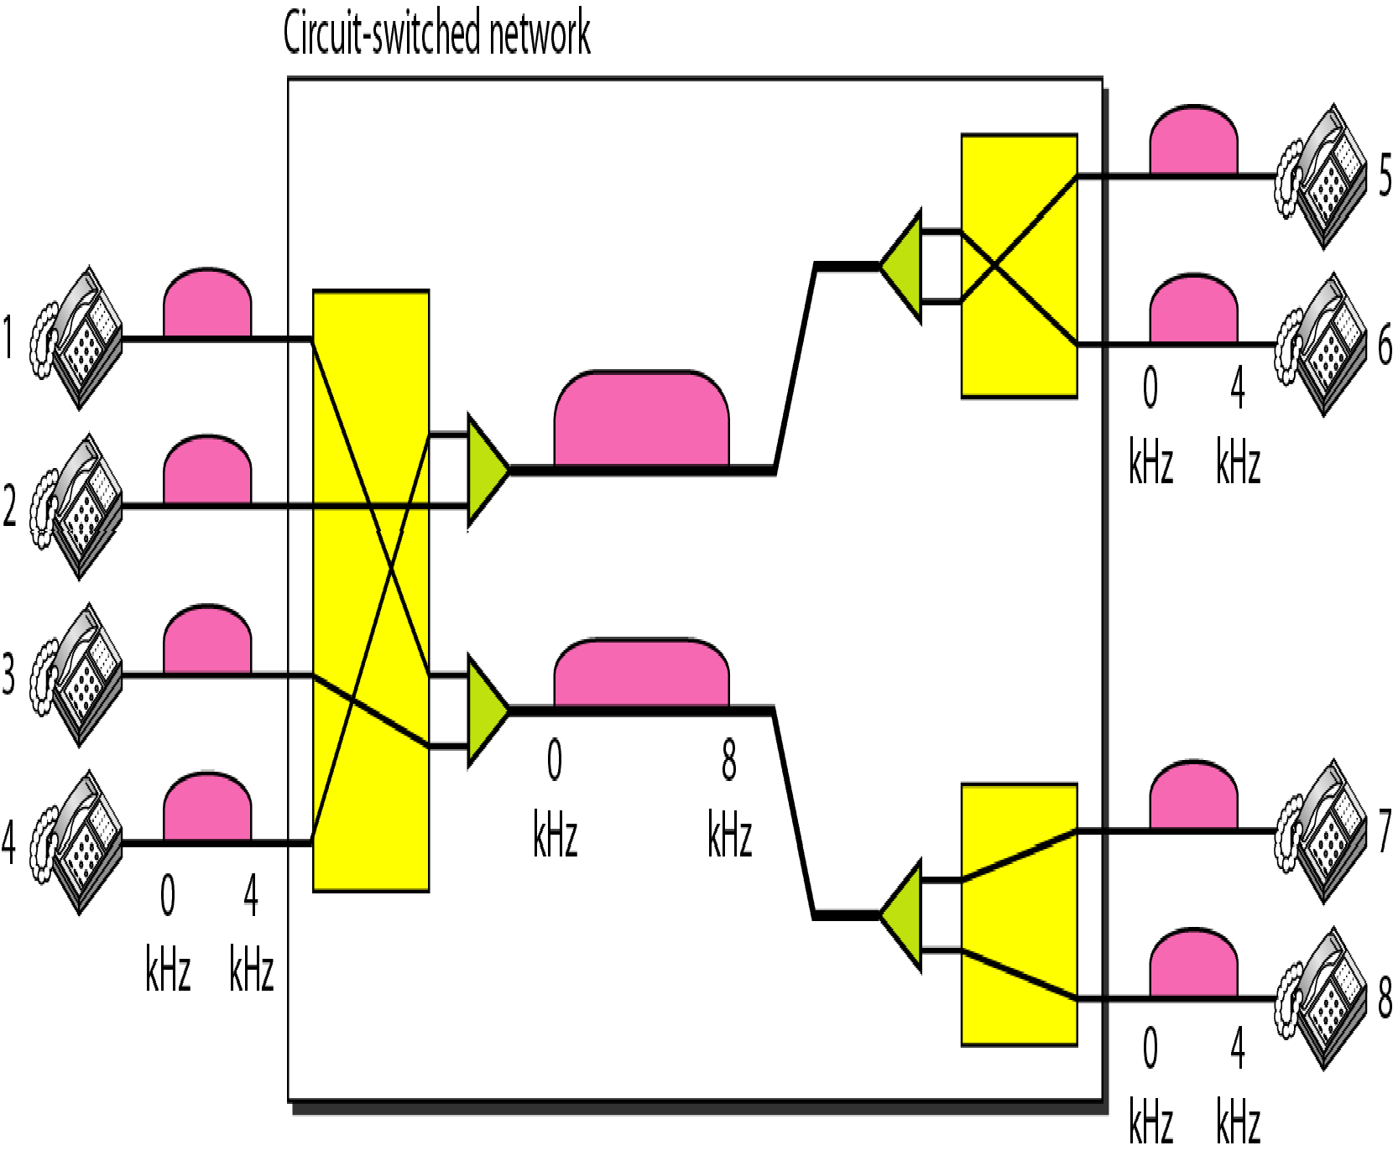
Figure 8.4 Circuit-switched network used in Example 8.1
8.7

Slide 8
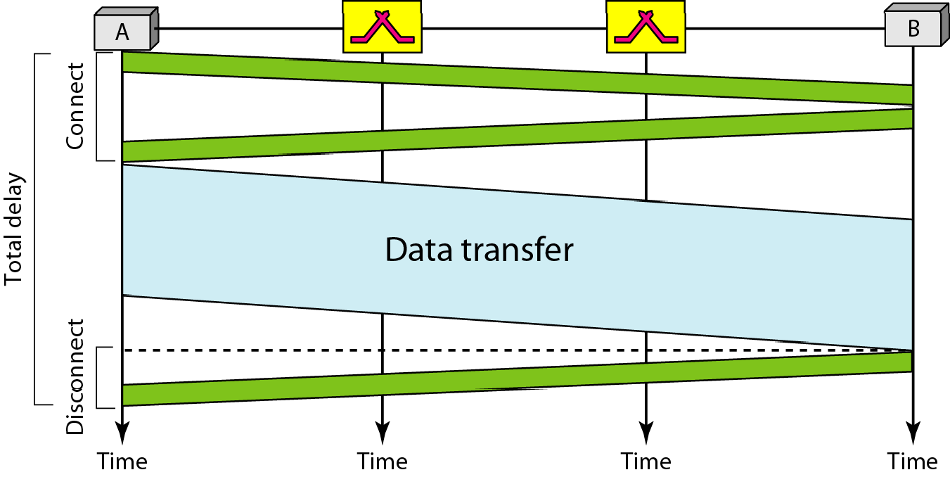
Figure 8.6 Delay in a circuit-switched network

Slide 9

Note
Switching at the physical layer in the traditional telephone network uses the circuit-switching approach.

Slide 10
8-2 DATAGRAM NETWORKS
In data communications, we need to send messages from one end system to another. If the message is going to pass through a packet-switched network, it needs to be divided into packets of fixed or variable size.. The size of the packet is determined by the network and the governing protocol.
Topics discussed in this section:
Routing Table Efficiency Delay
Datagram Networks in the Internet

Slide 11
Note
In a packet-switched network, there is no resource reservation; resources are allocated on demand.

Slide 12
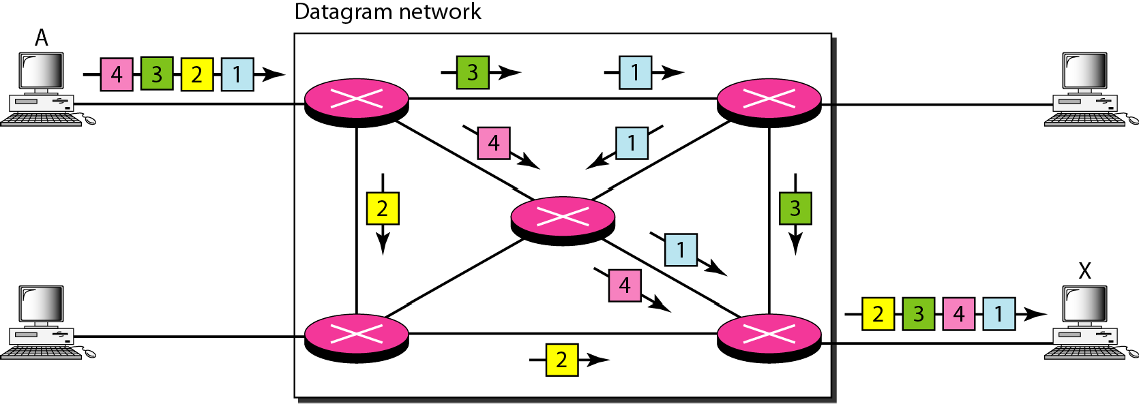
Figure 8.7 A datagram network with four switches (routers)

Slide 13
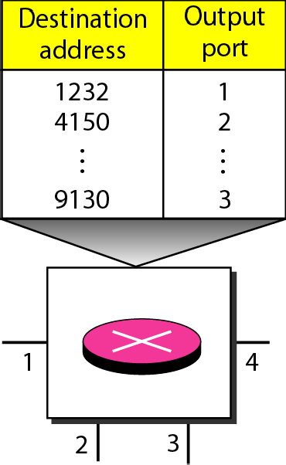
Figure 8.8 Routing table in a datagram network

Slide 14
Note
A switch in a datagram network uses a routing table that is based on the destination address.

Slide 15
Note
The destination address in the header of a packet in a datagram network
remains the same during the entire journey of the packet.

Slide 16
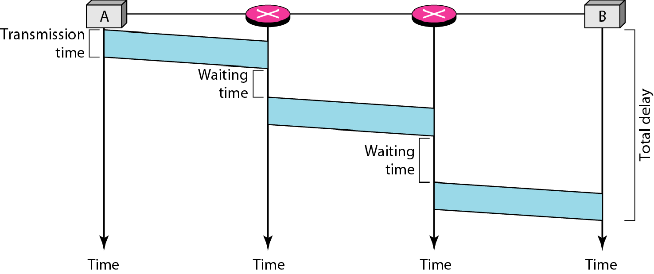
Figure 8.9 Delay in a datagram network

Slide 17
Note
Switching in the Internet is done by using the datagram approach
to packet switching at the network layer.

