Slide 1


UNIT-2 Stream ciphers and block ciphers
Prof. Rupesh G. Vaishnav
rupesh.vaishnav@darshan.ac.in
94280-37452
Information & Network Security (2170709) Darshan Institute of Engineering & Technology

Slide 2
Unit-2
Stream ciphers and block ciphers
Block Cipher structure
Data Encryption standard (DES)
Design principles of block cipher
AES with structure
AES Transformation functions
Key expansion
Notes:
X.800 and RFC 2828
International Telecommunication Union (ITU)

Slide 3
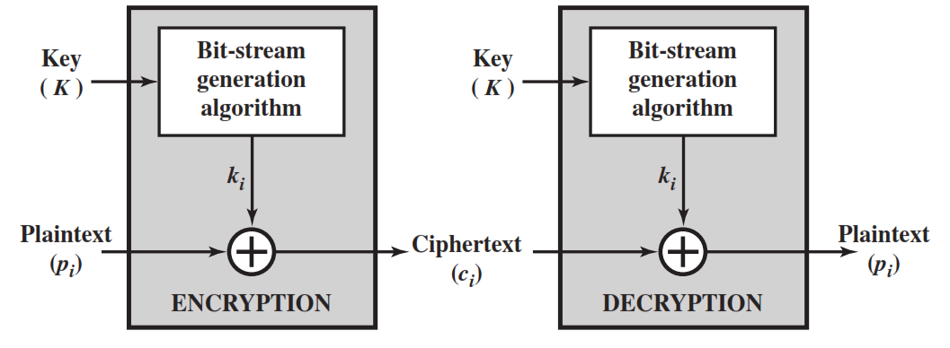
Stream Cipher
A stream cipher is one that encrypts a digital data stream one bit or one byte at a time.
Examples of classical stream ciphers are Autokeyed Vigenère cipher ,A5/1, RC4 and Vernam cipher.

Slide 4
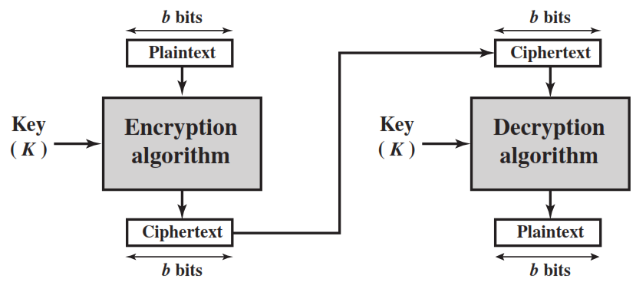
Block Cipher
A block cipher is one in which a block of plaintext is treated as a whole and used to produce a ciphertext block of equal length.
Typically, a block size of 64 or 128 bits is used.
Examples are Feistel Cipher, DES, Triple DES and AES

Slide 5
Diffusion and Confusion
Diffusion hides the relationship between the ciphertext and the plaintext.
This is achieved by having each plaintext digit affect the value of many ciphertext digits.
Confusion hides the relationship between the ciphertext and the key.
This is achieved by the use of a complex substitution algorithm.

Slide 6
Plaintext (2w bits)
Feistel Cipher Structure Or Block Cipher Structure
L₀
w bits
w bits
R₀
Round 1
K₁
F
L₁
R₁
Round i
K_{i}
F
L_{i}
R_{i}
Round n
K_{n}
L_{n}
R_{n}
F
L_{n+1}
R_{n+1}
L_{n}
R_{n}
Ciphertext (2w bits)

Slide 7
Feistel Cipher Structure
Input plaintext block of length 2w bits
key K = n bits , Sub-keys: K₁, K₂, …, K_{n} (Derived from K)
All rounds have the same structure.
A substitution is performed by taking exclusive-OR on left half(Li) of the data and the output of round function F which has inputs right half(Ri) and sub key ki.
A permutation is performed that consists of interchange of two halves of data.
This structure is called Substitution-Permutation Network (SPN)

Slide 8
Feistel Network Factors
Block size: Common block size of 64-bit. However, the new algorithms uses a 128-bit, 256-bit block size.
Key size: Key sizes of 64 bits or less are now widely considered to be insufficient, These days at least 128 bit, more better, e.g. 192 or 256 bit
Number of rounds: A typical size is 16 rounds.
Round function F: Again, greater complexity generally means greater resistance to cryptanalysis.
Subkey generation algorithm: Greater complexity in this algorithm should lead to greater difficulty of cryptanalysis.

Slide 9
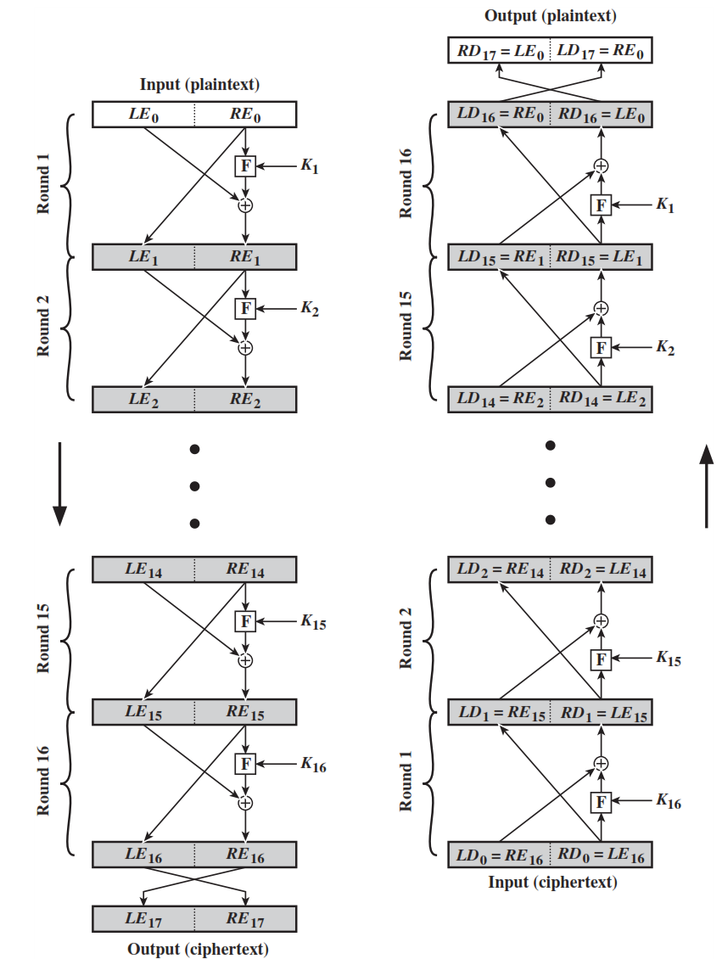
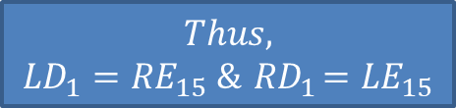

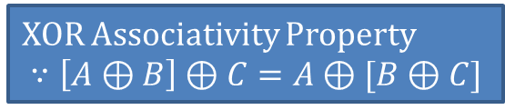





Feistel Encryption & Decryption
Prove that o/p of first round of Decryption is equal to 32-bit swap of i/p of 16th round of Encryption
LD₁=RE₁₅ & RD₁=LE₁₅
On Encryption Side:
$${LE}_{16}={RE}_{15}$$
$${RE}_{16}={LE}_{15} ⊕F({RE}_{15},K_{16})$$
On Decryption Side:
$${LD}_{1}={RD}_{0}={LE}_{16}={RE}_{15}$$
$${RD}_{1}={LD}_{0} ⊕F\left({RD}_{0},K_{16}\right)$$
$$={RE}_{16} ⊕F\left({RE}_{15},K_{16}\right)$$
$$={[LE}_{15} ⊕F\left({RE}_{15},K_{16}\right)] ⊕F\left({RE}_{15},K_{16}\right)$$
XOR Associativity Property
$$∵\left[A⊕B\right]⊕C=A⊕[B⊕C]$$
$$Thus,$$
$${LD}_{1}={RE}_{15} \&{ RD}_{1}={LE}_{15}$$

Slide 10
Data Encryption Standard (DES)
Type: Block Cipher
Block Size : 64-bit
Key Size: 64-bit, with only 56-bit effective
Number of Rounds: 16

Slide 11
64-bit plaintext
64-bit key
Initial Permutation
Permuted choice 1
64
56
Round 1
K₁
48
Permuted choice 2
56
Left circular shift
64
56
Round 2
K₂
48
Permuted choice 2
56
Left circular shift
Round 16
K₁₆
48
Permuted choice 2
56
Left circular shift
32-bit swap
64
DES Encryption Algorithm
Inverse
Initial Permutation
64-bit ciphertext

Slide 12
DES Encryption Algorithm (Cont…)
First, the 64-bit plaintext passes through an initial permutation (IP) that rearranges the bits to produce the permuted input.
This is followed by a phase consisting of sixteen rounds of the same function, which involves both permutation and substitution functions.
Finally, the preoutput is passed through a permutation that is the inverse of the initial permutation function, to produce the 64-bit ciphertext.
The 56-bit key is passed through a permutation function.
For each of the sixteen rounds, a subkey (K_{i}) is produced by the combination of a left circular shift and a permutation.

Slide 13
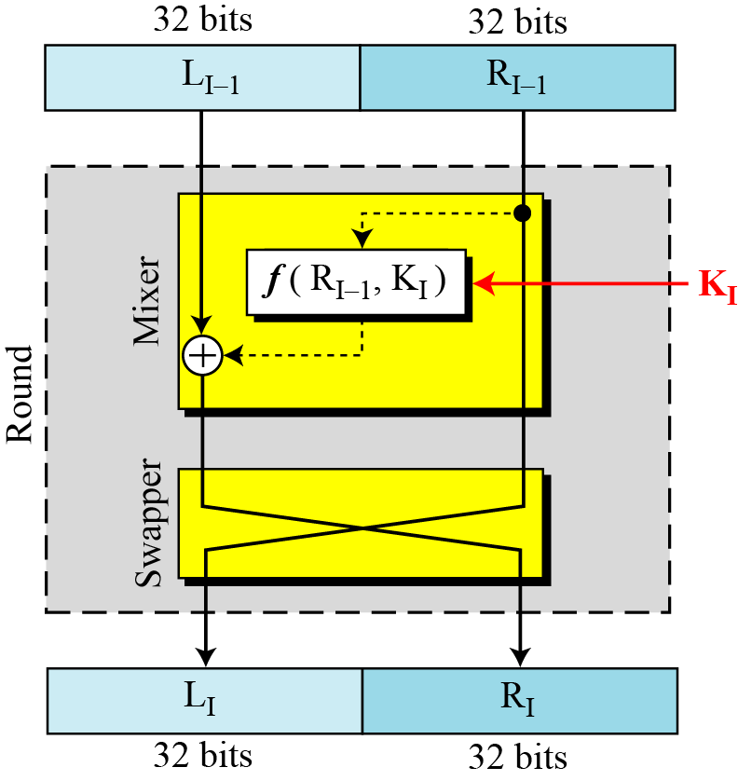
DES Single Round

Slide 14








32-bits
32-bits
28-bits
28-bits
$$L_{i−1}$$
$$R_{i−1}$$
$$C_{i−1}$$
$$D_{i−1}$$
Expansion/ permutation
(E table)
Left Shift
(S)
Left Shift
(S)
48
K_{i}
Permutation/ compression
(Permuted choice 2)
XOR
48
48
Substitution/choice
(S-box)
32
Permutation
(P)
32
XOR
$$L_{i}$$
$$R_{i}$$
$$C_{i}$$
$$D_{i}$$
Notes:
confusion step is the S-box substitution, while the diffusion step is where the output of the S-boxes is rearranged according to the P-box permutation rules.

Slide 15
DES Single Round (Cont…)
Key Transformation
Permutation of selection of sub-key from original key
Expansion Permutation (E-table)
Right half is expanded from 32-bits to 48-bits
S-box Substitution
Accepts 48-bits from XOR operation and produce 32-bits using 8 substitution boxes (each S-boxes has a 6-bit i/p and 4-bit o/p).
P-Box Permutation
XOR and Swap

Slide 16
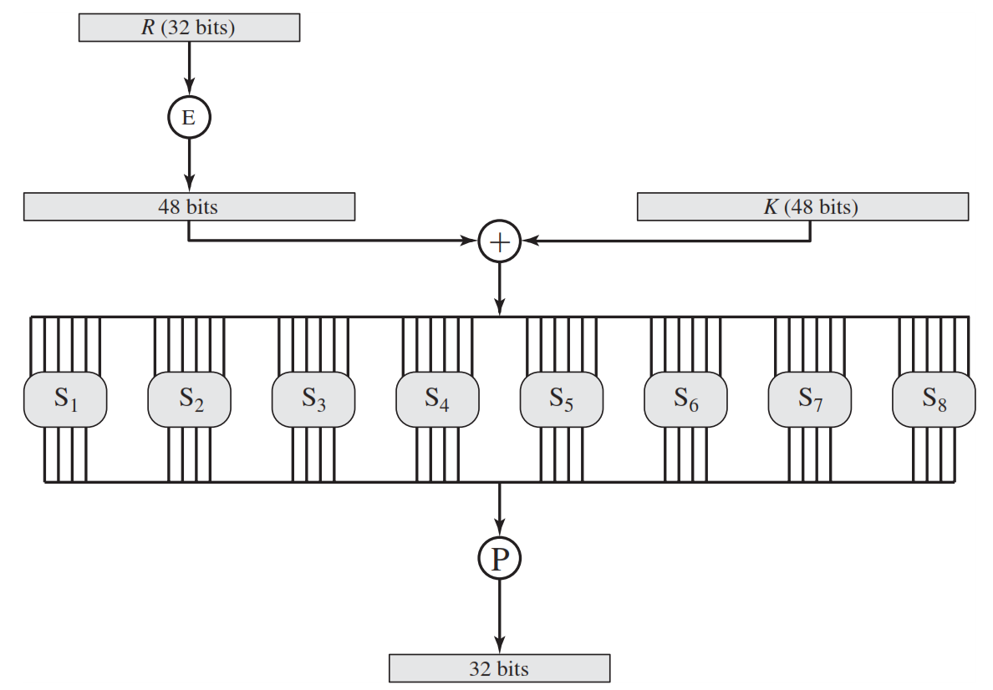
Role of S-box

Slide 17
Role of S-box (Cont…)
The outer two bits of each group select one row of an S-box.
Inner four bits selects one column of an S-box.
S-box 1
Example:
Input
0 | 1 | 1 | 0 | 0 | 1
Output
1 | 0 | 0 | 1
Row
Column

Slide 18
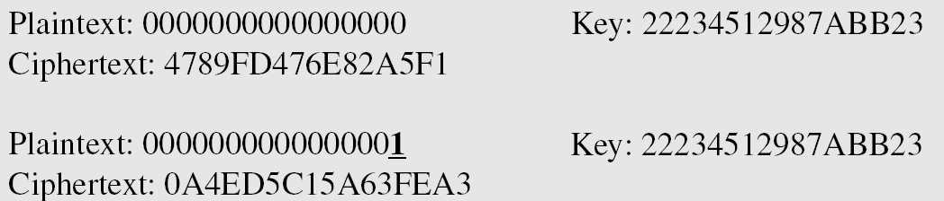
Avalanche Effect
Desirable property of any encryption algorithm is that a change in one bit of the plaintext or of the key should produce a change in many bits of cipher text.
DES performs strong avalanche effect.
Although the two plaintext blocks differ only in the rightmost bit, the ciphertext blocks differ in 29 bits.
This means that changing approximately 1.5 % of the plaintext creates a change of approximately 45 % in the ciphertext.

Slide 19
AES (Advanced Encryption Standard)
The Rijndael proposal for AES defined a cipher in which the block length and the key length can be independently specified to be 128, 192, or 256 bits.
AES designed to have characteristics
Resistance against all known attacks
Speed and code compactness on a wide range of platforms
Design simplicity
Key size (words/ bytes/ bits) | 4/16/128 | 6/24/192 | 8/32/256
Block size (words/ bytes/ bits) | 4/16/128 | 4/16/128 | 4/16/128
Round key size (words/ bytes/ bits) | 4/16/128 | 4/16/128 | 4/16/128
Number of Rounds | 10 | 12 | 14

Slide 20
AES (Advanced Encryption Standard)
Plaintext (128 bits)
AES
Key (128-256 bits)
Ciphertext (128 bits)

Slide 21
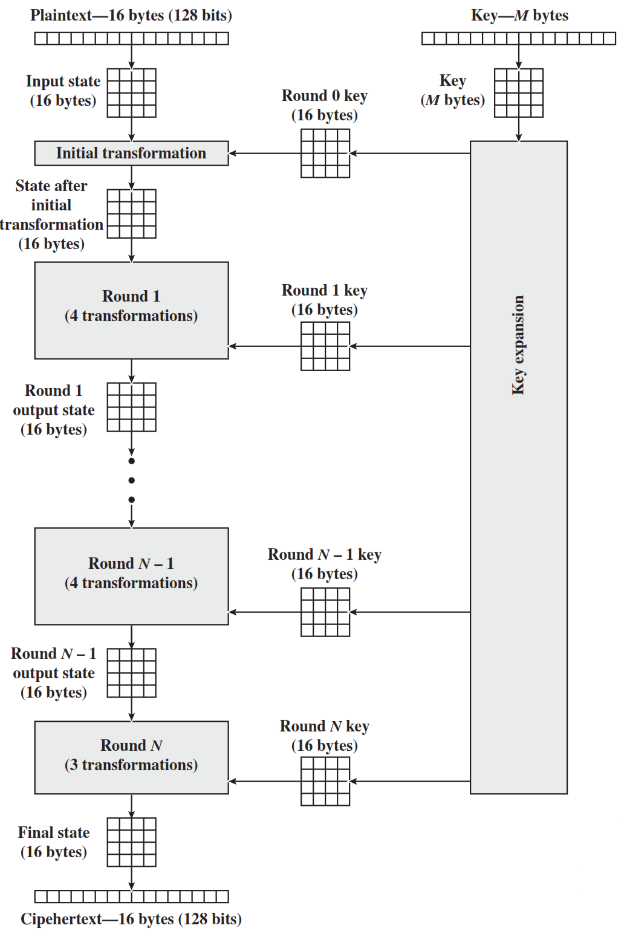
AES Structure
Initialization
Expand 16-byte key to get the actual key block to be used.
Initialize 16-byte plaintext block called as state.
XOR the state with the key block.
For each round
Apply S-box
Rotate rows of state
Mix columns
Add Round key: XOR the state with key block.

Slide 22
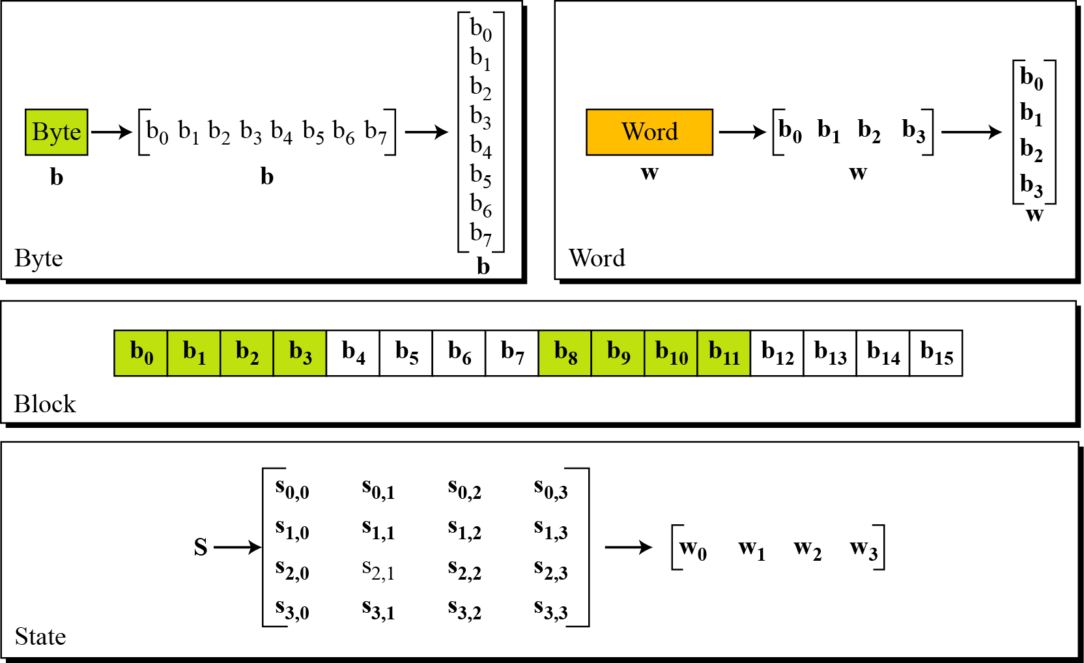
Data Units in AES

Slide 23
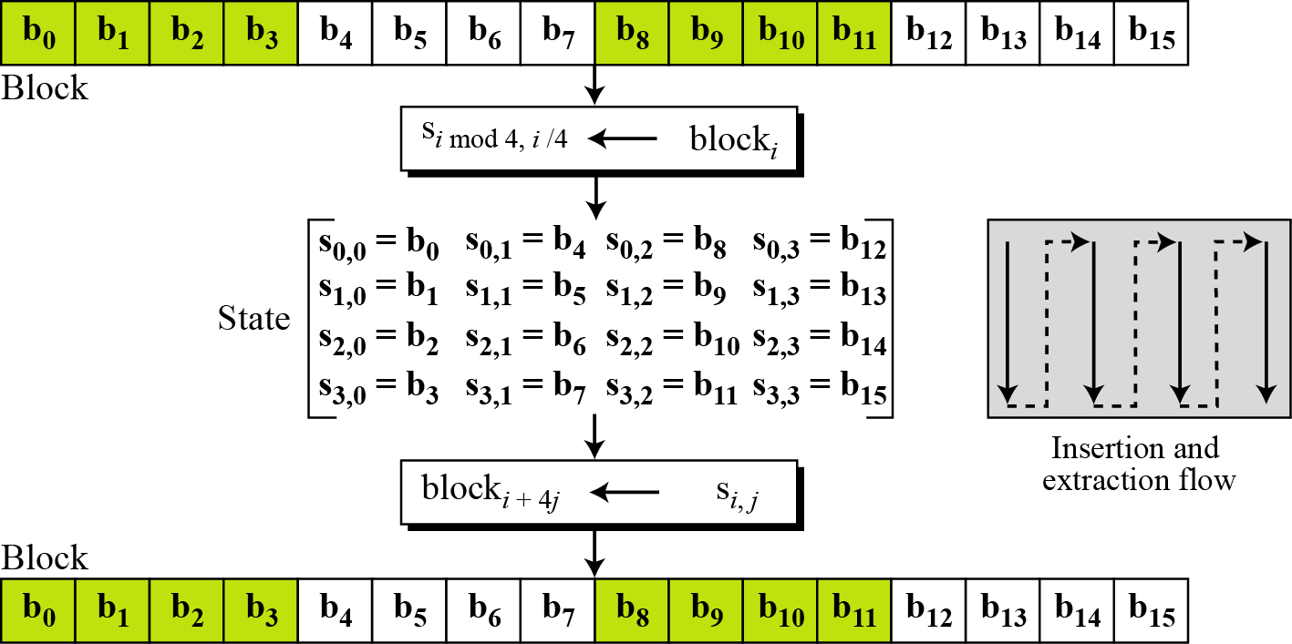
Block to State & State to Block

Slide 24
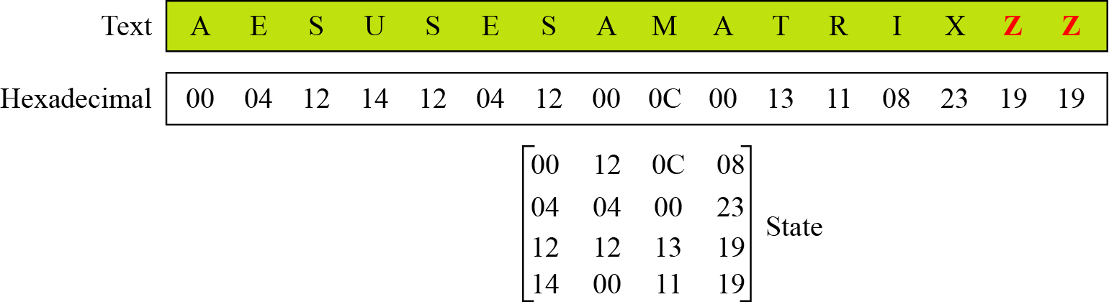
Plain Text to State

Slide 25
AES Structure
The first N-1 rounds consist of four distinct transformation functions.
SubBytes
The 16 input bytes are substituted using an S-box
ShiftRows
Each of the four rows of the matrix is shifted to the left
MixColumns
Each column of four bytes is now transformed using a special mathematical function.
AddRoundKey
The 16 bytes of the matrix are now considered as 128 bits and are XORed to the 128 bits of the round key.

Slide 26
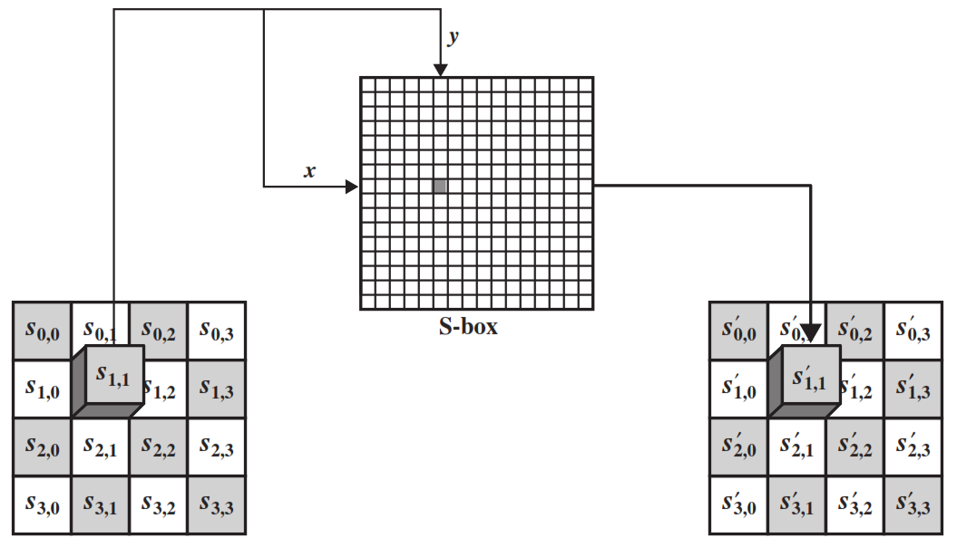
SubByte Transformation
The forward substitute byte transformation, called SubBytes, is a simple table lookup

Slide 27
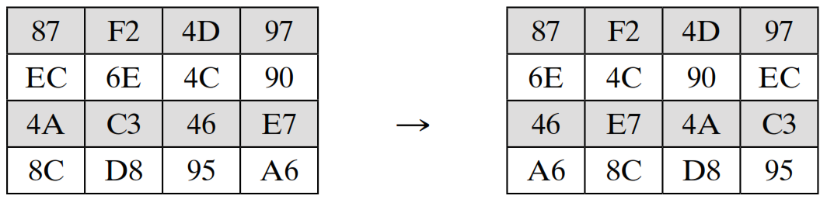
ShiftRows
The first row of State is not altered.
For the second row, a 1-byte circular left shift is performed.
For the third row, a 2-byte circular left shift is performed.
For the fourth row, a 3-byte circular left shift is performed.

Slide 28
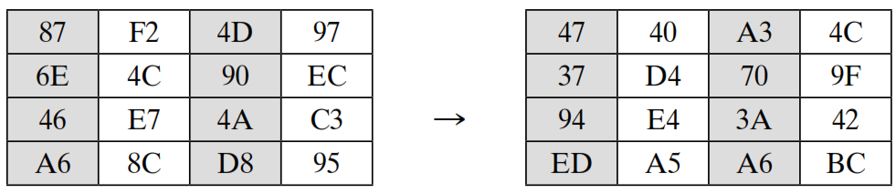
MixColumns
Each byte of a column is mapped into a new value that is a function of all four bytes in that column.

Slide 29
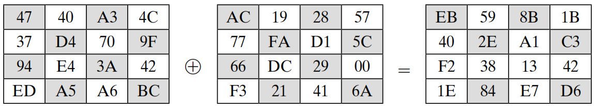
AddRoundKey
In the forward add round key transformation, the 128 bits of State are bitwise XORed with the 128 bits of the round key.
State
Round Key

Slide 30
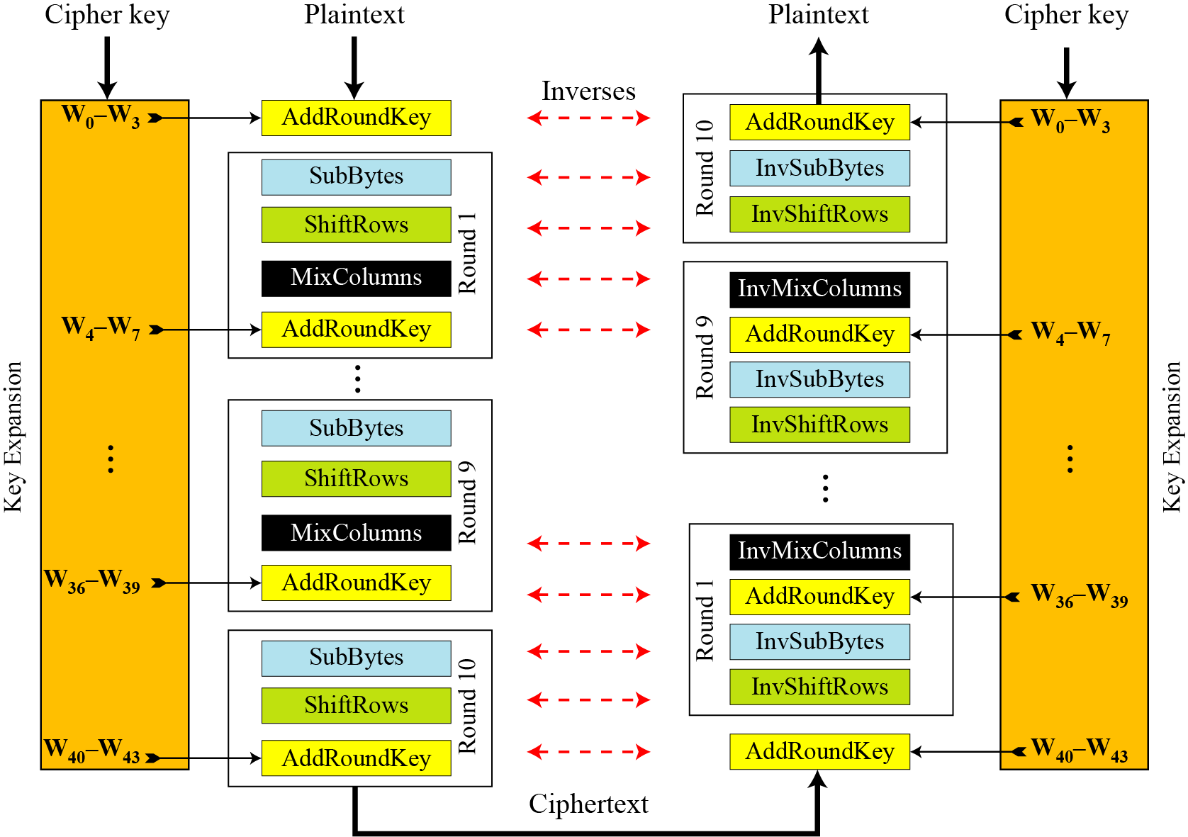
AES Overall Structure

Slide 31
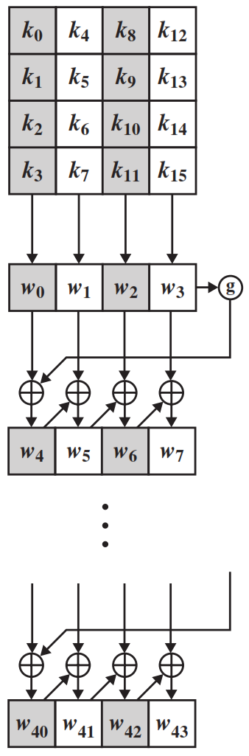
AES Key Expansion
The AES key expansion algorithm takes as input a four-word (16-byte) key and produces a linear array of 44 words (176 bytes).
Each added word w[i] depends on the immediately preceding word, w[i - 1].
In three out of four cases, a simple XOR is used.

Slide 32
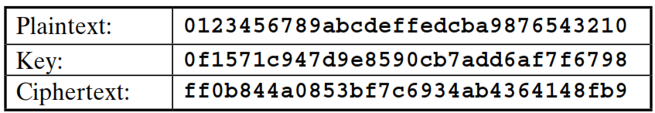
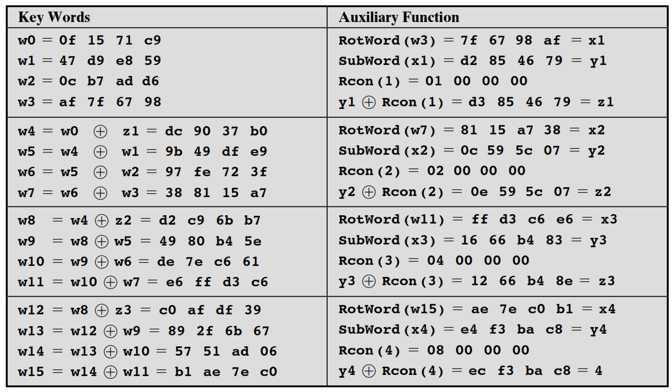
Key Expansion Example

Slide 33


