Slide 1


UNIT-3 Multiple encryptions and triple DES
Prof. Rupesh G. Vaishnav
rupesh.vaishnav@darshan.ac.in
94280-37452
Information & Network Security (2170709) Darshan Institute of Engineering & Technology

Slide 2
Outline
Multiple encryption and triple DES
Electronic Code Book Mode
Cipher Block Chaining Mode
Cipher Feedback Mode
Output Feedback Mode
Counter Mode
Notes:
X.800 and RFC 2828
International Telecommunication Union (ITU)

Slide 3
Block Cipher Modes of Operations
To apply a block cipher in a variety of applications, five "modes of operation" have been defined.
The five modes are intended to cover a wide variety of applications of encryption for which a block cipher could be used.
These modes are intended for use with any symmetric block cipher, including triple DES and AES.
Electronic Code Book (ECB)
Cipher Block Chaining (CBC)
Cipher Feedback (CFB)
Output Feedback (OFB)
Counter (CTR)

Slide 4
1. Electronic Code Book (ECB)
In ECB Mode Plaintext handled one block at a time and each block of plaintext is encrypted using the same key.
The term codebook is used because, for a given key, there is a unique ciphertext for every b-bit block of plaintext.

Slide 5
1. ECB Encryption & Decryption
P₁
P₂
P_{N}
64-bit
64-bit
64-bit
K
K
…
K
Encrypt
Encrypt
Encrypt
64-bit
64-bit
64-bit
C₁
C₂
C_{N}
C₁
C₂
C_{N}
64-bit
64-bit
64-bit
K
K
…
K
Decrypt
Decrypt
Decrypt
64-bit
64-bit
64-bit
P₁
P₂
P_{N}

Slide 6
Electronic Code Book - Cont…
Strength: it’s simple.
Weakness:
Repetitive information contained in the plaintext may show in the ciphertext, if aligned with blocks.
If the message has repetitive elements with a period of repetition a multiple of b bits, then these elements can be identified by the analyst.
Typical application:
Secure transmission of short pieces of information (e.g. a temporary encryption key)

Slide 7
2. Cipher Block Chaining (CBC)
CBC is a technique in which the same plaintext block, if repeated, produces different ciphertext blocks.
In this scheme, the input to the encryption algorithm is the XOR of the current plaintext block and the preceding ciphertext block; the same key is used for each block.
To produce the first block of ciphertext, an initialization vector (IV) is XORed with the first block of plaintext.
On decryption, the IV is XORed with the output of the decryption algorithm to recover the first block of plaintext.

Slide 8
2. CBC - Encryption & Decryption
P₁
P₂
P_{N}
IV
C_{N-1}
K
K
…
K
Encrypt
Encrypt
Encrypt
C₁
C₂
C_{N}
C₁
C₂
C_{N}
K
K
…
K
Decrypt
Decrypt
Decrypt
IV
C_{N-1}
P₁
P₂
P_{N}

Slide 9
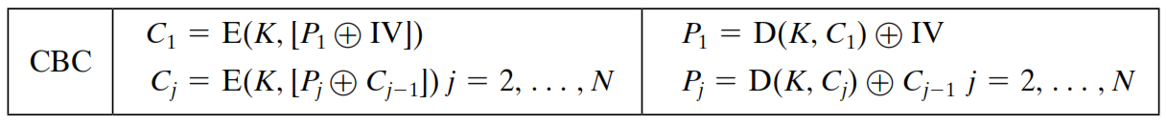
2. Cipher Block Chaining (CBC) – Cont…
Strength: because of the chaining mechanism of CBC, it is an appropriate mode for encrypting messages of length greater than b bits
Typical application:
General-purpose block oriented transmission
Authentication

Slide 10
3. Cipher Feedback Mode (CFB)
For AES, DES, or any block cipher, encryption is performed on a block of b bits. In DES, b = 64 and in AES, b = 128.
However, it is possible to convert a block cipher into a stream cipher, using cipher feedback (CFB) mode, output feedback (OFB) mode, and counter (CTR) mode.
A stream cipher eliminates the need to pad a message to be an integral number of blocks.

Slide 11
3. CFB Encryption
C_{N-1}
IV
Shift register b-s bits | s bits
Shift register b-s bits | s bits
K
K
K
Encrypt
Encrypt
Encrypt
…
Select s bits
Discard b-s bits
Select s bits
Discard b-s bits
Select s bits
Discard b-s bits
S bits
S bits
S bits
P₁
P₂
P_{N}
C₁
C₂
C_{N}
S bits
S bits
S bits
Notes:
Unit od transmission is 8 bits
Common value of s=8

Slide 12
3. CFB Decryption
C_{N-1}
IV
Shift register b-s bits | s bits
Shift register b-s bits | s bits
K
K
K
Encrypt
Encrypt
Encrypt
…
Select s bits
Discard b-s bits
Select s bits
Discard b-s bits
Select s bits
Discard b-s bits
C₁
C₂
C_{N}
S bits
S bits
S bits
P₁
P₂
P_{N}
S bits
S bits
S bits
Notes:
Unit od transmission is 8 bits
Common value of s=8

Slide 13
CFB Mode
The input to the encryption function is a b-bit shift register that is initially set to some initialization vector (IV).
The leftmost (most significant) s bits of the output of the encryption function are XORed with the first segment of plaintext P1 to produce the first unit of ciphertext C1 , which is then transmitted.
In addition, the contents of the shift register are shifted left by s bits, and C1 is placed in the rightmost (least significant) s bits of the shift register.
For decryption, the same scheme is used, except that the received ciphertext unit is XORed with the output of the encryption function to produce the plaintext unit.

Slide 14
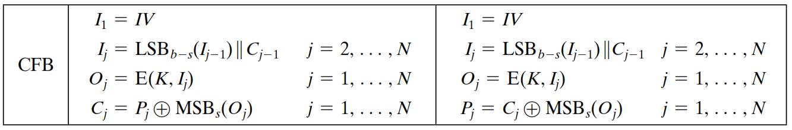
CFB Mode – Cont…

Slide 15
4. Output Feedback Mode (OFB)
The output feedback (OFB) mode is similar in structure to that of CFB.
For OFB, the output of the encryption function is fed back to become the input for encrypting the next block of plaintext.
In CFB, the output of the XOR unit is fed back to become input for encrypting the next block.
The other difference is that the OFB mode operates on full blocks of plaintext and ciphertext, whereas CFB operates on an s-bit subset.
Nonce: A time-varying value that has at most a negligible chance of repeating, for example, a random value that is generated anew for each use, a timestamp, a sequence number, or some combination of these.

Slide 16
4. OFB Encryption
Nonce
K
K
…
K
Encrypt
Encrypt
Encrypt
P₁
P₂
P_{N}
C₁
C₂
C_{N}

Slide 17
4. OFB Decryption
Nonce
K
K
…
K
Encrypt
Encrypt
Encrypt
C₁
C₂
C_{N}
P₁
P₂
P_{N}

Slide 18
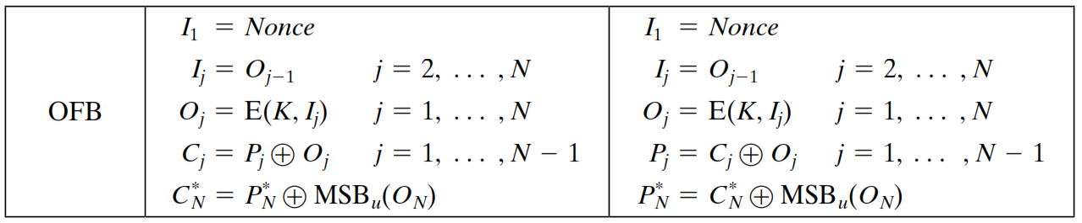
OFB Mode
Each bit in the ciphertext is independent of the previous bit or bits.
This avoids error propagation
Pre-compute of forward cipher is possible

Slide 19
5. Counter Mode (CTR)
Counter (CTR) mode has increased recently with applications to ATM (asynchronous transfer mode) network security and IP sec (IP security).
A counter equal to the plaintext block size is used.
The counter value must be different for each plaintext block that is encrypted.
Typically, the counter is initialized to some value and then incremented by 1 for each subsequent block

Slide 20
5. CTR Encryption
Counter 1
Counter 2
Counter N
K
K
…
K
Encrypt
Encrypt
Encrypt
P₁
P₂
P_{N}
C₁
C₂
C_{N}

Slide 21
4. CTR Decryption
Counter 1
Counter 2
Counter N
K
K
…
K
Encrypt
Encrypt
Encrypt
C₁
C₂
C_{N}
P₁
P₂
P_{N}

Slide 22
Advantages of the CTR Mode
Strengths:
Needs only the encryption algorithm
Random access to encrypted data blocks
blocks can be processed (encrypted or decrypted) in parallel
Simple; fast encryption/decryption
Counter must be
Must be unknown and unpredictable
pseudo-randomness in the key stream is a goal

Slide 23
Summary of all modes
Operation Mode | Description | Type of Result
ECB | Each n-bit block is encrypted independently with same key | Block Cipher
CBC | Same as ECB, but each block is XORed with previous cipher text | Block Cipher
CFB | Each s-bit block is XORed with s-bit key which is part of previous cipher text | Stream Cipher
OFB | Same as CFB, but the shift register is updated by the previous s-bit key | Stream Cipher
CTR | Same as OFB, but a counter is used instead of nonce | Stream Cipher

Slide 24
Multiple Encryption
Given the potential vulnerability of DES to a brute-force attack, there has been considerable interest in finding an alternative.
One approach is to design a completely new algorithm, of which AES is a prime example.
Another alternative, which would preserve the existing investment in software and equipment, is to use multiple encryption with DES and multiple keys.

Slide 25
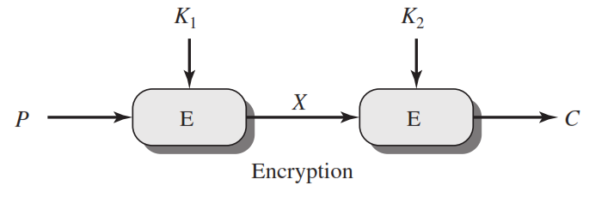
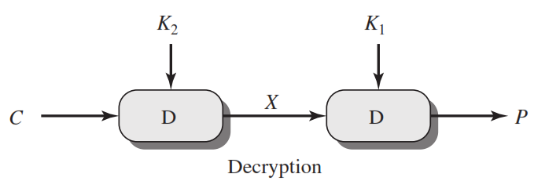
Double DES
C=E(K₂,E(K₁, P))
X = E(K₁, P) = D(K₂, C)
P=D(K₁,D(K₂, C))

Slide 26
Meet in the Middle Attack
This attack involves encryption from one end, decryption from the other and matching the results in the middle.
Suppose cryptanalyst knows P and corresponding C.
Now, the aim is to obtain the values of K₁ and K₂.

Slide 27
Meet in the Middle Attack Step-1
For all possible values (2⁵⁶) of key K1, the cryptanalyst would encrypt the P by performing E(K1,P).
The cryptanalyst would store output in a table.
Possible Keys
(Key = K1)
00
01
10
11
P
Table of Cipher Text
Encrypt
Cryptanalyst encryption operation

Slide 28
Meet in the Middle Attack Step-2
Cryptanalyst decrypt the known C with all possible values of K2.
In each case cryptanalyst will compare the resulting value with the all values in the table of ciphertext.
Possible Keys
(Key = K2)
00
01
10
11
Table of Cipher Text
C
Decrypt
For each result do a table look up
Cryptanalyst decryption operation

Slide 29
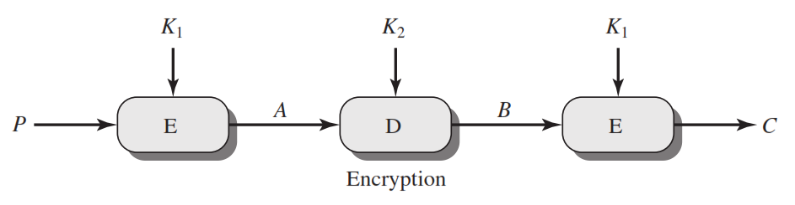
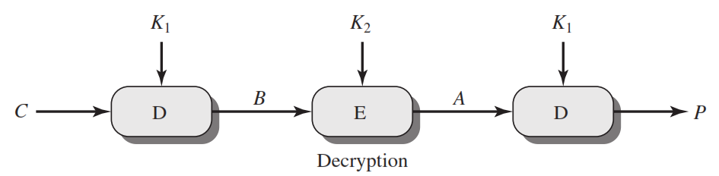
Triple DES
C=E(K₁,D(K₂, E(K₁,P)))
P=D(K₁,E(K₂, D(K₁,C)))

Slide 30


