Slide 1


UNIT-9 Remote user authentication
Prof. Rupesh G. Vaishnav
rupesh.vaishnav@darshan.ac.in
94280-37452
Information & Network Security (2170709) Darshan Institute of Engineering & Technology

Slide 2
Outline
Remote user authentication with symmetric encryption
Remote user authentication with asymmetric encryption
Kerberos
Notes:
X.800 and RFC 2828
International Telecommunication Union (ITU)

Slide 3
Remote user authentication with symmetric encryption
Mutual Authentication
A ---> KDC
IDa || IDb || N1
KDC ---> A
E(Ka, [Ks || IDb || N1 || E(Kb,[Ks || IDa)])
A ---> B
E(Kb, [Ks || IDa])
B ---> A
E(Ks, N2)
A ---> B
E(Ks, f(N2))

Slide 4
Remote user authentication with symmetric encryption
One-way Authentication
A ---> KDC
IDa || IDb || N1
KDC ---> A
E(Ka, [Ks || IDb || N1 || E(Kb, [Ks || IDa])])
A ---> B
E(Kb, [Ks || IDa]) || E(Ks, M)

Slide 5
Kerberos
Kerberos provides a trusted third-party authentication service that enables clients and servers to establish authenticated communication.
Kerberos is an authentication service designed for use in a distributed environment.
Version 4 of Kerberos makes use of DES, to provide the authentication service.

Slide 6


Kerberos – Simple Dialogue
C ---> AS: IDc || Pc || IDv
AS ---> C: Ticket
C ---> V: IDc || Ticket
Ticket = E(Kv, [IDc, ADc, IDv])
(1)
(2)
Authentication Server-AS
User - C
(3)
Application Server - V

Slide 7
Kerberos – Simple Dialogue
C ---> AS: IDc || Pc || IDv
AS ---> C: Ticket
C ---> V: IDc || Ticket
Ticket = E(Kv, [IDc, ADc, IDv])
Where,
C = Client
AS = Authentication Server
V = Server
IDc = Identification of user C
Idv = Identification of V
Pc = Password on User C
Adc = Network Address of C
Kv = Secret key shared by AS and V

Slide 8
Kerberos – More Secure Dialogue
Request for Ticket_{TGS}
Ticket_{TGS} to access TGS
Authentication Server-AS
Request for Service
Client-C
Request for Ticket_{V}
Request for Ticket_{V}
Ticket Granting Server-TGS

Slide 9
Kerberos – More Secure Dialogue
Once per user logon session
C ---> AS: IDc || IDTGS
AS ---> C: E(Kc, Ticket_{TGS})
Once per type of service
C ---> TGS: IDc || IDv || Ticket_{TGS}
TGS ---> C: Ticket_{V}
Once per service session
C ---> V: IDc || Ticket_{V}
Ticket_{TGS} = E(K_{TGS}, [IDc, ADc, Id_{TGS}, TS1, Lifetime1])
Ticket_{V} = E(K_{V}, [IDc, ADc, Id_{V}, TS2, Lifetime2])

Slide 10
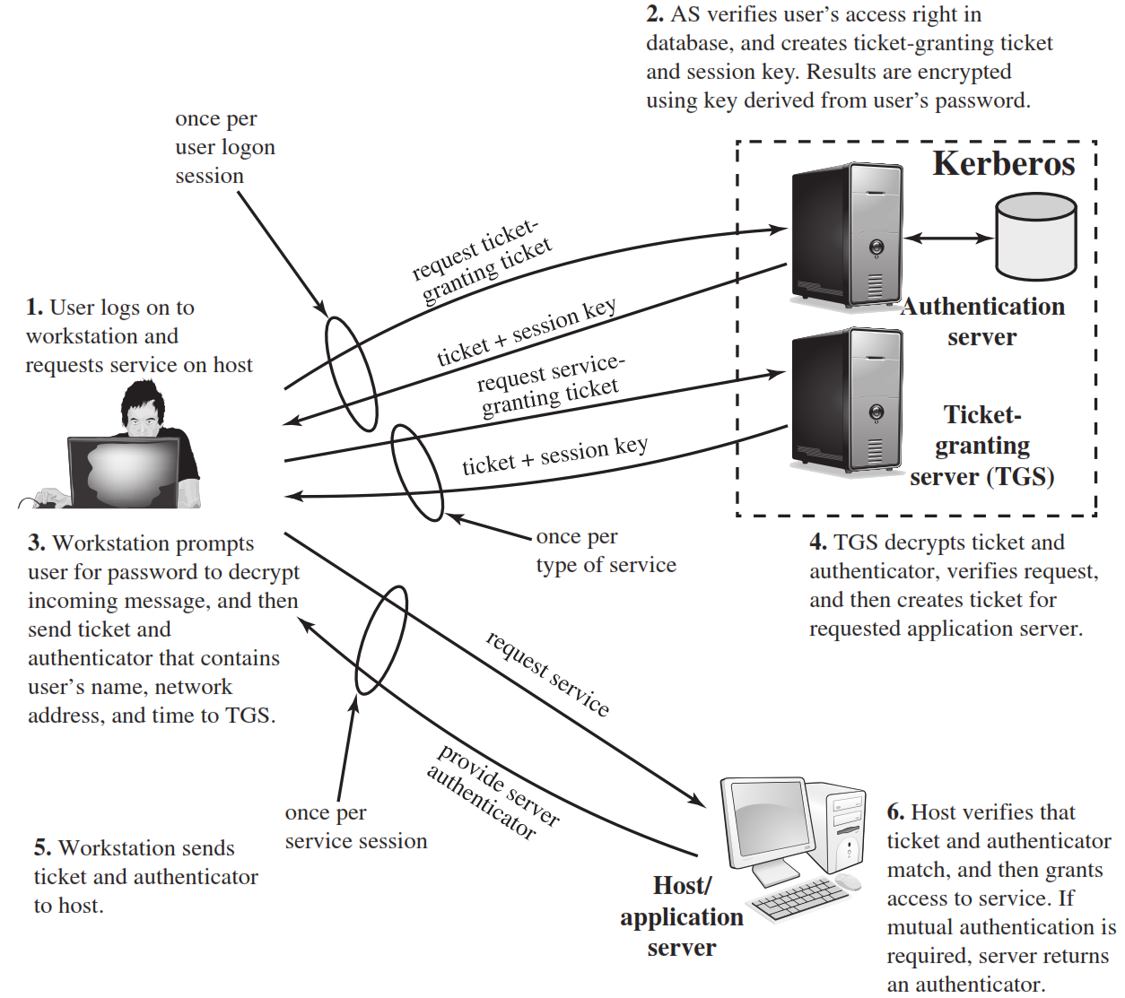

Slide 11
Kerberos Version 4 – Step-1
The client sends a plaintext request to the AS asking for a ticket it can use to talk to the TGS.
Request:
Login name
TGS name
Since this request contains only well-known names, it does not need to be sealed.
C--->AS : IDc||ID_{tgs}||TS₁

Slide 13
Kerberos Version 4 – Step-2
The AS finds the keys corresponding to the login name and the TGS name.
The AS creates a ticket:
Login name
TGS name
Client network address
TGS session key
The AS seals the ticket with the TGS secret key.
AS--->C: E(Kc, [K_{c,tgs}||ID_{tgs}||TS₂||Lifetime₂||Ticket_{tgs}])
Ticket_{tgs}=E(K_{tgs}, [K_{c,tgs}||IDc||ADc||ID_{tgs}||TS₂||Lifetime₂])

Slide 15
Kerberos Version 4 – Step-3
The client decrypts the message using the user’s password as the secret key.
The client now has a session key and ticket that can be used to contact the TGS.
The client cannot see inside the ticket, since the client does not know the TGS secret key.
When a client wants to start using a server (service), the client must first obtain a ticket.
The client composes a request to send to the TGS
C--->TGS: Idv||Ticket_{tgs}||Authenticator_{c}

Slide 17
Kerberos Version 4 – Step-4
The TGS decrypts the ticket using it’s secret key. Inside is the TGS session key.
The TGS decrypts the authenticator using the session key.
The TGS check to make sure login names, client addresses and TGS server name are all ok.
TGS makes sure the authenticator is recent.
Builds a ticket for the client and requested server. The ticket is sealed with the server key.
Creates a session key
Seals the entire message with the tgs session key and sends it to the client.
TGS--->C: E(K_{c,tgs}, [K_{c,v}||IDv||TS₄||Ticket_{v}])

Slide 19
Kerberos Version 4 – Step-4
Ticket_{tgs}=E(K_{tgs}, [K_{c,tgs}||IDc||ADc||ID_{tgs}||TS₂||Lifetime₂])
Ticket_{V}=E(K_{V}, [K_{c,V}||IDc||ADc||ID_{V}||TS₄||Lifetime₄])
Authenticator_{C}=E(K_{c,tgs}, [IDc||ADc||TS₃])

Slide 21
Kerberos Version 4 – Step-5, 6
The client now decrypts the TGS response using the TGS session key.
The client now has a session key for use with the new server, and a ticket to use with that server.
The client can contact the new server using the same format used to access the TGS.
Ticket_{V}=E(K_{V}, [K_{c,V}||IDc||ADc||ID_{V}||TS₄||Lifetime₄])
Authenticator_{C}=E(K_{c,v}, [IDc||ADc||TS₅])

Slide 22
Ticket
Each request for a service requires a ticket.
A ticket provides a single client with access to a single server.
Tickets are dispensed by the “ticket granting server” (TGS), which has knowledge of all the encryption keys.
Tickets are meaningless to clients, they simply use them to gain access to servers.
The TGS seals (encrypts) each ticket with the secret encryption key of the server.
Sealed tickets can be sent safely over a network - only the server can make sense out of it.
Each ticket has a limited lifetime (a few hours).

Slide 23
Ticket Contents
Client name (user login name)
Server name
Client host network address
Session key for client/server
Ticket lifetime
Creation timestamp

Slide 25
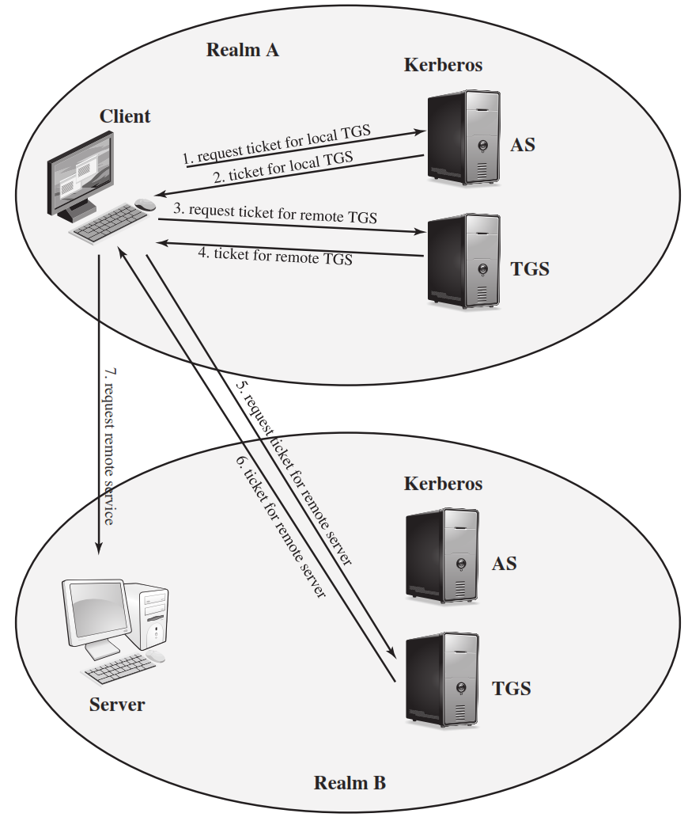
Kerberos Realm

Slide 26
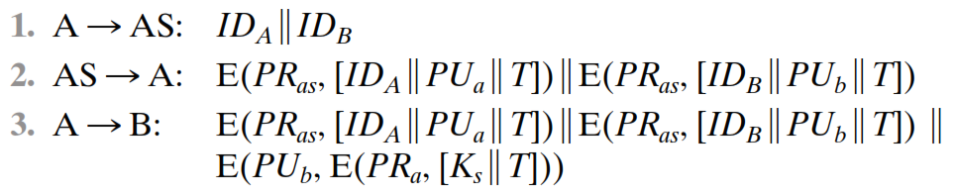
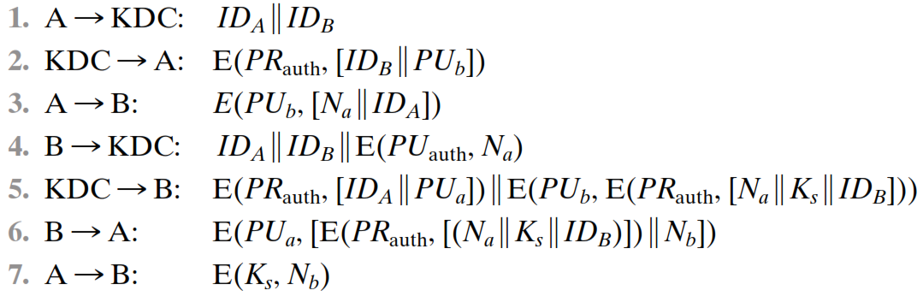
Remote user authentication with Asymmetric encryption
Mutual Authentication

Slide 27


