Slide 1


CS375 –MODERN NETWORKS
DECEMBER 2020– JULY 2021
Chapter – 2
Requirements and Technology

Slide 2






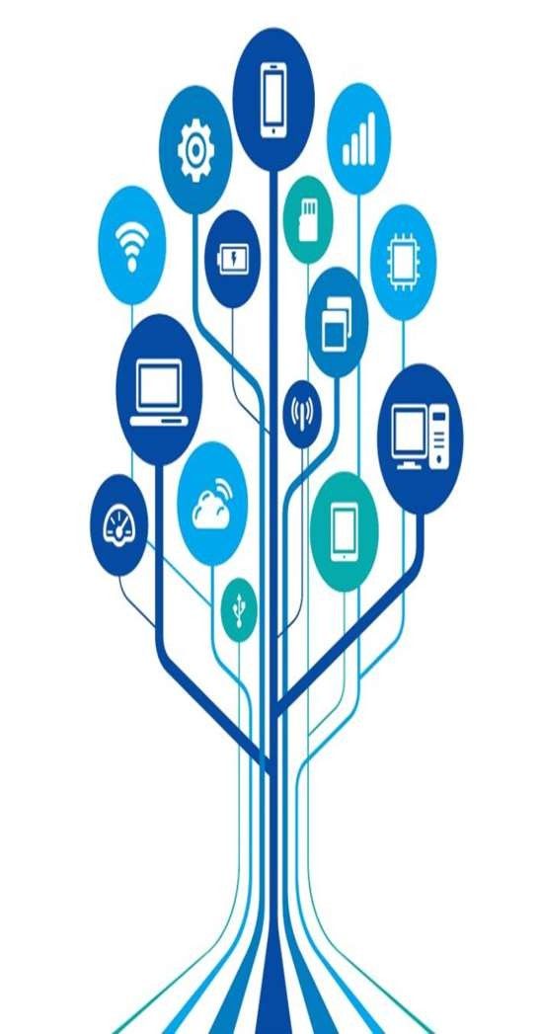






Network will make possible many straightforward and significant economies.
There will be problems such as loss of control, a potential lack of responsiveness to changing needs, and priority conflicts; but many of these problems have already been solved to a considerable degree.
Chapter 1, “Elements of Modern Networking,” provided a survey of the elements that make up the networking ecosystem, including network technologies, network architecture, services, and applications. In a concise fashion, this chapter provides motivation, technical background, and an overview of the key topics covered in
Chapter Objectives: After studying this chapter, you should be able to
Present an overview of the major categories of packet
traffic on the Internet and internets, including elastic, inelastic, and real-time traffic.
Discuss the traffic demands placed on contemporary
networks by big data, cloud computing, and mobile traffic.
Explain the concept of quality of service.

Slide 3
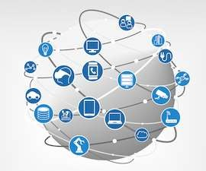

TYPES OF NETWORKS AND INTERNET TRAFFIC
Internet
A worldwide internetwork based on TCP/IP that
interconnects thousands of public and private
networks and millions of users. internet (with lower case i)
A large network made up of a number of smaller
networks. Also referred to as an internetwork.
Traffic on the Internet and enterprise networks can be divided into two broad categories: elastic and inelastic.
A consideration of their differing requirements clarifies the need for an enhanced networking architecture.

Slide 4
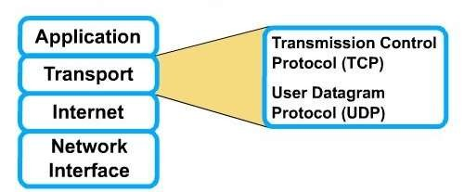
Elastic Traffic
Elastic traffic is that which can adjust,
over wide ranges, to changes in delay
and throughput across an internet and still meet the needs of its applications.
This is the traditional type of traffic
supported on TCP/IP-based internets and is the type of traffic for which internets were designed.
Applications that generate such traffic typically use Transmission Control Protocol (TCP) or User Datagram Protocol (UDP) as a transport protocol.
In the case of UDP, the application will
use as much capacity as is available up
to the rate that the application generates data.
In the case of TCP, the application will
use as much capacity as is available up
to the maximum rate that the end-to-

Slide 5
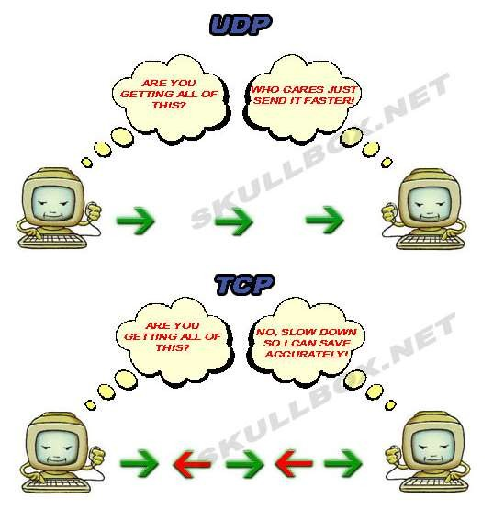
Applications that can be classified as elastic include the common applications that operate over TCP or UDP, including file transfer (File Transfer Protocol / Secure FTP [FTP/SFTP]), electronic mail (Simple Mail Transport Protocol [SMTP]), remote login (Telnet, Secure Shell [SSH]), network management (SimpleNetwork Management Protocol [SNMP]), and web access (Hypertext Transfer Protocol / HTTP Secure [HTTP/HTTPS]). However, there are differences among the requirements of these applications, including the following:
E-mail is generally insensitive to changes in delay.
When file transfer is done via user command rather than as an automated background task, the user expects the delay to be proportional to the file size and so is sensitive to changes in throughput.
With network management, delay is generally not a serious concern. However, if failures in an internet are the cause of congestion, then the need for SNMP messages to get through with minimum delay

Slide 6
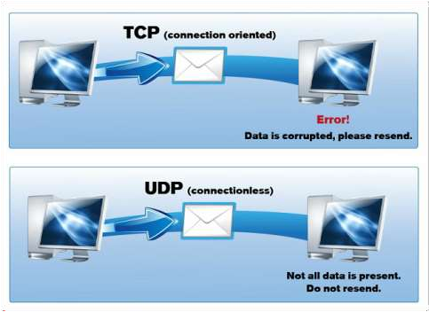

It is important to realize that it is not per- packet delay that is the quantity of interest.
Observation of real delays across the Internet suggest that wide variations in delay do not occur.
Because of the congestion control mechanisms in TCP, when congestion develops, delays only increase modestly before the arrival rate from the various TCP connections slow down.
Instead, the quality of service (QoS) perceived by the user relates to the total elapsed time to transfer an element of the current application.
For an interactive Telnet-based application, the element may be a single keystroke or single line.
For web access, the element is a web page, which could be as little as a few kilobytes or could be substantially larger for an image-rich page.
For a scientific application, the element could

Slide 7
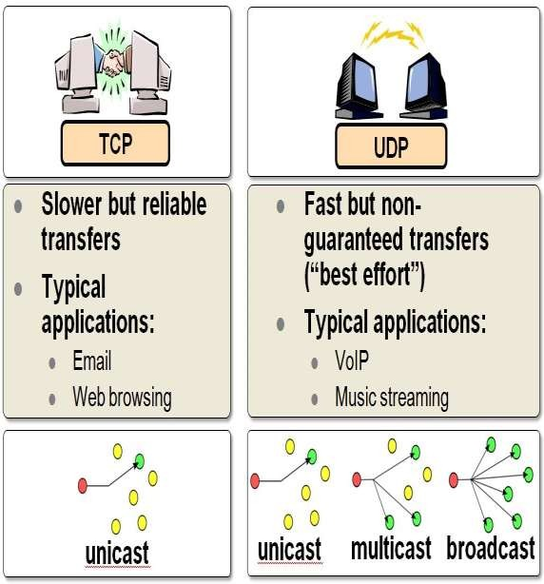

For very small elements, the total elapsed time is dominated by the delay time across the Internet.
However, for larger elements, the total elapsed time is dictated by the sliding-window performance of TCP and is therefore dominated by the throughput achieved over the TCP connection.
Thus, for large transfers, the transfer time is proportional to the size of the file and the degree to which the source slows because of congestion.
It should be clear that even if you confine your attention to elastic traffic, some service prioritizing and controlling traffic could be of benefit.
Without such a service, routers are dealing evenhandedly with arriving IP packets, with no concern for the type of application and whether a particular packet is part of a large transfer element or a small one.
Under such circumstances, and if congestion develops, it is unlikely that resources will be allocated in such a way as to meet the needs of all applications

Slide 8
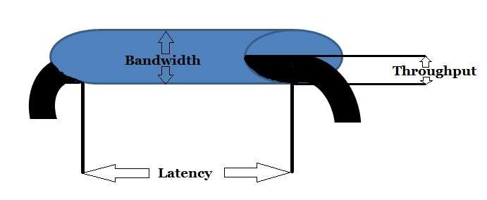
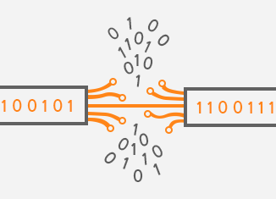

Inelastic Traffic
Inelastic traffic does not easily adapt, if at all, to changes in delay and throughput across an internet.
Examples of inelastic traffic include multimedia transmission, such as voice and video, and high-volume interactive traffic, such as an interactive simulation application (for example, airline pilot simulation).
The requirements for inelastic traffic may include the following:
Throughput: A minimum throughput value may be required. Unlike most elastic traffic, which can continue to deliver data with perhaps degraded service, many inelastic applications absolutely require a given minimum throughput.
Delay: Also called latency. An example of a delay-sensitive application is stock trading; someone who consistently receives later

Slide 9
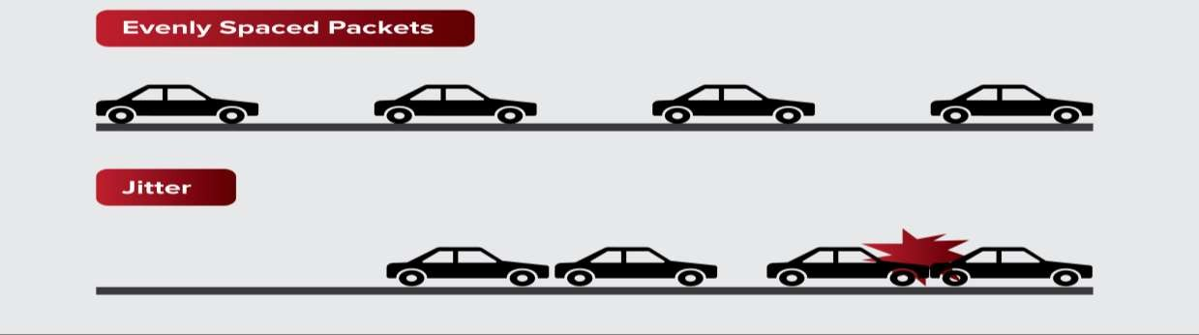
Inelastic Traffic
The requirements for inelastic traffic may include the following:
Delay jitter: The magnitude of delay variation, called delay jitter, or simply jitter, is a critical factor in real-time applications. Because of the variable delay imposed by an internet, the interarrival times between packets are not maintained at a fixed interval at the destination. To compensate for this, the incoming packets are buffered, delayed sufficiently to compensate for the jitter, and then released at a constant rate to the software that is expecting a steady real-time stream. The larger the allowable delay variation, the longer the real delay in delivering the data and the greater the size of the delay buffer required at receivers. Real-time interactive applications, such as teleconferencing, may require a
reasonable upper bound on jitter.

Slide 10
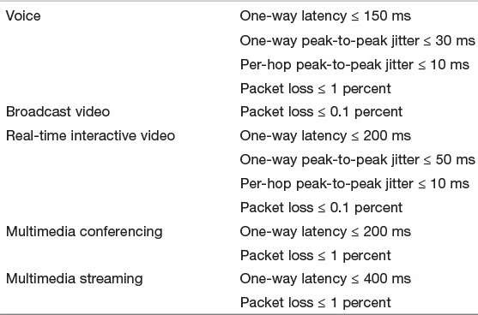
Inelastic Traffic
These requirements are difficult to environment with variable queuing
meet in an delays and
new
congestion losses.
Accordingly, inelastic
traffic introduces two
requirements into the internet architecture.
First, some means is needed to give treatment to applications with more
preferential demanding
requirements.
Applications need to be able to state their requirements, either ahead of time in some sort of service request function, or on the fly, by means of fields in the IP packet header.
The former approach provides more flexibility in stating requirements, and it enables the network to anticipate demands and deny new requests if the required resources are unavailable.
This approach implies the use of some sort of resource reservation protocol.
An additional requirement in supporting inelastic traffic in an internet architecture is that elastic traffic must still be supported.

Slide 11
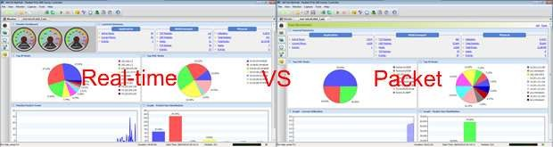
Real-Time Traffic Characteristics
As mentioned, a common example of inelastic traffic is Realtime traffic.
With traditional elastic applications, such as file transfer, electronic mail, and client/server applications including the web, the performance metrics of interest are generally throughput and delay.
There is also a concern with reliability, and mechanisms are used to make sure that no data are
lost, corrupted, or misordered during transit.
By contrast, realtime applications are concerned with timing issues as well as packet loss.
In most cases, there is a requirement that data be delivered at a constant rate equal to the sending rate.
•
In other cases, a deadline is associated with each block of data, such that the data are not usable after the deadline has expired.

Slide 12
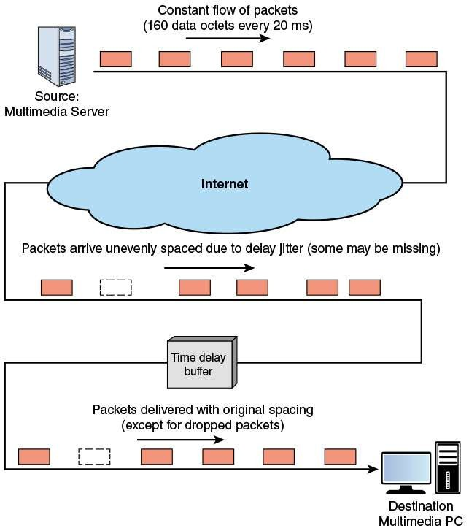
Real-Time Traffic Characteristics
Figure illustrates a typical real-time environment و Here, a server is generating audio to be transmitted at 64 kbps.
The digitized audio is transmitted in packets containing 160 octets of data, so that one packet is issued every 20 ms.
These packets are passed through an internet and delivered to a multimedia PC, which plays the audio in real time as it arrives.
However, because of the variable delay imposed by the internet, the interarrival times between packets are not maintained at a fixed 20 ms at the destination.
To compensate for this, the incoming packets are buffered, delayed slightly, and then released at a constant rate to the software that generates the audio.
The buffer may be internal to the destination machine or in an external network device.
The compensation provided by the delay buffer is limited.

Slide 13
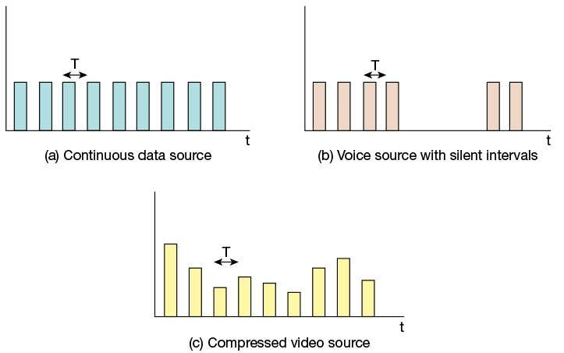
Real-Time Traffic Characteristics
The description of real-time traffic so far implies a series of equal-size packets generated at a
constant rate. This is not always the profile of the traffic ,Figure illustrates some of the common possibilities, as described in the list that follows.
Continuous data source: Fixed-size packets are generated at fixed intervals. This
characterizes applications that are constantly generating data, have few redundancies, and that are too important to compress in a lossy way. Examples are air traffic control radar and real-time simulations. Control radar and real- time simulations.
On/off source: The source alternates between periods when fixed-size packets are
generated at fixed intervals and periods of inactivity. A voice source, such as in telephony or audio conferencing, fits this profile.
Variable packet size: The source generates variable-length packets at uniform intervals.
An example is digitized video in which

Slide 14
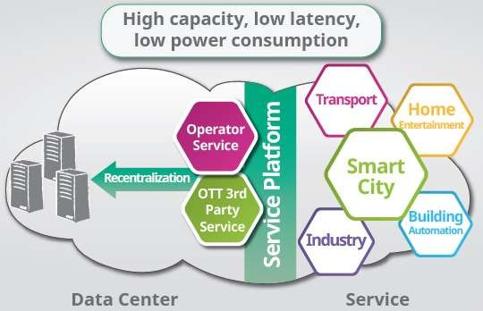
BIG DATA, CLOUD COMPUTING, AND
MOBILE TRAFFIC
Having looked at the types of traffic presented to the Internet and other IP-based networks, consider the application areas that are generating the greatest stress on network resources and management.
Three areas stand out: big data, cloud computing, and mobility.
All of these areas suggest the need for using
powerful tools such as software-defined networking (SDN) and network functions virtualization (NFV) for network operation and management, and for using comprehensive QoS and quality of experience (QoE) systems for effective delivery of services over IP-based networks.

Slide 15

BIG DATA, CLOUD COMPUTING, AND
MOBILE TRAFFIC
big data
A collection of data on such a large scale that standard data analysis and management tools are not adequate.
In simple terms, big data refers to everything that enables an organization to create, manipulate, and manage very large data sets (measured in terabytes, petabytes, exabytes, and so on) and the facilities in which these are stored.
Distributed data centers, data warehouses, and cloud- based storage are common aspects of today’s enterprise networks.
Many factors have contributed to the merging of “big data” and business networks, including continuing declines in storage costs, the maturation of data mining and business intelligence (BI) tools, and government regulations and court cases that have caused organizations to stockpile large masses of structured and unstructured data, including documents, e-mail messages, voice-mail messages, text messages, and social media data.

Slide 16
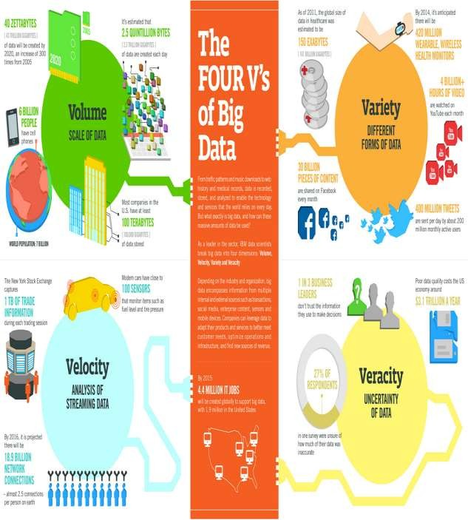
BIG DATA, CLOUD COMPUTING,
AND MOBILE TRAFFIC
More broadly, big data refers to the volume, variety, and velocity of structured and unstructured data pouring through networks into processors and storage devices, along with the conversion of such data into business advice for enterprises.
Data sets continue to grow with more and more being gathered by remote sensors, mobile devices, cameras,
microphones, radio frequency identification (RFID) readers, and similar technologies.
One study from a few
years ago estimated that 2.5 exabytes (2.5 × 10 bytes) of data are created each day, and 90 percent of the
data in the world was created in the past two years [IBM11]. Those numbers are likely higher today.

Slide 17

BIG DATA, CLOUD COMPUTING, AND MOBILE
TRAFFIC
Big Data Infrastructure Considerations
Traditional business data storage and management technologies include relational database management systems (RDBMS), network-attached storage (NAS),
storage-area networks (SANs), data warehouses (DWs),
and business intelligence (BI) analytics.
Traditional data warehouse and BI analytics systems tend
to be highly centralized within an enterprise infrastructure.
These often include a central data repository with a
RDBMS, high-performance storage, and analytics software, such as online analytical processing (OLAP) tools for mining and visualizing data..
analytics
Analysis of massive amounts of data, particularly with a
focus on decision making.
Increasingly, big data applications are becoming a source of competitive value for businesses, especially
those that aspire to build data products and services to profit from the huge volumes of data that they capture and store.

Slide 18
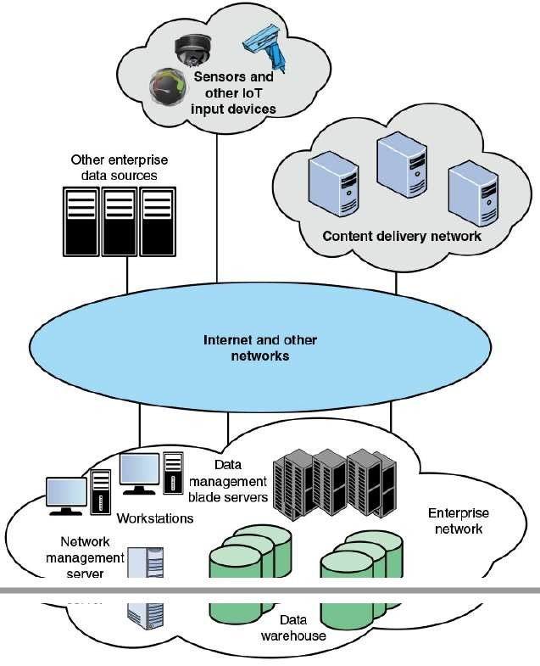
: BIG DATA, CLOUD COMPUTING, AND MOBILE
TRAFFIC
Key elements within the enterprise include the following: To get some feel for the networking requirements for a typical big data system, consider the example ecosystem of this Figure
Data warehouse: The DW holds integrated data from multiple data sources, used for reporting and data analysis.
Data management servers: Large banks of servers serve multiple functions with respect to big data. The servers run data analysis applications, such as data integration tools and analytics tools. Other applications integrate and structure data from enterprise activity, such as financial data, point-of-sale data, and ecommerce activity.
Workstations / data processing systems: Other systems involved in the use of big data applications and in the generation of input to big data warehouses.

Slide 19
BIG DATA, CLOUD COMPUTING, AND
MOBILE TRAFFIC
Key elements within the enterprise include the following: To get some feel for the networking requirements for a
typical big data system, consider the example ecosystem of this Figure
Network management server: One or more servers
responsible for network management, control, and monitoring.
Not shown in Figure 2.3 are other important network devices, including firewalls, intrusion detection/prevention systems (IDS/IPS), LAN switches, and routers.
The enterprise network can involve multiple sites distributed regionally, nationally, or globally.
In addition, depending on the nature of the big data system, an enterprise can receive data from other enterprise servers, from dispersed sensors and other devices in an Internet of Things, in addition to multimedia content from content delivery networks. The networking environment for big data is complex.

Slide 20
BIG DATA, CLOUD COMPUTING, AND
MOBILE TRAFFIC
Key elements within the enterprise include the following: To get some feel for the networking requirements for a
typical big data system, consider the example ecosystem of this Figure
Network capacity: Running big data analytics requires a
lot of capacity on its own; the issue is magnified when big data and day-to-day application traffic are combined over an enterprise network.
Latency: The real or near-real-time nature of big data demands a network architecture with consistent low latency to achieve optimal performance.
Storage capacity: Massive amounts of highly scalable storage are required to address the insatiable appetite of big data, yet these resources must be flexible enough to handle many different data formats and traffic loads.
Processing:Big data can add significant pressure on computational, memory, and storage systems, which, if not properly addressed, can negatively impact operational efficiency.
Secure data access:Big data combine sensitive data

Slide 21
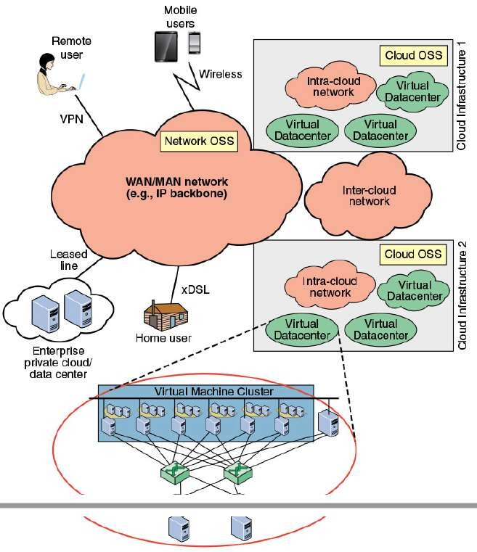

Cloud Computing
As with big data installations, cloud computing presents imposing challenges for effective and efficient flow of traffic through networks.
It will be helpful in this regard to consider the cloud network model developed by ITU-T, and shown in the Figure.
This figure indicates the scope of network concerns
for cloud network and service providers and for cloud service users.
A cloud service provider maintains one or more local or regional cloud infrastructures.
An intracloud network connects the elements of the infrastructure, including database servers, storage
•
arrays, and other servers (for example firewalls, load balancers, acceleration devices, and IDS/IPS).
The intracloud network will likely include a number of LANs interconnected with IP routers.
Within the infrastructure, database servers are organized as a cluster of virtual machines, providing
application

Slide 22
Cloud Computing
virtual machine : One instance of an operating system along with one or more applications running in an isolated partition within the computer. It enables different operating systems to run in the same computer at the same time and prevents applications from interfering with each other.
Intercloud networks interconnect cloud infrastructures together. These cloud infrastructures may be owned by the same cloud provider or by different ones.
Finally, a core transport network is used by customers to access and consume cloud services deployed within the cloud provider’s data center.

Slide 23
Cloud Computing
Also depicted in the Figure are two categories of operations support system (OSS):
Network OSS: The traditional OSS is a system
dedicated to providers of telecommunication services.
The processes supported by a network OSS include service management and maintenance of the network
inventory, configuration of particular network components, and fault management.
Cloud OSS: OSS of cloud infrastructure is the system dedicated to providers of cloud computing services.
Cloud OSS supports processes for the maintenance, monitoring, and configuration of cloud resources.
These intercloud three network components (intracloud, core), together with the OSS components, are the foundation of cloud services composition and delivery.

Slide 24
Cloud Computing
The ITU-T Focus Group on Cloud Computing Technical Report [ITUT12] lists the following functional requirements for this network capability:
Scalability:
Networks must be able to scale easily to meet the demands of moving from current cloud infrastructures of hundreds or a few thousand servers to networks of tens or even hundreds of thousands of servers.
This scaling presents challenges in areas such as addressing, routing, and congestion control.
Agility and flexibility:
The cloud-based data center needs to be able to respond and manage the highly dynamic nature of cloud resource utilization.
This includes the ability to adapt to virtual machine mobility and to provide fine-grained control of flows routing through the data center.

Slide 25
Cloud Computing
The ITU-T Focus Group on Cloud Computing Technical Report [ITUT12] lists the following functional requirements for this network capability:
Performance:
Traffic in both big data installations and cloud provider networks is unpredictable and quite variable [KAND12].
There are sustained spikes between nearby servers within the same rack and intermittent heavy traffic with a single source server and multiple destination servers.
Intracloud networks need to provide reliable high- speed direct (logical point-to-point) communications between servers with congestion-free links, and uniform capacity between any two arbitrary servers within the data center.
The ITU-T report concludes that the current three-tier topology (access, aggregation, and core) used in data centers is not well adapted to provide these requirements.

Slide 26

Mobile Traffic
Technical innovations have contributed to the success of what were originally just mobile phones.
The prevalence of the latest devices, with multimegabit Internet access, mobile apps, high megapixel digital cameras, access to multiple types of wireless networks (for example, Wi-Fi, Bluetooth, 3G, 4G), and several onboard sensors, all add to this momentous achievement.
Devices have become increasingly powerful while staying easy to carry.
Battery life has increased (even though device energy usage has also expanded), and digital technology has improved reception and allowed better use of a finite spectrum.
As with many types of digital equipment, the costs associated with mobile devices have been decreasing.
The first rush to wireless was for voice.
Now, the attention is on data; some wireless communication which requires data to be sent efficiently.

Slide 27
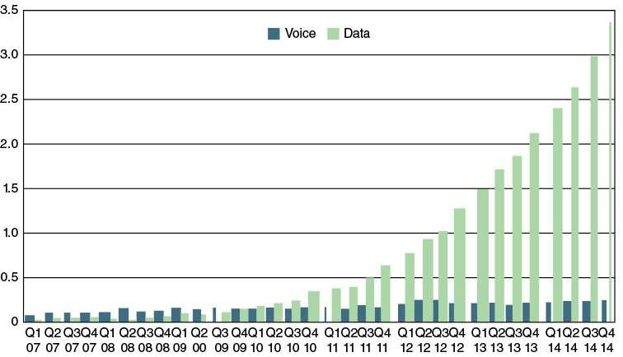
Mobile Traffic
The Figure shows the dramatic trend in world total mobile traffic in 2G, 3G, and 4G networks (not including
DVB-H, Wi-Fi, and Mobile WiMAX) estimated by Ericsson [AKAM15].
Ericsson’s presence in more than 180 countries and its customer base representing more than 1000 networks enable it to measure mobile voice and data volumes.
The result is a representative base for calculating world total mobile traffic.
A big part of the mobile market is the wireless Internet.
Wireless users use the Internet differently than fixed
users, but in many ways no less effectively.
Wireless smartphones have limited displays and input capabilities compared with larger devices such as laptops or PCs, but mobile apps give quick access to intended information without using websites.
Because wireless devices are location
aware, information can be tailored to the
geographic location of the user.
Information finds users, instead of users searching for information.
Tablet devices provide a happy medium between the larger screens and better input capabilities of PCs and the portability of smartphones.

Slide 28
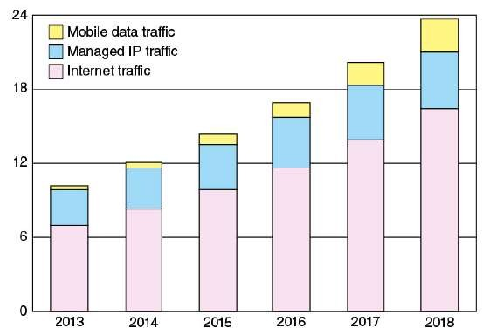
Mobile Traffic
The Figure shows a projection for mobile enterprise IP traffic [CISC14], where the term enterprise refers to businesses and governments.
Cisco’s methodology rests on a combination of analyst projections, in-house estimates and forecasts, and direct data collection.
As with mobile data traffic over cellular networks, mobile enterprise IP traffic is on a strong growth curve.
The FIGURE Forecast Monthly Enterprise IP Traffic Based on Cisco’s projections, the compound
(Exabytes/Month) [CISC14]
The Figure breaks the mobile traffic down into three 2018 for enterprise traffic is as follows:
categories:
Mobile data traffic: All enterprise traffic that crosses a
annual growth rate over the period 2013 to 2018
mobile access point
Managed IP traffic: All enterprise traffic that is transported over IP but remains within the corporate
Enterprise networks need to be flexible enough to handle the rapidly growing mobile data load.
WAN
Such a load is characterized by
Internet traffic: All enterprise traffic that crosses the public Internet Although mobile traffic is the smallest of the three categories of enterprise traffic, it is growing
dynamically changing physical access points into the network and a wide variety
of elastic and inelastic traffic types.

Slide 29
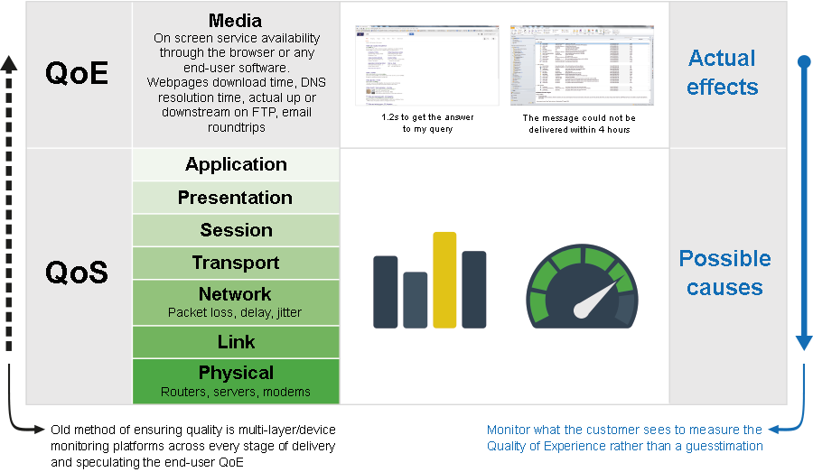
2.3 REQUIREMENTS: QOS AND QOE
So far, this chapter has focused on the types of traffic the enterprise networks and
the Internet carry and looked at three areas of demand that create significant challenges for providing effective and
efficient network service to users.
This section briefly introduces two concepts that provide a way of quantifying
the network performance that the enterprise desires to achieve:
quality of service (QoS) and quality of
•
experience (QoE).
QoS and QoE enable the network manager to determine whether the network is
meeting user needs and to diagnose problem areas that require adjustment to network management and network traffic control.
QoS and QoE are treated in detail in Part IV of the slides.

Slide 30
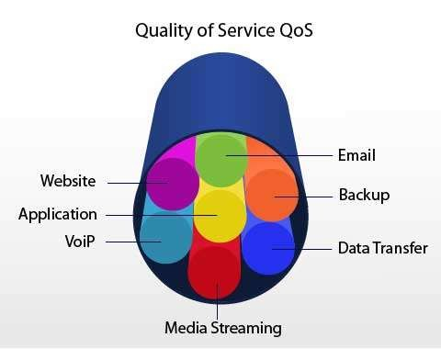
Quality of Service
You can define QoS as the measurable end-to-end performance properties of a network service, which can be guaranteed in advance by a service level agreement (SLA) between a user and a service provider, so as to satisfy specific
customer application requirements. Commonly specified properties include the following:
Throughput: A minimum or average throughput, in bytes per second or bits per second, for a given logical connection or traffic flow.
Delay: The average or maximum delay. Also called latency.
Packet jitter: Typically, the maximum allowable jitter.
Error rate: Typically maximum error rate, in terms of fraction of bits delivered in error.
Packet loss: Fraction of packets lost.
Priority: A network may offer a given number of levels of priority. The assigned level for various traffic flows influences the way in which the different flows are handled by the network.
Availability: Expressed as a percentage of time available.
Security: Different levels or types of security may be defined.

Slide 31
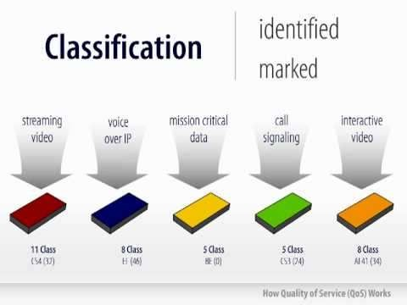
Quality of Service
QoS mechanisms ensure that business applications continue to receive the necessary performance guarantee even though they no longer run on
dedicated hardware, such as when applications are transferred to a cloud.
The QoS provided by an infrastructure is partially determined by its overall performance and efficiency.
However, QoS is also the ability to
prioritize specific workloads and allocate the needed resources to meet required service levels.
It can offer a powerful way to allocate processor, memory, I/O, and network traffic resources among applications and virtual guests..

Slide 32
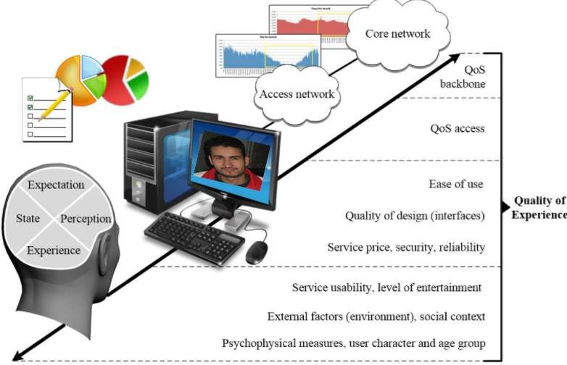
Quality of Experience
QoE is a subjective measure of performance as reported by the user.
Unlike QoS, which can be precisely measured,
QoE relies on human opinion.
QoE is important particularly when we deal with multimedia applications and multimedia content delivery.
QoS provides measurable, quantitative targets that guide the design and operation of a network and enable customer and provider to agree on what quantitative performance the network will deliver for give applications and traffic flows.
Although the maximum capacity may be fixed at a certain value by a media transmission system, this does not necessarily fix the quality of the multimedia content at, say, “high.” This is because there are numerous ways the multimedia content could have been encoded, giving rise to differing perceived qualities.

Slide 33
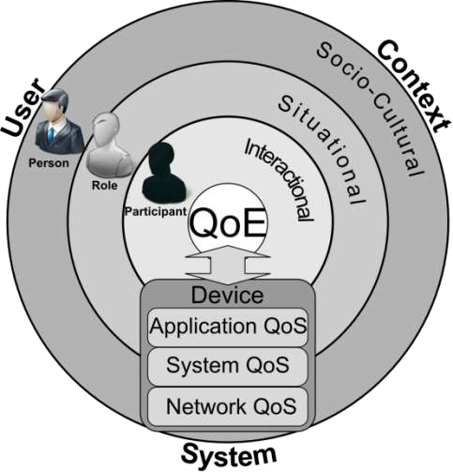

Quality of Experience
QoE augments the traditional QoS by providing information regarding the delivered services from an end user point of view.
There is factors and features included in a
requirement for QoE:
Perceptual: This category encompasses the quality of the sensory aspects of the user
experience. For video, examples include sharpness, brightness, contrast, flicker, and
distortion. Audio examples include clarity and
timbre.
Psychological: This category deals with the user’s feeling about the experience. Examples include
ease of use, joy of use, usefulness, perceived quality, satisfaction, annoyance, and boredom.
Interactive: This category deals with aspects of an experience related to the interaction between
the user and the application or device, such as responsiveness, naturalness of interaction,
communication efficiency and accessibility.

Slide 34

Quality of Experience
For practical application, these last features need to be converted to quantitative measures.
The management of QoE has become a crucial concept in the deployment of future successful applications, services, and products.
The greatest challenges in providing QoE are developing effective methods for converting QoE features to quantitative measures and translating QoE measures to QoS measures.
•
Whereas QoS can now easily be
measured, monitored, and controlled at both the networking and application layers, and at both the end system and network sides, QoE is something that is still quite intricate to manage.

Slide 35
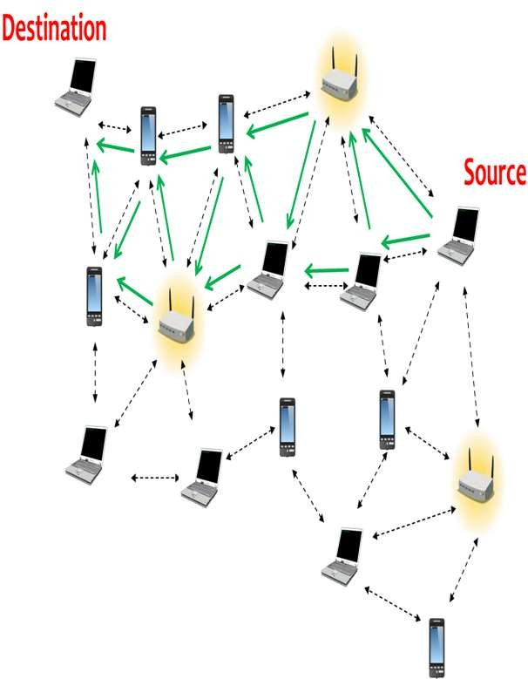
2.4 ROUTING
The purpose here is to indicate the basic concepts of
routing and congestion control, because these are the basic tools needed to support network traffic and to provide QoS and QoE.
The primary function of an internet is to accept
packets from a source station and deliver them to a destination station.
To accomplish this, a path or route through the
network must be determined; generally, more than one route is possible.
Therefore, a routing function must be performed.
The selection of a route is generally based on some performance criterion.
The simplest criterion is to choose the minimum-hop route (one that passes through the least number of
nodes) through the network.
This is an easily measured criterion and should minimize the consumption of network resources.
A generalization of the minimum-hop criterion is least-cost routing.
In this case, a cost is associated with each link, and,
for any pairof attached stations, the route through the shortest path

Slide 36
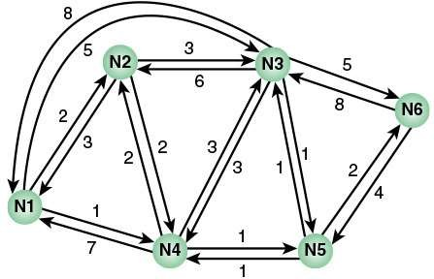

2.4 ROUTING
Figure illustrates a network in which the two arrowed
lines between a pair of nodes represent a link between these nodes, and the corresponding numbers represent the current link cost in each direction.
Our concern, of course, is with an internet, in which each node is a router and the links between adjacent routers are networks or direct communications links.
The shortest path (fewest hops) from node 1 to node
6 is 1-3-6 (Cost = 5 + 5 = 10), but the least-cost
path is 1-4-5-6 (Cost = 1 + 1 + 2 = 4).
Costs are assigned to links to support one or more design objectives.
For example, the cost could be inversely related to the data rate (that is, the higher the data rate on a
link, the lower the assigned cost of the link) or the current link delay.
In the first case, the least-cost route should provide
the highest throughput.
In the second case, the least-cost route should minimize delay.

Slide 37
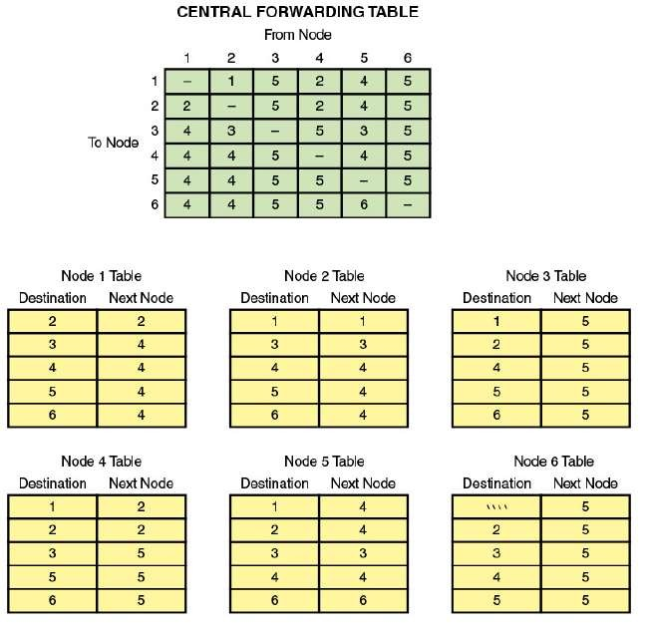
Packet Forwarding
The key function of any router is to accept incoming
packets and forward them.
For this purpose, a router maintains forwarding
tables.
Figure shows a simplified example of how this might
be implemented for the network, with its associated link costs, of Figure
A router’s forwarding table shows, for each
destination, the identity of the next node on the
router.
Each router may be responsible for discovering the appropriate
routes.
Alternatively, a network control center may be
responsible for designing routes for all routers and maintaining a central forwarding table, providing each router with individual forwarding tables relevant only to that router.

Slide 38
Packet Forwarding
Note that it is not necessary to store the complete route for each possible pair of nodes. Rather, it is
sufficient to know, for each pair of nodes, the
identity of the first node on the route.
In the Figure forwarding decisions are based solely on the identity of the destination system. Additional information is often used to determine the
forwarding decision, such as the source address, packet flow identifier, or security level of the packet:
Failure: When a node or link fails, it can no longer be
used as part of a route.
Congestion: When a particular portion of the network is heavily congested, it is desirable to route packets
around rather than through the area of congestion.
Topology change: The insertion of new links or nodes affects routing.
For adaptive routing to be possible, information about the state of the network must be exchanged
among the nodes or between the nodes and a central controller.

Slide 39
Packet Forwarding
Note that it is not necessary to store the complete route for each possible pair of nodes. Rather, it is
sufficient to know, for each pair of nodes, the
identity of the first node on the route.
In the Figure forwarding decisions are based solely on the identity of the destination system. Additional information is often used to determine the
forwarding decision, such as the source address, packet flow identifier, or security level of the packet:
Failure: When a node or link fails, it can no longer be
used as part of a route.
Congestion: When a particular portion of the network is heavily congested, it is desirable to route packets
around rather than through the area of congestion.
Topology change: The insertion of new links or nodes affects routing.
For adaptive routing to be possible, information about the state of the network must be exchanged
among the nodes or between the nodes and a central controller.

Slide 40
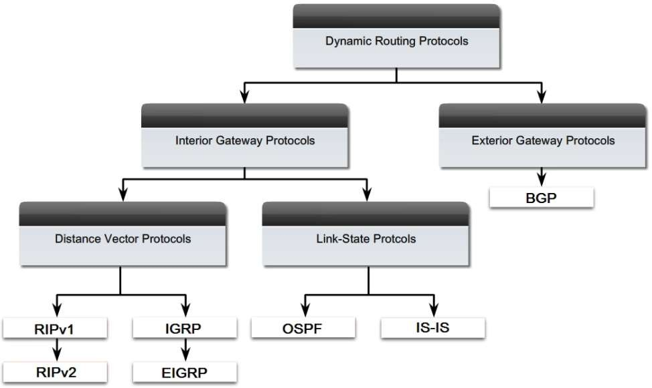
Routing Protocols
The routers in an internet are responsible for receiving and forwarding packets through the interconnected set of networks.
Each router makes routing decisions based on
knowledge of the topology and traffic/delay conditions of the internet.
Accordingly, a degree of dynamic cooperation is needed among the routers.
In particular, the router must avoid portions of the network that have failed and should avoid portions of the network that are congested.
To make such dynamic routing decisions, routers exchange routing information using a
routing protocol.
Information is needed about the status of the internet, in terms of which networks can be reached by which routes, and the delay characteristics of various routes.
In the literature, the terms interior gateway protocol (IGP) and exterior gateway protocol (EGP) are often used for what are referred to here as IRP and ERP. However, because the terms IGP and EGP also refer to specific protocols, we avoid their use when referring to the general concepts.

Slide 41
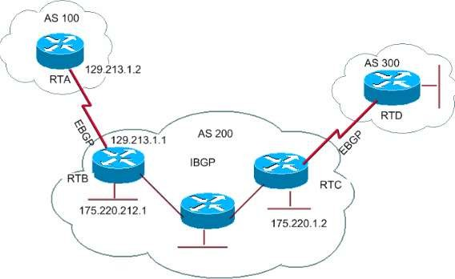
2.4 ROUTING Routing Protocols
There are essentially two categories of
routing protocols, which are based on the concept of an autonomous system (AS). We first define AS and then look at the two
categories.
An AS exhibits the following characteristics:
1. An AS is a set of routers and networks managed by a single organization.
2. An AS consists of a group of routers
exchanging information via a common
autonomous system (AS)
A network that is administered by a single set of
management rules that are controlled by one
person, group, or organization. Autonomous systems often use only one routing protocol, although multiple protocols can be used. The core of the Internet is made up of many autonomous systems.
routing protocol.
3. Except in times of failure, an AS is connected (in a graph-theoretic sense);
that is, there is a path between any pair of nodes.

Slide 42
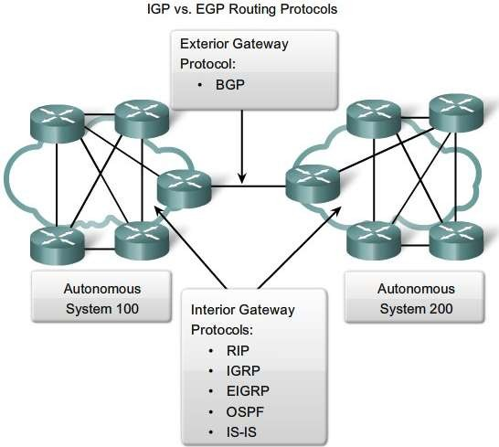
Routing Protocols
A shared routing protocol, called here an interior router protocol (IRP), passes routing
information between routers within an AS.
The protocol used within the AS does not
need to be implemented outside of the system.
This flexibility allows IRPs to be custom tailored to specific applications and requirements.
It may happen, however, that an internet will
be constructed of more than one AS.
For example, all the LANs at a site, such as an office complex or campus, could be linked by routers to form an AS.
This system might be linked through a wide- area network to other autonomous systems.
Figure illustrates this situation.
interior router protocol (IRP)
A protocol that distributes routing information to collaborating routers within an AS. Routing
Information Protocol (RIP) and Open Shortest Path First (OSPF) Protocol are examples of IRPs. Historically, an IRP was referred to as an interior gateway protocol.

Slide 43
Routing Protocols
In this case, the routing algorithms and information in routing tables used by routers in different
autonomous systems may differ.
Nevertheless, the routers in one AS need at least a
minimal level of information concerning networks outside the system that can be reached.
We refer to the protocol used to pass routing
information between routers in different autonomous
systems as an exterior router protocol (ERP).
You can expect that an ERP will need to pass less
information than an IRP for the following reason.
If a packet is to be transferred from a host in one AS to a host in another AS, a router in the first system need only determine the target AS and devise a route to get into that target system.
Once the packet enters the target AS, the routers within that system can cooperate to deliver the packet; the ERP is not concerned with, and does not know about, the details of the route followed within the target AS.
exterior router protocol (ERP)
A protocol that distributes routing information to collaborating routers that connect autonomous systems.
BGP is an example of an ERP. Historically, an ERP was referred to as an exterior gateway protocol.

Slide 44
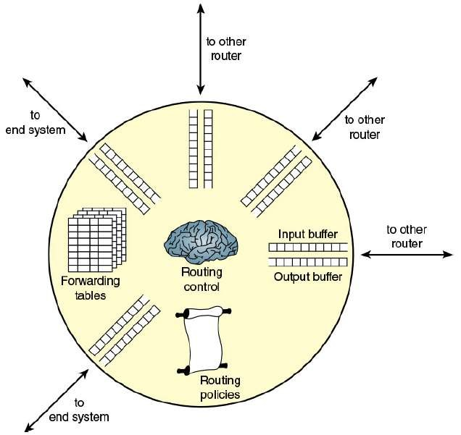

Elements of a Router
Figure depicts the principal elements of a router,
from the point of view of its routing function.
Any given router has a number of I/O ports attached to it: one or more to other routers, and
zero or more to end systems.
On each port, packets arrive and depart.
You can consider that there are two buffers, or
queues, at each port: one to accept arriving packets, and one to hold packets that are waiting to
depart.
In practice,there might be two fixed-size buffers associated with each port, or there might be a pool
of memory available for all buffering activities.
In the latter case, you can think of each port having
two variable-size buffers associated with it, subject to the constraint that the sum of all buffer sizes is a constant.
In any case, as packets arrive, they are stored in the input buffer of the corresponding port.

Slide 45
Elements of a Router
The router examines each incoming packet, makes a routing decision based on the forwarding tables, and then moves the packet to the appropriate output buffer.
Packets queued for output are transmitted as rapidly as
possible.
Each output queue can be operated as a simple first-in,
first-out (FIFO) queue.
More commonly, a more complex queuing discipline is used, to take into account the relative priority of the queued packets.
A set of routing policies may also influence the construction of the forwarding tables and how various packets are to be treated.
Policies may determine routing not just on the destination
address but other factors, such as source address, packet size, and protocol of the payload.
The final element shown in Figure is a routing control
function.
This function includes execution of routing protocols, adaptive maintenance of the routing tables, and supervising congestion control policies.

Slide 46
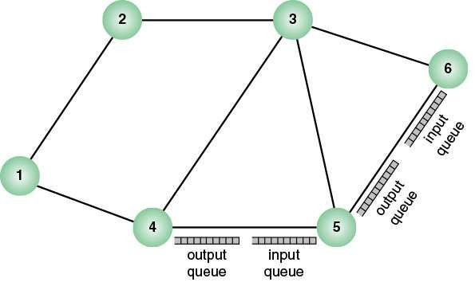
2.5 CONGESTION CONTROL Effects of Congestion
If packets arrive too fast for a router to process them
(that is, make routing decisions) or faster than packets can be cleared from the outgoing buffers, eventually packets will arrive for which no memory is available.
When such a saturation point is reached, one of two general strategies can be adopted.
The first such strategy is to discard any incoming packet
for which there is no available buffer space.
The alternative is for the node that is experiencing these problems to exercise some sort of flow control over its neighbors so that the traffic flow remains manageable.
But, as Figure illustrates, each of a node’s neighbors is
also managing a number of queues.
If node 6 restrains the flow of packets from node 5, this
causes the output buffer in node 5 for the port to node 6 to fill up.
Thus, congestion at one point in the network can quickly
propagate throughout a region or the entire network.
Although flow control is indeed a powerful tool, you
need to use it in such a way as to manage the traffic on the entire network.
If the traffic demand on an internet exceeds capacity, or if the internet does not manage the traffic efficiently,
congestion will occur.
This section provides a brief overview of
the effects of congestion and a general introduction to approaches to congestion control.

Slide 47
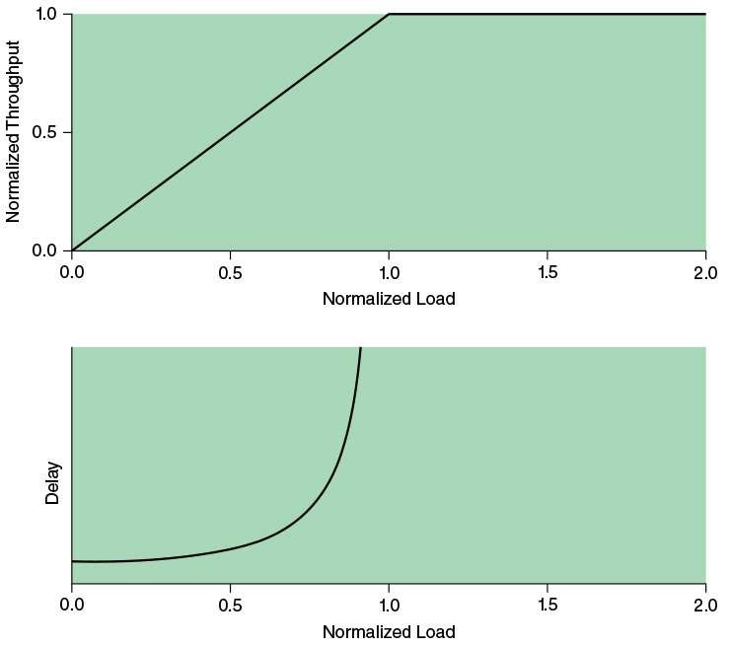

Ideal Performance
The top graph plots the steady-state total
throughput (number of packets delivered to destination end systems) through the network as a function of the offered load (number of
packets transmitted by source end systems), both normalized to the maximum theoretical throughput of the network.
In the ideal case, the throughput of the network increases to accommodate load up to an offered load equal to the full capacity of the network; then normalized throughput remains at 1.0 at higher input loads.
Note, however, what happens to the end-to- end delay experienced by the average packet even with this assumption of ideal performance.
At negligible load, there is some small constant amount of delay that consists of the propagation delay through the network from source to destination plus processing delay at each node.

Slide 48
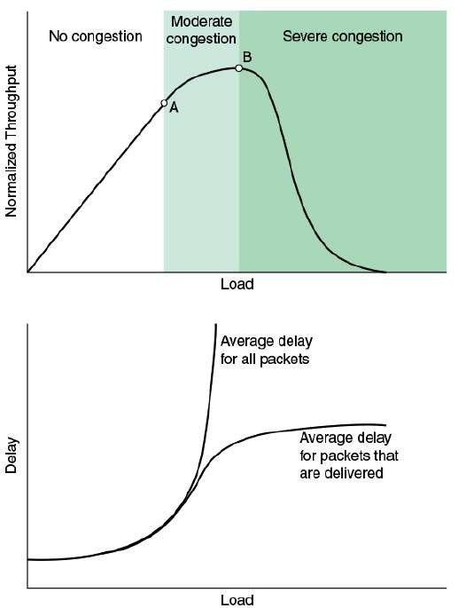
2.5 CONGESTION CONTROL Practical Performance
The ideal case reflected in last Figure assumes infinite buffers and no overhead related to congestion control.
In practice, buffers are finite, leading to buffer overflow, and attempts to control congestion consume network capacity in the exchange of control signals.
Consider what happens in a network with finite buffers if no attempt is made to control congestion or to restrain input from end systems. The details, of course, differ depending on network architecture and on the
statistics of the presented traffic; however, the graphs in this Figure depict the devastating outcome in general terms.

Slide 49
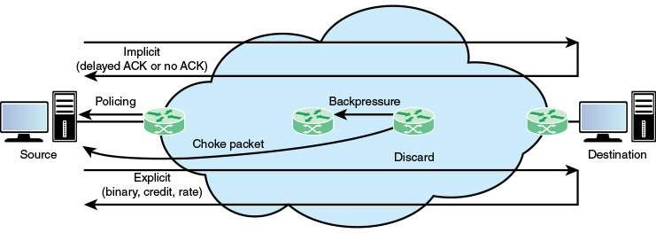

Congestion Control Techniques
Figure provides a general depiction of important congestion control techniques. This section examines each of these.

Slide 50
Congestion Control Techniques
Backpressure
Backpressure can be exerted on the basis of links or logical connections (for example, virtual circuits).
if node 6 becomes congested (buffers fill up), node
6 can slow down or halt the flow of all packets from node 5 (or node 3, or both nodes 5 and 3).
If this restriction persists, node 5 will need to slow down or halt traffic on its incoming links.
This flow restriction propagates backward (against the flow of data traffic) to sources, which are restricted in the flow of new packets into the network.
In this case, the restriction propagates back along the connection to the source.
Such a mechanism is used in Frame Relay and
Asynchronous Transfer Mode (ATM) networks.
However, the use of these networks has declined considerably in favor of Ethernet carrier networks and IP-based Multiprotocol Label Switching (MPLS) networks

Slide 51
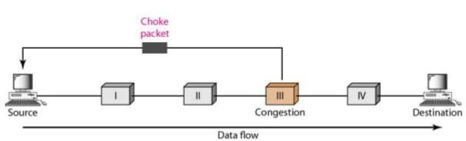
Congestion Control Techniques Choke Packet
A choke packet is a control packet generated at a congested node and transmitted back to a source node to restrict traffic flow.
Either a router or a destination end system may send this message to a source end system, requesting that it reduce the rate at which it is sending traffic to the internet destination.
On receipt of a choke packet, the source host should cut back the rate at which it is sending traffic to the specified destination until it no longer receives choke packets.
The choke packet used by a router or host that must discard IP datagrams because of a full buffer.
In that case, the router or host will issue a choke packet for every packet that it discards.
a system may anticipate congestion and issue choke packets when its buffers approach capacity.
In that case, the packet referred to in the choke packet may well be delivered.
Therefore, receipt of a choke packet does not imply delivery or nondelivered of the corresponding packet.

Slide 52
Congestion Control Techniques Implicit Congestion Signaling
When network congestion occurs, two things may happen:
The transmission delay for an individual packet from source to destination increases, so that it is noticeably longer than the fixed propagation delay
Packets are discarded
If a source can detect increased delays and packet discards, it has implicit evidence of network congestion.
Implicit signaling is an effective congestion control technique in connectionless, or datagram, networks, such as IP-based internets.
In such cases, there are no logical connections through the internet on which flow can be regulated.
However, between the two end systems, logical
connections can be established at the TCP level.
TCP includes mechanisms for acknowledging receipt of TCP segments and for regulating the flow of data between source and destination on a TCP connection.

Slide 53
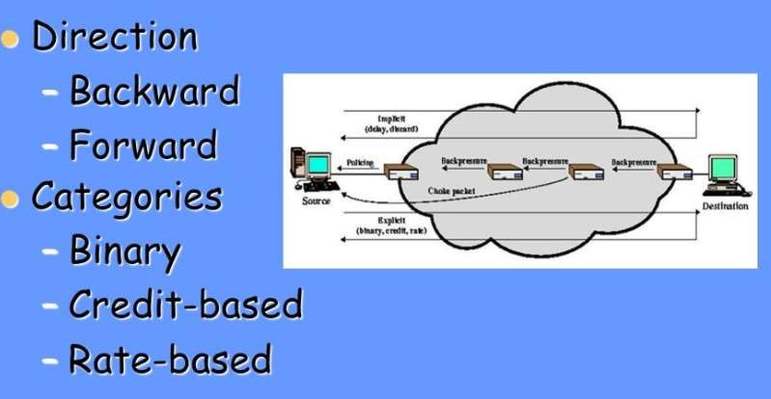
PART I MODERN NETWORKING
Chapter 2: Requirements and Technology
2.5 CONGESTION CONTROL Congestion Control Techniques Explicit Congestion Signaling
Explicit congestion signaling approaches can work in one of two directions:
Backward: Notifies the source that congestion avoidance procedures should be initiated where applicable for traffic in the opposite direction of the received notification. It indicates that the packets that the use transmits on this logical connection may encounter congested resources. Forward: Notifies the user that congestion avoidance procedures should be initiated where applicable for traffic in the same direction as the received notification. It indicates that this packet, on this logical connection, has encountered congested resources. Again, this information may be transmitted either as altered bits in data packets or in separate control packets.

Slide 54
Congestion Control Techniques Explicit Congestion Signaling
explicit congestion signaling divided into three categories:
Binary: A bit is set in a data packet as it is forwarded by the congested node. When a source receives a binary indication of congestion on a logical connection, it reduce its traffic flow.
Credit based: based on providing an explicit credit to a source over a logical connection. The credit indicates how many packets the source may transmit. Credit-based schemes are common for end-to-end flow control, in which a destination system uses credit to prevent the source from overflowing the destination buffers, but credit-based schemes have also been considered for congestion control. Credit-based schemes are defined in Frame Relay and ATM networks.
Rate based: based on providing an explicit data rate limit to the source over a logical connection. The source may transmit data at a rate up to the set limit. To control congestion, any node along the path of the connection can reduce the data rate limit in a control message to the source.

Slide 55
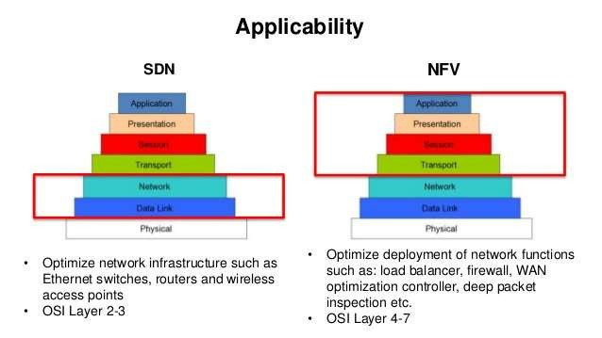

2.6 SDN AND NFV
With the ever-increasing volume and variety of network traffic, generated by such high-demand sources as big data, cloud computing, and mobile traffic, it becomes increasingly difficult to meet stringent QoS and QoE requirements.
Networks need to be more adaptable and scalable.
To provide adaptability and scalability, two key technologies that are rapidly being deployed by a variety of network service and application providers are software-defined networking (SDN) and network functions virtualization (NFV).
Because these two topics occupy a large portion of this book, only a brief introduction is appropriate here.

Slide 56
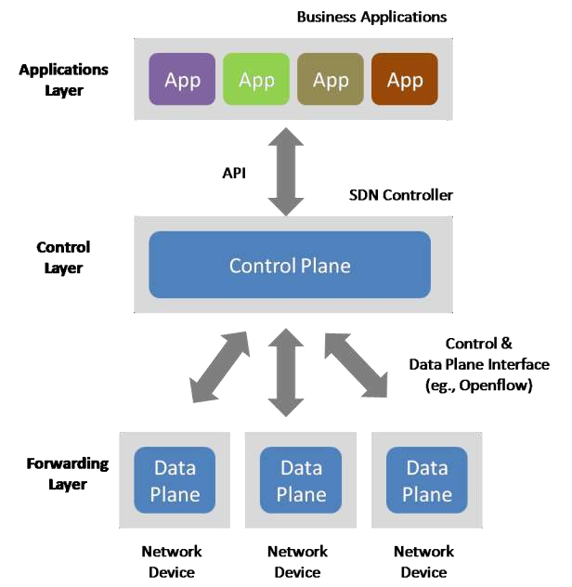
SDN has reached a tipping point at which it is replacing the traditional networking model.
Software-defined networks provide an enhanced level of flexibility and customizability to meet the needs of newer networking and IT trends such as cloud, mobility, social networking, and video.
Software defined networking (SDN)
An approach to designing, building and operating large-scale networks based on programming the forwarding decisions in routers and switches via software from a central server.
SDN differs from traditional networking, which requires configuring each device separately and which relies on protocols that cannot be altered.

Slide 57
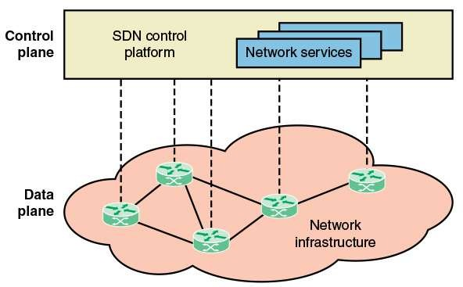
The two elements involved in forwarding packets through routers are a control function, which decides the route the traffic takes and the relative
priority of traffic, and a data function, which forwards data based on control-function policy.
Prior to SDN, these functions were performed in
an integrated fashion at each network device
(router, bridge, packet switch, and so on).
Control in such a traditional network is exercised by means of a routing and control network
protocol that is implemented in each network
This constitutes the SDN control plane, and consists of one or more SDN controllers.
The SDN controller defines the data flows that occur in the SDN data plane.
Each flow through the network is configured by the controller, which verifies that the communication is permissible by the network policy.
If the controller allows a flow requested by an end system, it computes a route for the flow to take, and adds an entry for that flow in each of the switches along the path.
With all complex function subsumed by the controller, switches simply manage flow tables whose entries can only be populated by the controller.
The switches constitute the data plane.
Communication between the controller and the switches uses a standardized protocol.
node.
This approach is relatively inflexible and requires all the network nodes to implement the same protocols.
With SDN, a central controller performs all
complex functionality, including routing, naming, policy declaration, and security checks (see Figure
)..

Slide 58
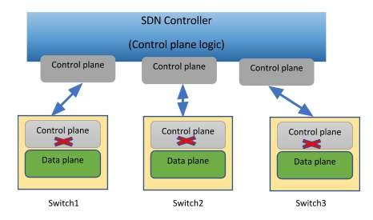
One driving factor for SDN is the increasingly widespread use
of server virtualization.
In essence, server virtualization masks server resources, including the number and identity of individual physical servers, processors, and operating systems, from server users.
This makes it possible to partition a single machine into multiple, independent servers, conserving hardware resources.
It also makes it possible to quickly migrate a server from one machine to another for load balancing or for dynamic
switchover in the case of machine failure.
But with the VM being movable, it is necessary to reconfigure the VLAN every time that a virtual server is moved.
In general terms, to match the flexibility of
Server virtualization has become a central element in dealing
with big data applications and in implementing cloud
computing infrastructures.
But it
creates problems with traditional network
server virtualization, the network manager
architectures. One problem is configuring virtual LANs. Network managers need to make sure the VLAN used by the virtual machine (VM) is assigned to the same switch port as the physical server running the VM.
needs to be able to dynamically add, drop, and change network resources and profiles.
This is difficult to do with conventional
network switches, in which the control logic for each switch is collocated with the switching logic.

Slide 59
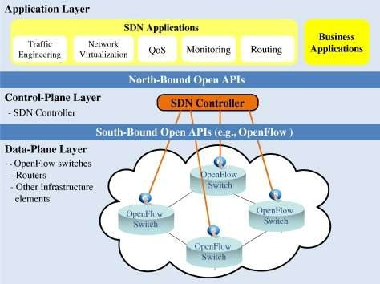
Another effect of server virtualization is that traffic flows
differ substantially from the traditional client/server model.
Typically, there is a considerable amount of traffic among virtual servers, for such purposes as maintaining consistent images of database and invoking security functions such as access control.
Another factor leading to the need for rapid response in
allocating network resources is the increasing use by
employees of mobile devices, such as smartphones, tablets, and notebooks to access enterprise resources.
These devices can add fast-changing and unpredictable large•
loads on the network, and can rapidly change their network
attachment point.
Existing network infrastructures can respond to changing requirements for the management of traffic flows, providing• differentiated QoS levels and security levels for individual flows, but the process can be very time-consuming if the enterprise network is large or involves network devices from multiple vendors.
each
vendor’s equipment separately, and adjust
The network manager must configure
performance and security parameters on a per- session, per-application basis.
In a large enterprise, every time a new VM is brought up, it can take hours or even days for network managers to do the necessary reconfiguration

Slide 60

The discussion of SDN mentioned that a key driving factor in the deployment of SDN is the need to provide flexible network response to the widespread use of virtualized servers.
VM technology over the Internet or an enterprise network has, until recently, been used for application-level server functions such as database servers, cloud servers, web servers, e-mail servers, and so on.
This same technology, however, can equally be applied to network devices, such as routers, LAN
switches, firewalls, and IDS/IPS servers (see Figure).
Network functions virtualization (NFV) decouples
network functions, such as routing, firewalling,
intrusion detection, and Network Address
Translation from proprietary hardware platforms and implements these functions in software.
It utilizes standard virtualization technologies that
run on high-performance hardware to virtualize network
functions
It is applicable to any data plane processing or control plane function in both wired and wireless network infrastructures

Slide 61
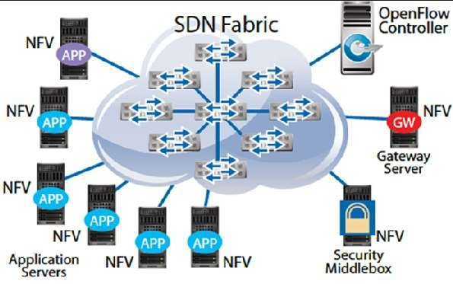
2.6 SDN AND NFV Network Functions Virtualization network functions virtualization (NFV) The virtualization of network functions by
implementing these functions in software and running them on virtual machines.
NFV has a number of features in common with SDN. They share the following objectives:
Move functionality to software
Use commodity hardware platforms instead of proprietary platforms
Use standardized or open application
program interfaces (APIs)
Support more efficient evolution, deployment, and repositioning of network functions
NFV and SDN are independent but complementary schemes.
SDN decouples the data and control planes of network traffic control, making the control and routing of network traffic more flexible and efficient.
NFV decouples network functions from specific hardware platforms via virtualization to make the provision of these functions more efficient and flexible
Virtualization can be applied to the data plane functions of the routers and other network functions, including SDN controller functions.
So, either can be used alone, but the two can be combined to reap greater benefits

Slide 62
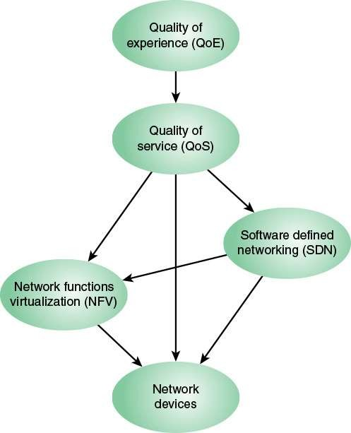
2.7 MODERN NETWORKING ELEMENTS
The discussion that follows works through this figure from the bottom up.
Ultimately, the concern of a network service provider is about the set of network devices (such as routers) and the control and management of the functions they perform (such as packet forwarding).
If NFV is used, these network functions are implemented in software and executed on VMs.
If instead the network functions are implemented on dedicated machines and SDN is used, the control functions are implemented on central SDN controllers, which interact with the network devices.
However, SDN and NFV are not mutually exclusive.
If both SDN and NFV are implemented for a network, the following relationships hold:
Network data plane functionality is implemented on VMs.
The control plane functionality may be implemented on a
dedicated SDN platform or on an SDN VM.

Slide 63
2.7 MODERN NETWORKING ELEMENTS
In either case, the SDN controller interacts with the data plane functions running on VMs.
QoS measures are commonly used to specify the service required by various network customers or users and to dictate the traffic management policies used on the network.
The common case, until recently, is that QoS was implemented on network that used neither NFV nor SDN.
In this case, routing and traffic control policies must be configured directly on network devices using a variety of automated and manual techniques.
If NFV but not SDN is implemented, the QoS settings are communicated to the VMs.
With SDN, regardless of whether NFV is used, it is the SDN controller that is responsible for enforcing QoS parameters for the various network users.
If QoE considerations come into play, these are used to
adjust QoS parameters to satisfy the users’ QoE
requirements.

