Slide 1
SDN: Background and Motivation
Bansari Patel
CS374 –MODERN NETWORKS
DECEMBER 2021– JULY 2022
Teaching cum. Research Assistant
Computer Science and Engineering
20-12-2021

Slide 2
Chapter Objectives
After studying this chapter, you should be able to justify the position that traditional network architectures are inadequate for modern networking needs.
List and explain the key requirements for an SDN architecture.
Present an overview of an SDN architecture, to include explaining the significance of northbound and southbound APIs.
Summarize the work being done on SDN and NFV standardization by various organizations.

Slide 3
Evolving Network Requirements
1. Demand Is Increasing
A number of trends are increasing the load on enterprise networks, the Internet, and other internets. Few of them are:
Cloud computing:
There has been a dramatic shift by enterprises to both public and private cloud services.
Big data:
The processing of huge data sets requires massive parallel processing on thousands of servers, all of which require interconnection to each other. Therefore, there is a large and constantly growing demand for network capacity within the data center.
Problems are: How to store this huge amount of data, how to process this huge amount of data, How to make decision on this data, How to analyze this data, How to make this data useful

Slide 4
Evolving Network Requirements
Mobile traffic: Employees are increasingly accessing enterprise network resources via mobile personal devices, such as smartphones, tablets, and notebooks. These devices support sophisticated apps that can consume and generate image and video traffic, placing new burdens on the enterprise network.
The Internet of Things (IoT): Most “things” in the IoT generate modest traffic, although there are exceptions, such as surveillance video cameras. But the sheer number of such devices for some enterprises results in a significant load on the enterprise network.
As the Demand is increasing – Supply is also increasing on the other side.

Slide 5
Evolving Network Requirements
2. Supply Is Increasing
The capacity of network technologies are increasing like we have gigabit per sec. in both cases of Wi-Fi and ethernet they are available.
Similarly, in 4G and 5G cellular networks are also providing greater capacity for mobile devices.
So the increase in capacity of the network transmission technologies has been matched by an increase in the performance of the network devices - such as LAN switches, routers, firewalls, intrusion detection system/intrusion prevention systems (IDS/IPS), and network monitoring and management systems.
And every year these devices are becoming more powerful, more larger, more faster in memory and they also enable greater buffering capacities.

Slide 6
Evolving Network Requirements
3. Traffic Patterns Are More Complex
For eg: - Big Data (We are generating data in different formats) – Traditional network is not well suited for increasing data.
Current network is well suited to -
Client/server applications typically access multiple databases and servers that must communicate with each other, generating “horizontal” traffic between servers as well as “vertical” traffic between servers and clients.
Network convergence of voice, data, and video traffic creates unpredictable traffic patterns, often of large multimedia data transfers.
Unified communications (UC) strategies involve heavy use of applications that trigger access to multiple servers.

Slide 7
Evolving Network Requirements
The heavy use of mobile devices is becoming an increasingly significant fraction of enterprise network traffic. (BYOD)

Slide 8
Evolving Network Requirements
4. Traditional Network Architectures are Inadequate
Even with the greater capacity of transmission schemes and the greater performance of network devices, traditional network architectures are increasingly inadequate in the face of the growing complexity, variability, and high volume of the imposed load.
Three noteworthy characteristics of this approach are as follows:
Two-level end system addressing
Routing based on destination
Distributed, autonomous control

Slide 9
Evolving Network Requirements
Based on these characteristics, the Open Networking Foundation (ONF) cites four general limitations of traditional network architectures.
Static, complex architecture - : To respond for demands such as differing levels of QoS, high and fluctuating traffic volumes, and security requirements, networking technology has grown more complex and difficult to manage. This has resulted in a number of independently defined protocols each of which addresses a portion of networking requirements.
Inconsistent policies - : To implement a network-wide security policy, staff may have to make configuration changes to thousands of devices and mechanisms.

Slide 10
Evolving Network Requirements
Inability to scale - : Demands on networks are growing rapidly, both in volume and variety. Adding more switches and transmission capacity, is difficult because of the complex, static nature of the network.
Vendor dependence - : Given the nature of today’s traffic demands on networks, enterprises and carriers need to deploy new capabilities and services rapidly in response to changing business needs and user demands. A lack of open interfaces for network functions leaves the enterprises limited by the relatively slow product cycles of vendor equipment.

Slide 11
SDN Approach
Management
Programmable network
Centralized management
Agility
Visibility
Cost Efficiency
Security

Slide 12
SDN Approach
Adaptability: Networks must adjust and respond dynamically, based on application needs, business policy, and network conditions.
Automation: Policy changes must be automatically propagated so that manual work and errors can be reduced.
Maintainability: Introduction of new features and capabilities (software upgrades, patches) must be seamless with minimal disruption of operations.
Model management: Network management software must allow management of the network at a model level, rather than implementing conceptual changes by reconfiguring individual network elements.

Slide 13
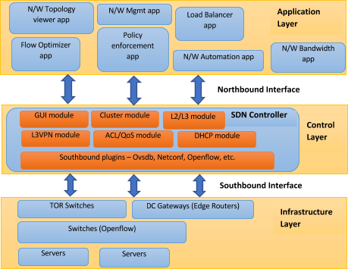
An Overview of SDN Architecture

Slide 14
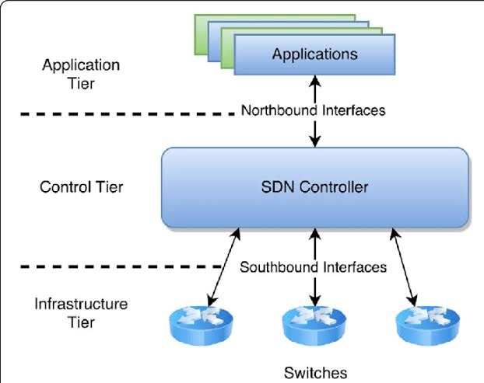
SDN Architecture

Slide 15
Characteristics of Software-Defined Networking
Putting it all together, the key characteristics of SDN are as follows:
The control plane is separated from the data plane. Data plane devices become simple packet-forwarding devices .
The control plane is implemented in a centralized controller or set of coordinated centralized controllers. The SDN controller has a centralized view of the network or networks under its control. The controller is portable software that can run on commodity servers and is capable of programming the forwarding devices based on a centralized view of the network.

Slide 16
Characteristics of Software-Defined Networking
An Open interfaces are defined between the devices in the control plane (controllers) and those in the data plane.
The network is programmable by applications running on top of the SDN controllers. The SDN controllers present an abstract view of network resources to the applications

Slide 17
SDN and NFV
Ever-increasing volume and variety of network traffic
Big Data
Cloud Computing
Mobile Traffic
Becomes increasingly difficult to meet QoS and QoE requirements
Networks need to be more adaptable and scalable
Two key technologies are SDN and NFV

Slide 18
NFV – Network Function Virtualization
SDN needs to provide flexible network response to the widespread use of virtualized servers.
Generally, VM technology has been used for application level server functions
Same technology can be applied to network devices, such as routers, LAN switches, firewalls and servers.

Slide 19
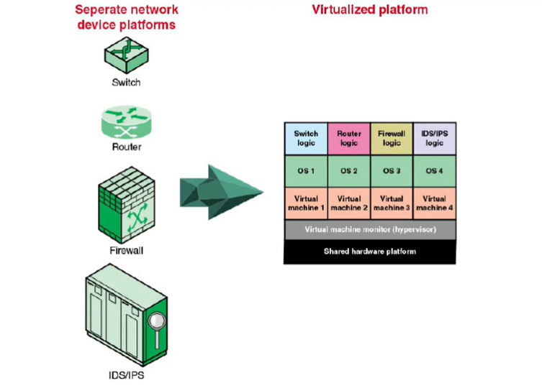
NFV

Slide 20
NFV-Network Function Virtualization
Network Function Virtualization, or NFV, is a way to reduce cost and accelerate service deployment for network operators by decoupling functions like a firewall or encryption from dedicated hardware and moving them to virtual servers.
Instead of installing expensive proprietary hardware, service providers can purchase inexpensive switches, storage and servers to run virtual machines that perform network functions. This collapses multiple functions into a single physical server, reducing costs and minimizing truck rolls. If a customer wants to add a new network function, the service provider can simply spin up a new virtual machine to perform that function.
For example, instead of deploying a new hardware appliance across the network to enable network encryption, encryption software can be deployed on a standardized server or switch already in the network.
This virtualization of network functions reduces dependency on dedicated hardware appliances for network operators, and allows for improved scalability and customization across the entire network.

Slide 21
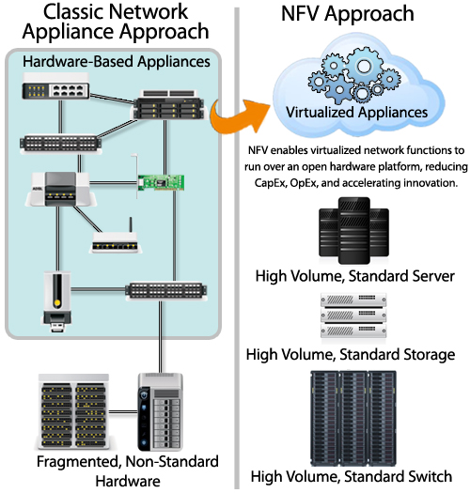
NFV Approach
CapEx – Capital Expenses
OpEx – Operating Expenses

Slide 22
What are the advantages of NFV?
Separating network functions from hardware yields numerous benefits for the network operator, which include:
Reduced space needed for network hardware
Reduce network power consumption
Reduced network maintenance costs
Easier network upgrades
Longer life cycles for network hardware
Reduced maintenance and hardware costs

Slide 23
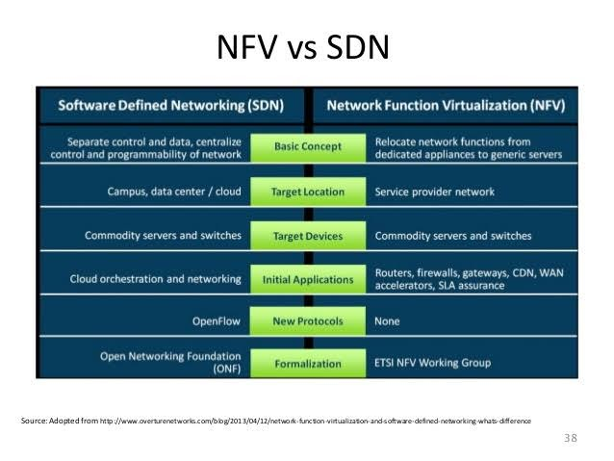
SDN- and NFV-Related Standards

Slide 24
Cont…
SDN | NFV
SDN architecture mainly focuses on data centers. | NFV is targeted at service providers or operators.
SDN separates control plane and data forwarding plane by centralizing control and programmability of network. | NFV helps service providers or operators to virtualize functions like load balancing, routing, and policy management by transferring network functions from dedicated appliances to virtual servers.
SDN uses OpenFlow as a communication protocol. | There is no protocol determined yet for NFV.
SDN supports Open Networking Foundation. | NFV is driven by ETSI NFV Working group.
Various enterprise networking software and hardware vendors are initiative supporters of SDN. | Telecom service providers or operators are prime initiative supporters of NFV.
Corporate IT act as a Business initiator for SDN. | Service providers or operators act as a Business initiator for NFV.
SDN applications run on industry-standard servers or switches. | NFV applications run on industry-standard servers.
SDN reduces cost of network because now there is no need of expensive switches & routers. | NFV increases scalability and agility as well as speed up time-to-market as it dynamically allot hardware a level of capacity to network functions needed at a particular time.
Application of SDN:Networking Cloud orchestration | Application of NFV:Routers, firewalls, gateways WAN accelerators SLA assurance Video Servers Content Delivery Networks (CDN)

Slide 25
Assignment Questions
Difference between Software Defined Network and Traditional Network
Why Is Software-Defined Networking (SDN) Important?
Advantages of Software-Defined Networking (SDN)
Write down SDN Architecture
What are the characteristics of a software-defined networking or SDN system?
What is NFV and NFV vs SDN.

Slide 26
Thankyou

