Slide 1
OSPF – Open Shortest Path First
Interior gateway routing protocol
A routing algorithm within autonomous system is called interior gateway routing protocol
OSPF supports 3 kinds of connections and n/w
Point-to-point lines between exactly two routers
Multiaccess n/ws with broadcasting
Multiaccess n/ws without broadcasting

Slide 2
Large Ases is divided in to numbered areas, where area is a n/w or set of contiguous n/ws.
An area is a generalization of subnet
Outside an area, its topology and details are not visible
Every AS has a backbone area, called area 0
All areas are connected to backbone, possibly by tunnels
During normal operation, 3 kinds of routes may be needed
Intra-area
Interarea
Inter-AS

Slide 3
Intra-area routes are the easiest
3 steps:- go from source to backbone
go across backbone to destination area
go to destination
This algo forces star configuration on OSPF with backbone being hub and other areas being spokes

Slide 4
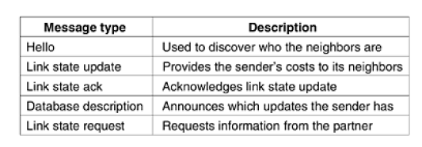
5 types of messages in OSPF

Slide 5
BGP – Border Gateway Protocol
Exterior gateway routing protocol
n/w grouped into one o three categories
1. stub n/w : only one connection to BGP graph
2. multiconnected n/w
3. transit n/w : willing to handle third party packets, possibly with some restrictions and usually for pay
TCP connection

Slide 6
