Slide 1
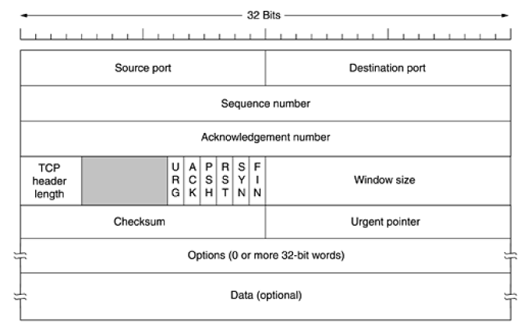
TCP – Transmission Control Protocol
Note :
Size of TCP header – 20 Bytes
Vary – 20 to 60 bytes
Because of options
Advantages:
Error control
Flow control
Congestion control
Concern for ACK
Retransmit the data
Disadvantage: multicasting
Broadcasting
Note:
Duplex connection
Point to point connection

Slide 2
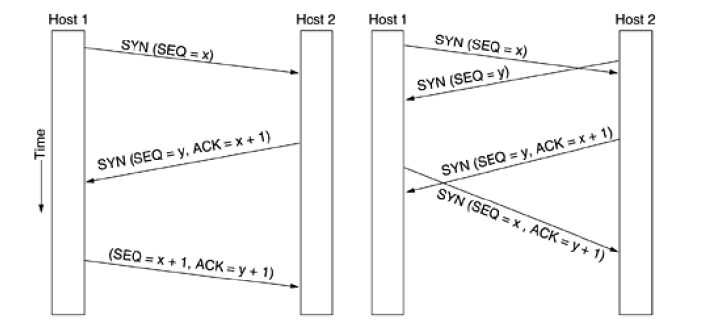
TCP – Connection Establishment
Normal Connection Call Collision

Slide 3
TCP – Connection Release
TCP connections are full duplex, but each simplex connection is released independently of its sibling
To release connection, party send TCP segment with FIN bit set
When FIN is acknowledged, that direction is shut down for new data
When both directions have been shut down, connection is released

Slide 4
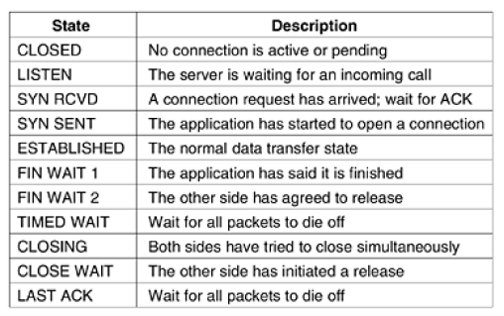
TCP Connection Management Modeling

Slide 5
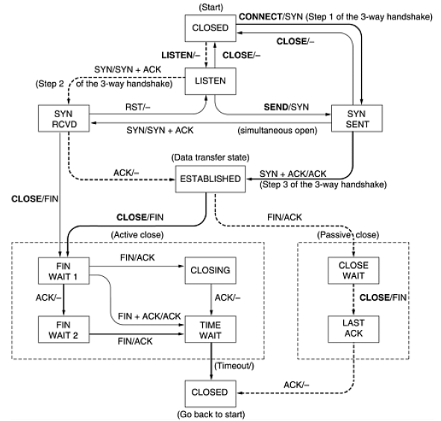

Slide 6
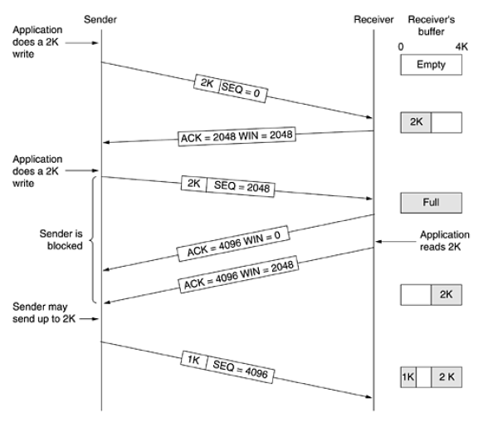
TCP Transmission Policy

Slide 7
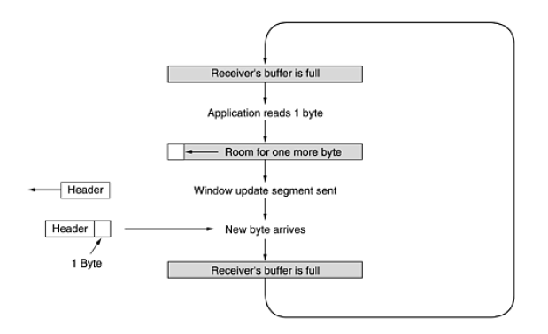
Silly Window Syndrome

Slide 8
TCP Congestion Control
To control congestion, TCP dynamically manipulate window size
1. Detecting congestion and then take action
2. Prevent congestion before occurring
Window Congestion
Slow start Problem

Slide 9
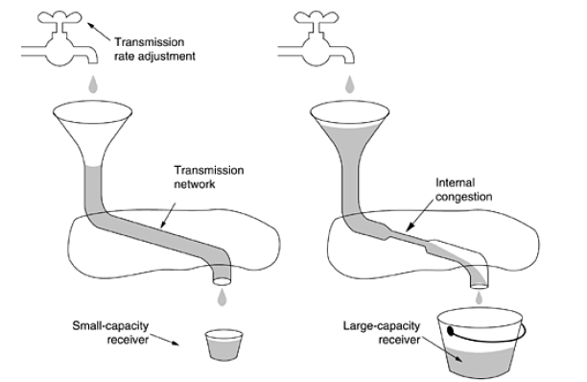

Slide 10
TCP Timer Management
Type of Timer
Persistence Timer : designed to prevent deadlock
Keepalive Timer : to check whether other side is still there or not
Timed Wait Timer : runs twice maximum packet lifetime to make sure that when connection is closed

