Slide 1
TCP | UDP
Connection oriented | Connection less
Provides flow control | Do not provide flow control
Provides error control | Do not provide error control
Can not do broadcasting or multicasting | Broadcasting, multicasting
It uses duplex connection + point to point connection | Providing simplex connection
concern for ack | Not concern for ack
Retransmit the data | Do not retransmit the data

Slide 2
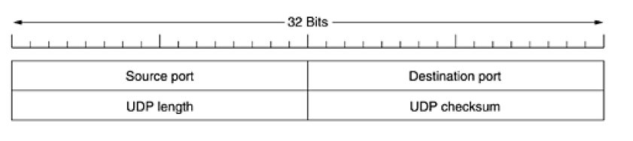
UDP – User Datagram Protocol
UDP transmits segment consisting of 8 byte header followed by payload
UDP Header

Slide 3
Total length = header length + data
CB84-000D-001C-001C
a. What is the source port number?
b. What is the destination port number?
c. What is the total length of the user datagram?
d. What is the length of the data?
e. Is the packet directed from a client to a server or vice versa?
f. What is the client process?

Slide 4
Solution
The source port number is the first four hexadecimal digits (CB84)₁₆, which means that the source port number is 52100.
b. The destination port number is the second four hexadecimal digits (000D)₁₆, which means that the destination port number is 13.
c. The third four hexadecimal digits (001C)₁₆ define the length of the whole UDP packet as
28 bytes.
d. The length of the data is the length of the whole packet minus the length of the header, or 28 − 8 = 20 bytes.

Slide 5
e. Since the destination port number is 13 (well-known port), the packet is from the client to the server.
f. The client process is the Daytime

Slide 6
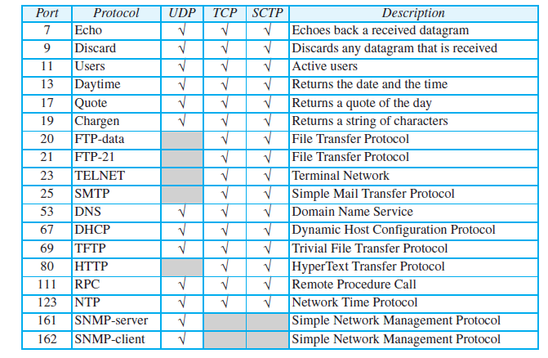

Slide 7
Disadvantages of UDP
Do not provide error control
Do not provide flow control
Do not establish the connection before sending the data – known as connection less protocol
Do not care about acknowledgement
Do not retransmit the data
Note : Application of UDP – DNS, video streaming

