Slide 1
WIRELESS CONNECTIONS
19DCS098 – Parth N Patel

Slide 2
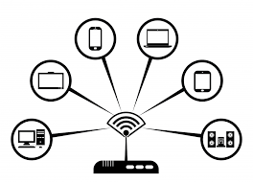

Slide 3
CATEGORIES:
BASED ON AREA COVERED
BASED ON UTILITIES

Slide 4
AREA COVERED:
Wireless PAN
Wireless LAN
Wireless MAN
Wireless WAN

Slide 5
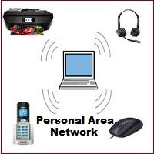
WIRELESS PAN

Slide 6
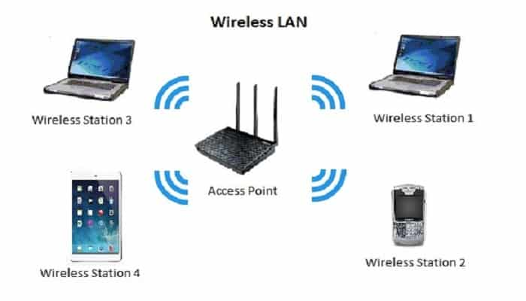
WIRELESS LAN

Slide 7
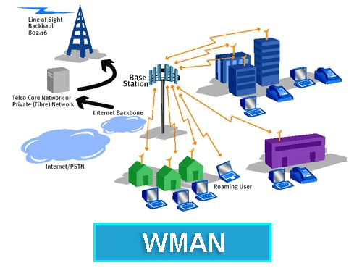
WIRELESS MAN

Slide 8
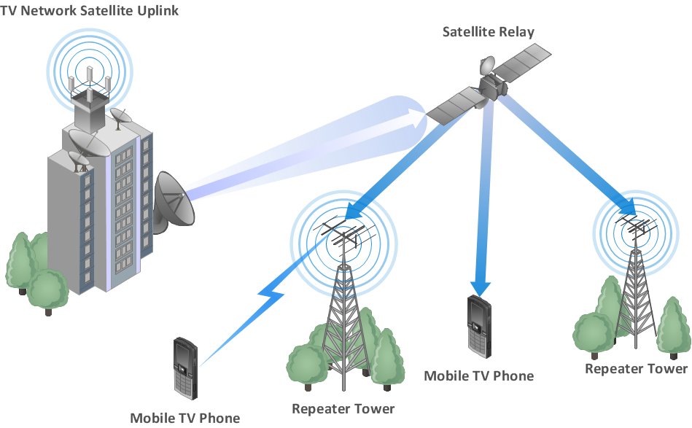
WIRELESS WAN

Slide 9
UTILITY
GSM
GPS
WiFi
Bluetooth
NFC

Slide 10


Slide 11


Slide 12


Slide 13


Slide 14


