Slide 1

Software Engineering (3150711)
Unit-10 Advanced Topics in Software Engineering
Dr. Pradyumansinh U. Jadeja
Computer Engineering Department
pradyuman.jadeja@darshan.ac.in
+91-9879461848

Slide 2

Looping
Outline
Component-Based Software Engineering
Client/Server Software Engineering
Web Engineering
Computer-Aided Software Engineering

Slide 3

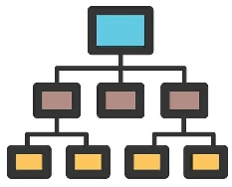
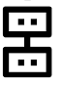

Component-Based Software Engineering
Component-based software engineering (CBSE) is a process that makes the design and construction of computer-based systems using reusable software “components”
CBSE seems quite similar to conventional or object-oriented software engineering
Time
Software
System
Specification
Decomposition
Component
Specification,
search, modification,
creation
Integration
Software
System

Slide 4
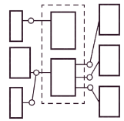
CBSE Activities
1
Component Qualification
2
Component Adaptation
Component qualification ensures that a component will
Domain engineering creates a library of components that can be easily integrated into an application architecture
Perform the function required
The implication of “easy integration” is that
Will properly “fit” into the architectural style specified for the system
Consistent methods of resource management have been implemented for all components in the library
Common activities such as data management exist for all components
Interfaces within the architecture and with the external environment have been implemented in a consistent manner
Will have the quality characteristics (e.g., performance, reliability, usability) that are required for the application
3
Component Composition
4
Component Update
Architectural style again plays a key role in the way in which software components are integrated to form a working system
When systems are implemented with a third party components, update is complicated.
i.e., the organization that developed the reusable component may be outside the control of the software engineering organization

Slide 5
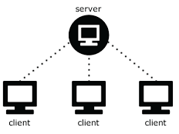
Client/Server Software Engineering
Two approaches are most commonly used
Software Components for Client/Server Systems
An evolutionary paradigm that makes use of event-based and/or object-oriented software engineering
User interaction/presentation subsystem
This subsystem implements all functions that are typically associated with a graphical user interface
Application subsystem
This subsystem implements the requirements defined by the application
Database management subsystem
This subsystem performs the data manipulation and management required by an application
Data manipulation and management may be as simple as the transfer of a record or as complex as the processing of SQL transactions.
Component based software engineering that draws on a library of COTS (commercial off-the-shelf)
Client/server systems are developed using the classic software engineering activities - analysis, design, construction and testing
Instead of viewing software as a monolithic application to be implemented on one machine, the software has several distinct subsystems that can be allocated to the client, the server or distributed between both machines

Slide 6
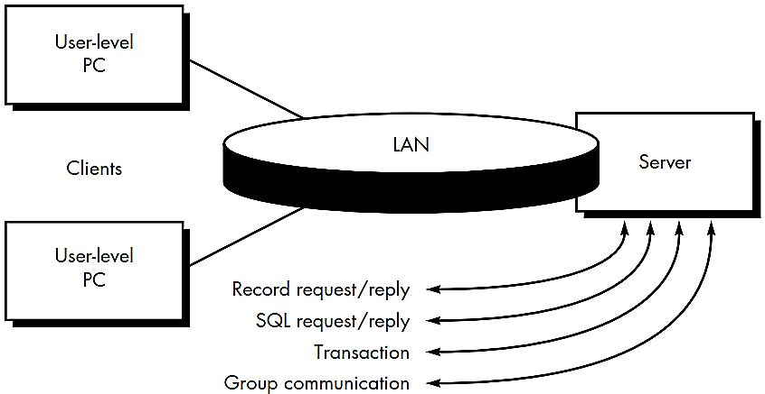
Client/Server Software Engineering Cont.
Structure of Client/Server System
1
File Server
The client requests specific records from a file, the server transmits these records to the client across the network
2
Database Server
The client sends structured query language (SQL) requests to the server
These are transmitted as messages across the network
The server processes the SQL request and finds the requested information, passing back the results only to the client

Slide 7
Client/Server Software Engineering Cont.
Structure of Client/Server System
3
Transaction Server
4
Groupware Server
The client sends a request that invokes remote procedures at the server site
The remote procedures are a set of SQL statements
A transaction occurs when a request results in the execution of the remote procedure with the result transmitted back to the client
When the server provides a set of applications that enable communication among clients (and the people using them) using text, images, bulletin boards, video, and other representations, a groupware architecture exists

Slide 8

Web Engineering
Web Engineering Process
Web engineering is the process used to create high-quality Web Apps
Web engineering is not a perfect clone of software engineering, but it borrows many of software engineering’s fundamental concepts and principles, emphasizing the same technical and management activities
Web Engineering (WebE) is concerned with the establishment and use of sound scientific, engineering and management principles
It is a systematic approach to the successful development, deployment and maintenance of high quality Web-based systems and applications
The characteristics of Web-based applications have a impact on the WebE process
Immediacy and continuous evolution require an iterative, incremental process model that produces WebApp releases in rapid sequence
The network-intensive nature of applications in this domain suggests a population of users that is diverse and an application architecture that can be highly specialized
Because WebApps are often content driven with an emphasis on aesthetics
It is likely that parallel development activities will be scheduled within the WebE process and involve a team of both technical and non-technical people

Slide 9
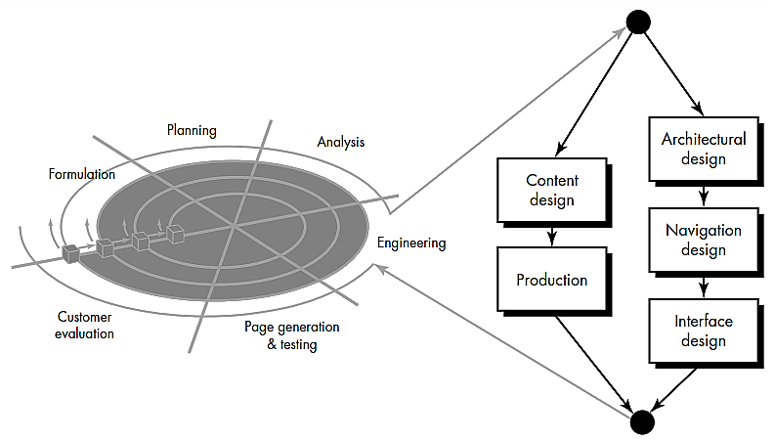
Framework for Web Engineering

Slide 10
Framework for Web Engineering Cont.
As WebApps evolve from static (content-directed information) to dynamic (user-directed application environments) the need to apply solid management and engineering principles grows
To accomplish this, it is necessary to develop a WebE framework that encompasses an effective process model
The WebE process begins with a formulation
An activity that identifies the goals
Objectives of the WebApp and establishes the scope for the first increment
Planning estimates
overall project cost
evaluates risks associated with the development effort
defines a finely granulated development schedule for the initial WebApp increment
and a more granulated schedule for subsequent increments

Slide 11
Framework for Web Engineering Cont.
Analysis establishes technical requirements for the WebApp and identifies the content items that will be incorporated
Requirements for graphic design (aesthetics) are also defined
The engineering activity incorporates two parallel tasks illustrated on the right side of Figure.
Content design and Content production are tasks performed by nontechnical members of the WebE team
The intent of these tasks is to design, produce and/or acquire all text, graphics, audio, and video content that are to be integrated into the WebApp
Page generation is a construction activity that makes heavy use of automated tools for WebApp creation
Testing exercises
WebApp navigation
attempts to uncover errors in scripts and forms
ensure that the WebApp will operate correctly in different environments (e.g., with different browsers)
Each increment produced as part of the WebE process is reviewed during customer evaluation
This is the point at which changes are requested (scope extensions occur).

Slide 12
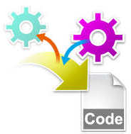
Computer-Aided Software Engineering
Components of CASE
A CASE (Computer Aided Software Engineering) tool is a generic term used to denote any form of automated support for software engineering
A CASE tool means any tool used to automate some activity associated with software development
The primary reasons for using a CASE tool are:
To increase productivity
To help produce better quality software at lower cost
Design
Generator
Analysis
tool
Drawing
Tool
Code
Generator
CASE
Repository
Document
Generator
Database
Generator
Error-checking
tool
Prototyping
Tool
Security and
Version Control
Screen and
Report Generator

Slide 13
Components of CASE Cont.
CASE repository
Central component of any CASE tool
Also known as the information repository or data dictionary
Centralized database
Allows easy sharing of information between tools and SDLC activities
Used to store graphical diagrams and prototype forms and reports during analysis and design workflows
Provides wealth of information to project manager and allows control over project
Facilitates reusability
Diagramming tools
Allow you to represent a system and its components visually
Allows higher level processes to be easily decomposed
Can examine processes or data models at high or low level
Screen and report generators
Used to Create, modify and test prototypes of computer displays and reports
Identify which data items to display or collect for each screen or report
Some tools have templates

Slide 14
Components of CASE Cont.
Analysis tools
Generate reports that help identify possible inconsistencies, redundancies and omissions (deficiency)
Generally focus on
diagram completeness and consistency
data structures and usage
CASE documentation generator tools
Create standard reports based on contents of repository
Need textual descriptions of requirements, solutions, diagrams of data and processes, prototype forms and reports, program specifications and user documentation
High-quality documentation leads to 80% reduction in system maintenance effort in comparison to average quality documentation

Slide 15
CASE Tool Classification
Business process engineering tools
represent business data objects, their relationships and flow of the data objects between company business areas
Process modeling and management tools
represent key elements of processes and provide links to other tools that provide support to defined process activities
Project planning tools
used for cost and effort estimation and project scheduling
Risk analysis tools
help project managers build risk tables by providing detailed guidance in the identification and analysis of risks
Requirements tracing tools
provide systematic database-like approach to tracking requirement status beginning with specification

Slide 16
CASE Tool Classification
Metrics and management tools
management oriented tools capture project specific metrics that provide an overall indication of productivity or quality
Documentation tools
provide opportunities for improved productivity by reducing the amount of time needed to produce work products
System software tools
network system software, object management services, distributed component support and communications software
Quality assurance tools
metrics tools that audit source code to determine compliance with language standards or tools that extract metrics to project the quality of software
Database management tools
RDBMS and OODMS (object-oriented database management system) serve as the foundation for the establishment of the CASE repository

Slide 17
CASE Tool Classification
Software configuration management tools
uses the CASE repository to assist with all SCM tasks (identification, version control, change control, auditing, status accounting)
Analysis and design tools
enable the software engineer to create analysis and design models of the system to be built, perform consistency checking between models
Simulation tools
simulation tools provide software engineers with ability to predict the behavior of real-time systems before they are built and the creation of interface mockups for customer review
Interface design and development tools
toolkits of interface components, often part environment with a GUI to allow rapid prototyping of user interface designs
Prototyping tools
enable rapid definition of screen layouts, data design, and report generation

Slide 18
CASE Tool Classification
Programming tools
compilers, editors, debuggers, OO programming environments, graphical programming environments, applications generators, and database query generators
Web development tools
assist with the generation of web page text, graphics, forms, scripts, applets, etc.
Integration and testing tools
data acquisition - get data for testing
static measurement - analyze source code without using test cases
dynamic measurement - analyze source code during execution
test management
Static analysis tools
code-based testing tools, specialized testing languages, requirements-based testing tools

Slide 19
CASE Tool Classification
Dynamic analysis tools
intrusive tools modify source code by inserting probes (enquiry) to check path coverage, assertions or execution flow
Test management tools
coordinate regression testing, compare actual and expected output, conduct batch testing and serve as generic test drivers
Client/server testing tools
exercise the GUI and network communications requirements for the client and server
Reengineering tools
reverse engineering to specification tools
generate analysis and design models from source code
code restructuring and analysis tools
analyze program syntax, generate control flow graph and automatically generates a structured program
on-line system reengineering tools
used to modify on-line DBMS

Slide 20
Software Engineering (3150711)
Dr. Pradyumansinh U. Jadeja
Computer Engineering Department
pradyuman.jadeja@darshan.ac.in
91-9879461848

