Slide 1

Software Engineering (3150711)
Unit-1 Introduction to
Software &
Software Engineering
Dr. Pradyumansinh U. Jadeja
Computer Engineering Department
pradyuman.jadeja@darshan.ac.in
+91-9879461848

Slide 2

Looping
Outline
Software, Characteristics of Software, Software Application Domains
Software Engineering, Software Engineering Layered Approach
Software Process, Process Framework Activities , Umbrella Activities
Software Myths
Management Myth
Customer Myth
Practitioner's/Developer Myth)
Software Process Models
The Waterfall Model
Incremental Process Model
Prototyping Model, Spiral Model
Spiral Model
Rapid Application Development Model (RAD)
Component based Development

Slide 3
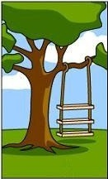

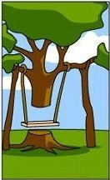


Why to Study Software Engineering?
Software Development Life Cycle without Software Engineering
1
2
3
4
5
How the Customer
Explains Requirement
How the Project Leader
understand it
How the System Analyst
design it
How the Programmer Works
on it
How the Business
Consultant describe it

Slide 4


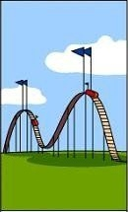

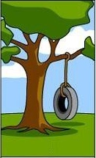
Why to Study Software Engineering?
Software Development Life Cycle without Software Engineering
6
7
8
9
10
How the Project
documented
What
Operations Installed
How the Customer
billed
How it
was supported
What the
customer
really needed

Slide 5
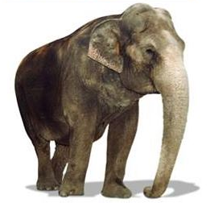

SDLC without Software Engineering
Customer Requirement
Solution
The software development
process needs to be
engineered
to avoid the
communication gap
& to meet the actual
requirements of customer
within stipulated budget
& time
Have one trunk
Have four legs
Should carry load both passenger & cargo
Black in color
Should be herbivorous
Have one trunk
Have four legs
Should carry load both passenger & cargo
Black in color
Should be herbivorous
Our value added,
also gives milk

Slide 6
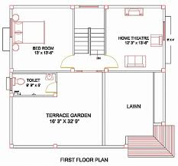
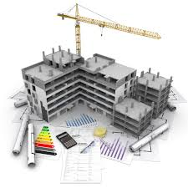
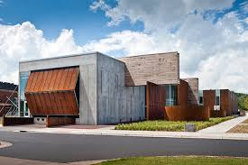

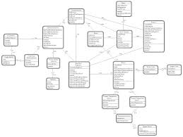
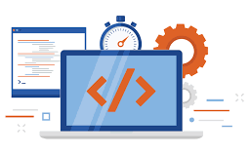
Software Engineering
Engineering
Software Engineering
Design
Build
Product

Slide 7
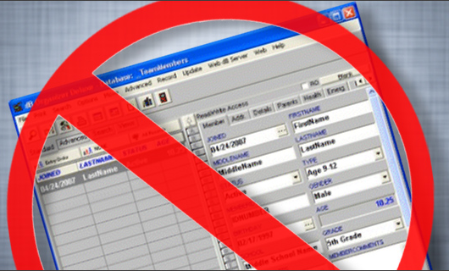
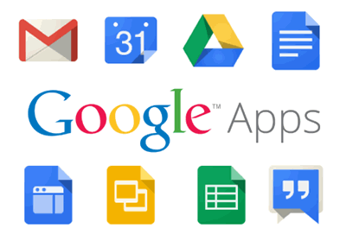
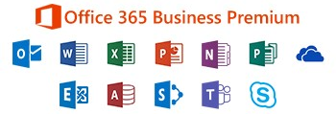
Software is dead…..!
The old School view of Software
You buy it
You own it &
It’s your job to manage it
That is coming to an end
Because of web 2.0 & extensive computing power, there is a different generation of software
It is delivered via Internet
It looks exactly like it’s residing on each user’s computing device
Actually it reside on far away server

Slide 8



What is Software?
Software is
Computer program that when executed provide desired features, function & performance
Data Structure that enable programs to easily manipulate information
Descriptive information in both hard and soft copy that describes the operation and use of programs
+
+
Computer
Program
Data
Structure
Documents
Soft & Hard

Slide 9
List of documentation & manuals
Documentation Manuals
Analysis / Specification
Design
Implementation
Formal Specification
Context Diagram
Data Flow Diagram
Flow Charts
ER Diagram
Testing
Source Code Listings
Cross-Reference Listings
Test Data
Test Results
Documentation Manuals
User Manuals
Operational Manuals
System Overview
Beginner’s Guide Tutorials
Installation Guide
System Administration Guide
Reference Guide

Slide 10
Characteristics of Software
Software is developed or engineered
It is not manufactured like hardware
Manufacturing phase can introduce quality problem that are nonexistent (or easily corrected) for software
Both requires construction of “product” but approaches are different
Software doesn’t “wear-out”
Increate failure rate due to side effect
Change
Infant
morality
“Wear out”
Failure Rate
Failure Rate
Actual Curve
Idealized Curve
Time
Time
Bathtub curve of hardware failure
Software failure curve

Slide 11



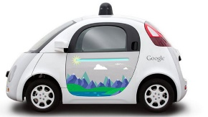

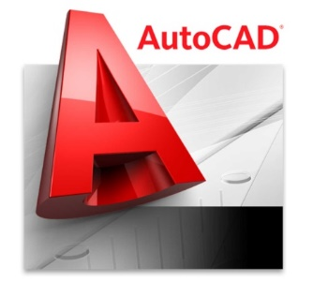





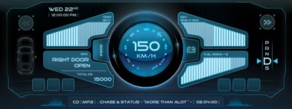

Software Application Domains
System Software
Application Software
Engineering / Scientific Software
Embedded Software
Product line Software
Web Application
Artificial intelligence Software
System Software
Point of Sale,
Customized
Software
Artificial intelligence Software
Application
Software
Software Application Domains
Web Application
Engineering / Scientific Software
Product line Software
Embedded Software

Slide 12
Software Engineering
Software engineering is the establishment and use of sound engineering principles in order to obtain economically software that is reliable and works efficiently in real machines.
Software Engineering is the science and art of building (designing and writing programs) a software systems that are:
on time
on budget
with acceptable performance
with correct operation

Slide 13
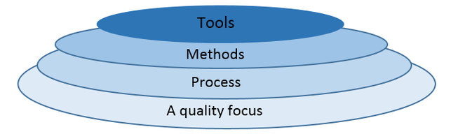
Software Engineering Layered Approach
Software Engineering Tools allows automation of activities which helps to perform systematic activities. A system for the support of software development, called computer-aided software engineering (CASE). Examples: Testing Tools, Bug/Issue Tracking Tools etc…
It provides technical how-to’s for building software, it encompasses many tasks including communication, requirement analysis, design modeling, program construction, testing and support
It is a foundation of Software Engineering, It is the glue the holds the technology layers, It defines a framework activities
Defines continuous process improvement principles

Slide 14
Software Engineering Layered Approach Cont.
Software Engineering is a layered technology
Quality
Main principle of Software Engineering is Quality Focus.
An engineering approach must have a focus on quality.
Total Quality Management (TQM), Six Sigma, ISO 9001, ISO 9000-3, CAPABILITY MATURITY MODEL (CMM), CMMI & similar approaches encourages a continuous process improvement culture
Process Layer
It is a foundation of Software Engineering, It is the glue the holds the technology layers together and enables logical and timely development of computer software.
It defines a framework with activities for effective delivery of software engineering technology
It establish the context in which technical methods are applied, work products (models, documents, data, reports, forms, etc.) are produced, milestones are established, quality is ensured, and change is properly managed.

Slide 15
Software Engineering Layered Approach Cont.
Method
It provides technical how-to’s for building software
It encompasses many tasks including communication, requirement analysis, design modeling, program construction, testing and support
Tools
Software engineering tools provide automated or semiautomated support for the process and the methods
Computer‐aided software engineering (CASE) is the scientific application of a set of tools and methods to a software system which is meant to result in high‐quality, defect‐free, and maintainable software products.
CASE tools automate many of the activities involved in various life cycle phases.

Slide 16
Software Process
A process is a collection of activities, actions and tasks that are performed when some work product is to be created
A process is not a rigid prescription for how to build the software, rather it is adaptable approach that enables the people doing the work to pick and choose the appropriate set of work actions and tasks
An activity try to achieve a broad objective (e.g., communication with stakeholders)
An activity is applied regardless of the application domain, size of the project, complexity of the effort, or degree of accuracy with which software engineering is to be applied.
An action (e.g., architectural design) encompasses a set of tasks that produce a major work product (e.g., an architectural design model).
A task focuses on a small, but well-defined objective (e.g., conducting a unit test) that produces a noticeable outcome.
Each of these activities, actions & tasks reside within a framework or model

Slide 17
Software Process
Software Process Framework
Figure represents “The Software Process”
Each framework activity is populated by set of software engineering actions
Each software engineering action is defined by a task set that identifies work to be completed, product to be produced, quality assurance points & milestones to indicate progress
Process framework
Umbrella activities
framework activity #1
Software Engineering action #1.1
Software Process
Task Sets
Work tasks
Work products
Quality assurance points
… …
Software Engineering action #1.k
Task Sets
Work tasks
Work products
Quality assurance points
… …
The purpose of software process is
to deliver software in timely manner and
within sufficient quality to satisfy those
Who has given proposal for software development and
Those who will use software
framework activity #n

Slide 18

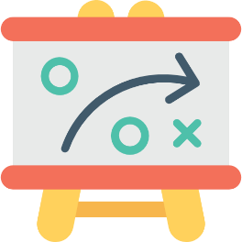
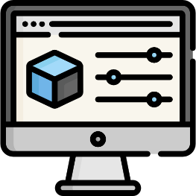

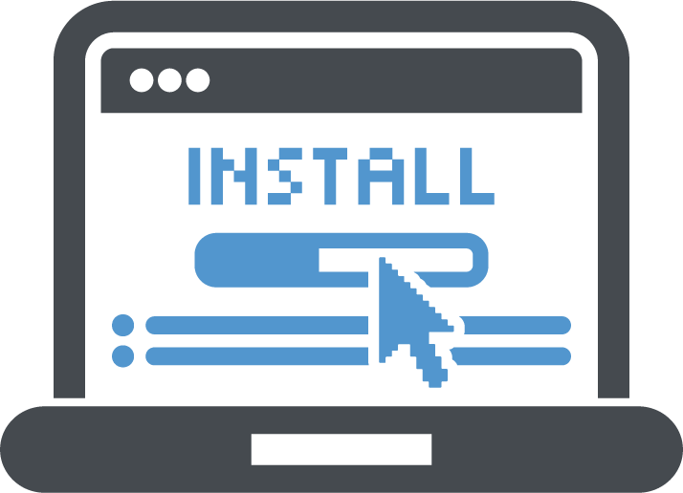
Process Framework Activities (CPMCD)
A process framework establishes the foundation for complete software engineering process, it encompasses five activities
Communication
Communication with Customers / stockholders to understand project requirements for defining software features
Planning
Software Project Plan which defines workflow that is to follow.
It describes technical task, risks, resources, product to be produced & work schedule
Modeling
Creating models to understand requirements and shows design of software to achieve requirements
Construction
Code Generation
(manual or automated)
&
Testing
(to uncover errors in the code)
Deployment
Deliver Software to Customer
Collect feedback from customer based on evaluation
Software Support

Slide 19

Umbrella Activities
Umbrella activities applied throughout the software project & help a software team to manage and control progress, quality, change & risks
Umbrella activities are those which keep running in the background throughout the software development
Software project Tracking & Control
Risk Management
Software quality assurance
It establish a skeleton architecture for software engineering work.
Technical Reviews
Measurement
Reusability Management
Software Configuration Management
Work product preparation and production

Slide 20
Umbrella Activities Cont.
Software project tracking and control: allows the software team to assess progress against the project plan and take any necessary action to maintain the schedule.
Risk management: assesses (evaluates) risks that may affect the outcome of the project or the quality of the product.
Software quality assurance: defines and conducts the activities required to ensure software quality.
Technical reviews: assesses software engineering work products in an effort to uncover and remove errors before they are propagated to the next activity.
Measurement: defines and collects process, project and product measures that assist the team in delivering software that meets stakeholders’ needs.
Software configuration management: it manages the effects of change throughout the software process.

Slide 21
Umbrella Activities Cont.
Reusability management: it defines criteria for work product reuse (including software components) and establishes mechanisms to achieve reusable components.
Work product preparation and production: it encompasses (includes) the activities required to create work products such as models, documents, logs, forms and lists.

Slide 22

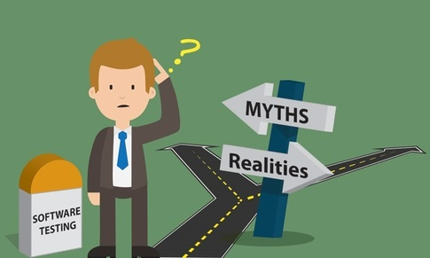


Software Myths
Beliefs about software and the process used to build it.
Management Myths
Customer Myths
“Misleading Attitudes that cause serious problem” are myths.
Practitioner's (Developer) Myths

Slide 23

Management myth - 1 & 2
We have standards and procedures to build a system, which is enough.
We have the newest computers and development tools.
Reality
Reality
Are software practitioners aware of standard’s existence?
Does it reflect modern software engineering practice?
Is it complete?
Is it streamlined to improve time to delivery while still maintaining a focus on quality?
In many cases, the answer to all of these questions is "no.“
It takes much more than the latest model computers to do high-quality software development.
Computer-aided software engineering (CASE) tools are more important than hardware.

Slide 24
Management myth - 3 & 4
We can add more programmers and can catch up the schedule.
I outsourced the development activity, now I can relax and can wait for the final working product.
Reality
Reality
Software development is not a mechanistic process like manufacturing.
In the words of Fred Brooks : "adding people to a late software project makes it later."
People who were working must spend time educating the newcomers.
People can be added but only in a planned and well-coordinated manner.
If an organization does not understand how to manage and control software projects internally, it will invariably struggle when it outsources software projects.

Slide 25

Customer myth - 1 & 2
A general statement of objectives (requirements) is sufficient to start a development.
Requirement Changes can be easily accommodated because software is very flexible.
Reality
Reality
Comprehensive (detailed) statements of requirements is not always possible, an ambiguous (unclear) “statement of objectives” can lead to disaster.
Unambiguous (clear) requirements can be gathered only through effective and continuous communication between customer and developer.
It is true that software requirements change, but the impact of change varies with the time at which it is introduced.
When requirements changes are requested early the cost impact is relatively small.

Slide 26

Practitioner's (Developer) myth – 1 & 2
Once we write the program, our job is done.
I can’t access quality until it is running.
Reality
Reality
Experts say "the sooner you begin 'writing code', the longer it will take you to get done."
Industry data indicates that 60 to 80 % effort expended on software will be after it is delivered to the customer for the first time.
One of the most effective software quality assurance mechanisms can be applied from the beginning of a project - the technical review.
Software reviews are more effective “quality filter” than testing for finding software defects.

Slide 27
Practitioner's (Developer) myth – 3 & 4
Working program is the only deliverable work product.
Software engineering is about unnecessary documentation.
Reality
Reality
A working program is only one part of a software configuration.
A variety of work products (e.g., models, documents, plans) provide a foundation for successful engineering and, more important, guidance for software support.
Software engineering is not about creating documents. It is about creating a quality product.
Better quality leads to reduced rework. And reduced rework results in faster delivery times.

Slide 28
Software Process Models
The process model is the abstract representation of process.
Also known as Software development life cycle (SDLC) or Application development life cycle Models
Process models prescribe a distinct set of activities, actions, tasks and milestones (deliverables) required to engineer high quality software.
Process models are not perfect, but provide roadmap for software engineering work.
Software models provide stability, control and organization to a process that if not managed can easily get out of control.
Software process models are adapted (adjusted) to meet the needs of software engineers and managers for a specific project.
SDLC Phases
Communication
SDLC
Deployment
Planning
Software
Development
Life
Cycle
Construction
Modeling

Slide 29
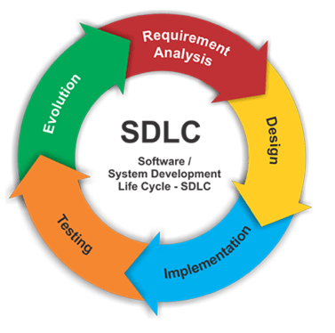
Different Process Models
Process model is selected based on different parameters
Type of the project & people
Complexity of the project
Size of team
Expertise of people in team
Working environment of team
Software delivery deadline
Process Models
Waterfall Model (Linear Sequential Model)
Incremental Process Model
Prototyping Model
The Spiral Model
Rapid Application Development Model
Agile Model

Slide 30
The Waterfall Model
Classic life cycle or linear sequential model
Communication
Project initiation
Planning
Estimating
Modeling
Analysis
Coding
Construction
Deployment
Delivery
Requirements gathering
Scheduling
Tracking
Support
Feedback
Design
Testing
When requirements for a problems are well understood then this model is used in which work flow from communication to deployment is linear

Slide 31
The Waterfall Model
When to use ?
Advantages
Requirements are very well known, clear and fixed
Product definition is stable
Technology is understood
There are no ambiguous (unclear) requirements
Ample (sufficient) resources with required expertise are available freely
The project is short
Simple to implement and manage
Drawbacks
Unable to accommodate changes at later stages, that is required in most of the cases.
Working version is not available during development. Which can lead the development with major mistakes.
Deadlock can occur due to delay in any step.
Not suitable for large projects.

Slide 32
Incremental Process Model
There are many situations in which initial software requirements are reasonably well defined, but the overall scope of the development effort prevent a purely linear process.
In addition, there may be a compelling need to provide a limited set of software functionality to users quickly and then refine and expand on that functionality in later software releases.
In such cases, there is a need of a process model that is designed to produce the software in increments.

Slide 33
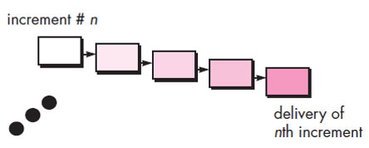
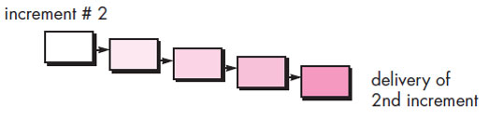
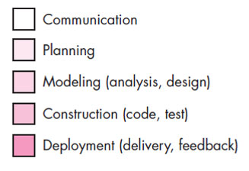
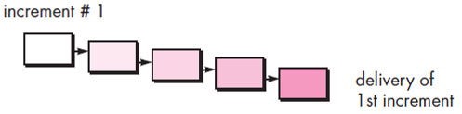
Incremental Process Model
Software Functionality & Features
Project Calendar Time
The incremental model combines elements of linear and parallel process flows.
This model applies linear sequence in a iterative manner.
Initially core working product is delivered.
Each linear sequence produces deliverable “increments” of the software.

Slide 34
Incremental Process Model
e.g. word-processing software developed using the incremental model
It might deliver basic file management, editing and document production functions in the first increment
more sophisticated editing in the second increment;
spelling and grammar checking in the third increment; and
advanced page layout capability in the fourth increment.
Advantages
Generates working software quickly and early during the software life cycle.
It is easier to test and debug during a smaller iteration.
Customer can respond to each built.
Lowers initial delivery cost.
Easier to manage risk because risky pieces are identified and handled during iteration.
When to use ?
When the requirements of the complete system are clearly defined and understood but staffing is unavailable for a complete implementation by the business deadline.

Slide 35
Evolutionary Process Models
When a set of core product or system requirements is well understood but the details of product or system extensions have yet to be defined.
In this situation there is a need of process model which specially designed to accommodate product that evolve with time.
Evolutionary Process Models are specially meant for that which produce an increasingly more complete version of the software with each iteration.
Evolutionary Models are iterative.
They are characterized in a manner that enables you to develop increasingly more complete versions of the software.
Evolutionary models are
Prototyping Model
Spiral Model

Slide 36
Prototyping model
When to use ?
Customers have general objectives of software but do not have detailed requirements for functions & features.
Developers are not sure about efficiency of an algorithm & technical feasibilities.
It serves as a mechanism for identifying software requirements.
Prototype can be serve as “the first system”.
Both stakeholders and software engineers like prototyping model
Users get feel for the actual system
Developers get to build something immediately

Slide 37
Prototyping model cont.
It works as follow
Communicate with stockholders & define objective of Software
Deployment & Feedback
Communication
Identify requirements & design quick plan
Model a quick design (focuses on visible part of software)
Construct Prototype & deploy
Construction of Prototype
Quick Plan
Stakeholders evaluate this prototype and provides feedback
Iteration occurs and prototype is tuned based on feedback
Modeling Quick Design

Slide 38
Prototyping model cont.
Problem Areas
Customer demand that “a few fixes” be applied to make the prototype a working product, due to that software quality suffers as a result
Developer often makes implementation in order to get a prototype working quickly; without considering other factors in mind like OS, Programming language, etc.
Advantages
Users are actively involved in the development
Since in this methodology a working model of the system is provided, the users get a better understanding of the system being developed
Errors can be detected much earlier

Slide 39
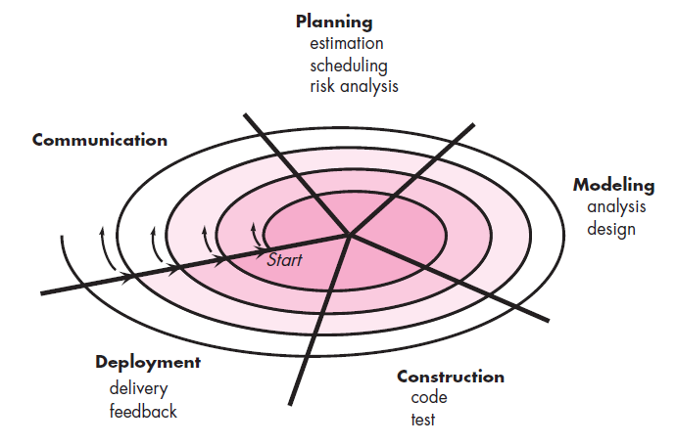
The Spiral Model
It provides the potential for rapid development.
Software is developed in a series of evolutionary releases.
Early iteration release might be prototype but later iterations provides more complete version of software.
It is divided into framework activities (C,P,M,C,D). Each activity represent one segment of the spiral
Each pass through the planning region results in adjustments to
the project plan
Cost & schedule based on feedback

Slide 40
The Spiral Model Cont.
When to use Spiral Model?
Advantages
For development of large scale / high-risk projects.
When costs and risk evaluation is important.
Users are unsure of their needs.
Requirements are complex.
New product line.
Significant (considerable) changes are expected.
High amount of risk analysis hence, avoidance of Risk is enhanced.
Strong approval and documentation control.
Additional functionality can be added at a later date.
Software is produced early in the Software Life Cycle.
Disadvantages
Can be a costly model to use.
Risk analysis requires highly specific expertise.
Project’s success is highly dependent on the risk analysis phase.
Doesn’t work well for smaller projects.

Slide 41
Rapid Application Development Model (RAD)
It is a type of incremental model in which; components or functions are developed in parallel.
Team - 1
Communication
Modeling
Planning
Construction
Integration
Delivery
Feedback
Rapid development is achieved by component based construction
Team - 2
Business Modeling
Data Modeling
Process Modeling
Modeling
Deployment
Construction
This can quickly give the customer something to see and use and to provide feedback.
Team - 3
Component Reuse
Automatic Code Generation
Testing
Modeling
Construction

Slide 42
Rapid Application Development Model (RAD) Cont.
Communication
This phase is used to understand business problem.
Planning
Multiple software teams work in parallel on different systems/modules.
Modeling
Construction
Business Modeling: Information flow among the business.
Ex. What kind of information drives (moves)?
Who is going to generate information?
From where information comes and goes?
Data Modeling: Information refine into set of data objects that are needed to support business.
Process Modeling: Data object transforms to information flow necessary to implement business.
It highlighting the use of pre-existing software component.
Deployment
Integration of modules developed by parallel teams, delivery of integrated software and feedback comes under deployment phase.

Slide 43
Rapid Application Development Model (RAD) Cont.
When to Use?
There is a need to create a system that can be modularized in 2-3 months of time.
High availability of designers and budget for modeling along with the cost of automated code generating tools.
Resources with high business knowledge are available.
Advantages
Drawback
Reduced development time.
Increases reusability of components.
Quick initial reviews occur.
Encourages customer feedback.
Integration from very beginning solves a lot of integration issues.
For large but scalable projects, RAD requires sufficient human resources.
Projects fail if developers and customers are not committed in a much shortened time-frame.
Problematic if system can not be modularized.
Not appropriate when technical risks are high (heavy use of new technology).

Slide 44
Component based Development
Commercial off the shelf (COTS) software components are offered as product.
COTS provides set of functionality with well defined interfaces that enables component to be integrated into software.
The component based development model incorporates many characteristics of the spiral model.
It is evolutionary in nature.
Component based development model constructs applications from prepackaged software components.
Modeling and construction activities begin with the identification of components.

Slide 45
Component based Development
Component based development incorporates the following steps
Available component-based products are researched & evaluated for software development.
Component integration issues are considered.
A software architecture is designed to accommodate the components.
Components are integrated into the architecture.
Testing is conducted to insure proper functionality.
Advantages
It leads to software reuse.
It reduces development cycle time.
Reduction in project cost.

Slide 46
Product & Process
If the process is weak, the end product will suffer. But more confidence on process is also dangerous.
People gain more satisfaction from the creative process as they do from the end product.
Like an artist enjoys the brush strokes as much as the framed result.
A writer enjoys the search for the proper metaphor (comparison) as much as the finished book.
As software professional, you should also derive as much satisfaction from the process as the end product.
The duality (contrast) of product and process is one important element in keeping creative people engaged as software engineering continues to evolve.

Slide 47
Software Engineering (3150711)
Dr. Pradyumansinh U. Jadeja
Computer Engineering Department
pradyuman.jadeja@darshan.ac.in
91-9879461848

