Slide 1

Software Engineering (3150711)
Unit 4 Requirement Analysis and Specification
Analysis Models Part 2
⬥ Use Case Diagram
⬥ Usage Scenarios & Story Writing
Dr. Pradyumansinh U. Jadeja
Computer Engineering Department
pradyuman.jadeja@darshan.ac.in
+91-9879461848

Slide 2
Use Case Diagram
A use case diagram is a representation of a user's interaction with the system.
This interaction shows the relationship between the user and the different use cases in which the user is involved.
The purpose of the use case diagrams is simply to provide a high-level view of the system and convey the requirements in layman's terms for the stakeholders.

Slide 3

Components of Use Case diagram
System boundary
Use case
Represent the scope of the system
Use cases of the system are placed inside the system boundary
Actors who interact with the system are placed outside the system
A use case represents a user goal / piece of functionality that can be achieved by accessing the system or software application.
Use
Cases
Actor
Association
An actor is an entity that interacts directly with the system but that is not part of system
Actor may be people, computer hardware, other systems, etc.
An actor and use case can be associated to indicate that the actor participates in that use case

Slide 4
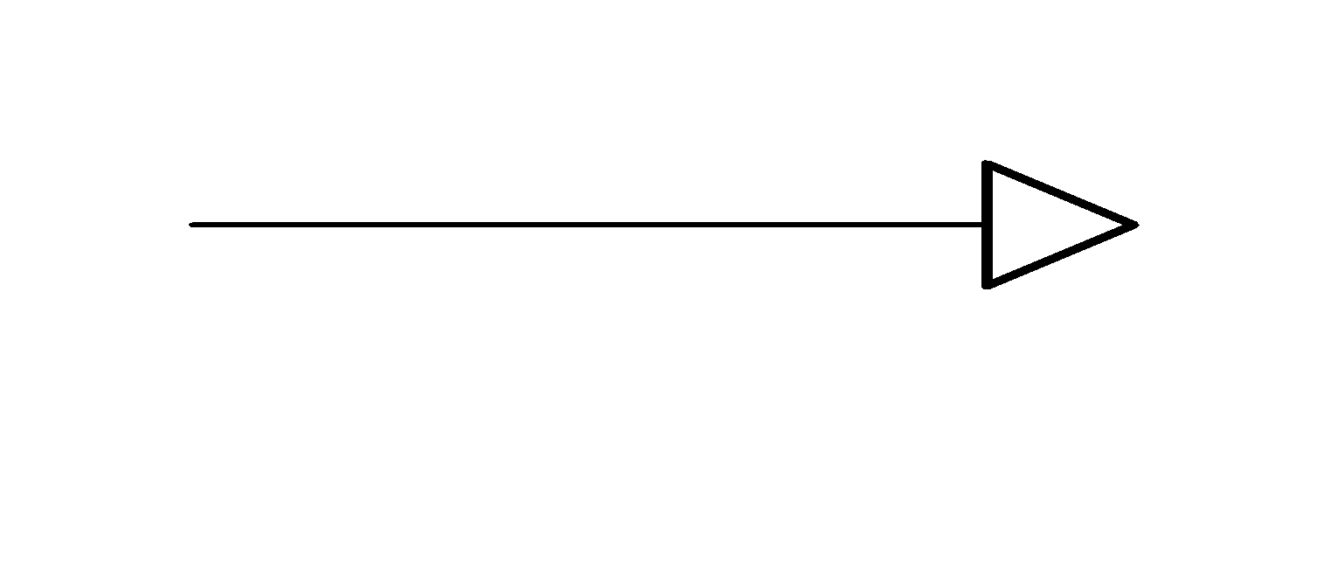
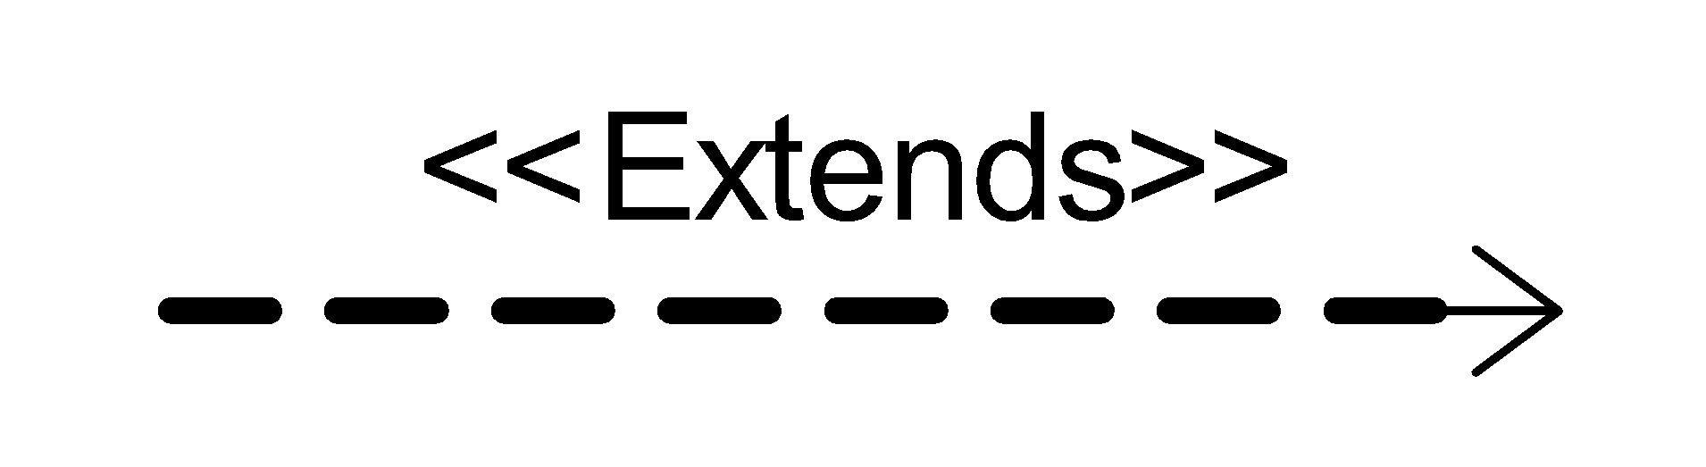
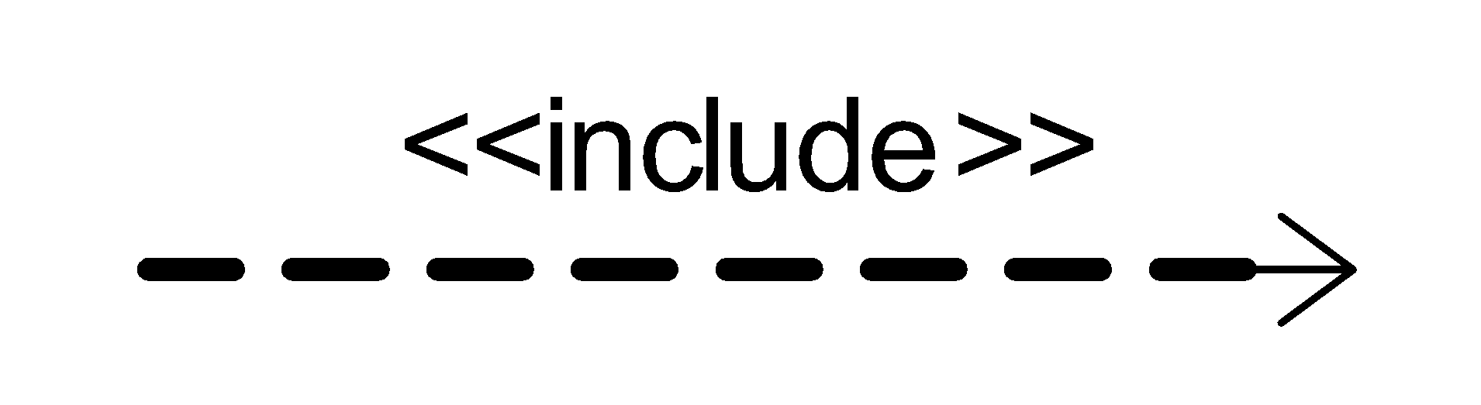
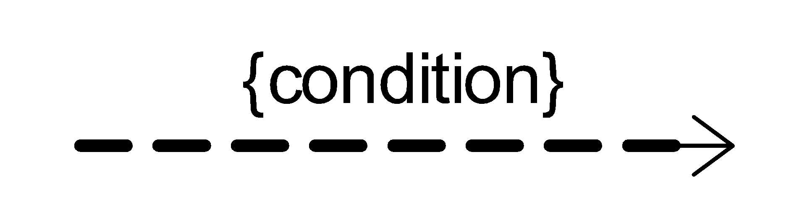
Components of Use Case diagram Cont.
Generalization
Extends
A generalization relationship is used to represent the inheritance relationship between model elements of the same type
The extend relationship specifies that the incorporation of the extension use case is dependent on what happens when the base use case executes.
Include
Constraint
An include relationship is a relationship in which one use case includes the functionality of another use case
The include relationship supports the reuse of functionality in a use-case model.
Show condition exists between actors and activity

Slide 5
Example of Extends and Include
Includes
Login
In e-commerce application that provides customers with the option of checking the status of their orders. For checking the status of their order user should be login.
This behavior is modeled with a base use case called CheckOrderStatus that has an inclusion use case called LogIn.
<<include>>
CheckOrder Status
Extends
pay for item
In e-commerce site, When paying for an item, you may choose to pay on delivery, pay using PayPal, or pay by card.
These are all alternatives to the "pay for item" use case. I may choose any of these options depending on my preference.
<<extend>>
<<extend>>
pay by card
pay on delivery

Slide 6
Guideline for constructing use case diagram
Determine the system boundary.
Ensure that actors are focused, each actor should have a single, coherent purpose. If a real world object contains multiple purpose, capture them with separate actors
Each use case must provide value of users
Relate use cases and actors

Slide 7
Library Management System(LMS) formal Requirement
A Library Management System is a software built to handle the primary housekeeping functions of a library.
In library management systems to manage asset collections as well as relationships with their members.
Library management systems help libraries keep track of the books and their checkouts, as well as members’ subscriptions and profiles.
Library management systems also involve maintaining the database for entering new articles and recording articles that have been borrowed with their respective due dates.

Slide 8
Identify the Functionality & Stakeholders for LMS
Functionality
Stakeholders
Register User
Add Article
Update Article
Delete Article
Inquiry Members
Inquiry Issuance
Check out Article
Check in Article
Reserve Article
Set user Permission
Search Article
Check Account
Prepare Library Database
Librarian
Member
Guest

Slide 9
Relationship Between Functionality & Stakeholders
Register user
Add Article
Update Article
Delete Article
Inquiry Members
Inquiry Issuance
Check out Article
Check in Article
Set user Permission
Request for registration
Guest
Librarian
Reserve Article
Search Article
Check Account
Member

Slide 10
Use Case Diagram Library Management
Library Management System
1. Login
10. Request registration
2. Register user
.3. Manage member permission
Guest
4. Add Article
11. Check account
5. Delete Article
13.Search by title
6. Inquiry article
<<extend>>
Member
7. Inquiry member
12. Search article
Librarian
8. Check in articles
<<extend>>
9. Check out articles
14 Search by publication

Slide 11
Use cases & Usage Scenarios
A collection of user scenarios that describe the thread of usage of a system
Each scenario is described from the point-of-view of an “actor”
An actor is a person or device that interacts with the software
Each scenario answers the following questions
Who is the primary actor, the secondary actor (s)?
What are the actor’s goals?
What preconditions should exist before the story begins?
What main tasks or functions are performed by the actor?
What extensions might be considered as the story is described?
What variations in the actor’s interaction are possible?
What information does the actor desire from the system?
What system information will the actor acquire, produce, or change?
Will the actor have to inform the system about changes in the external environment?
Does the actor wish to be informed about unexpected changes?

Slide 12
Usage Scenarios & Story Writing
Scenarios are created by user researchers to help communicate with the design team.
User stories are created by project/product managers to define the requirements prior to a sprint in agile development.
Scenarios are stories that capture the goals, motivations, and tasks of a persona in a given system.
User stories provide a rapid way of handling customer requirements instead of formal requirement documents
Gherkin language is used to writing an effective story of the system requirement.
Gherkin is a human-readable language for system behavior description, which uses indentation to define the structure of the document.
Each line starts with one of the keywords and describes one of the steps.
Refer to Gherkin Syntax for story writing (More details refer this link: https://www.guru99.com/gherkin-test-cucumber.html).

Slide 13
Login Usage Scenarios and Story
Feature | Login
Scenario | User Login with valid username and password
Prerequisite | User must have proper client installed on user terminal.
Story | Given: User navigated to the Login Screen. When: User enters the correct User Name. And the user enters the correct password. And user Click “login” button. Then: System verify user information. display dashboard of user. display username on top of the right side. display logout button.

Slide 14
Login Usage Scenarios and Story
Feature | Login
Scenario | User Login with invalid username and password
Prerequisite | User must have proper client installed on user terminal.
Story | Given: User navigated to the Login Screen. When: User enters the wrong User Name. And the user enters the wrong password. And user Click “login” button. Then: System verify user information. display error message for invalid username and password.

Slide 15
Software Engineering (3150711)
Dr. Pradyumansinh U. Jadeja
Computer Engineering Department
pradyuman.jadeja@darshan.ac.in
91-9879461848

