Slide 1

Software Engineering (3150711)
Unit-6 Software Coding &
Testing
Dr. Pradyumansinh U. Jadeja
Computer Engineering Department
pradyuman.jadeja@darshan.ac.in
+91-9879461848

Slide 2

Looping
Outline
Code Review
Software Documentation
Testing Strategies
Testing Techniques and Test Case
Test Suites Design
Testing Conventional Applications
Testing Object Oriented Applications
Testing Web and Mobile Applications

Slide 3

Coding Standards
Most software development organizations formulate their own coding standards that suit them most, and require their engineers to follow these standards strictly
The purpose of requiring all engineers of an organization to adhere to a standard style of coding is the following:
A coding standard gives a uniform appearance to the codes written by different engineers.
Good software development organizations normally require their programmers to adhere to some well-defined and standard style of coding called coding standards.
It enhances code understanding.
It encourages good programming practices.

Slide 4

Coding Standards Cont.
A coding standard lists several rules to be followed such as, the way variables are to be named, the way the code is to be laid out, error return conventions, etc.
The following are some representative coding standards
1
Rules for limiting the use of global
These rules list what types of data can be declared global and what cannot.
2
Naming conventions for global & local variables & constant identifiers
A possible naming convention can be that global variable names always start with a capital letter, local variable names are made of small letters, and constant names are always capital letters.
3
Contents of the headers preceding codes for different modules
The information contained in the headers of different modules should be standard for an organization.
The exact format in which the header information is organized in the header can also be specified
The following are some standard header data
Module Name
Creation Date
Author’s Name
Modification history
Synopsis of the module
Global variables accessed/modified by the module
Different functions supported, along with their input/output parameters

Slide 5
Coding Standards Cont.
Sample Header
/*
* MyClass <br>
* This class is merely for illustrative purposes. <br>
*Revision History:<br>
* 1.1 – Added javadoc headers <br>
* 1.0 - Original release<br>
* @author P.U. Jadeja
* @version 1.1, 12/02/2018
*/
public class MyClass {
. . .
}
4
Error return conventions and exception handling mechanisms
The way error conditions are reported by different functions in a program are handled should be standard within an organization.
For example, different functions while encountering an error condition should either return a 0 or 1 consistently.

Slide 6
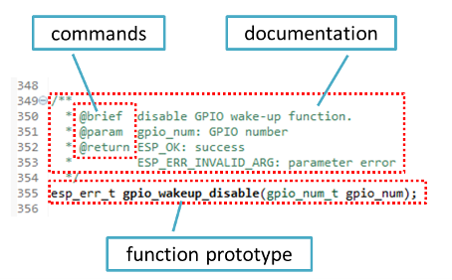
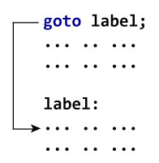
Coding guidelines
The following are some representative coding guidelines
Do not use a coding style that is too clever or too difficult to understand
Do not use an identifier for multiple purposes
Avoid obscure side effects
The code should be well-documented
The side effects of a function call include modification of parameters passed by reference, modification of global variables, and I/O operations.
An obscure side effect is one that is not obvious from a casual examination of the code.
Obscure side effects make it difficult to understand a piece of code.
For example, if a global variable is changed obscurely in a called module or some file I/O is performed which is difficult to infer from the function’s name and header information, it becomes difficult for anybody trying to understand the code.
The length of any function should not exceed 10 source lines
Do not use goto statements
Well Documented
Do not use goto

Slide 7
Software Faults
Types of Faults
Quite inevitable (unavoidable)
Many reasons
Algorithmic
Logic is wrong Code reviews
Syntax
Wrong syntax; typos Compiler
Software systems with large number of states
Computation/ Precision
Not enough accuracy
Documentation
Misleading documentation
Complex formulas, activities, algorithms
Stress/Overload
Maximum load violated
Capacity/Boundary
Boundary cases are usually special cases
Customer is often unclear of needs
Timing/Coordination
Synchronization issues Very hard to replicate
Throughput/Performance
System performs below expectations
Size of software
Recovery
System restarted from abnormal state
Number of people involved
Hardware & related software
Compatibility issues
Standards
Makes for difficult maintenance

Slide 8



Software Quality
Software Quality remains an issue
Code Review
Code Walk Through
Code Inspection
Who is to blame?
Customers blame developers
Arguing that careless practices lead to low-quality software
Developers blame Customers & other stakeholders
Arguing that irrational delivery dates and continuous stream of changes force the to deliver software before it has been fully validated
Who is Right? Both – and that’s the problem

Slide 9
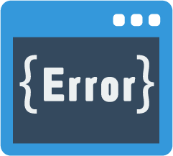


Code Review
Few classical programming errors
Code Review is carried out after the module is successfully compiled and all the syntax errors have been eliminated.
Code Reviews are extremely cost-effective strategies for reduction in coding errors and to produce high quality code.
Use of uninitialized variables
Jumps into loops
Nonterminating loops
Incompatible assignments
Array indices out of bounds
Improper storage allocation and deallocation
Mismatches between actual and formal parameter in procedure calls
Use of incorrect logical operators or incorrect precedence among operators
Improper modification of loop variables
Types of Reviews
Code Walk Through
Code Inspection

Slide 10

Code Review
Code Walk Through & Code Inspection
Code Walk Through
Code Inspection
Code walk through is an informal code analysis technique.
The main objectives of the walk through are to discover the algorithmic and logical errors in the code.
A few members of the development team are given the code few days before the walk through meeting to read and understand code.
Each member selects some test cases and simulates execution of the code by hand
The members note down their findings to discuss these in a walk through meeting where the coder of the module is present.
The aim of Code Inspection is to discover some common types of errors caused due to improper programming.
In other words, during Code Inspection the code is examined for the presence of certain kinds of errors.
For instance, consider the classical error of writing a procedure that modifies a parameter while the calling routine calls that procedure with a constant actual parameter.
It is more likely that such an error will be discovered by looking for these kinds of mistakes in the code.
In addition, commitment to coding standards is also checked.

Slide 11

Software Documentation
When various kinds of software products are developed, various kinds of documents are also developed as part of any software engineering process e.g..
Users’ manual
Design documents
Test documents
Installation manual
Software requirements specification (SRS) documents, etc
Different types of software documents can broadly be classified into the following:
Software Documents
Internal Documentation
External Documentation

Slide 12

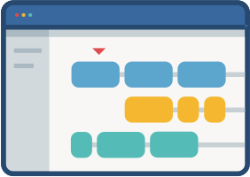
Software Documentation Cont.
Internal & External Documentation
Internal Documentation
External Documentation
It is the code perception features provided as part of the source code.
It is provided through appropriate module headers and comments embedded in the source code.
It is also provided through the useful variable names, module and function headers, code indentation, code structuring, use of enumerated types and constant identifiers, use of user-defined data types, etc.
Even when code is carefully commented, meaningful variable names are still more helpful in understanding a piece of code.
Good organizations ensure good internal documentation by appropriately formulating their coding standards and guidelines.
It is provided through various types of supporting documents
such as users’ manual
software requirements specification document
design document
test documents, etc.
A systematic software development style ensures that all these documents are produced in an orderly fashion.

Slide 13
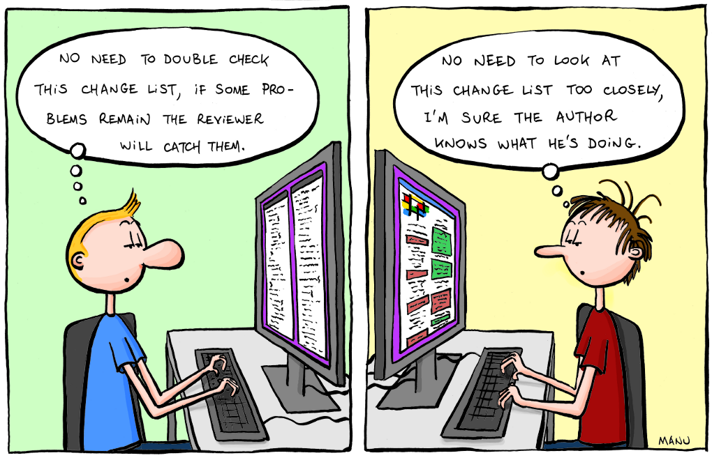


Software Testing
Testing is the process of exercising a program with the specific intent of finding errors prior to delivery to the end user.
Don’t view testing as a “safety net” that will catch all errors that occurred because of weak software engineering practice.

Slide 14


Who Test the Software
Tester
Who Test the Software?
Developer
Understands the system but, will test "gently"
and, is driven by "delivery"
Must learn about the system, but, will attempt to break it
and, is driven by quality
<Developer>
OR
Testing without plan is of no point
It wastes time and effort
Testing need a strategy Dev team needs to work with Test team, “Egoless Programming”
[Tester]

Slide 15
When to Test the Software?
Component Code
Component Code
Component Code
Unit Test
Unit Test
Unit Test
Design Specifications
Integration Test
Integrated modules
System functional requirements
Function Test
Functioning system
Other software requirements
Performance Test
Verified, validated software
Customer SRS
Acceptance Test
Accepted system
User environment
Installation Test
System in use!

Slide 16
Verification & Validation
Verification
Verification
Validation
Are we building the product right?
Process of evaluating products of a development phase to find out whether they meet the specified requirements.
Process of evaluating software at the end of the development to determine whether software meets the customer expectations and requirements.
The objective of Verification is to make sure that the product being develop is as per the requirements and design specifications.
Activities involved: Reviews, Meetings and Inspections
Activities involved: Testing like black box testing, white box testing, gray box testing
Validation
Carried out by QA team
Carried out by testing team
Are we building the right product?
Execution of code is not comes under Verification
Execution of code is comes under Validation
The objective of Validation is to make sure that the product actually meet up the user’s requirements, and check whether the specifications were correct in the first place.
Explains whether the outputs are according to inputs or not
Describes whether the software is accepted by the user or not
Cost of errors caught is less
Cost of errors caught is high

Slide 17
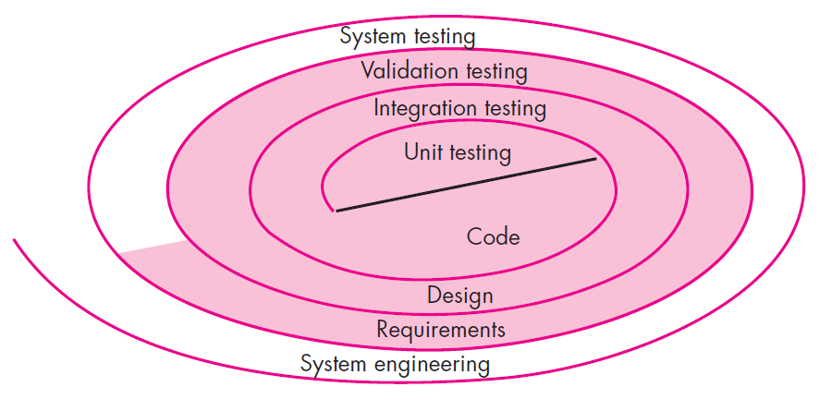

Software Testing Strategy
Unit Testing
It concentrate on each unit of the software as implemented in source code
Unit Testing
Integration Testing
Validation Testing
System Testing
It focuses on each component individual, ensuring that it functions properly as a unit.

Slide 18



Software Testing Strategy Cont.
Integration Testing
Validation Testing
System Testing
It focus is on design and construction of software architecture
Software is validated against requirements established as a part of requirement modeling
The software and other software elements are tested as a whole
Software once validated, must be combined with other system elements e.g. hardware, people, database etc…
Integration testing is the process of testing the interface between two software units or modules
It give assurance that software meets all informational, functional, behavioral and performance requirements
It verifies that all elements mesh properly and that overall system function / performance is achieved.

Slide 19
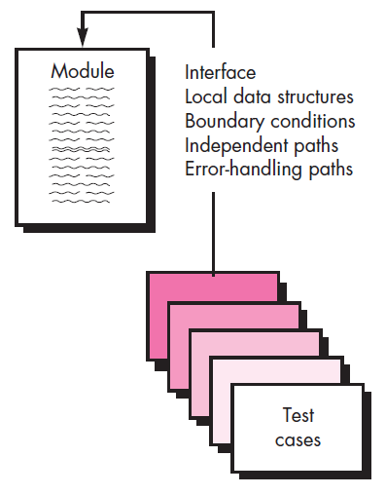
Unit Testing
Unit is the smallest part of a software system which is testable.
It may include code files, classes and methods which can be tested individually for correctness.
Unit Testing validates small building block of a complex system before testing an integrated large module or whole system
The unit test focuses on the internal processing logic and data structures within the boundaries of a component.
The module is tested to ensure that information properly flows into and out of the program unit
Local data structures are examined to ensure that data stored temporarily maintains its integrity during execution
All independent paths through the control structures are exercised to ensure that all statements in module have been executed at least once
Boundary conditions are tested to ensure that the module operates properly at boundaries established to limit or restricted processing
All error handling paths are tested

Slide 20
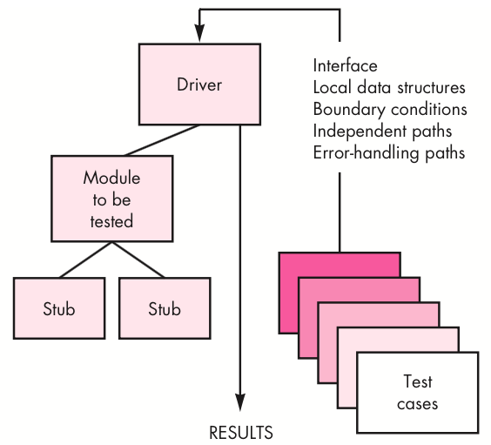
Diver & Stub (Unit Testing)
A
B
C
Let’s take an example to understand it in a better way.
Suppose there is an application consisting of three modules say, module A, module B & module C.
Developer has design in such a way that module B depends on module A & module C depends on module B
The developer has developed the module B and now wanted to test it.
But the module A and module C has not been developed yet.
In that case to test the module B completely we can replace the module A by Driver and module C by stub
Component-testing (Unit Testing) may be done in isolation from rest of the system
In such case the missing software is replaced by Stubs and Drivers and simulate the interface between the software components in a simple manner

Slide 21
Diver & Stub (Unit Testing) Cont.
Driver
Stub
Driver and/or Stub software must be developed for each unit test
A driver is nothing more than a "main program"
It accepts test case data
Passes such data to the component and
Prints relevant results.
Driver
Used in Bottom up approach
Lowest modules are tested first.
Simulates the higher level of components
Dummy program for Higher level component
Stubs serve to replace modules that are subordinate (called by) the component to be tested.
A stub or "dummy subprogram"
Uses the subordinate module's interface
May do minimal data manipulation
Prints verification of entry and
Returns control to the module undergoing testing
Stubs
Used in Top down approach
Top most module is tested first
Simulates the lower level of components
Dummy program of lower level components

Slide 22
Integration Testing
Integration testing is the process of testing the interface between two software units or modules
It can be done in 3 ways
1. Big Bang Approach
2. Top Down Approach
3. Bottom Up Approach
Big Bang Approach
Top Down Approach
Combining all the modules once and verifying the functionality after completion of individual module testing
Testing take place from top to bottom
High level modules are tested first and then low-level modules and finally integrated the low level modules to high level to ensure the system is working as intended
Stubs are used as a temporary module, if a module is not ready for integration testing
Bottom Up Approach
Testing take place from bottom to up
Lowest level modules are tested first and then high-level modules and finally integrated the high level modules to low level to ensure the system is working as intended
Drivers are used as a temporary module, if a module is not ready for integration testing

Slide 23
Regression Testing
When to do regression testing?
Repeated testing of an already tested program, after modification, to discover any defects introduced or uncovered as a result of the changes in the software being tested
Regression testing is done by re-executing the tests against the modified application to evaluate whether the modified code breaks anything which was working earlier
Anytime we modify an application, we should do regression testing
It gives confidence to the developers that there is no unexpected side effects after modification
When new functionalities are added to the application
E.g. A website has login functionality with only Email. Now the new features look like “also allow login using Facebook”
When there is a change requirement
Forgot password should be removed from the login page
When there is a defect fix
E.g. assume that “Login” button is not working and tester reports a bug. Once the bug is fixed by developer, tester tests using this approach
When there is a performance issue
E.g. loading a page takes 15 seconds. Reducing load time to 2 seconds
When there is an environment change
E.g. Updating database from MySQL to Oracle
When to do regression testing?

Slide 24

Smoke Testing
Smoke Testing is an integrated testing approach that is commonly used when product software is developed
This test is performed after each Build Release
Smoke testing verifies – Build Stability
This testing is performed by “Tester” or “Developer”
This testing is executed for Integration Testing, System Testing & Acceptance Testing
What to Test?
All major and critical functionalities of the application is tested
It does not go into depth to test each functionalities
This does not incudes detailed testing for the build
Build
F1
F2
F3
F4
F5
F6
Critical
Critical
Major
Major
It test the build just to check if any major or critical functionalities are broken
If there are smoke or Failure in the build after Test, build is rejected and developer team is reported with the issue

Slide 25

Validation Testing
The process of evaluating software to determine whether it satisfies specified business requirements (client’s need).
It provides final assurance that software meets all informational, functional, behavioral, and performance requirements
When custom software is build for one customer, a series of acceptance tests are conducted to validate all requirements
It is conducted by end user rather then software engineers
If software is developed as a product to be used by many customers, it is impractical to perform formal acceptance tests with each one
Most software product builders use a process called alpha and beta testing to uncover errors that only the end user seems able to find

Slide 26
Validation Testing – Alpha & Beta Test
Alpha Test
The alpha test is conducted at the developer’s site by a representative group of end users
The software is used in a natural setting with the developer “looking over the shoulders” of the users and recording errors and usage problems
The alpha tests are conducted in a controlled environment
Beta Test
The beta test is conducted at one or more end-user sites
Developers are not generally present
Beta test is a “live” application of the software in an environment that can not be controlled by the developer
The customer records all problems and reports to the developers at regular intervals
After modifications, software is released for entire customer base

Slide 27
System Testing
In system testing the software and other system elements are tested.
To test computer software, you spiral out in a clockwise direction along streamlines that increase the scope of testing with each turn.
System testing verifies that all elements mesh properly and overall system function/performance is achieved.
System testing is actually a series of different tests whose primary purpose is to fully exercise the computer-based system.
Types of System Testing
1
Recovery Testing
4
Performance Testing
2
Security Testing
5
Deployment Testing
3
Stress Testing

Slide 28

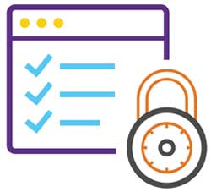
Types of System Testing
Recovery Testing
It is a system test that forces the software to fail in a variety of ways and verifies that recovery is properly performed.
If recovery is automatic (performed by the system itself)
Re-initialization, check pointing mechanisms, data recovery, and restart are evaluated for correctness.
If recovery requires human intervention
The mean-time-to-repair (MTTR) is evaluated to determine whether it is within acceptable limits
Security Testing
It attempts to verify software’s protection mechanisms, which protect it from improper penetration (access).
During this test, the tester plays the role of the individual who desires to penetrate the system.

Slide 29


Types of System Testing Cont.
Stress Testing
It executes a system in a manner that demands resources in abnormal quantity, frequency or volume.
A variation of stress testing is a technique called sensitivity testing.
Performance Testing
It is designed to test the run-time performance of software.
It occurs throughout all steps in the testing process.
Even at the unit testing level, the performance of an individual module may be tested.

Slide 30

Types of System Testing Cont.
Deployment Testing
It exercises the software in each environment in which it is to operate.
In addition, it examines
All installation procedures
Specialized installation software that will be used by customers
All documentation that will be used to introduce the software to end users

Slide 31

Acceptance Testing
It is a level of the software testing where a system is tested for acceptability.
The purpose of this test is to evaluate the system’s compliance with the business requirements.
It is a formal testing conducted to determine whether or not a system satisfies the acceptance criteria with respect to user needs, requirements, and business processes
It enables the customer to determine, whether or not to accept the system.
It is performed after System Testing and before making the system available for actual use.

Slide 32
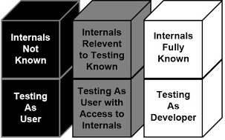
Views of Test Objects
Black Box Testing
White Box Testing
Grey Box Testing
Close Box Testing
Testing based only on specification
Open Box Testing
Testing based on actual source code
Partial knowledge of source code

Slide 33
Black Box Testing
Also known as specification-based testing
Tester has access only to running code and the specification it is supposed to satisfy
Test cases are written with no knowledge of internal workings of the code
No access to source code
So test cases don’t worry about structure
Emphasis is only on ensuring that the contract is met
Advantages
Scalable; not dependent on size of code
Testing needs no knowledge of implementation
Tester and developer can be truly independent of each other
Tests are done with requirements in mind
Does not excuse inconsistencies in the specifications
Test cases can be developed in parallel with code

Slide 34
Black Box Testing Cont.
Disadvantages
Test Case Design
Examine pre-condition, and identify equivalence classes
All possible inputs such that all classes are covered
Apply the specification to input to write down expected output
Test size will have to be small
Specifications must be clear, concise, and correct
May leave many program paths untested
Weighting of program paths is not possible
Test Case 1
Input: x1 (sat. X)
Exp. Output: y2
Test Case 2
Input: x2 (sat. X)
Exp. Output: y2
Specification
Operation op
Pre: X
Post: Y
Specification-
Based Test Case
Design

Slide 35
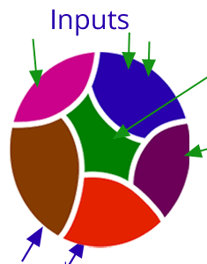
Black Box Testing Cont.
Exhausting testing is not always possible when there is a large set of input combinations, because of budget and time constraint.
The special techniques are needed which select test-cases smartly from the all combination of test-cases in such a way that all scenarios are covered
Two techniques are used
1
Equivalence Partitioning
2
Boundary Value Analysis (BVA)
Equivalence Partitioning
Input data for a program unit usually falls into a number of partitions, e.g. all negative integers, zero, all positive numbers
Each partition of input data makes the program behave in a similar way
Two test cases based on members from the same partition is likely to reveal the same bugs

Slide 36
Equivalence Partitioning (Black Box Testing)
By identifying and testing one member of each partition we gain 'good' coverage with 'small' number of test cases
Testing one member of a partition should be as good as testing any member of the partition
Example - Equivalence Partitioning
For binary search the following partitions exist
Inputs that conform to pre-conditions
Inputs where the precondition is false
Inputs where the key element is a member of the array
Inputs where the key element is not a member of the array
Pick specific conditions of the array
The array has a single value
Array length is even
Array length is odd

Slide 37
Equivalence Partitioning (Black Box Testing) Cont.
Example - Equivalence Partitioning
Example: Assume that we have to test field which accepts SPI (Semester Performance Index) as input (SPI range is 0 to 10)
SPI
* Accepts value 0 to 10
Equivalence Partitioning
Invalid | Valid | Invalid
<=-1 | 0 to 10 | >=11
Valid Class: 0 – 10, pick any one input test data from 0 to 10
Invalid Class 1: <=-1, pick any one input test data less than or equal to -1
Invalid Class 2: >=11, pick any one input test data greater than or equal to 11

Slide 38
Boundary Value Analysis (BVA) (Black Box Testing)
It arises from the fact that most program fail at input boundaries
Boundary testing is the process of testing between extreme ends or boundaries between partitions of the input values.
In Boundary Testing, Equivalence Class Partitioning plays a good role
Boundary Testing comes after the Equivalence Class Partitioning
The basic idea in boundary value testing is to select input variable values at their:
Just below the minimum
Minimum
Just above the minimum
Just below the maximum
Maximum
Just above the maximum
Boundary
Boundary Values

Slide 39
Boundary Value Analysis (BVA) (Black Box Testing)
Suppose system asks for “a number between 100 and 999 inclusive”
The boundaries are 100 and 999
We therefore test for values
99 100 101
999 999 1000
Lower boundary
Upper boundary
BVA - Advantages
The BVA is easy to use and remember because of the uniformity of identified tests and the automated nature of this technique.
One can easily control the expenses made on the testing by controlling the number of identified test cases.
BVA is the best approach in cases where the functionality of a software is based on numerous variables representing physical quantities.
The technique is best at user input troubles in the software.
The procedure and guidelines are crystal clear and easy when it comes to determining the test cases through BVA.
The test cases generated through BVA are very small.

Slide 40
Boundary Value Analysis (BVA) (Black Box Testing) Cont.
BVA - Disadvantages
This technique sometimes fails to test all the potential input values. And so, the results are unsure.
The dependencies with BVA are not tested between two inputs.
This technique doesn’t fit well when it comes to Boolean Variables.
It only works well with independent variables that depict quantity.

Slide 41
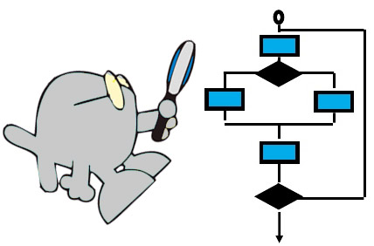
White Box Testing
Also known as structural testing
White Box Testing is a software testing method in which the internal structure/design/implementation of the module being tested is known to the tester
Focus is on ensuring that even abnormal invocations are handled gracefully
Using white-box testing methods, you can derive test cases that
Guarantee that all independent paths within a module have been exercised at least once
Exercise all logical decisions on their true and false sides
Execute all loops at their boundaries
Exercise internal data structures to ensure their validity
...our goal is to ensure that all statements and conditions have been executed at least once ...

Slide 42
White Box Testing Cont.
It is applicable to the following levels of software testing
Unit Testing: For testing paths within a unit
Integration Testing: For testing paths between units
System Testing: For testing paths between subsystems
Advantages
Disadvantages
Testing can be commenced at an earlier stage as one need not wait for the GUI to be available.
Testing is more thorough, with the possibility of covering most paths
Since tests can be very complex, highly skilled resources are required, with thorough knowledge of programming and implementation
Test script maintenance can be a burden, if the implementation changes too frequently
Since this method of testing is closely tied with the application being testing, tools to cater to every kind of implementation/platform may not be readily available

Slide 43
White-box testing strategies
One white-box testing strategy is said to be stronger than another strategy, if all types of errors detected by the first testing strategy is also detected by the second testing strategy, and the second testing strategy additionally detects some more types of errors.
White-box testing strategies
1
Statement coverage
2
Branch coverage
3
Path coverage
Statement coverage
It aims to design test cases so that every statement in a program is executed at least once
Principal idea is unless a statement is executed, it is very hard to determine if an error exists in that statement
Unless a statement is executed, it is very difficult to observe whether it causes failure due to some illegal memory access, wrong result computation, etc.

Slide 44
White-box testing strategies Cont.
Consider the Euclid’s GCD computation algorithm
int compute_gcd(x, y)
int x, y;
{
1 while (x! = y){
2 if (x>y) then
3 x= x – y;
4 else y= y – x;
5 }
6 return x;
}
By choosing the test set {(x=3, y=3), (x=4, y=3), (x=3, y=4)}, we can exercise the program such that all statements are executed at least once.

Slide 45
White-box testing strategies Cont.
Branch coverage
In the branch coverage based testing strategy, test cases are designed to make each branch condition to assume true and false values in turn
It is also known as edge Testing as in this testing scheme, each edge of a program’s control flow graph is traversed at least once
Branch coverage guarantees statement coverage, so it is stronger strategy compared to Statement Coverage.
Path Coverage
In this strategy test cases are executed in such a way that every path is executed at least once
All possible control paths taken, including
All loop paths taken zero, once and multiple items in technique
The test case are prepared based on the logical complexity measure of the procedure design
Flow graph, Cyclomatic Complexity and Graph Metrices are used to arrive at basis path.

Slide 46
White-box testing strategies Cont.
Branch coverage
Path Coverage
In the branch coverage based testing strategy, test cases are designed to make each branch condition to assume true and false values in turn
It is also known as edge Testing as in this testing scheme, each edge of a program’s control flow graph is traversed at least once
Branch coverage guarantees statement coverage, so it is stronger strategy compared to Statement Coverage.
In this strategy test cases are executed in such a way that every path is executed at least once
All possible control paths taken, including
All loop paths taken zero, once and multiple items in technique
The test case are prepared based on the logical complexity measure of the procedure design
Flow graph, Cyclomatic Complexity and Graph Metrices are used to arrive at basis path.

Slide 47
Grey Box Testing
Combination of white box and black box testing
Tester has access to source code, but uses it in a restricted manner
Test cases are still written using specifications based on expected outputs for given input
These test cases are informed by program code structure

Slide 48
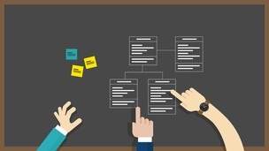
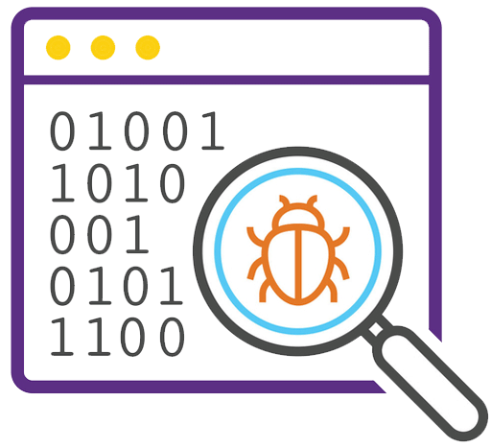
Testing Object Oriented Applications
Unit Testing in the OO Context
The concept of the unit testing changes in object-oriented software
Encapsulation drives the definition of classes and objects
Means, each class and each instance of a class (object) packages attributes (data) and the operations (methods or services) that manipulate these data
Rather than testing an individual module, the smallest testable unit is the encapsulated class
Unlike unit testing of conventional software,
which focuses on the algorithmic detail of a module and the data that flows across the module interface,
class testing for OO software is driven by the operations encapsulated by the class and the state behavior of the class

Slide 49
Integration Testing in the OO Context
Object-oriented software does not have a hierarchical control structure,
conventional top-down and bottom-up integration strategies have little meaning
There are two different strategies for integration testing of OO systems.
Thread-based testing
integrates the set of classes required to respond to one input or event for the system
Each thread is integrated and tested individually
Regression testing is applied to ensure that no side effects occur
Use-based testing
begins the construction of the system by testing those classes (called independent classes) that use very few (if any) of server classes
After the independent classes are tested, the next layer of classes, called dependent classes, that use the independent classes are tested
Cluster testing is one step in the integration testing of OO software
Here, a cluster of collaborating classes is exercised by designing test cases that attempt to uncover

Slide 50
Validation Testing in an OO Context
At the validation or system level, the details of class connections disappear
Like conventional validation, the validation of OO software focuses on user-visible actions and user-recognizable outputs from the system
To assist in the derivation of validation tests, the tester should draw upon use cases that are part of the requirements model
Conventional black-box testing methods can be used to drive validation tests

Slide 51


Testing Web Applications
WebApp testing is a collection of related activities with a single goal to uncover errors in WebApp content, function, usability, navigability, performance, capacity, and security
To accomplish this, a testing strategy that encompasses both reviews and executable testing is applied.
Dimensions of Quality
Content is evaluated at both a syntactic and semantic level.
At the syntactic level spelling, punctuation, and grammar are assessed for text-based documents.
At a semantic level correctness of information presented, Consistency across the entire content object and related objects, and lack of ambiguity are all assessed.

Slide 52
Dimensions of Quality Cont.
Function is tested to uncover errors that indicate lack of conformance to customer requirements
Structure is assessed to ensure that it properly delivers WebApp content
Usability is tested to ensure that each category of user is supported by the interface and can learn and apply all required navigation.
Navigability is tested to ensure that all navigation syntax and semantics are exercised to uncover any navigation errors
Ex., dead links, improper links, and erroneous links
Performance is tested under a variety of operating conditions, configurations and loading
to ensure that the system is responsive to user interaction and handles extreme loading
Compatibility is tested by executing the WebApp in a variety of different host configurations on both the client and server sides
Interoperability is tested to ensure that the WebApp properly interfaces with other applications and/or databases
Security is tested by assessing potential vulnerabilities

Slide 53
Content Testing
User Interface Testing
Errors in WebApp content can be
as trivial as minor typographical errors or
as significant as incorrect information, improper organization, or violation of intellectual property laws
Content testing attempts to uncover these and many other problems before the user encounters them
Content testing combines both reviews and the generation of executable test cases
Reviews are applied to uncover semantic errors in content
Executable testing is used to uncover content errors that can be traced to dynamically derived content that is driven by data acquired from one or more databases.
Verification and validation of a WebApp user interface occurs at three distinct points
During requirements analysis
the interface model is reviewed to ensure that it conforms to stakeholder requirements
During design
the interface design model is reviewed to ensure that generic quality criteria established for all user interfaces have been achieved
During testing
the focus shifts to the execution of application-specific aspects of user interaction as they are manifested by interface syntax and semantics.
In addition, testing provides a final assessment of usability

Slide 54
Component-Level Testing
Navigation Testing
Component-level testing (function testing), focuses on a set of tests that attempt to uncover errors in WebApp functions.
Each WebApp function is a software component (implemented in one of a variety of programming languages)
WebApp function can be tested using black-box (and in some cases, white-box) techniques.
Component-level test cases are often driven by forms-level input.
Once forms data are defined, the user selects a button or other control mechanism to initiate execution.
The job of navigation testing is to ensure that
the mechanisms that allow the WebApp user to travel through the WebApp are all functional and,
to validate that each Navigation Semantic Unit (NSU) can be achieved by the appropriate user category
Navigation mechanisms should be tested are
Navigation links,
Redirects,
Bookmarks,
Frames and framesets,
Site maps,
Internal search engines.

Slide 55
Configuration Testing
Security Testing
Configuration variability and instability are important factors that make WebApp testing a challenge.
Hardware, operating system(s), browsers, storage capacity, network communication speeds, and a variety of other client-side factors are difficult to predict for each user.
One user’s impression of the WebApp and the manner in which he/she interacts with it can differ significantly.
Configuration testing is to test a set of probable client-side and server-side configurations
to ensure that the user experience will be the same on all of them and,
to isolate errors that may be specific to a particular configuration
Security tests are designed to probe
vulnerabilities of the client-side environment,
the network communications that occur as data are passed from client to server and back again, and
the server-side environment.
Each of these domains can be attacked, and it is the job of the security tester to uncover weaknesses
that can be exploited by those with the intent to do so.

Slide 56
Performance Testing
Performance testing is used to uncover
performance problems that can result from lack of server-side resources,
inappropriate network bandwidth,
inadequate database capabilities,
faulty or weak operating system capabilities,
poorly designed WebApp functionality, and
other hardware or software issues that can lead to degraded client-server performance

Slide 57
Software Engineering (3150711)
Dr. Pradyumansinh U. Jadeja
Computer Engineering Department
pradyuman.jadeja@darshan.ac.in
91-9879461848

