Slide 1
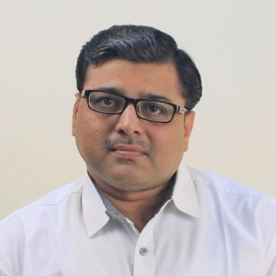
Software Engineering (3150711)
Unit-7 Quality Assurance & Management
Dr. Pradyumansinh U. Jadeja
Computer Engineering Department
pradyuman.jadeja@darshan.ac.in
+91-9879461848

Slide 2

Looping
Outline
Quality Concepts and Software Quality Assurance
Software Reviews (Formal Technical Reviews)
Software Reliability
The Quality Standards
ISO 9000
CMM
Six Sigma for SE
SQA Plan

Slide 3
What is Quality
Quality
Developed product meets it’s specification
Software Quality Assurance (SQA)
Software quality assurance (also called quality management) is an umbrella activity that is applied throughout the software process
It is planned and systematic pattern of activities necessary to provide high degree of confidence in the quality
Software quality assurance (SQA) encompasses
An SQA process
Specific quality assurance and quality control tasks
Effective software engineering practice
Control of all software work products
A procedure to ensure compliance with software development standards
Measurement and reporting mechanisms
Quality Management
Ensuring that required level of product quality is achieved
Defining procedures and standards
Applying procedures and standards to the product and process
Checking that procedures are followed
Collecting and analyzing various quality data

Slide 4
SQA Activities
Prepare an SQA plan for a project
Participate in the development of the project’s software process description
Review software engineering activities to verify compliance with the defined software process
Audit designated software work products to verify compliance with those defined as part of the software process
Ensure that deviations in software work and work products are documented and handled according to a documented procedure
Records any noncompliance and reporting to senior management

Slide 5
SQA Techniques
Statistical quality assurance implies the following steps:
Information about software defects is collected and categorized
An attempt is made to trace each defect to its underlying cause
Ex., non-conformance to specifications, design error, violation of standards, poor communication with the customer
Using the Pareto principle (80 percent of the defects can be traced to 20 percent of all possible causes), isolate the 20 percent (the "vital few").
Once the vital few causes have been identified, move to correct the problems that have caused the defects.
Some of the defects are uncovered as software is being developed.
Other are encountered after the software has been released.

Slide 6

SQA Techniques (Cont.)
Uncovered errors can be tracked to (one or more) of the following causes
Incomplete or erroneous specifications (IES)
Misinterpretation of customer communication (MCC)
Intentional deviation from specifications (IDS)
Violation of programming standards (VPS)
Error in data representation (EDR)
Inconsistent component interface (ICI)
Error in design logic (EDL)
Incomplete or erroneous testing (IET)
Inaccurate or incomplete documentation (IID)
Error in programming language translation of design (PLT)
Ambiguous or inconsistent human/computer interface (HCI)
Miscellaneous (MIS)

Slide 7
Software Reviews (Formal Technical Reviews)
A formal technical review (FTR) is a software quality control activity performed by software engineers (and others)
The objectives of an FTR are:
To uncover errors in function, logic, or implementation; for any representation of the software
To verify that the software under review meets its requirements
To ensure that the software has been represented according to predefined standards
To achieve software that is developed in a uniform manner
To make projects more manageable
During the FTR,
a reviewer (the recorder) actively records all issues that have been raised
These are summarized at the end of the review meeting, and a reviewed issues list is produced
In addition, a formal technical review summary report is completed

Slide 8
Review Guidelines
Guidelines for conducting formal technical reviews must be
established in advance, distributed to all reviewers, agreed upon & then followed
Review the product, not the producer
Set an agenda and maintain it
Limit debate and denial
Speak problem areas, but don't attempt to solve every problem noted
Take written notes
Conduct meaningful training for all reviewers
Limit the number of participants and insist upon advance preparation
Develop a checklist for each product that is likely to be reviewed
Allocate resources and schedule time for FTRs
Review your early reviews

Slide 9

Differentiation of SQA & SQC
Criteria
SQA
SQC
Definition
SQA is a set of activities for ensuring quality in software engineering processes (that ultimately result in quality in software products). The activities establish and evaluate the processes that produce products
SQC is a set of activities for ensuring quality in software products. The activities focus on identifying defects in the actual products produced
Focus
Process focused
Product focused
Orientation
Prevention oriented
Detection oriented
Breadth
Organization wide
Product/project specific
Scope
Relates to all products that will ever be created by a process
Relates to specific product
Activities
Process Definition and Implementation, Audits, Training
Reviews, Testing

Slide 10

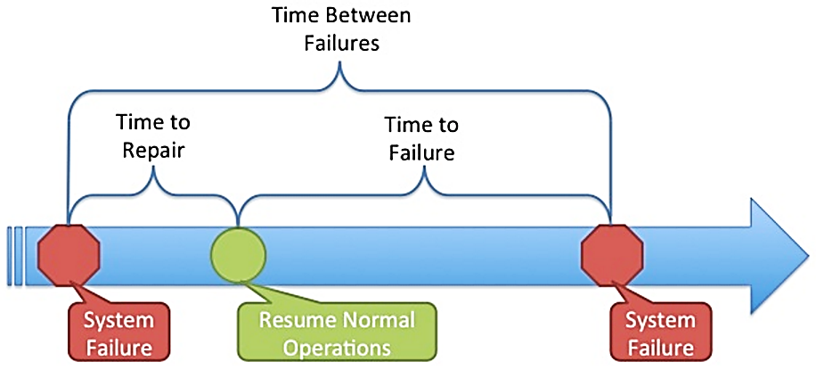
Software Reliability
Software reliability is defined in statistical terms as
Measures of Reliability
Many researchers argue that MTBF is a far more useful measure than other quality-related software metrics
An end user is concerned with failures, not with the total defect count
Because each defect contained within a program does not have the same failure rate, the total defect count provides little indication of the reliability of a system
An alternative measure of reliability is failures-in-time (FIT)
a statistical measure of how many failures a component will have over one billion hours of operation
The probability of failure-free operation of a computer program in a specified environment for a specified time
A simple measure of reliability is meantime-between-failure (MTBF):
MTBF = MTTF + MTTR
MTTF = mean-time-to-failure, MTTR = mean-time-to-repair

Slide 11

Software Safety
Software safety is a software quality assurance activity
that focuses on the identification and assessment of potential hazards that may affect software negatively and cause an entire system to fail
If hazards can be identified early in the software process,
software design features can be specified that will either eliminate or control potential hazards
A modelling and analysis process is conducted as part of software safety
Initially, hazards are identified and categorized by criticality and risk
Although software reliability and software safety are closely related to one another, it is important to understand the subtle difference between them
Software reliability uses statistical analysis to determine the likelihood that a software failure will occur
However, the occurrence of a failure does not necessarily result in a hazard or accident
Software safety examines the ways in which failures can lead to an accident

Slide 12



The quality standards
ISO 9001
ISO 9000 and 9001
Six Sigma
CMM
In order to bring quality in product and service, many organizations are adopting Quality Assurance System
ISO standards are issued by the International Organization for Standardization (ISO) in Switzerland
Proper documentation is an important part of an ISO 9001 Quality Management System.
ISO 9001 is the quality assurance standard that applies to software engineering
It includes, requirements that must be present for an effective quality assurance system
ISO 9001 standard is applicable to all engineering discipline

Slide 13
ISO 9001 Cont.
The requirements described by ISO 9001:2000 address topics such as
Management Responsibility
Quality System
In order for a software organization to become registered to ISO 9001:2000
Design Control
Document
Product Identification
Traceability
1. It must establish policies and procedures to address each of the requirements just noted
Inspection
Testing
Control of Quality Records
Internal Quality
Training
Servicing
2. Able to demonstrate that these policies and procedures are being followed
Contract Review
Process Control
Data Control
Preventive Action
Audits

Slide 14

Six Sigma
Several Software Packages available to assist in measuring
yield, defects per million opportunities, etc.
DMAIC - Six Sigma
Six sigma is “A generic quantitative approach to improvement that applies to any process”
Six Sigma is a disciplined, data-driven approach and methodology for eliminating defects in any process - from manufacturing to transactional and from product to service
To achieve six sigma, a process must not produce more than 3.4 defects per million opportunities
4 Sigma → 6210 defects per million opportunities
5 Sigma → 230 defects per million opportunities
Six sigma have two methodologies.
DMAIC (Define, Measure, Analyze, Improve, Control)
DMADV (Define, Measure, Analyze, Design, Verify)
Define: Define the problem or process to improve upon related to the customer and goals
Measure: How can you measure this process in a systematic way?
Analyze: Analyze the process or problem and identify the way in which it can be improved. What are the root causes of problems within the process?
Improve: Once you know the causes of the problems, present solutions for them and implement them.
Control: Utilize Statistical Process Control to continuously measure your results and ensure you are improving

Slide 15
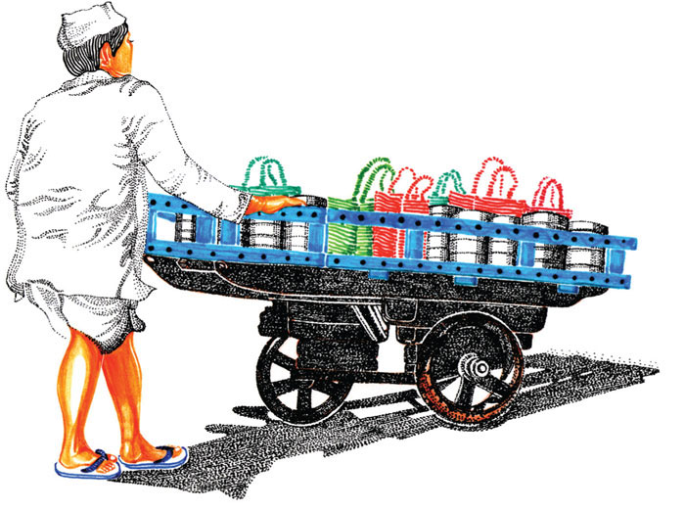
DMADV - Six Sigma
Mumbai's
Dabbawalas
Define, Measure and analyze are similar to above method
Example of Six Sigma Company
Design: Avoid root causes of defects and meet the customer requirements
Verify: To verify the process, compare the process with the standard plan and find differences
For over 100 years they have delivered food to every part of the city, earning them a Six Sigma rating (a Forbes rating of 99.9 % which means one error in 6 million transactions).

Slide 16
CMM (Capability Maturity Model)
To determine an organization’s current state of process maturity, the SEI (Software Engineering Institute) uses an assessment that results in a five point grading scheme
The grading scheme determines compliance with a capability maturity model (CMM) that defines key activities required at different levels of process maturity
The SEI approach establishes five process maturity levels that are defined in the following manner
Level 1: Initial
The software process is characterized as ad hoc and occasionally
Few processes are defined and success depends on individual effort
Level 2: Repeatable
Basic project management processes are established to track cost, schedule, and functionality.
The necessary process discipline is in place to repeat earlier successes on Project
Level 3: Defined
The software process for both management and engineering activities is documented, standardized and integrated
This level includes all characteristics defined for level 2

Slide 17
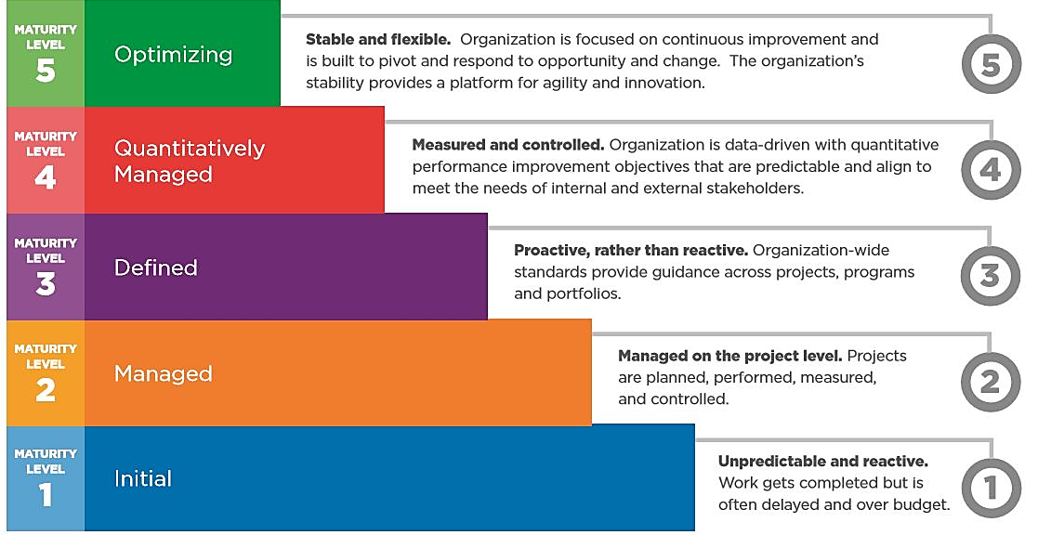
CMM (Capability Maturity Model) Cont.
Level 4: Managed
Detailed measures of the software process and product quality are collected
This level includes all characteristics defined for level 3
Level 5: Optimizing
Continuous process improvement is enabled by quantitative feedback from the process and from testing innovative ideas and technologies
This level includes all characteristics defined for level 4

Slide 18
SQA Plan
The SQA Plan provides a road map for establishing software quality assurance
The plan serves as a template for SQA activities that are instituted for each software project
The standard recommends a structure that identifies:
The purpose and scope of the plan
A description of all software engineering work products (e.g., models, documents, source code).
All applicable standards that are applied during the software process
SQA actions and their placement throughout the software process
The tools and methods that support SQA actions and tasks
Software configuration management procedures
Methods for assembling, safeguarding and maintaining all SQA-related records
Organizational roles and responsibilities relative to product quality

Slide 19
Software Engineering (3150711)
Dr. Pradyumansinh U. Jadeja
Computer Engineering Department
pradyuman.jadeja@darshan.ac.in
91-9879461848

