Slide 1
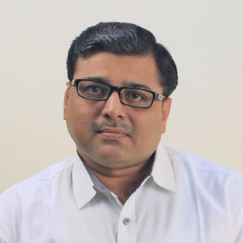
Software Engineering (3150711)
Unit-8 Software Maintenance & Configuration Management
Dr. Pradyumansinh U. Jadeja
Computer Engineering Department
pradyuman.jadeja@darshan.ac.in
+91-9879461848

Slide 2

Looping
Outline
Types of Software Maintenance
Re-Engineering
Reverse Engineering
Forward Engineering
The SCM Process
Identification of Objects in the Software Configuration
Version Control and Change Control

Slide 3


Types of Software Maintenance
In a software lifetime, type of maintenance may vary based on its nature
It may be just a routine maintenance tasks as some bug discovered by some user or it may be a large event in itself based on maintenance size or nature
Following are some types of maintenance based on their characteristics
Corrective Maintenance
Adaptive Maintenance
Perfective Maintenance
Preventive Maintenance
Corrective Maintenance
This includes modifications done in order to fix problems
Corrective maintenance deals with the repair of defects found in day-to-day system functions
Adaptive Maintenance
This includes modifications applied to keep the software product up-to-date
Adaptive maintenance is the implementation of changes in a part of the system, which has been affected by a change that occurred in some other part of the system

Slide 4
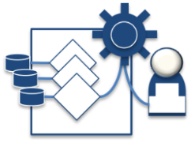

Types of Software Maintenance Cont.
Perfective Maintenance
This includes modifications done in order to keep the software usable over long period of time
It includes new features, new user requirements for refining the software and improve its reliability and performance.
This includes changing the functionalities of as per the user’s changing needs
Preventive Maintenance
Modifications to prevent future problems of software
It aims to attend problems, which are not significant at this moment but may cause serious issues in future
It comprises documentation updating, code optimization and code restructuring.

Slide 5
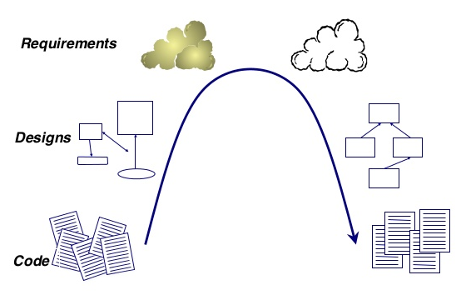
Re-Engineering
When we need to update the software to keep it to the current market, without impacting its functionality, it is called software re-engineering
It is a process where the design of software is changed and programs are re-written
Legacy software cannot keep tuning with the latest technology available in the market
For example, initially UNIX was developed in assembly language. When language C came into existence, UNIX was re-engineered in C, because working in assembly language was difficult.
Other than this, sometimes programmers notice that few parts of software need more maintenance than others and they also need re-engineering
Forward Engineering
Reverse Engineering

Slide 6

Re-Engineering Cont.
Reverse Engineering
Obtain specifications of existing software
Decide what to re-engineer.
Is it whole software or a part of it?
Perform Reverse Engineering, in order to obtain specifications of existing software
Restructure Program if required
For example, changing function-oriented programs into object-oriented programs and re-structure data as required
Apply Forward engineering concepts in order to get re-engineered software
Change program and/or data structure
Program Restructuring
Get re-engineered software developed
Forward Engineering

Slide 7

Reverse Engineering
Reverse engineering can extract design information from source code
The abstraction level of a reverse engineering process refers to the sophistication of the design information that can be extracted from source code
Ideally, the abstraction level should be as high as possible
The reverse engineering process should be capable of
Deriving procedural design representations (a low-level abstraction)
Program and data structure information (a somewhat higher level of abstraction)
Object models, data flow models (a relatively high level of abstraction)
Entity relationship models (a high level of abstraction).
As the abstraction level increases, information will allow easier understanding of the program
Interactivity refers to the degree to which the human is “integrated” with automated tools to create an effective reverse engineering process
In most cases, as the abstraction level increases, interactivity must increase
The directionality of the reverse engineering process is one-way, all information extracted from the source code is provided to the software engineer

Slide 8
Forward engineering
Forward engineering is a process of obtaining desired software from the specifications, which were brought by reverse engineering
Forward engineering is same as software engineering process with only one difference it is carried out always after reverse engineering
In most cases, forward engineering does not simply create a modern equivalent of an older program
Rather, new user and technology requirements are integrated into the reengineering effort
The redeveloped program extends the capabilities of the older application

Slide 9

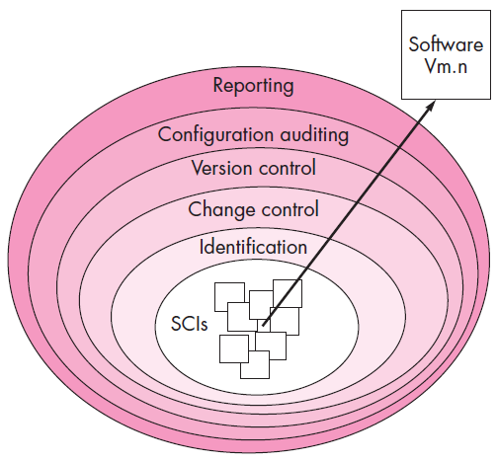
Software Configuration Management
The SCM (Software Configuration Management) is a set of activities that have been developed to manage change throughout the software life cycle
Layers of SCM Process
Purpose:
Systematically control changes to the configuration and maintain the integrity and traceability of the configuration throughout the system’s life cycle
Four primary objectives
To identify all items that collectively define the software configuration
To manage changes to one or more of these items
To facilitate the construction of different versions of an application
To ensure that software quality is maintained as the Configuration evolves over time

Slide 10
The SCM Process
Identification Task
Referring to the figure, SCM tasks can viewed as concentric layers
SCIs (Software Configuration Item) flow outward through these layers throughout their useful life
As an SCI moves through a layer, the actions implied by each SCM task may or may not be applicable
For example, when a new SCI is created, it must be identified.
However, if no changes are requested for the SCI, the change control layer does not apply
The SCI is assigned to a specific version of the software (version control mechanisms come into play)
A record of the SCI (its name, creation date, version, etc.) is maintained for configuration auditing purposes
Identification separately names each SCI and then organizes it in the SCM repository using an object-oriented approach
Objects start out as basic objects and are then grouped into aggregate objects.
Each object has a set of distinct features that identify it.
A name that is unambiguous to all other objects
A description that contains the SCI type, a project identifier, and change and/or version information
List of resources needed by the object
The object realization (i.e., the document, the file, the model, etc.)

Slide 11

Change Control Cont.
Change control is a procedural activity that ensures quality and consistency as changes are made to a configuration object
A change request is submitted to a configuration control authority, which is usually a change control board (CCB).
The request is evaluated for technical merit, potential side effects, overall impact on other configuration objects and system functions, and projected cost in terms of money, time and resources
An engineering change order (ECO) is issued for each approved change request
Describes the change to be made, the constraints to follow and the criteria for review and audit
The Base lined SCI is obtained from the SCM repository
Access control governs which software engineers have the authority to access and modify a particular configuration object
Synchronization control helps to ensure that parallel changes performed by two different people don't overwrite one another.

Slide 12




Version Control
Version control is a set of procedures and tools for managing the creation and use of multiple occurrences of objects in the SCM repository
Version Control Capabilities
An SCM repository that stores all relevant configuration objects
A version management capability that stores all versions of a configuration object
A make facility that enables the software engineer to collect all relevant configuration objects and construct a specific version of the software
Issues or bug tracking capability that enables the team to record and track the status of all outstanding issues associated with each configuration object
The SCM repository maintains a change set
Serves as a collection of all changes made to a baseline configuration
Used to create a specific version of the software
Captures all changes to all files in the configuration along with the reason for changes and details of who made the changes and when
Few version control systems

Slide 13

Configuration Audit
Configuration auditing is an SQA activity that helps to ensure that quality is maintained as changes are made.
It complements the formal technical review and is conducted by the SQA group
It addresses the following questions
Has a formal technical review been conducted to assess technical correctness?
Has the software process been followed and have software engineering standards been properly applied?
Has the change been "highlighted" and "documented" in the SCI? Have the change data and change author been specified? Do the attributes of the configuration object reflect the change?
Have SCM procedures for noting the change, recording it and reporting it been followed?
Have all related SCIs been properly updated?
A configuration audit ensures that
The correct SCIs (by version) have been incorporated into a specific build
That all documentation is up-to-date and consistent with the version that has been built

Slide 14
Status Reporting
Configuration status reporting (CSR) is also called status accounting
Provides information about each change to those personnel in an organization with a need to know
Answers what happened, who did it, when did it happen and what else will be affected?
Sources of entries for configuration status reporting
Each time a SCI is assigned new or updated information
Each time a configuration audit is conducted
The configuration status report
Placed in an on-line database or on a website for software developers and maintainers to read
Given to management and practitioners to keep them appraised of important changes to the project SCIs

Slide 15
Software Engineering (3150711)
Dr. Pradyumansinh U. Jadeja
Computer Engineering Department
pradyuman.jadeja@darshan.ac.in
91-9879461848

