Slide 1


Ce443 : Cloud computing
Ch-5 Fundamental Cloud Architectures
Chandubhai S. Patel Institute of Technology

Slide 2
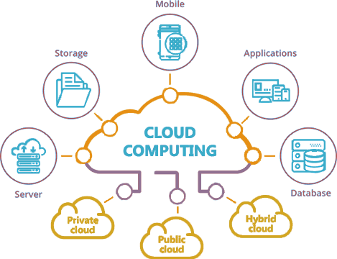
Cloud Computing
The cloud refers to servers that are accessed over the Internet, and the software and databases that run on those servers. Cloud servers are located in data centers all over the world
Cloud computing is the on-demand availability of computer system resources, especially data storage (cloud storage) and computing power, without direct active management by the user

Slide 3
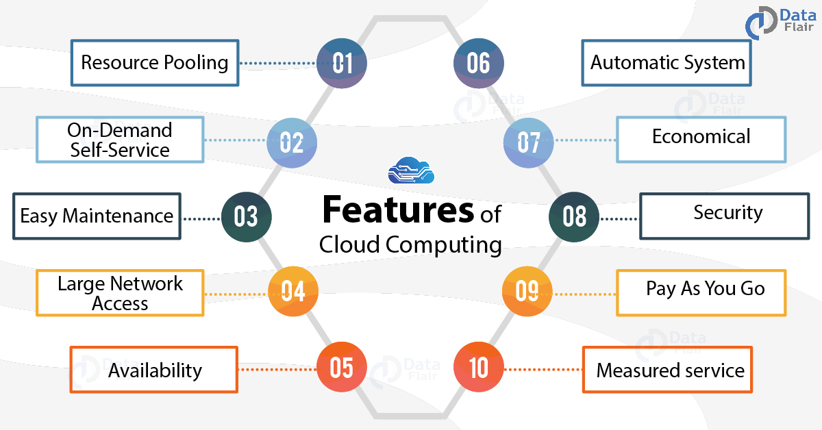

Slide 4
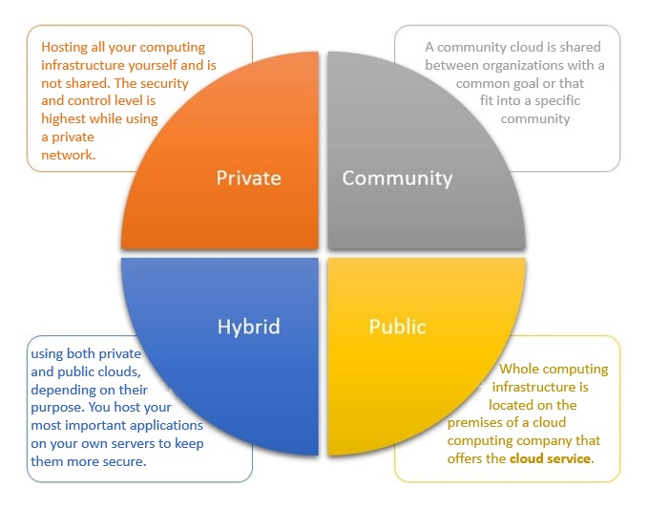
Types of Cloud

Slide 5
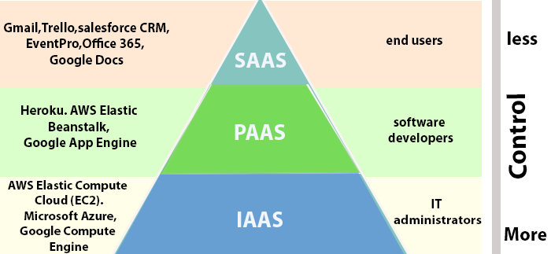
Types of Cloud Services

Slide 6
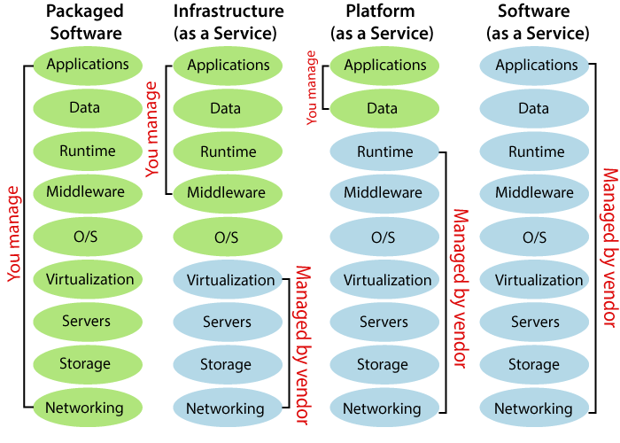
Types of Cloud Services

Slide 7
Types of Fundamental Cloud Architectures
Workload Distribution Architecture
Resource Pooling Architecture
Dynamic Scalability Architecture
Elastic Resource Capacity Architecture
Service Load Balancing Architecture
Cloud Bursting Architecture
Elastic Disk Provisioning Architecture
Redundant Storage Architecture

Slide 8
Workload Distribution Architecture
IT resources can be horizontally scaled via the addition of one or more identical IT resources, and a load balancer that provides runtime logic capable of evenly distributing the workload among the available IT resources.
The resulting workload distribution architecture reduces both IT resource over-utilization and under-utilization to an extent dependent upon the sophistication of the load balancing algorithms and runtime logic.

Slide 9
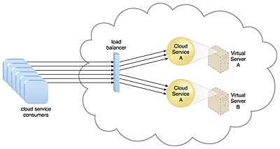
A redundant copy of Cloud Service A is implemented on Virtual Server B.
The load balancer intercepts cloud service consumer requests and directs them to both Virtual Servers A and B to ensure even workload distribution

Slide 10
This fundamental architectural model can be applied to any IT resource, with workload distribution commonly carried out in support of distributed virtual servers, cloud storage devices, and cloud services.
Load balancing systems applied to specific IT resources usually produce specialized variations of this architecture that incorporate aspects of load balancing

Slide 11
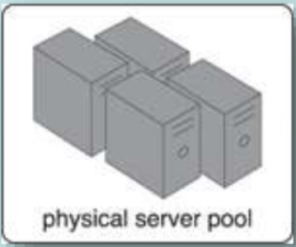
Resource Pooling Architecture
A resource pooling architecture is based on the use of one or more resource pools, in which identical IT resources are grouped and maintained by a system that automatically ensures that they remain synchronized.
Provided here are common examples of resource pools:
Physical server pools are composed of networked
servers that have been installed with operating
systems and other necessary programs and/or
applications and are ready for immediate use.

Slide 12


Virtual server pools are usually configured using one of
several available templates chosen by the cloud consumer
during provisioning. For example, a cloud consumer can set up
a pool of mid-tier Windows servers with 4 GB of RAM or
a pool of low-tier Ubuntu servers with 2 GB of RAM
Storage pools, or cloud storage device pools, consist of
file-based or block-based storage structures that contain
empty and/or filled cloud storage devices.

Slide 13


Network pools (or interconnect pools) are composed of
different preconfigured network connectivity devices.
For example, a pool of virtual firewall devices or physical
network switches can be created for redundant connectivity,
load balancing, or link aggregation.
CPU pools are ready to be allocated to virtual servers, and are
typically broken down into individual processing cores.

Slide 14


Pools of physical RAM can be used in newly provisioned
physical servers or to vertically scale physical servers.
Dedicated pools can be created for each type of IT resource and individual pools can be grouped into a larger pool, in which case each individual pool becomes a sub-pool

Slide 15
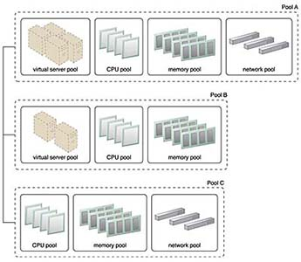
Resource pools can become highly complex, with multiple pools created for specific cloud consumers or applications.
A hierarchical structure can be established to form parent, sibling, and nested pools in order to facilitate the organization of diverse resource pooling requirements
Pools B and C are sibling pools that are taken
from the larger Pool A, which has been allocated
to a cloud consumer. This is an alternative to
taking the IT resources for Pool B and Pool C from
a general reserve of IT resources that is shared
throughout the cloud

Slide 16
Sibling resource pools are usually drawn from physically grouped IT resources, as opposed to IT resources that are spread out over different data centers.
Sibling pools are isolated from one another so that each cloud consumer is only provided access to its respective pool.
In the nested pool model, larger pools are divided into smaller pools that individually group the same type of IT resources together
Nested pools can be used to assign resource pools to different departments or groups in the same cloud consumer organization.

Slide 17
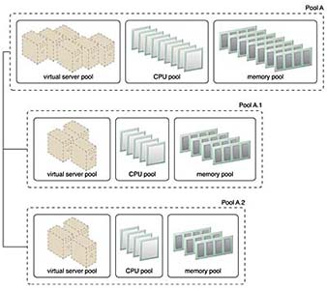
Nested Pools A.1 and Pool A.2 are comprised of the same IT resources as Pool A, but in different quantities.
Nested pools are typically used to provision cloud services that need to be rapidly instantiated using the same type of IT resources with the same configuration settings

Slide 18
Dynamic Scalability Architecture
The dynamic scalability architecture is an architectural model based on a system of predefined scaling conditions that trigger the dynamic allocation of IT resources from resource pools.
Dynamic allocation enables variable utilization as dictated by usage demand fluctuations, since unnecessary IT resources are efficiently reclaimed without requiring manual interaction

Slide 19
The following types of dynamic scaling are commonly used:
Dynamic Horizontal Scaling – IT resource instances are scaled out and in to handle fluctuating workloads. The automatic scaling listener monitors requests and signals resource replication to initiate IT resource duplication, as per requirements and permissions.
Dynamic Vertical Scaling – IT resource instances are scaled up and down when there is a need to adjust the processing capacity of a single IT resource. For example, a virtual server that is being overloaded can have its memory dynamically increased or it may have a processing core added.
Dynamic Relocation – The IT resource is relocated to a host with more capacity. For example, a database may need to be moved from a tape-based SAN storage device with 4 GB per second I/O capacity to another disk-based SAN storage device with 8 GB per second I/O capacity. Figures illustrate the process of dynamic horizontal scaling.

Slide 20
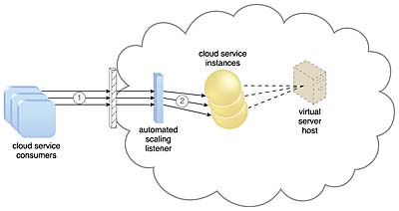
Cloud service consumers are sending requests to a cloud service (1).
The automated scaling listener monitors the cloud service to determine if predefined capacity thresholds are being exceeded (2).

Slide 21
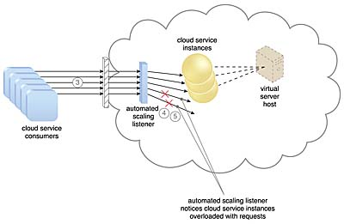
The number of requests coming from cloud service consumers increases (3).
The workload exceeds the performance thresholds. The automated scaling listener determines the next course of action based on a predefined scaling policy (4).
If the cloud service implementation is deemed eligible for additional scaling, the automated scaling listener initiates the scaling process (5).

Slide 22
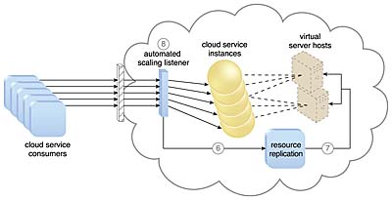
The automated scaling listener sends a signal to the resource replication mechanism (6),
which creates more instances of the cloud service (7).
Now that the increased workload has been accommodated, the automated scaling listener resumes monitoring and detracting and adding IT resources, as required (8).

Slide 23
Elastic Resource Capacity Architecture
The elastic resource capacity architecture is primarily related to the dynamic provisioning of virtual servers, using a system that allocates and reclaims CPUs and RAM in immediate response to the fluctuating processing requirements of hosted IT resources

Slide 24
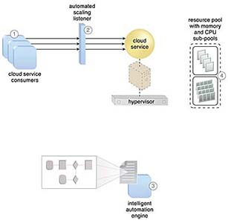
Cloud service consumers are actively sending requests to a cloud service (1),
which are monitored by an automated scaling listener (2).
An intelligent automation engine script is deployed with workflow logic (3)
that is capable of notifying the resource pool using allocation requests (4).

Slide 25
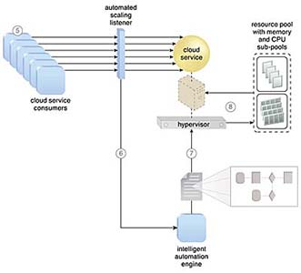
Cloud service consumer requests increase (5),
causing the automated scaling listener to signal the intelligent automation engine to execute the script (6).
The script runs the workflow logic that signals the hypervisor to allocate more IT resources from the resource pools (7).
The hypervisor allocates additional CPU and RAM to the virtual server, enabling the increased workload to be handled (8).

Slide 26
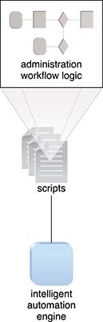
Virtual servers that participate in elastic resource allocation systems may require rebooting in order for the dynamic resource allocation to take effect.

Slide 27
Service Load Balancing Architecture
The service load balancing architecture can be considered a specialized variation of the workload distribution architecture that is geared specifically for scaling cloud service implementations.
Redundant deployments of cloud services are created, with a load balancing system added to dynamically distribute workloads.
The duplicate cloud service implementations are organized into a resource pool, while the load balancer is positioned as either an external or built-in component to allow the host servers to balance the workloads themselves.

Slide 28
Service Load Balancing Architecture
Depending on the anticipated workload and processing capacity of host server environments, multiple instances of each cloud service implementation can be generated as part of a resource pool that responds to fluctuating request volumes more efficiently
The load balancer can be positioned either independent of the cloud services and their host servers (Figure 1), or built-in as part of the application or server’s environment.
In the latter case, a primary server with the load balancing logic can communicate with neighboring servers to balance the workload (Figure 2).

Slide 29
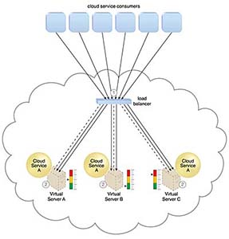
The load balancer intercepts messages sent by cloud service consumers (1)
and forwards them to the virtual servers so that the workload processing is horizontally scaled (2).

Slide 30
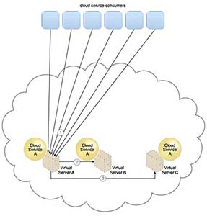
Cloud service consumer requests are sent to Cloud Service A on Virtual Server A (1).
The cloud service implementation includes built-in load balancing logic that is capable of distributing requests to the neighboring Cloud Service A implementations on Virtual Servers B and C (2).

Slide 31
Cloud Bursting Architecture
The cloud bursting architecture establishes a form of dynamic scaling that scales or “bursts out” on-premise IT resources into a cloud whenever predefined capacity thresholds have been reached.
The corresponding cloud-based IT resources are redundantly pre-deployed but remain inactive until cloud bursting occurs. After they are no longer required, the cloud-based IT resources are released and the architecture “bursts in” back to the on-premise environment.
Cloud bursting is a flexible scaling architecture that provides cloud consumers with the option of using cloud-based IT resources only to meet higher usage demands.
The foundation of this architectural model is based on the automated scaling listener and resource replication mechanisms.

Slide 32
The automated scaling listener determines when to redirect requests to cloud-based IT resources, and resource replication is used to maintain synchronicity between on-premise and cloud-based IT resources in relation to state information

Slide 33
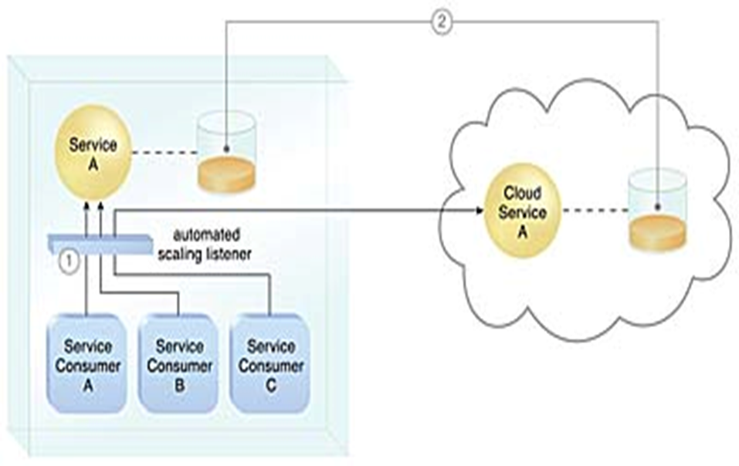
An automated scaling listener monitors the usage of on-premise Service A, and redirects Service Consumer C’s request to Service A’s redundant implementation in the cloud (Cloud Service A) once Service A’s usage threshold has been exceeded. (1).
A resource replication system is used to keep state management databases synchronized (2).

Slide 34
Elastic Disk Provisioning Architecture
Cloud consumers are commonly charged for cloud-based storage space based on fixed-disk storage allocation, meaning the charges are predetermined by disk capacity and not aligned with actual data storage consumption.
Figure demonstrates this by illustrating a scenario in which a cloud consumer provisions a virtual server with the Windows Server operating system and three 150 GB hard drives.
The cloud consumer is billed for using 450 GB of storage space after installing the operating system, even though the operating system only requires 15 GB of storage space.

Slide 35
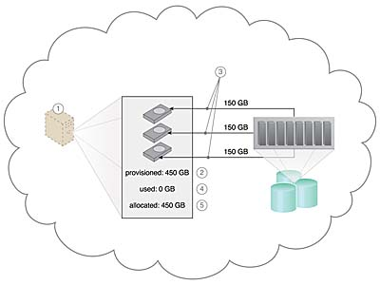
The cloud consumer requests a virtual server with three hard disks, each with a capacity of 150 GB. (1).
The virtual server is provisioned according to the elastic disk provisioning architecture, with a total of 450 GB of disk space. (2).
The 450 GB is allocated to the virtual server by the cloud provider. (3). The cloud consumer has not installed any software yet, meaning the actual used space is currently 0 GB. (4).
Because the 450 GB are already allocated and reserved for the cloud consumer, it will be charged for 450 GB of disk usage as of the point of allocation (5).

Slide 36
The elastic disk provisioning architecture establishes a dynamic storage provisioning system that ensures that the cloud consumer is granularly billed for the exact amount of storage that it actually uses.
This system uses thin-provisioning technology for the dynamic allocation of storage space, and is further supported by runtime usage monitoring to collect accurate usage data for billing purposes

Slide 37
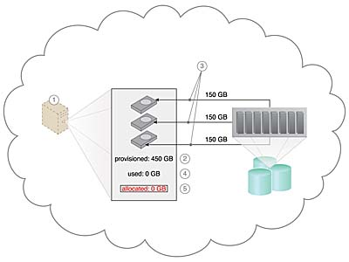
The cloud consumer requests a virtual server with three hard disks, each with a capacity of 150 GB (1).
The virtual server is provisioned by this architecture with a total of 450 GB of disk space. (2).
The 450 GB are set as the maximum disk usage that is allowed for this virtual server, although no physical disk space has been reserved or allocated yet. (3).
The cloud consumer has not installed any software, meaning the actual used space is currently at 0 GB. (4).
Because the allocated disk space is equal to the actual used space (which is currently at zero), the cloud consumer is not charged for any disk space usage (5).

Slide 38
Thin-provisioning software is installed on virtual servers that process dynamic storage allocation via the hypervisor, while the pay-per-use monitor tracks and reports granular billing-related disk usage data

Slide 39
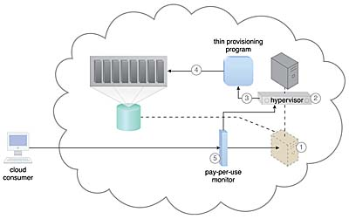
A request is received from a cloud consumer, and the provisioning of a new virtual server instance begins (1).
As part of the provisioning process, the hard disks are chosen as dynamic or thin-provisioned disks (2).
The hypervisor calls a dynamic disk allocation component to create thin disks for the virtual server (3).
Virtual server disks are created via the thin-provisioning program and saved in a folder of near-zero size. The size of this folder and its files grow as operating applications are installed and additional files are copied onto the virtual server (4).
The pay-per-use monitor tracks the actual dynamically allocated storage for billing purposes (5).

Slide 40
Cloud storage devices are occasionally subject to failure and disruptions that are caused by network connectivity issues, controller or general hardware failure, or security breaches.
A compromised cloud storage device’s reliability can have a ripple effect and cause impact failure across all of the services, applications, and infrastructure components in the cloud that are reliant on its availability.

Slide 41

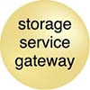
A logical unit number (LUN) is a logical drive that represents a partition of a physical drive.
Storage Service Gateway: The storage service gateway is a component that acts as the external interface to cloud storage services, and is capable of automatically redirecting cloud consumer requests whenever the location of the requested data has changed.

Slide 42
Redundant Storage Architecture
The redundant storage architecture introduces a secondary duplicate cloud storage device as part of a failover system that synchronizes its data with the data in the primary cloud storage device.
A storage service gateway diverts cloud consumer requests to the secondary device whenever the primary device fails

Slide 43
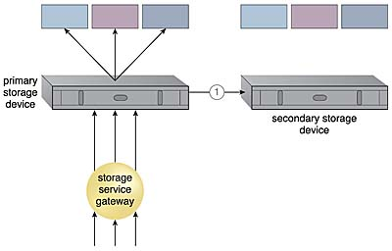
The primary cloud storage device is routinely replicated to the secondary cloud storage device (1).

Slide 44
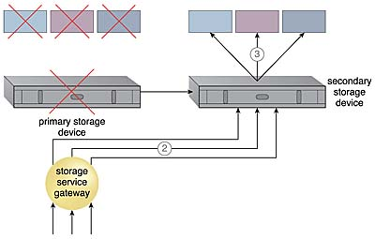
The primary storage becomes unavailable and the storage service gateway forwards the cloud consumer requests to the secondary storage device (2).
The secondary storage device forwards the requests to the LUNs, allowing cloud consumers to continue to access their data (3).

Slide 45
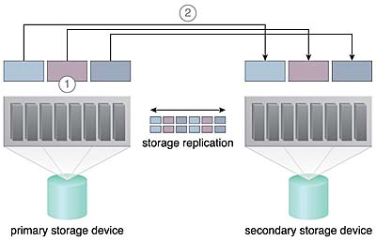
This cloud architecture primarily relies on a storage replication system that keeps the primary cloud storage device synchronized with its duplicate secondary cloud storage devices
Storage replication is used to keep the redundant storage device synchronized with the primary storage device.

Slide 46

STORAGE REPLICATION
Storage replication is a variation of the resource replication mechanisms used to synchronously or asynchronously replicate data from a primary storage device to a secondary storage device.
It can be used to replicate partial and entire LUNs

Slide 47
Cloud providers may locate secondary cloud storage devices in a different geographical region than the primary cloud storage device, usually for economic reasons.
The location of the secondary cloud storage devices can dictate the protocol and method used for synchronization, as some replication transport protocols have distance restrictions.
Some cloud providers use storage devices with dual array and storage controllers to improve device redundancy, and place secondary storage devices in a different physical location for cloud balancing and disaster recovery purposes.

Slide 48
Thank You

