Slide 1
Ce443 : Cloud computing
Unit -2 virtualization

Slide 2
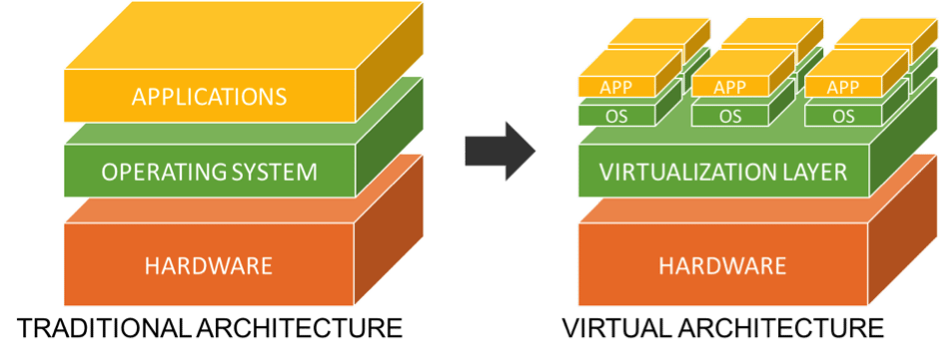
Virtualization
In computing, virtualization means to create a virtual version of a device or resource, such as a server, storage device, network or even an operating system where the framework divides the resource into one or more execution environments.

Slide 3
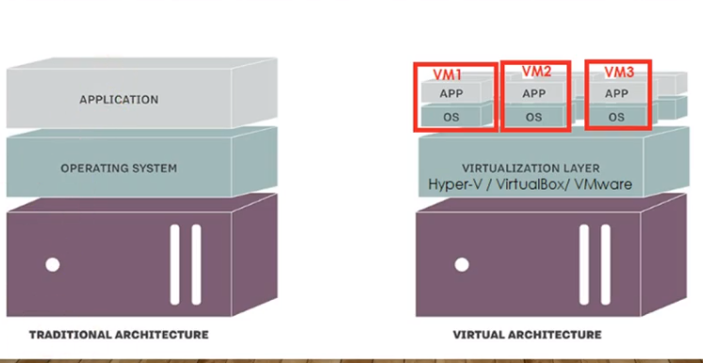
Difference between Traditional Computer and Virtual machines

Slide 4
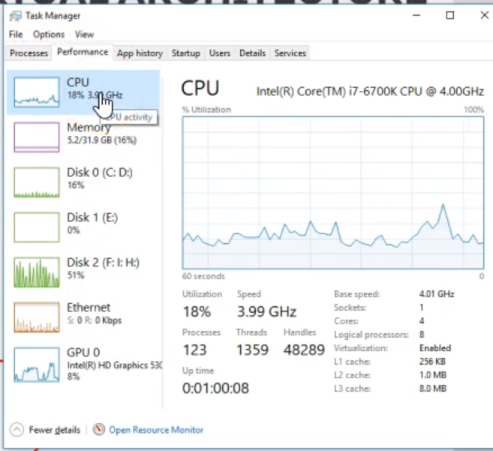
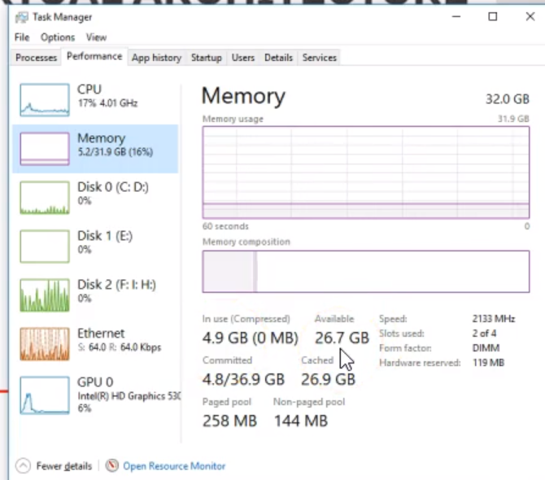

Slide 5
Where you want to create? Is it for Personal use or for Production
Hyper-V on Windows 10 / Server OS
VirtualBox
VMWare Workstation
VMWare Player
Hyper-V on Windows Server 2008 R2 & above OS
VMWare ESXi
XenServer from Citrix

Slide 6
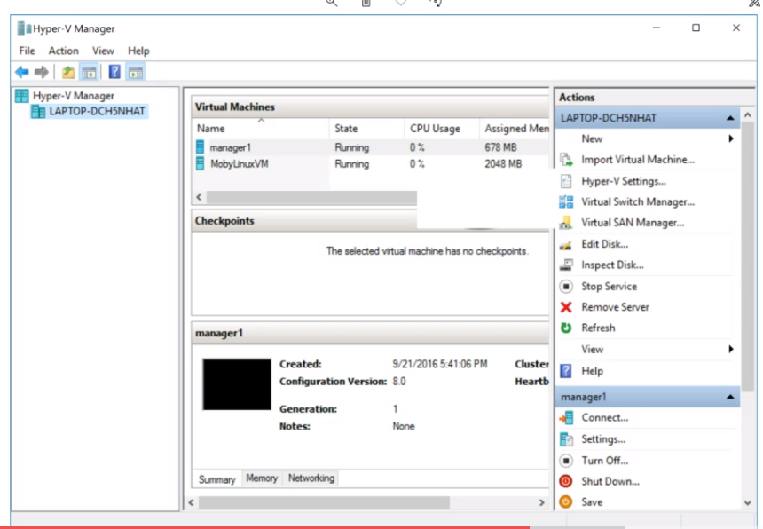

Slide 7
Virtualization for Data Center Automation - To serve millions of clients, simultaneously
Server Consolidation in Virtualized Datacenter
Virtual Storage Provisioning and Deprovisioning
Cloud Operating Systems for Virtual Datacenters
Trust Management in virtualized Datacenters

Slide 8
Virtualization Ranging from Hardware to Applications in Five Abstraction Levels

Slide 9
Core Components
Speed of VM – Depends on
HDD or SSD (Solid State Disk)
Memory
Number of CPUs
Storage Assignment
For each machine
Optimize the existing storage with master images and master VMs
Networking
NAT (Network Address Translation)

Slide 10
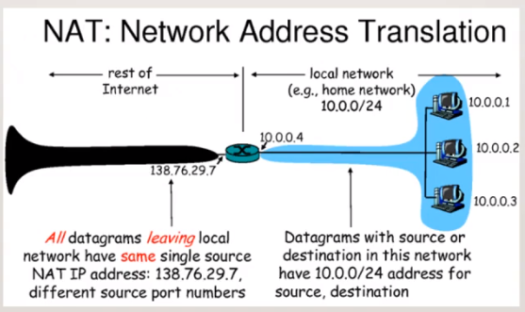

Slide 11
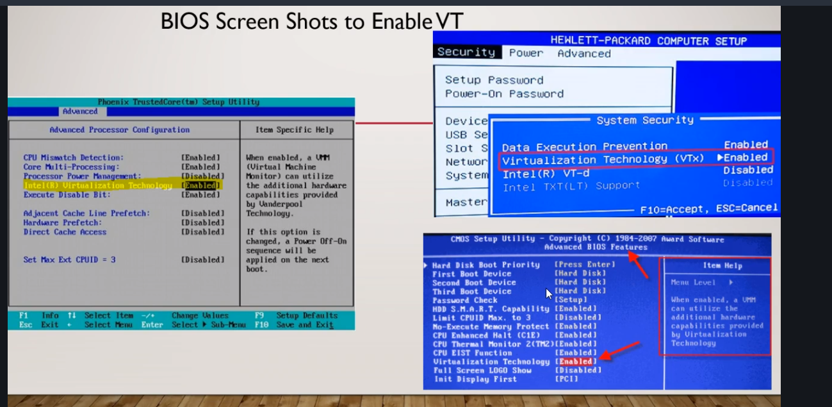

Slide 12
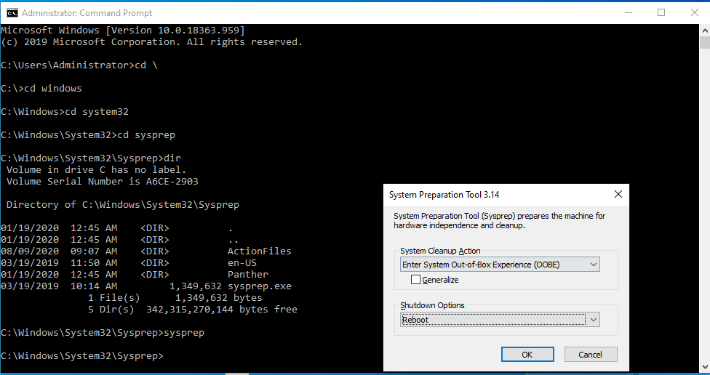

Slide 13
Hyper – V
A hypervisor is a function which abstract – isolate – operating system and applications from the underlaying hardware.
Type 1: bare metal hypervisor
Type 2: hosted hypervisor

Slide 14
How to setup Hyper - V
Enable VT in BIOS
Install hyper-v features/roles
Setup folders
Setup shutdown and restart behavior
Setup networking
Setup NAT
Create a VM
Check communication between two VM’s
Create a master VM /Images/Sysprep
Creating snapshots & checkpoints
Add harddisk
Expand existing harddisk
Change resources for existing VM
Create domain controller , member server

Slide 15
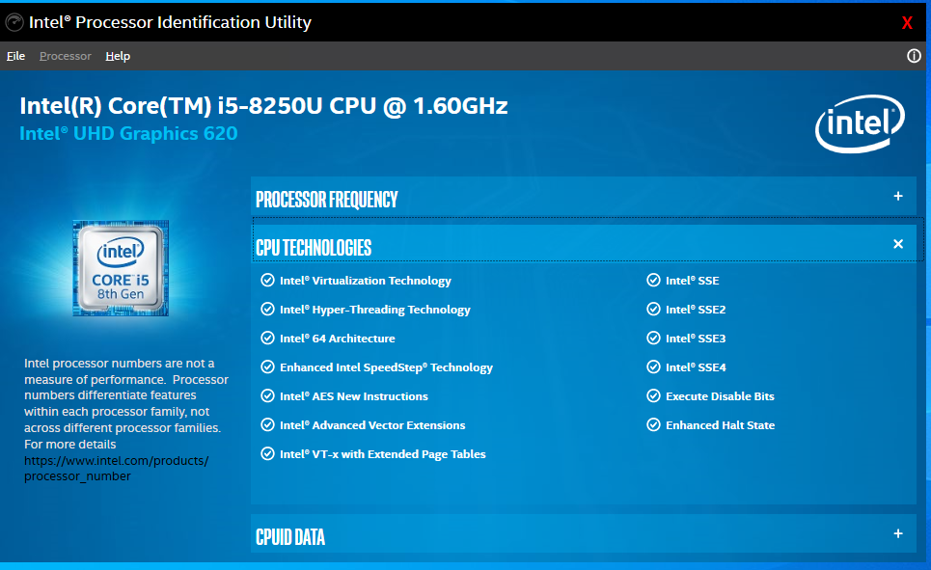
https://downloadcenter.intel.com/download/28539?v=t

Slide 16
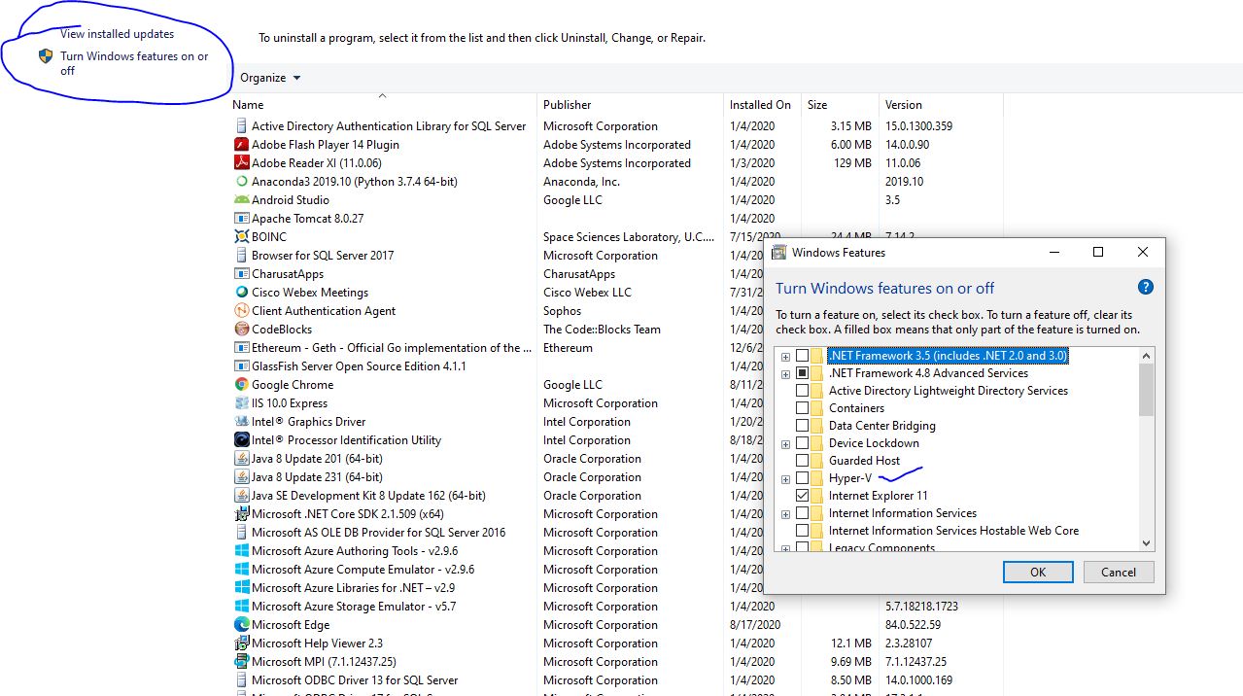

Slide 18
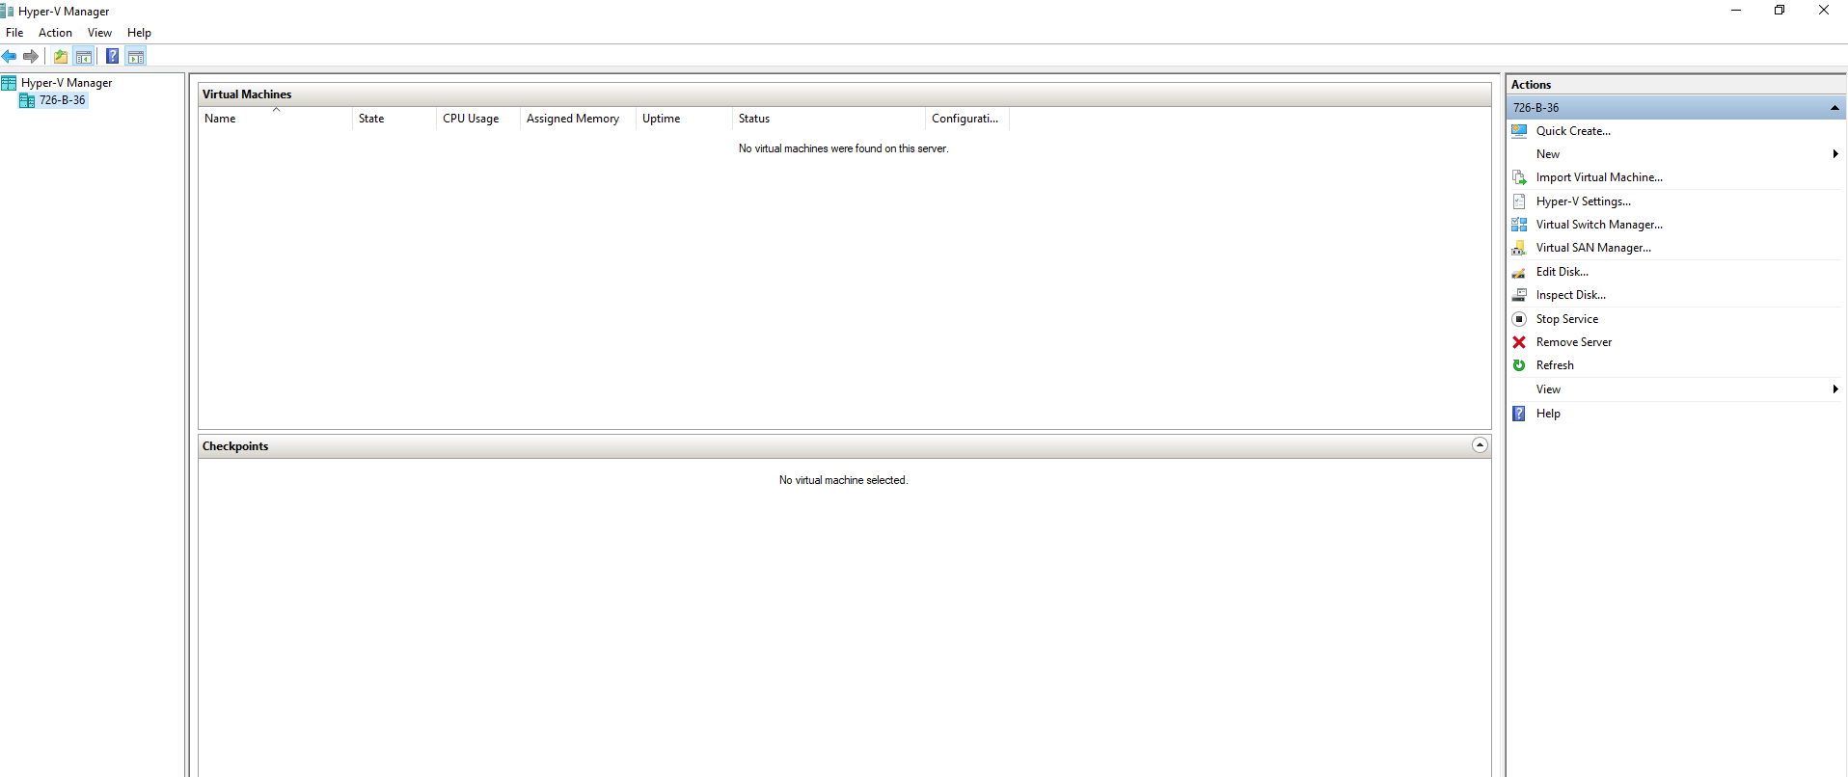

Slide 19
Case Study
Xen hypervisor
Eucalyptus : An Open-Source OS for Setting Up and Managing Private Clouds

Slide 20


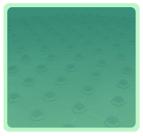



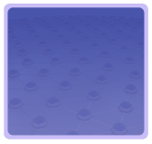

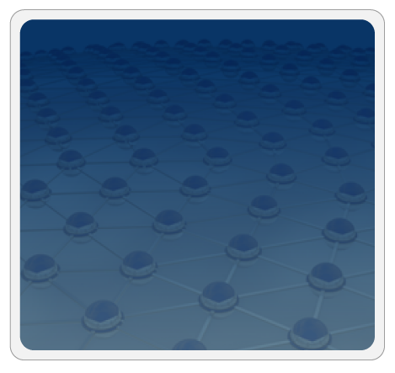



Trusted Zones for VM Insulation
Insulate infrastructure from Malware, Trojans and cybercriminals
Anti-malware
Federate identities with public clouds
Identity federation
Cybercrime intelligence
Strong authentication
APP
APP
Tenant #2
OS
OS
Control and isolate VM in the virtual infrastructure
Virtual Infrastructure
Insulate information
from other tenants
Virtual network security
Data loss prevention
APP
APP
Tenant #1
OS
OS
Virtual Infrastructure
Insulate information from cloud providers’ employees
Encryption & key mgmt
Access Mgmt
Segregate and control user access
Cloud Provider
Tokenization
Security Info. & Event Mgmt
Physical Infrastructure
GRC
Enable end to end view of security events and compliance across infrastructures

