Slide 1
CISCO Architecture

Slide 2
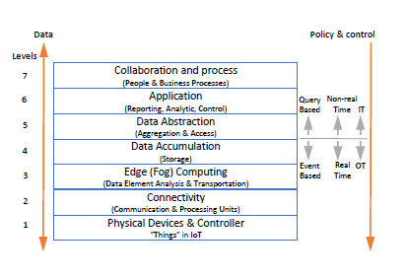

Slide 3
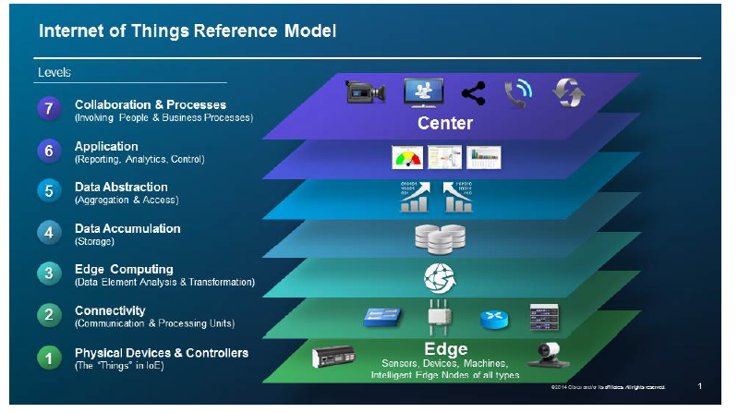

Slide 4
There are 7 distinct layers of different activities that are conducted in a vertical slice of a typical
Internet of Things system.
The vertical slice refers to the fact that the system incorporates all 3 tiers of the systems (Constrained Devices or “Things”, Edge, Cloud). “Constrained Devices”, are various sensors, cameras, servos or even microcontrollers (like Arduino) and other arbitrary Internet of Things (IoT) devices as in the sense that they have a very narrowly focused function and limited processing capability (if any).
While the typical architecture implies that layer 1 is at the “Things” tier, layers 2 and 3 at the Edge tier and layer 4 to 7 at the Cloud tier, the Edge computing paradigm pushes functionality from layer 4 to 7 down to layer 3.

Slide 5
In terms of physical machines, a typical IoT hierarchical structure can be viewed, where the fog nodes communicate both with the cloud and with other fog nodes, either wirelessly or by wire.
Fog nodes can also function in a layered fashion, performing a different functionality according to their proximity to the data generators, which is still much closer than the cloud. Near the data source, fog nodes are mainly positioned in order to aggregate data, perform semantic notation and control the various actuators. Actuators are simply constrained devices that can interact with the physical world (e.g servos).
Fog nodes that are upwards could perform more abstract functions, such as turning raw data into knowledge via processing. In this example, fog nodes can even be a nonhomogenous group, even for the same stakeholder and system, as nodes closer to the source could be lighter in terms of processing and power consumption, such as the Raspberry pi , while fog nodes that perform the bulk of pre-processing would be akin to a Micro DataCenter(μDC).

