Slide 1
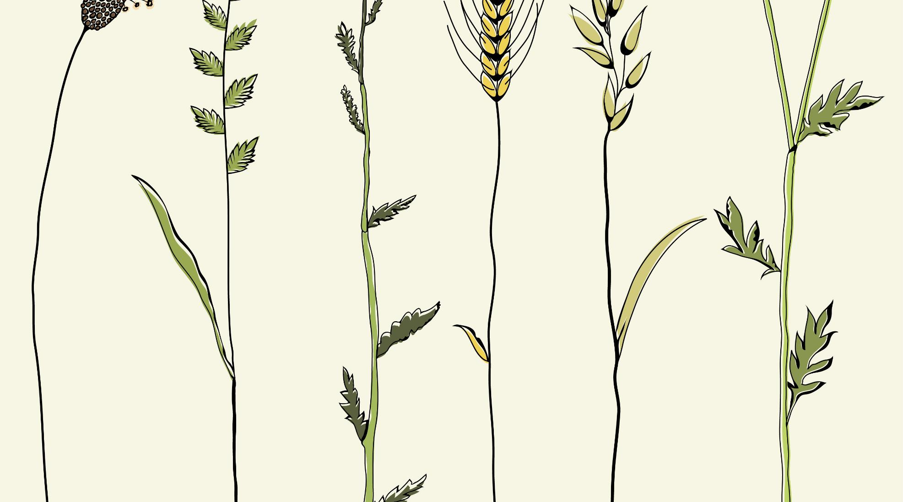




Cam Motion Detector

Slide 2

Outline
Why this Project?
What is Does?
System requirements
Usage
Flow Chart
Future Scope
Summary
Bibliography

Slide 3




Why This Project?
SECURITY
MOTION TRACKING
DIVERSIFIED APPLICATIONS
Security is one of the main concerns of today’s world
Motion Tracking is one of the most important tool in terms of security and observation.
Motion Detection is used in almost all the major areas of the world

Slide 4


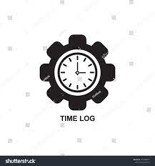

What It Does?
DETECTS MOTION
The application detects any sort of motion that happens within the frame limit
GIVES LOG
The application maintains the log of motion that is detected
FLEXIBLE
The detection area is adjusted according to the size of object

Slide 5
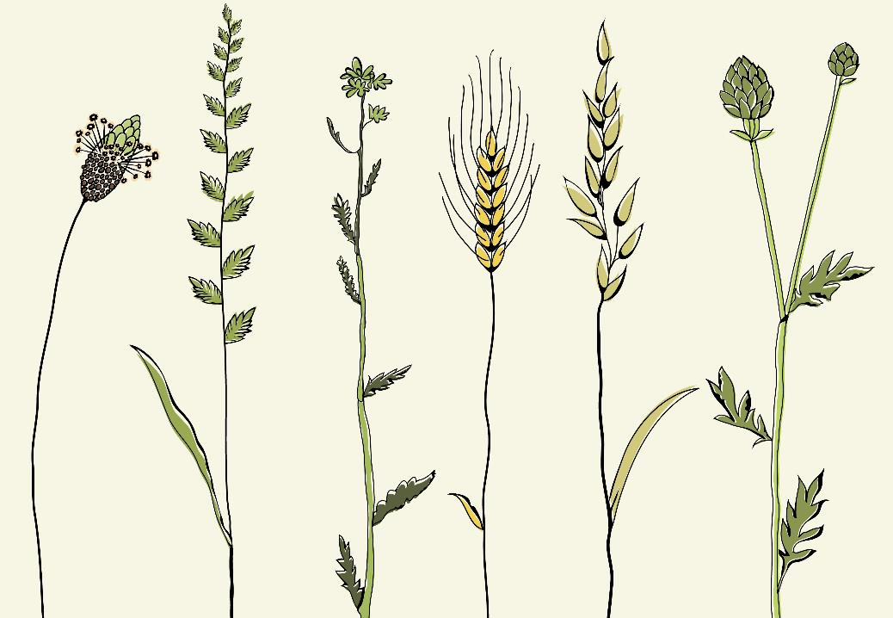
System Requirements
Camera (integrated or external)
Battery Back-up

Slide 6



Usage:
This application can be used as supporting role
CCTV MOTION DETECTOR
WILDLIFE DETECTION
ATTENDENCE SYSTEM
Integrating the application with cctv, one can detect any kind of object
Integrating the application with app. Cameras, one can detect wildlife behaviours.
Integrating the application with camera, one can setup a convenient system.

Slide 7
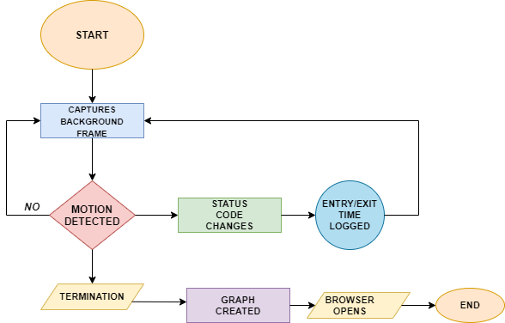
Flow Chart:

Slide 8
Future Scope:
Phase 1 (Completed)
Phase 2
Phase 3
Developing the cam motion detector
Detection of motion of objects
Maintaining the time log of the motion
Depicting the graph of motion
Applying machine learning concepts so that the type of object can be identified
Training the application with different datasets.
Integrating the application with database to store the time log permanently
Plotting different graph for each individual object detected

Slide 9

Summary
We discussed regarding the python mini-project which is undertaken as an application of python concepts.
Cam Motion Detector is used for detecting the motion happening within the frame.
The application maintains and generates a time log graph which gives information about entry and exit of object from the frame.
We also discussed about how the application works.
We discussed about the Future Scope of the application

Slide 10
Bibliography
https://opencv.org/
https://pandas.pydata.org/
https://docs.bokeh.org/en/latest/index.html
https://www.udemy.com/
https://code.visualstudio.com/
https://stackoverflow.com/
https://www.geeksforgeeks.org/

Slide 11

Thank You

