Slide 1
HBase

Slide 2
HBase History
2006: Google releases paper on Bigtable
2007: First usable Hbase
2010: HBase becomes Apache top level project

Slide 3
What is Apache HBase?
Apache HBase is an open source,
Distributed
Column oriented,
scalable, consistent, low latency,
non-relational database
built on Apache Hadoop

Slide 4
Why HBase ?
HBase is a Bigtable(Google) clone.
It is open source
It is developed on top of and has good integration for the Hadoop platform.
Linear Scalability.
Automatic failover
Consistent reads and writes
Java API for client access
Shell support

Slide 5
Column oriented databases
Column-oriented DBMS is a database management system (DBMS) that stores data tables as sections of columns of data rather than as rows of data.
The goal of a columnar database is to efficiently write and read data to and from hard disk storage in order to speed up the time it takes to return a query
A column-oriented architecture looks the same on the surface, but stores data differently than legacy/row-based database.

Slide 6
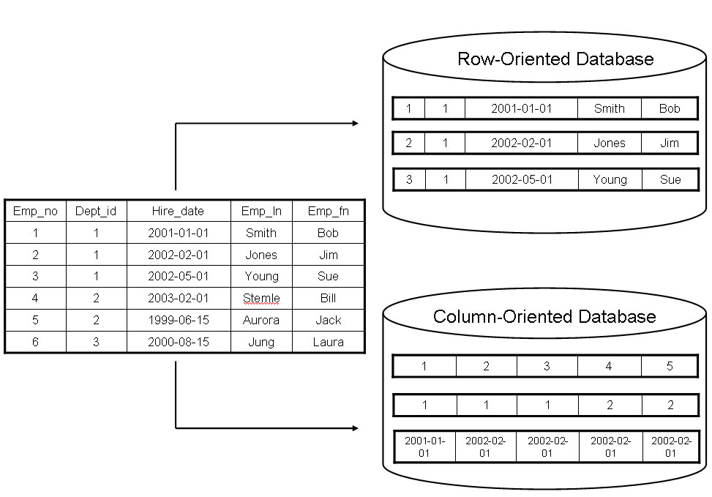
Column vs. row orientation

Slide 7
Advantages of Column Database
Data can be highly compressed. The compression permits columnar operations — like MIN, MAX, SUM, COUNT and AVG— to be performed very rapidly.
Column-based DBMSs are self-indexing,
it uses less disk space than a RDBMS for containing the same data.
Column architecture doesn’t read unnecessary columns.
Avoids decompression costs and perform operations faster.
Use compression schemes allow us to lower our disk space requirements.

Slide 8
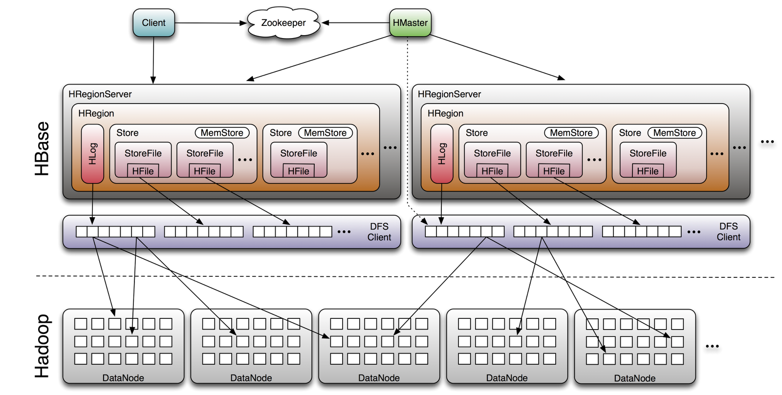
HBASE Architecture

Slide 9
HMaster
Responsible for monitoring region servers
Redirect client to correct region servers
Master controls critical functions such as RegionServer failover and completing region splits. So while the cluster can still run for a time without the Master, the Master should be restarted as soon as possible.
the interface for all metadata changes, it runs on the server which hosts namenode.

Slide 10
Regionservers
Responsible for serving and managing regions, its like a data node for Hbase.
It handle the actual data storage and request.
Send HeartBeat to Hmaster and Zookeeper
RegionServers are usually configured to run on servers of HDFS DataNode.
Running RegionServer on the DataNode server has the advantage of data locality too

Slide 11
Zookeeper
Zookeeper is an open source software providing a highly reliable, distributed coordination service
Entry point for an HBase system
It includes tracking of region servers, where the root region is hosted

Slide 12
Demo

